Slide 1
Kids Speak Out
说出你的观点
选自《多维阅读第12级》

Slide 2
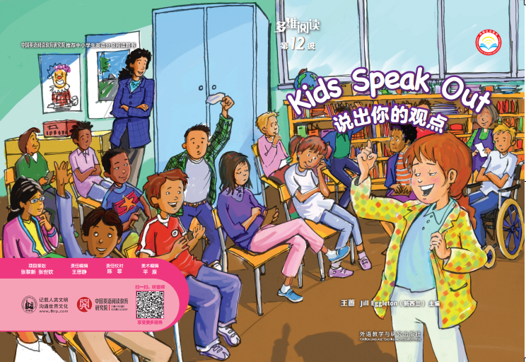
1. What can you see from the cover?
2. What’s the title? What does it mean?
3. Do you dare to speak out on your problems?

Slide 3
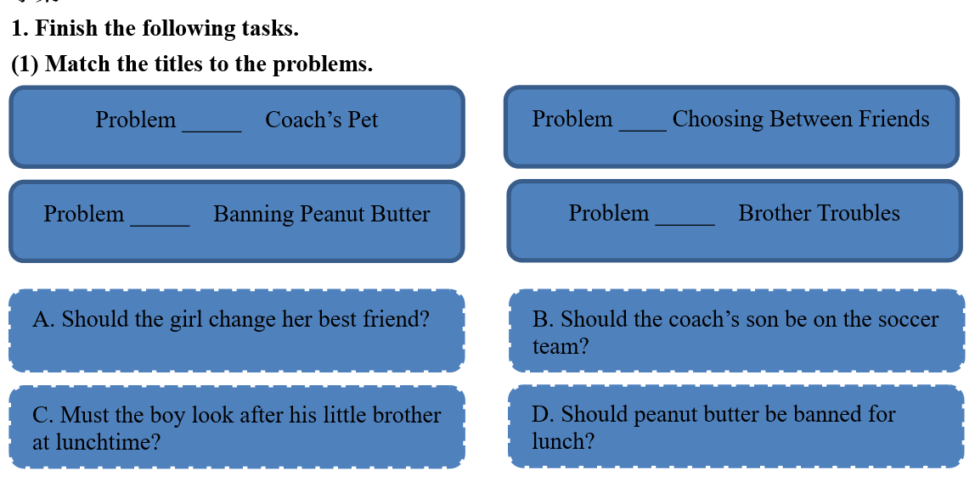
Read the passage in the speech bubbles on pages 2, 6, 10, 14 to find out the kids’ problems and finish the task on the worksheet.

Slide 4
B
A
D
C
Choose a problem out of the four and share your opinions on it with your desk-mate.

Slide 5
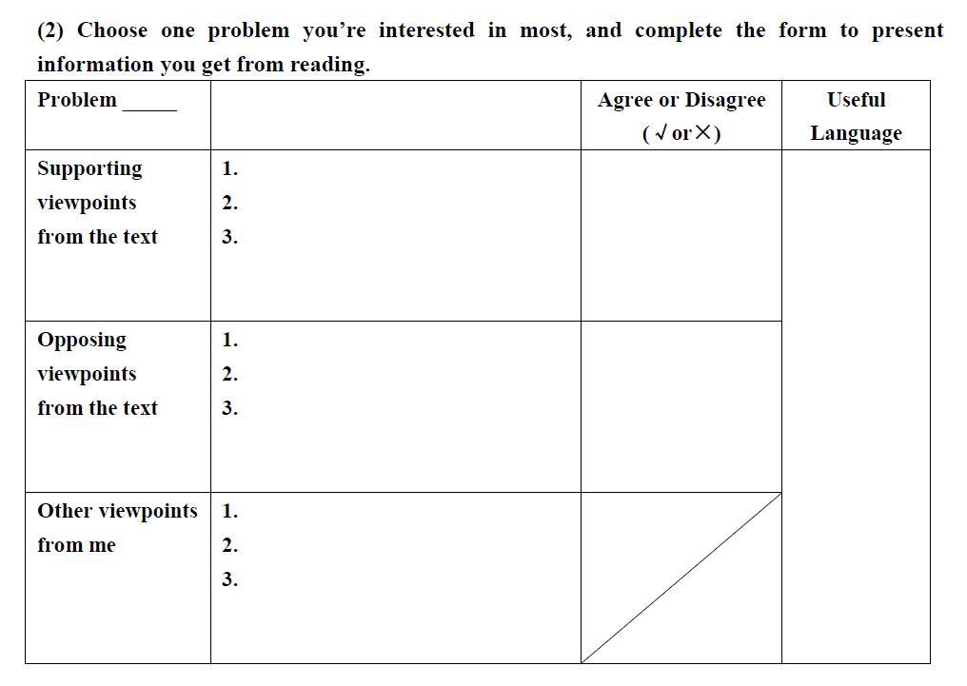
Choose one problem, read other kids’ opinions on the problem and finish the following part.

Slide 6
1. Check your answer in groups(students who choose the same problem make a group).
2. What’s your own opinion on the problem?
3. Why do you think so? Can you think of more reasons to support your idea?

Slide 7
Share what you know from reading and your own opinions in new groups(students who choose different problems make a group).

Slide 8
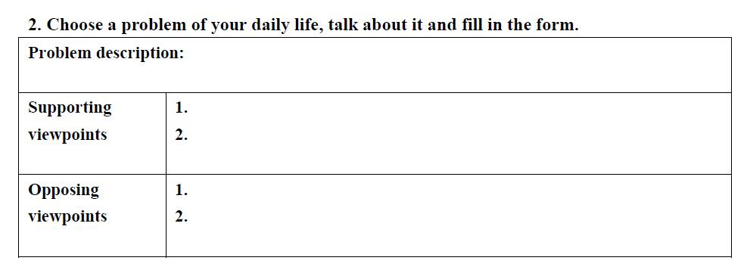
1. What problems do you have in your daily life? Can you speak them out in your group?
2. Which problem do your group members all want to talk about?
3. Do you approve or disapprove of the idea? What reasons do you have?

Slide 9
Share your group’s ideas in class.

Slide 10
Assignments
Option 1: Read about the other three problems and find out whether the students who share them with you in the class miss some information out or not.
Option 2: Write an article about the problem your group talked about at the end of the class.

