Slide 1
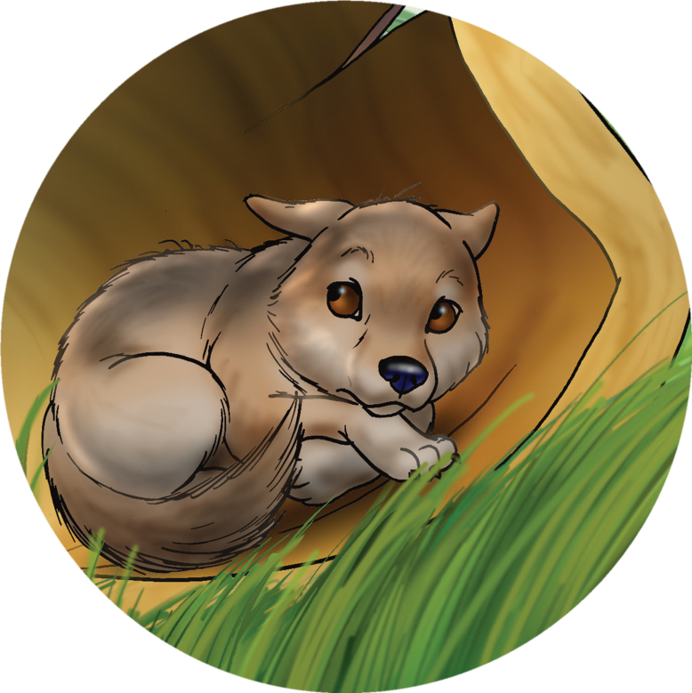
Banjo
“小狗”巴尼奥
选自《多维阅读第11级》

Slide 2
1. What can you see on the front cover?
2. What’s the title?

Slide 3
Let’s read and find the answers.
Where did the story happen?
What’s the story about?
Who are the main characters?
Why is there a quotation mark in the title?

Slide 4
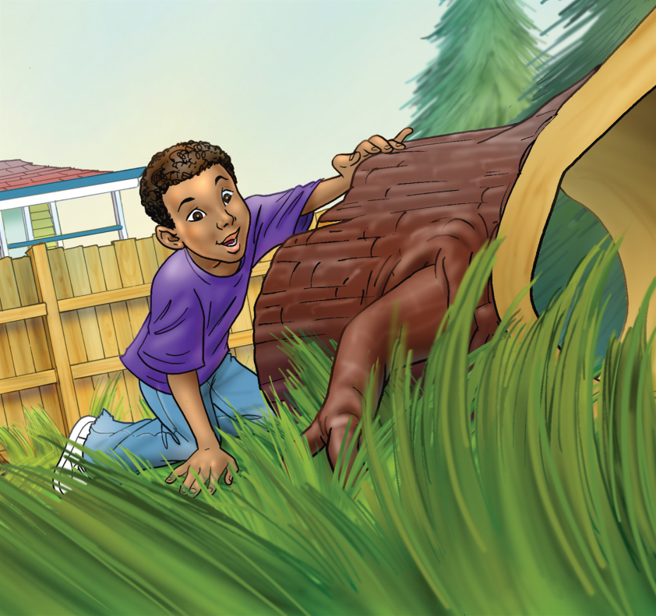
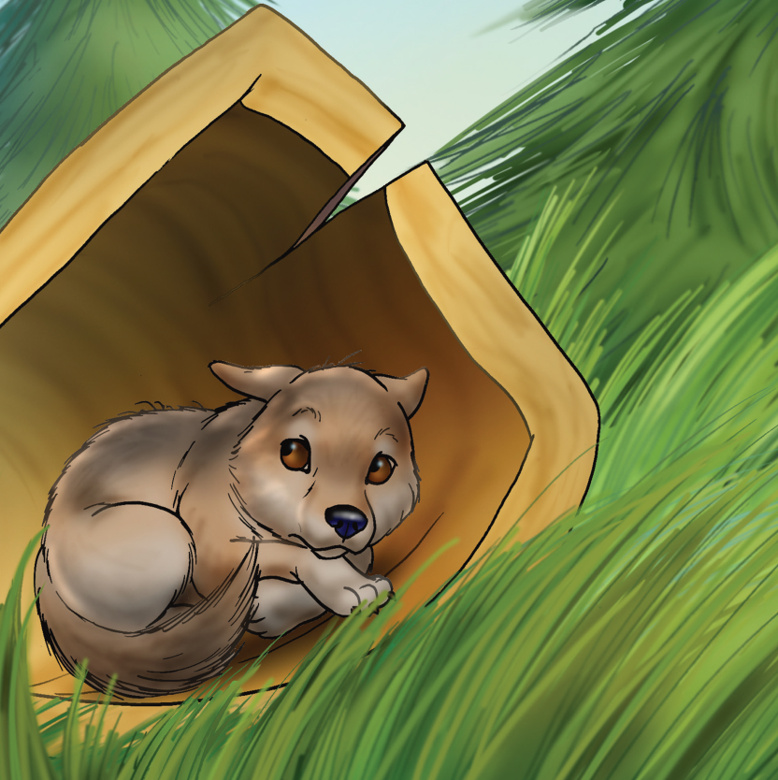
Please read PP2-7.
1. What did Rudy find in an old log at the bottom of the garden?
2. What did he want to do?
3. What name did he give to the puppy?

Slide 5
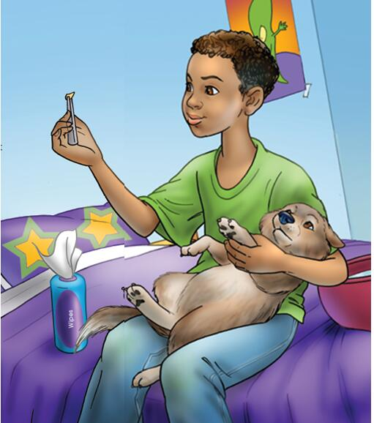
Please read PP8-13.
What happened to Banjo’s foot?
2. How did Rudy look after it?

Slide 6
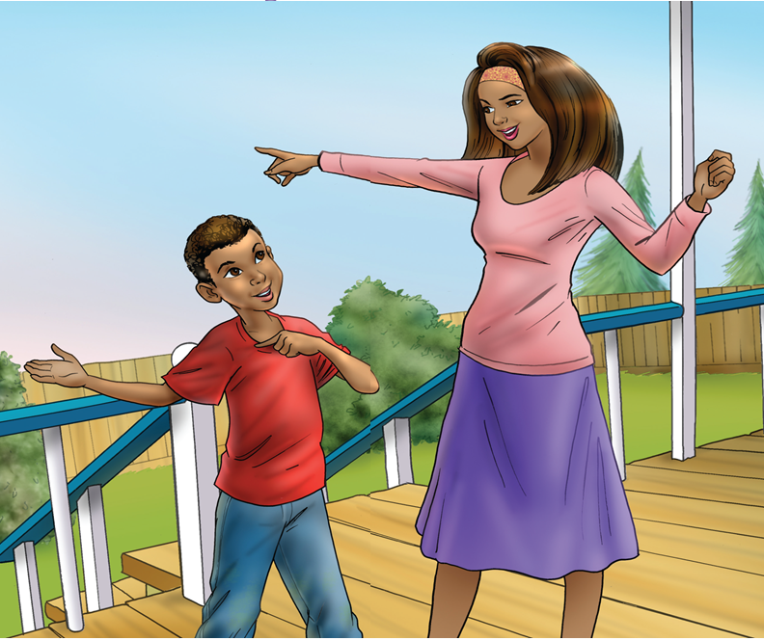
Please read PP14-17.
Mom told Rudy a wolf was found in his cupboard. How did Rudy feel?
What did people do to Banjo?
What did Jacob and Rudy do then?

Slide 7
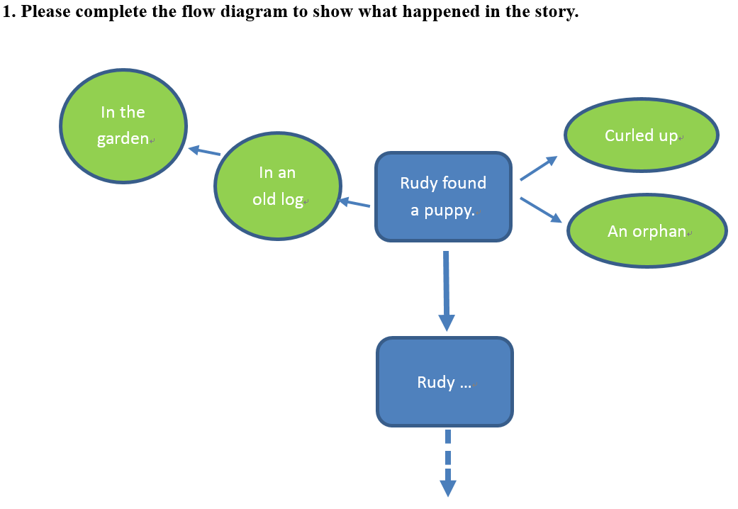

Slide 8
Let’s tell the story.
Tips:
Tell the story with the help of your story map.
Rudy…

Slide 9
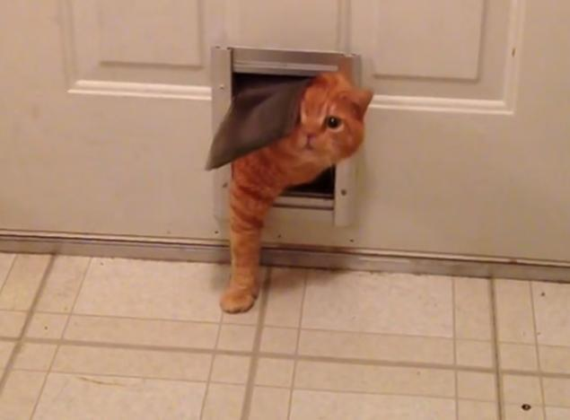
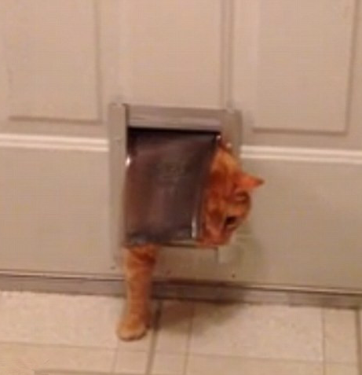
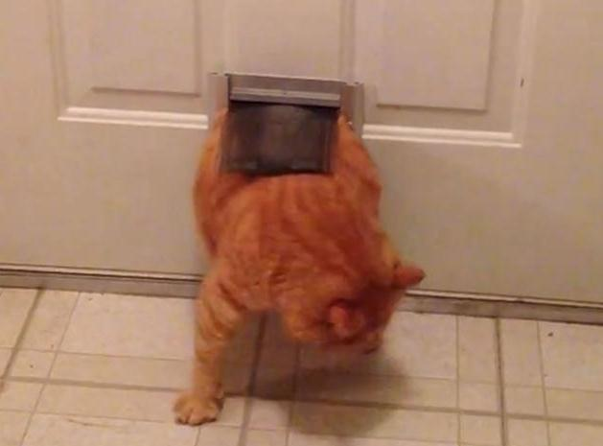
Let’s go deep into the story.
P2
How did Rudy get into the garden?
squeeze
The cat is squeezing through the hole.
Notes:
He squeezed under the fence and pushed his way through the long grass.

Slide 10
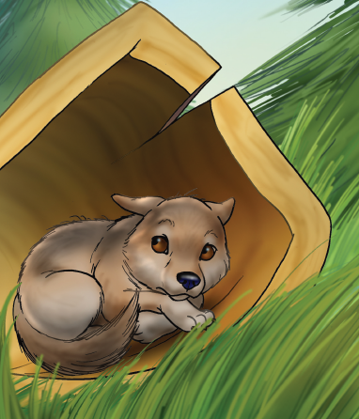
P2
What was the puppy like when Rudy saw it in the old log?
Notes:
Rudy saw a puppy curled up and crying like a baby.

Slide 11
P6
How do you know Jacob liked the puppy? Find the words that make you think this.
And what did the puppy do to Jacob?
Notes:
Jacob stroked its fur.
The puppy sniffed at his hand.

Slide 12
P8
Do you think the idea of looking after the puppy works well?
Why? Why not?
The boys gave the puppy bones and scraps of meat.
How did it eat them?
P10
What other consequences might there be when the puppy stayed the night in the house?
How did Rudy cure Banjo?
Notes:
P8: It crunched them in his strong teeth, as quickly as a fox crunching eggs.
P10: Rudy pulled out the thorn with tweezers and washed Banjo’s foot with wipes.

Slide 13
P14
1. Do you think Rudy knew Banjo was a wolf before? Why do you think that?
2. Which sentence told you Rudy’s feeling? Read the sentence.
3. If you were Rudy, how would you feel?
Please use “as if” to describe your feeling.
Notes:
2. Rudy felt a fluttering feeling inside him, as if a bunch of butterflies had landed there.

Slide 14
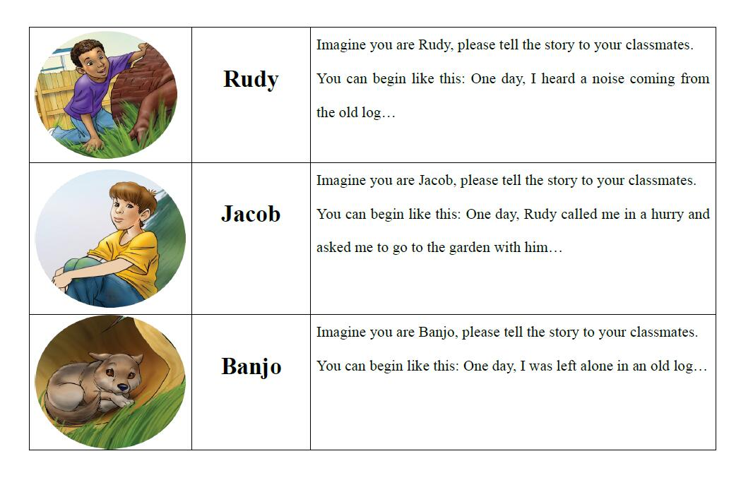
Tell the story in the name of different characters.

Slide 15
Imagine…
· Some months later, Banjo came back to the old log …
If you were Rudy, how would you feel? What would you do/say?
If you were Banjo and you can speak, how would you feel and what would you do/say?
· If you were Rudy, would you choose other ways to help Banjo? You can begin like this:
I wanted to help the puppy. I …

Slide 16
Homework
Tell the story “Banjo” to your parents.
Tell another story about an animal friend you have read or heard or composed to your classmates.

