Slide 1
选自《多维阅读第9级》

Slide 2
Free Talk
What’s your favourite animal? Please try to introduce it.
My Favourtie Animal
What does it look like?
How does it live?
Where does it live?
Why do you like it?
What does it like to do?
…

Slide 3
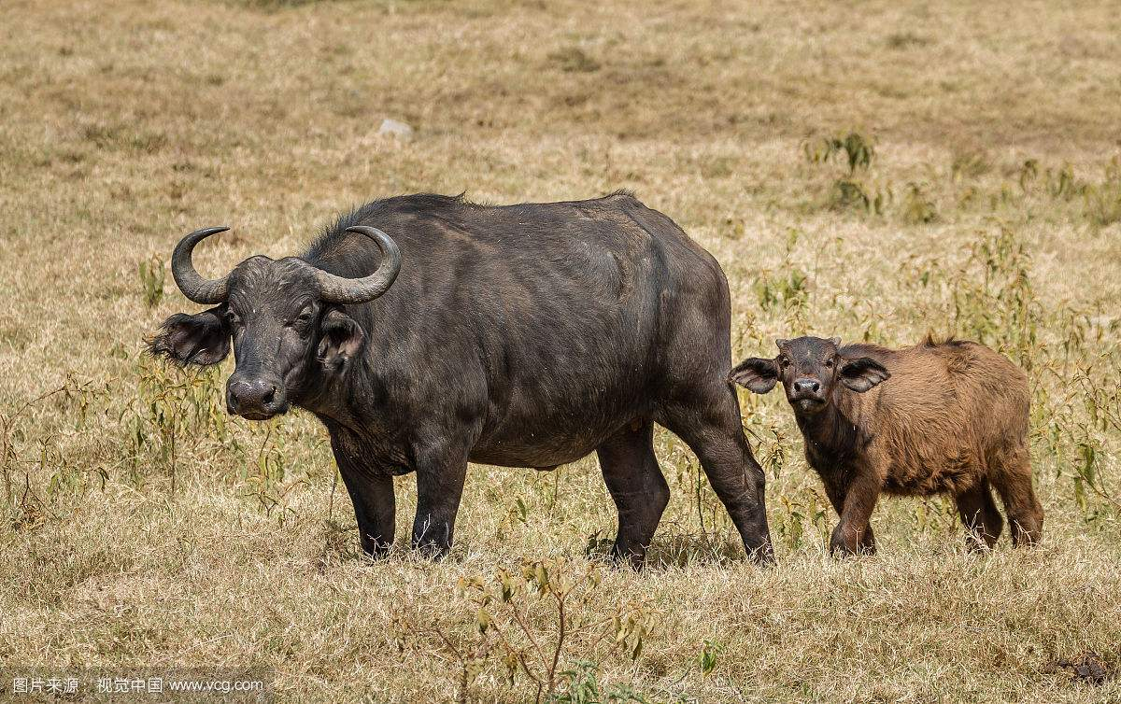
Free Talk
1. What’s my favourtie animal? Please look and guess.
2. What might be the relationship between them?
buffalo calf

Slide 4
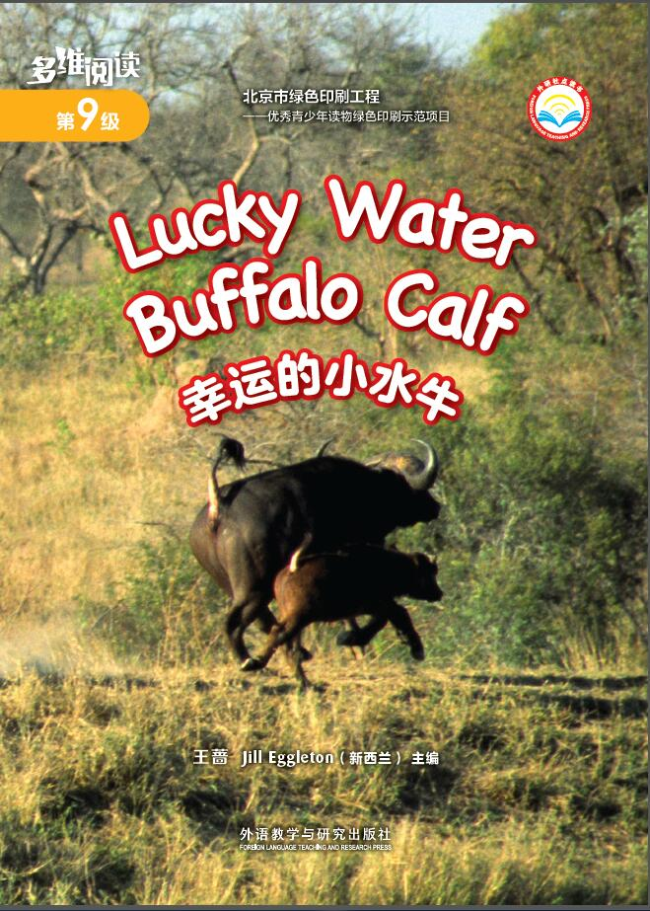
What can you see from the cover?
What do you want to know from the book?

Slide 5
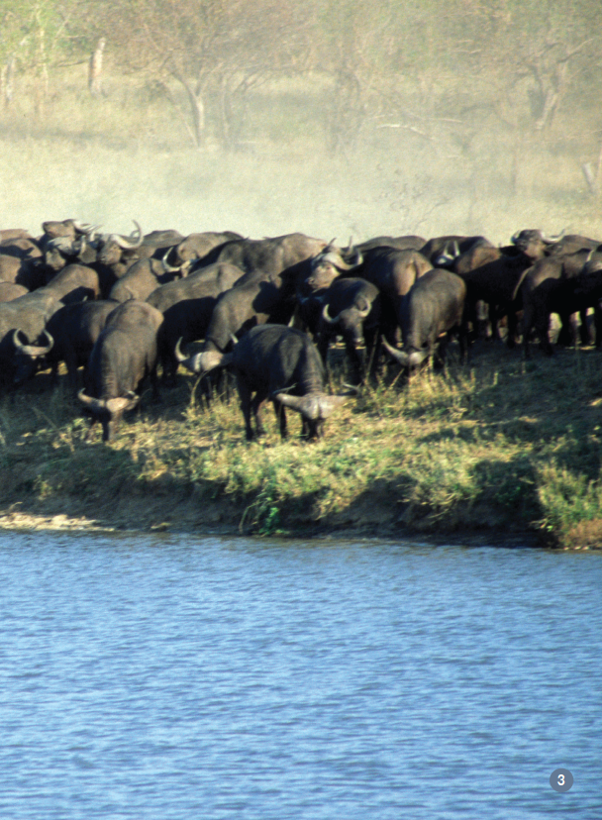
Task 1 Read PP2-5.

Slide 6
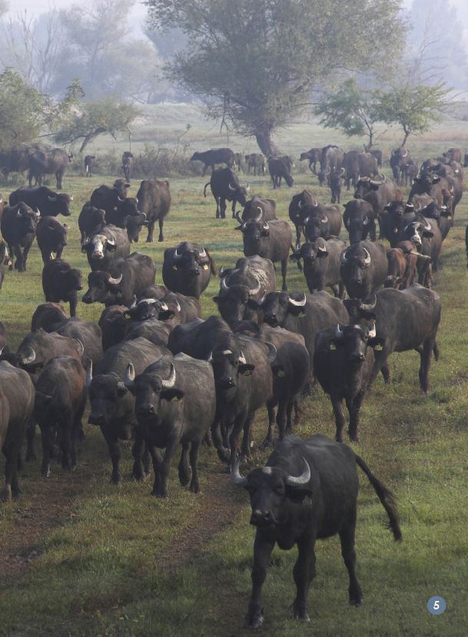

Slide 7
Task 1：Read PP2-5
What do you know about the buffalo and buffalo calf?
Home
General information about buffaloes
Lucky Water Buffalo Calf
Appearance
Living style
…

Slide 8
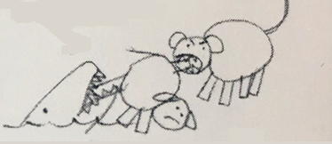
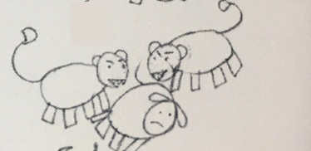
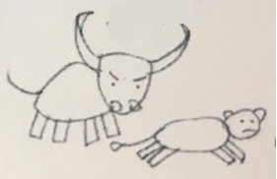
Activity 1: Match the pictures and the sentences.
The buffalo calf fell into the river.
A crocodile and the lion pulled it.
The lion got the buffalo calf out.
The buffalo chased the lion away.

Slide 9
Activity 2: Number these pictures.
1
2
The buffalo calf fell into the river.
A crocodile and the lion pulled it.
3
4
The lion got the buffalo calf out.
The buffalo chased the lion away.
Activity 3: Open the book and check your answer.

Slide 10
Task 2: Jigsaw Reading
Activity 1:
Six of you make a group. There are three different parts, two of you choose the same part to read.
On the back of the paper, there are some questions to follow.
Group 1
Part A
The lions can see the buffaloes going by.
Part B
The crocodile snapped at the buffalo calf.
Part C
The big buffaloes charged at the lions

Slide 11
Task 2: Jigsaw Reading
Activity 2:
Please try to catch some key verbs or verb phrases while reading, and write them down.

Slide 12
Task 2: Jigsaw Reading
Activity 3:
Now, let’s share the part you’ve read within the group.

Slide 13
Task 2: Jigsaw Reading
Activity 4:
Please try to put the three parts in the big piece of paper in the correct sequence.

Slide 14
Read the whole story by yourself

Slide 15
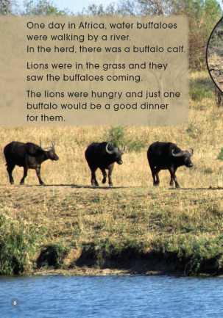
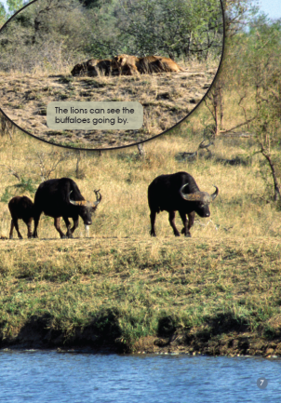
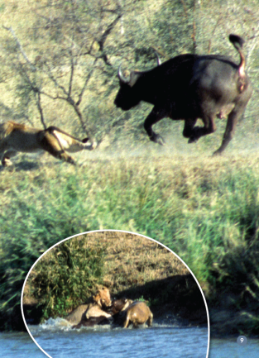
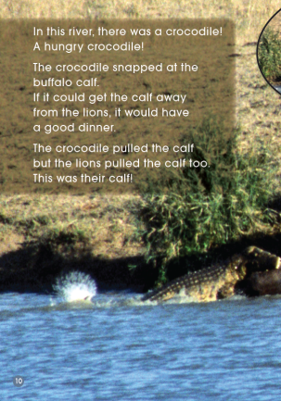
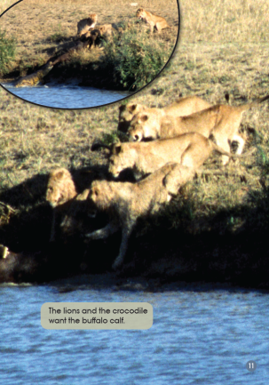
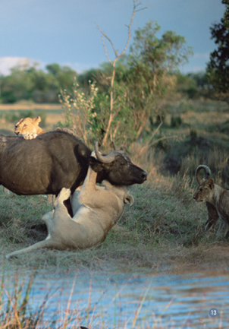
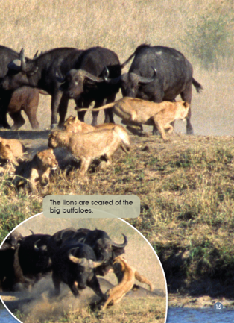
Listen and Read

Slide 16
Try to describe the part you like.
Do you have any questions about this book?

Slide 17
Homework
Try to retell one part of the book that you like.
2. Draw the sequence of events that happened to the buffalo calf by adding captions to each drawing.

