Slide 1
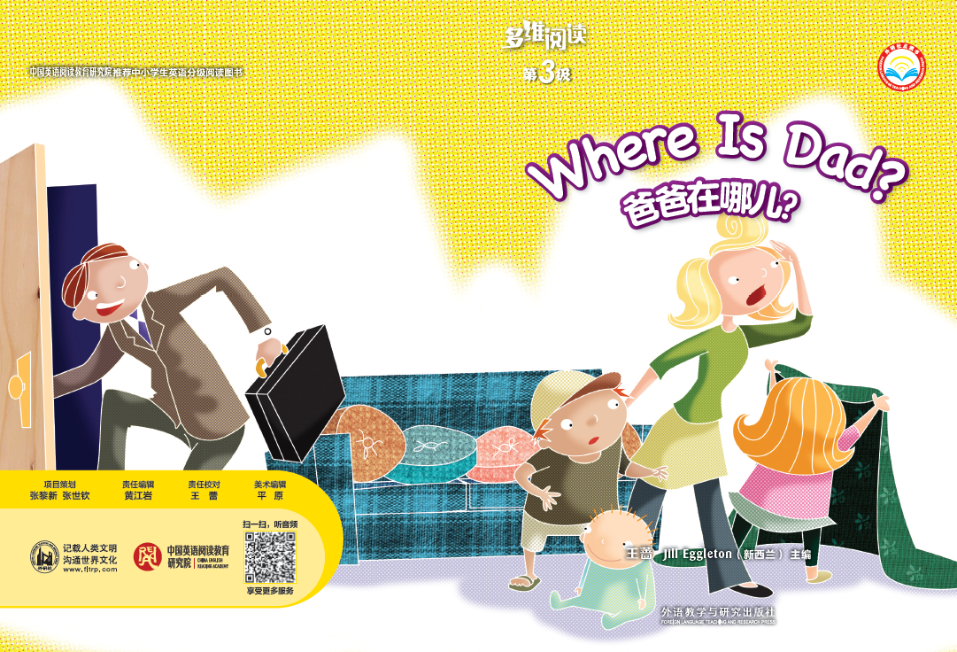
多维阅读 第3级
Where Is Dad?

Slide 2
What’s the title?
Who’s the writer?
What will happen
to the family in
the book?

Slide 3
Where was Dad?
Where was Dad going?

Slide 4
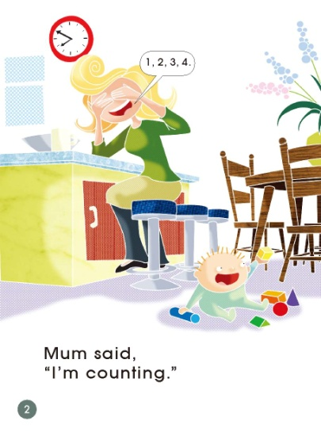
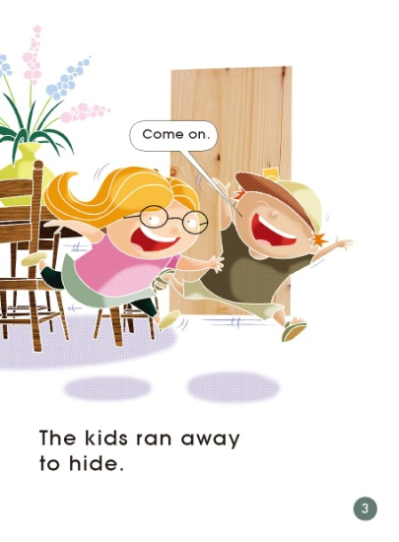
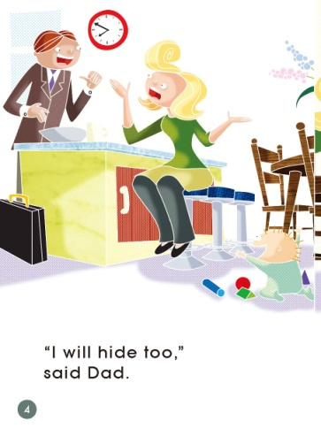
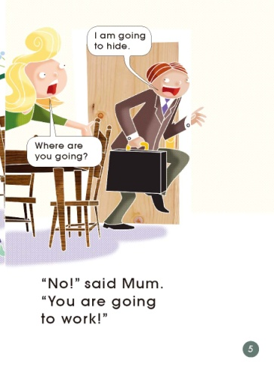
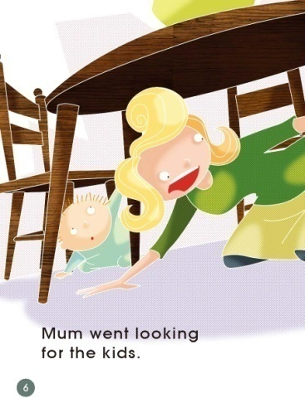
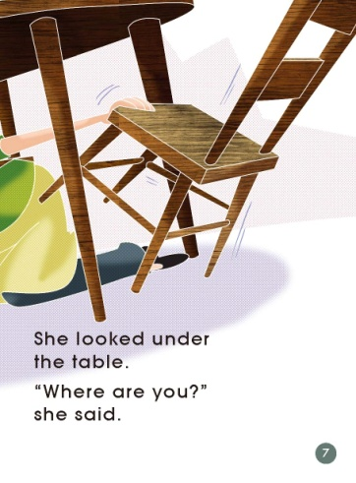
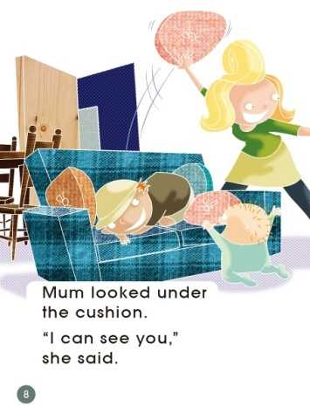
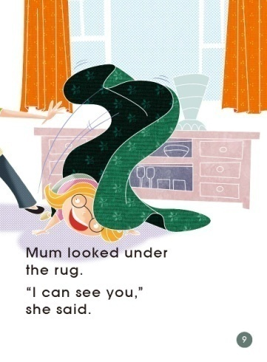
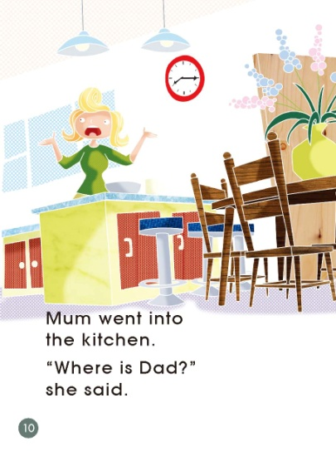
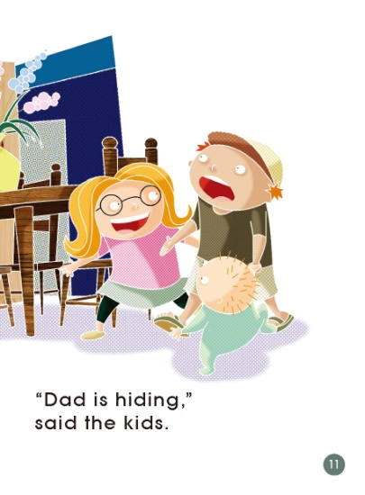
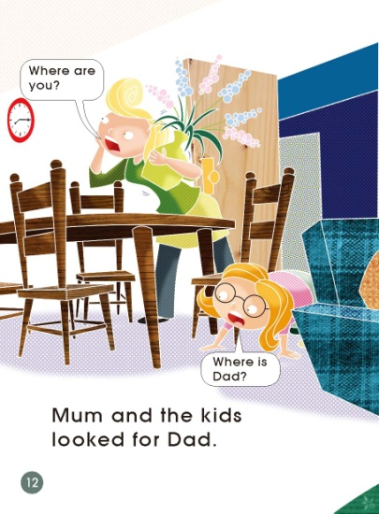
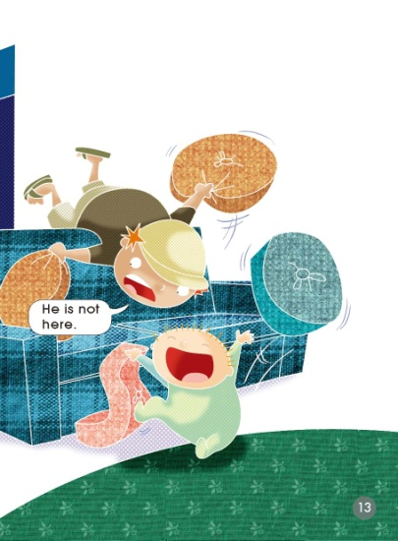
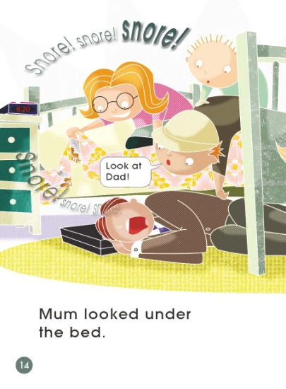
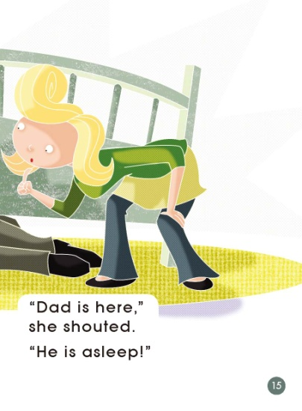
Read and Listen.

Slide 5
Read again and answer questions.

Slide 6
What game were they playing?

Slide 7
Where was Dad going?

Slide 8
Where did Mum look for the kids?

Slide 9
Do you think these are good places to hide?

Slide 10
Where do you think Dad might be?

Slide 11
Do you think Dad has gone to work?

Slide 12
If you were Mum, what would you feel?

Slide 13
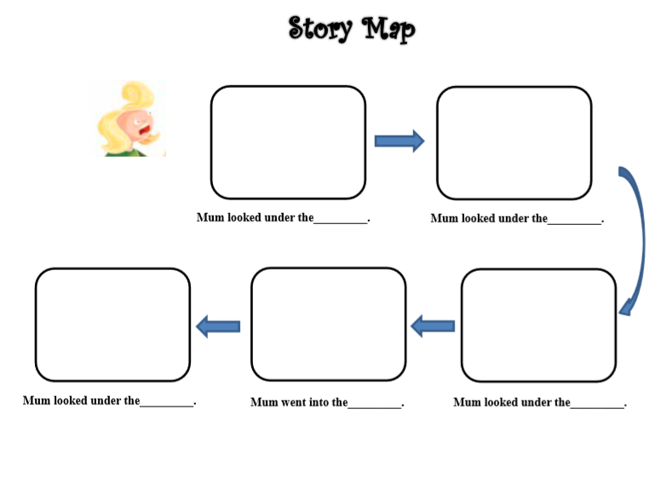
Read and complete the story map.

Slide 14
Tell the story to your group members.

Slide 15
Discuss: Do you think Dad was really asleep or just
pretending?

Slide 16
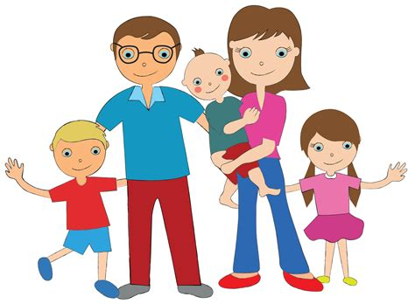
Think and answer.
1. What did Mum and Dad do with the kids?
2. Have you played hide and seek with
your family before?
3. What interesting
activities did you have
with your family?

Slide 17
Be happy with your family!

Slide 18
Homework
（1）Tell the story “Where is Dad?”
to your parents.
（2）Draw and tell a happy activity
with your family.

