Slide 1

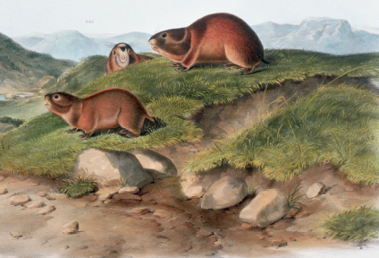
Fact or Fiction？
是真是假？
选自《多维阅读第19级》

Slide 2


Option 1: Prediction
1. What can you see from the cover?
2. What is the title of the book and what do you think it means?
3. What do you think the topic or theme of the book is?
4. Do you know anything about the stories shown in the pictures?

Slide 3
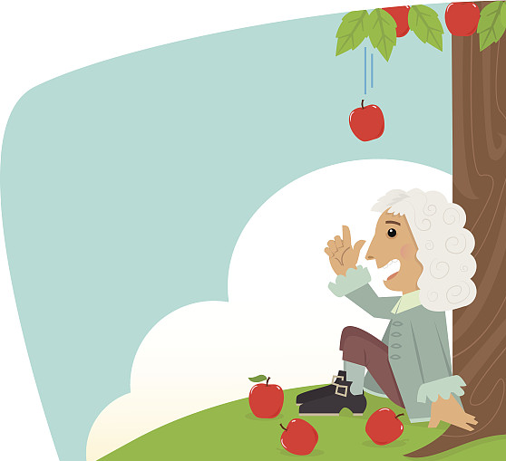
Option 2: Do you know?
1. Who discovered gravity?
2. How was it discovered?
3. Do you believe the story?

Slide 4
Reading for main ideas
1. How many parts can the article be divided into?
2. What is the main idea of each part?

Slide 5
Reading for main ideas
1. How many parts can the article be divided into?
The article can be divided into three parts.

Slide 6
Reading for main ideas
2. What is the main idea of each part?
The first part is an introduction. It introduces the opinion of the author – we need to distinguish fact from fiction when we hear something. The second part provides lots of examples to explain the author’s viewpoint. The third part makes a conclusion about the whole article and restates the viewpoint.

Slide 7
Reading for main ideas
2. What is the main idea of each part?
Leaping Lemmings
Newton and gravity
Vanishing boats and planes in Bermuda Triangle
…
Introduction
Conclusion

Slide 8
Reading for details (Handout)
1. What is the event about?
2. Do people believe it?
3. What’s the author’s point of view? Why?

Slide 9
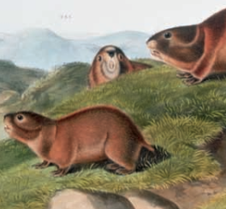
Check your handout
Stories | Basic information | Fact / Fiction | Reasons
the growth of population
a movie
lemmings commit suicide together
fiction

Slide 10
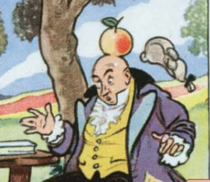
Check your handout
Stories | Basic information | Fact / Fiction | Reasons
no written records
Newton had been thinking about the idea for years
an apple fell and Newton discovered the law of gravity
not sure
/ some truth

Slide 11
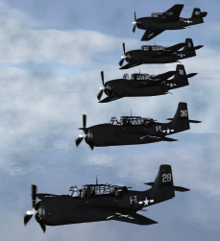
Check your handout
Stories | Basic information | Fact / Fiction | Reasons
vanishing boats and planes in Bermuda Triangle
mystery
magnetic
weather

Slide 12
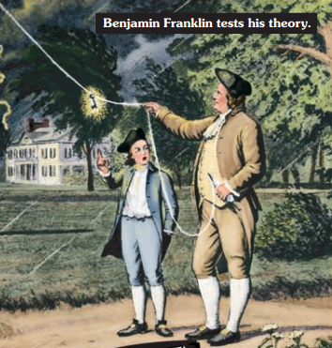
Check your handout
Stories | Basic information | Fact / Fiction | Reasons
Franklin’s kite experiment
the danger of lightening
fiction

Slide 13
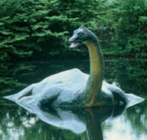
Check your handout
Stories | Basic information | Fact / Fiction | Reasons
a monster in Loch Ness
large fish
volcanic activity
fiction

Slide 14
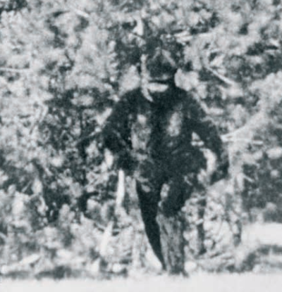
Check your handout
Stories | Basic information | Fact / Fiction | Reasons
questionable proof
no hard facts
ape-like creature
mystery

Slide 15
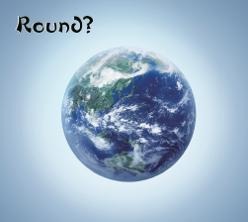
Check your handout
Stories | Basic information | Fact / Fiction | Reasons
the Earth is flat
fiction
proved wrong

Slide 16
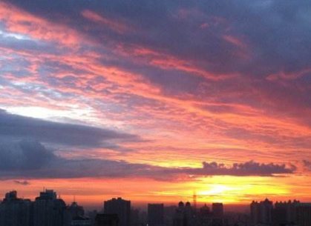
Check your handout
Stories | Basic information | Fact / Fiction | Reasons
patterns predicting weather
proved by science
fact

Slide 17
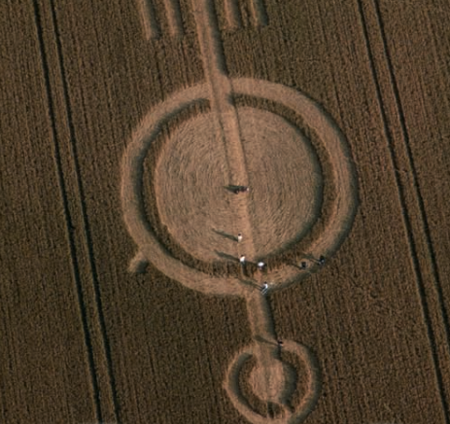
Check your handout
Stories | Basic information | Fact / Fiction | Reasons
mysterious geometric patterns in grain fields
admitted by two men, but there is still doubt
mystery

Slide 18
Pair work: Question what you hear
Choose three most impressive stories. One student tells the story, while the other students question the story using supportive details from the text.
You know, Newton discovered gravity only by accident. One day, he was hit by an apple on the head …
Student A
That’s not true …
Student B

Slide 19
Understanding the text
1. What is the purpose of the writing?
2. How do the examples in the text help support the author’s point of view?
3. What can you learn from the text? Can you connect it with real life?

Slide 20
Understanding the text
1. What is the purpose of the writing?
The article tells readers to keep a critical eye on what they have heard. There will always be stories and mysteries for people to think about and question. We need to judge for ourselves.

Slide 21
Understanding the text
2. How do the examples in the text help support the author’s point of view?
A variety of stories are provided in the text. Some have been proved as fact or fiction, while some are still mysteries to people. Some stories are told so many times that they feel so true, yet they have been proved as fiction. Some stories sound false, yet they may have some truth in them. The difficulty to decide what is true or false supports the author’s point of view that we should not believe everything that we have heard, and it is important to keep a critical eye.

Slide 22
Option1: Discussion
1. Have you ever heard of any similar stories in life? What is it?
2. Do you think it’s fact or fiction? Share your opinion.

Slide 23
Option2: Discussion
1. How do you understand the sentence in the last part? (“Scientists need facts to prove that stories are true, but fiction is valuable too.”)
2. Can you give some examples in history or real life to further explain the sentence?

Slide 24
Group work: Make a speech
Please work in groups and make a speech entitled “To Hear Is Not to Believe”. Provide both examples from the text and new examples to support your argument. Use a mind map to help you organize your speech.

Slide 25
Homework
Option 1: Do further research on one or two of the stories mentioned in the text. Find out more information to decide whether they are true or false.
Option 2: Write a passage about a similar story. Provide evidence to prove whether it is fact, fiction, or still mystery.

