Slide 1
Helping the Helpless
伸出援手
选自《多维阅读第18级》

Slide 2

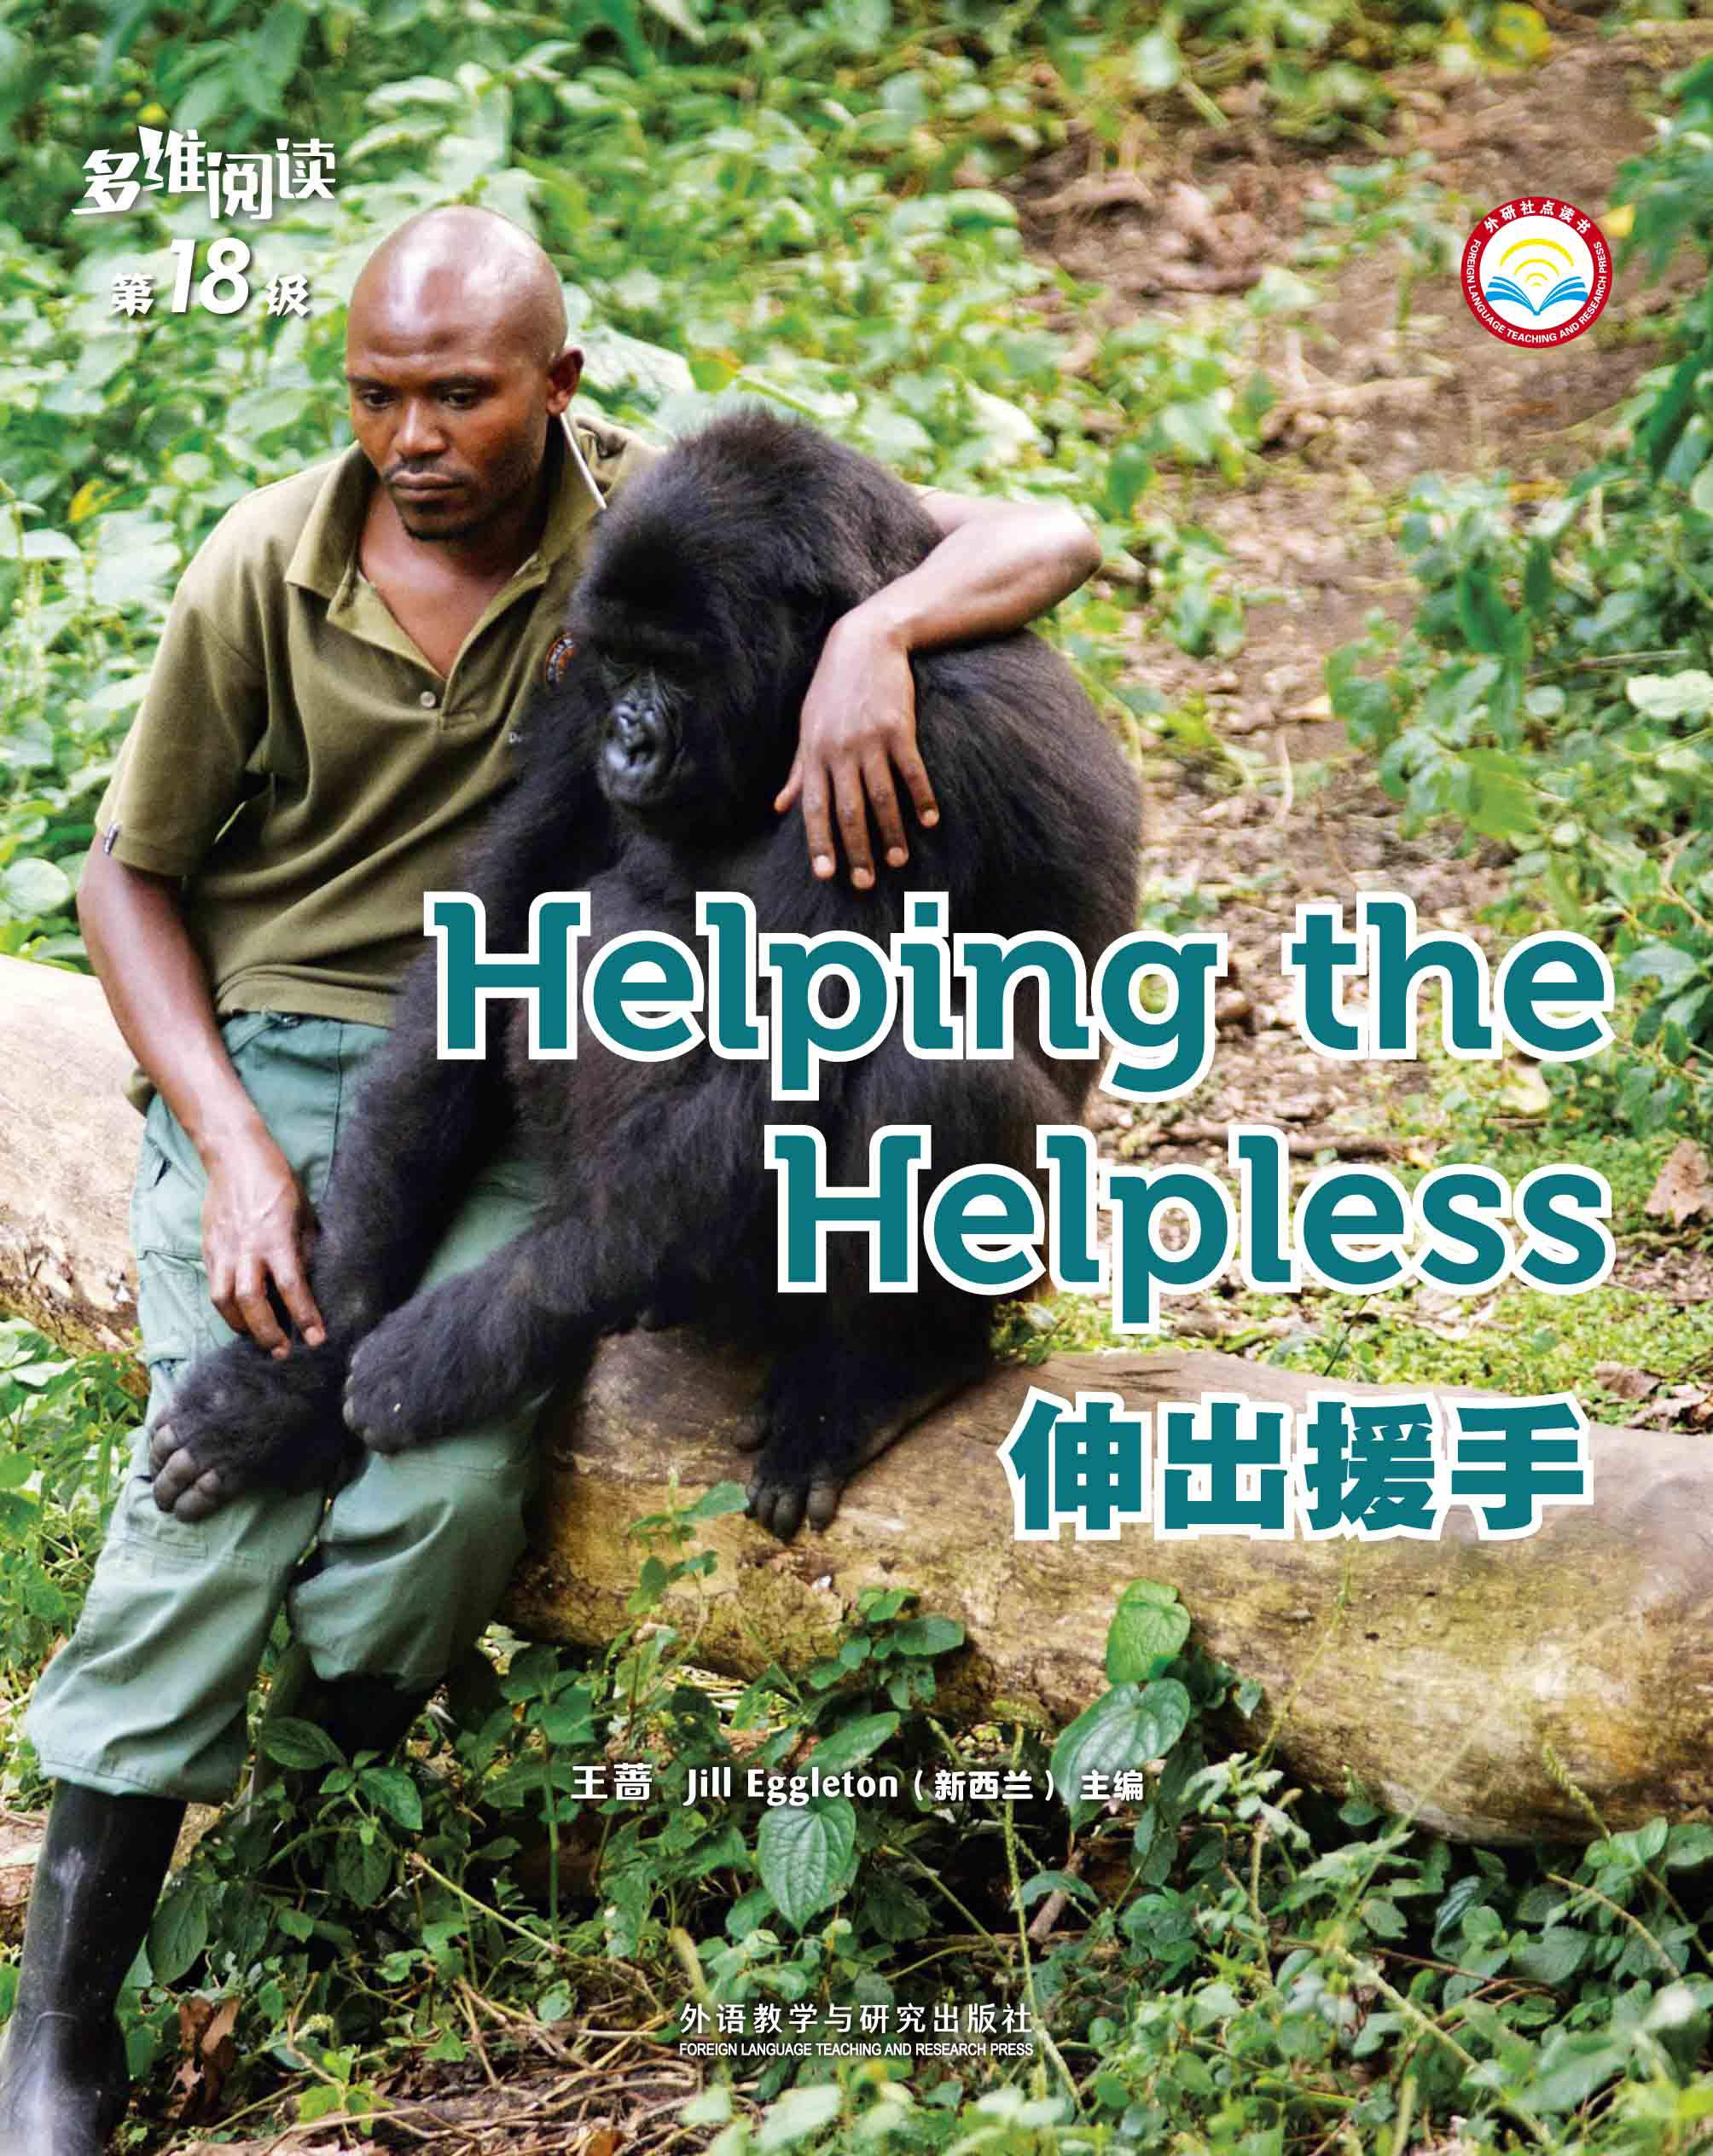
2018的结束，
我们一年的工作也将有一个总结，在总公司的帮助下，我们从公司的销售业绩、员工素质、销售技巧、专业基础知识的掌握、以及客户储备等等都有了明显的提升与进步，于此同时也暴露了我们很多的问题，在总公司的帮助下如抽茧剥丝一样一个一个的解决它。在此我向总公司的领导与同仁表示感谢。下面我对一年来的工作进行一个简要的总结。
1
Observe the cover
Who ?
Why ?

Slide 3
2
How would you divide the passage?
The 1st Paragraph
Read
Headings
Pictures
Notes:
3

Slide 4


2
How can you divide the passage?
Orphan survival
Bat hospital
The Sloth Sanctuary
Questions about sloths
Virunga: a haven for mountain gorillas
Danger at Virunga
Human help
Notes:
4

Slide 5



3
KWL
Know
Want to Know
Learnt
Before Reading
After Reading
Notes:
5

Slide 6
Task 1 Complete the KWL table
 | What I Know | What I Want to Know | What I Learnt
Fruit Bats
Sloths
Mountain Gorillas

Slide 7
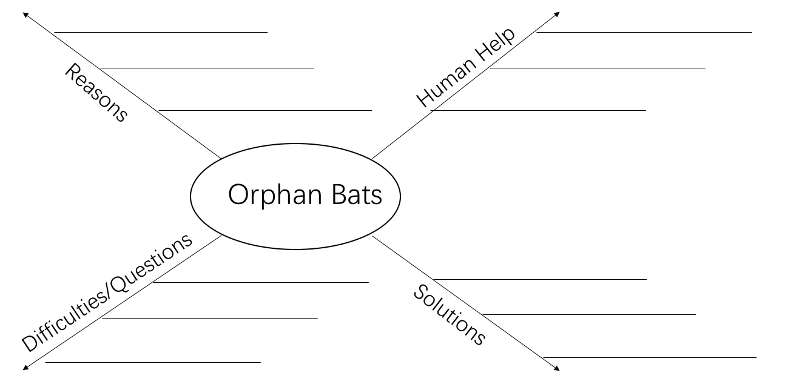
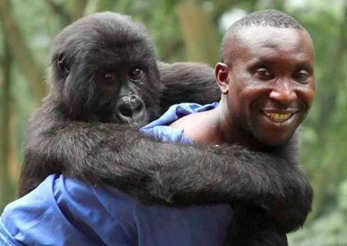
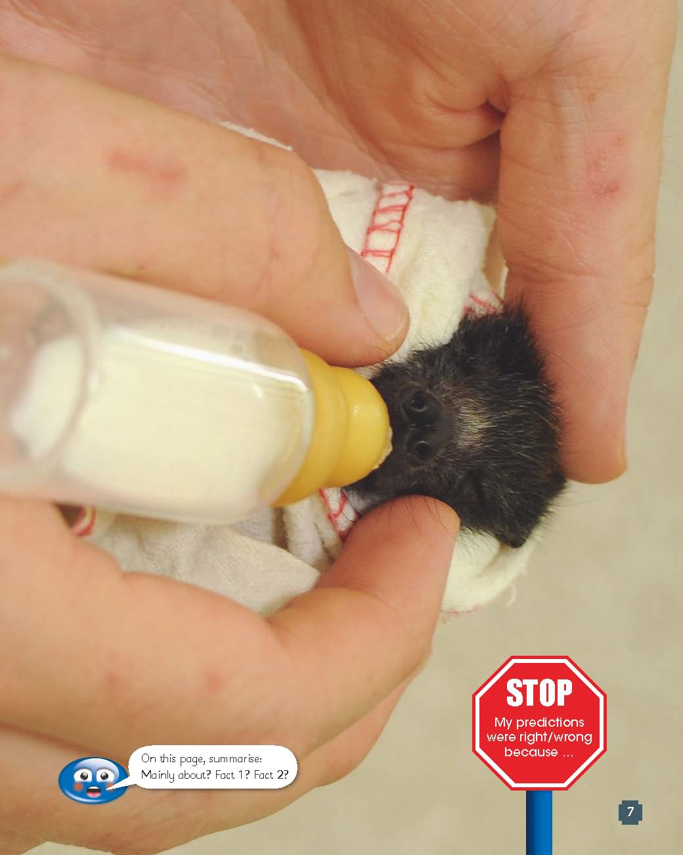
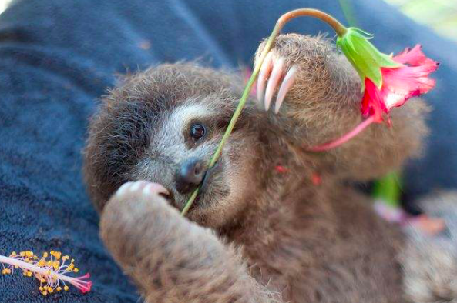
4
Read and Complete
Task 2
Notes:
7

Slide 8
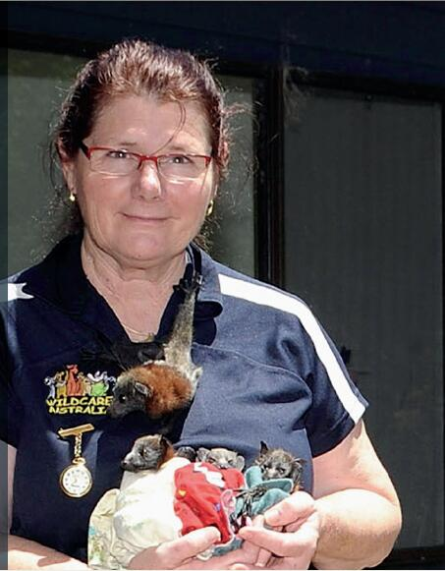
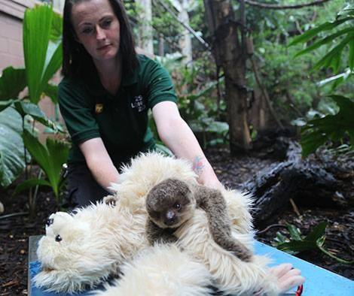
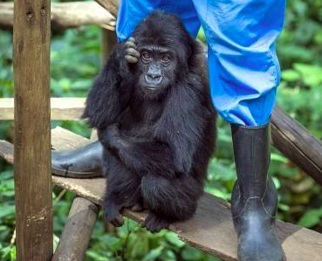
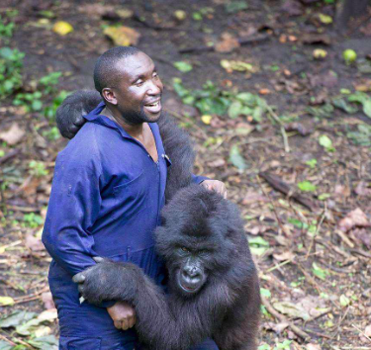
5
Story Telling
Task 3
or
Notes:
8

Slide 9
Version 1
I am a(n) orphan bat/sloth/gorilla, because____________________.
I was ____________________ by (the bat hospital/sloth sanctuary/ranges at Virunga).
They (how they take care of the orphan animal).
I want to ____________________ the nature, but ____________________, so ____________________. I am (feelings).
Version 2
I am a worker/ranger at (a) bat hospital/sloth sanctuary/Virunga.
We ____________________ a bat/sloth/gorilla, because ____________________. We ____________________ (how we take care of the orphan animal). We want to ____________________ back to the nature, but ____________________, so ____________________. I am (feelings).

Slide 10
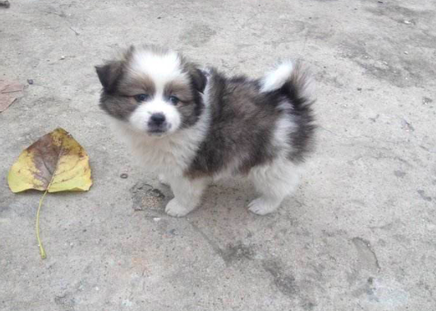
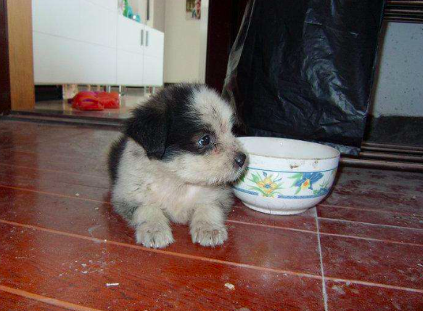
6
Discuss the situation.
Task 4
Try to persuade your mother to agree to help an orphan dog.
Notes:
10

Slide 11
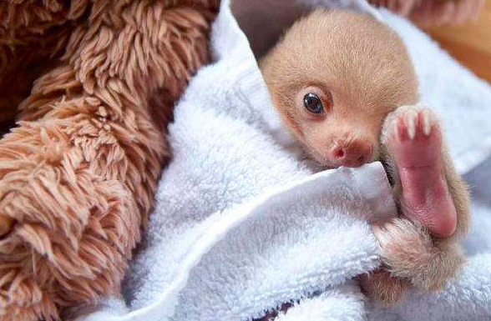
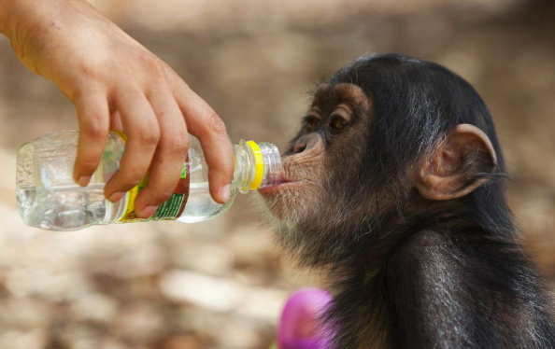
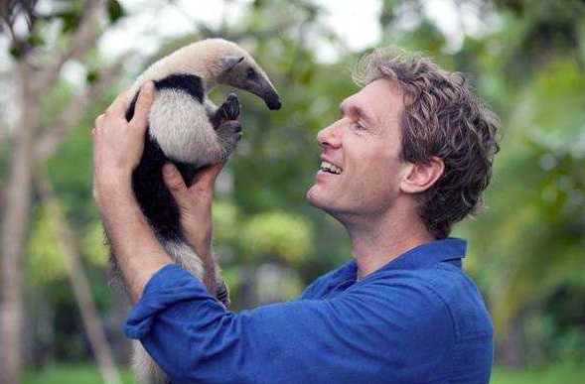
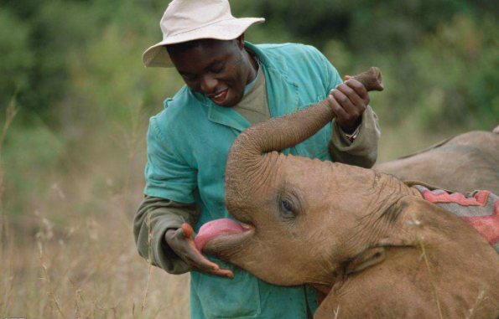
7
Voice your opinions.
What do you think of the act of saving orphan animals?
What influences do the helping acts on humans and animals according to the book?
Notes:
11

Slide 12
THANKS

