Slide 1
Pirate Treasure Dreaming
搜寻海盗宝藏
选自《多维阅读第17级》

Slide 2
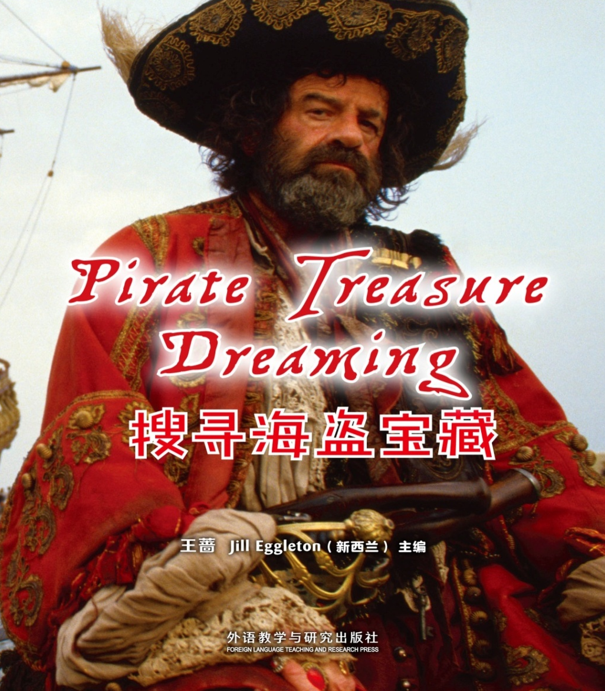
Observe the cover
Why do people become pirate?
Why do people look for pirate treasure?
How could they find these treasure?

Slide 3
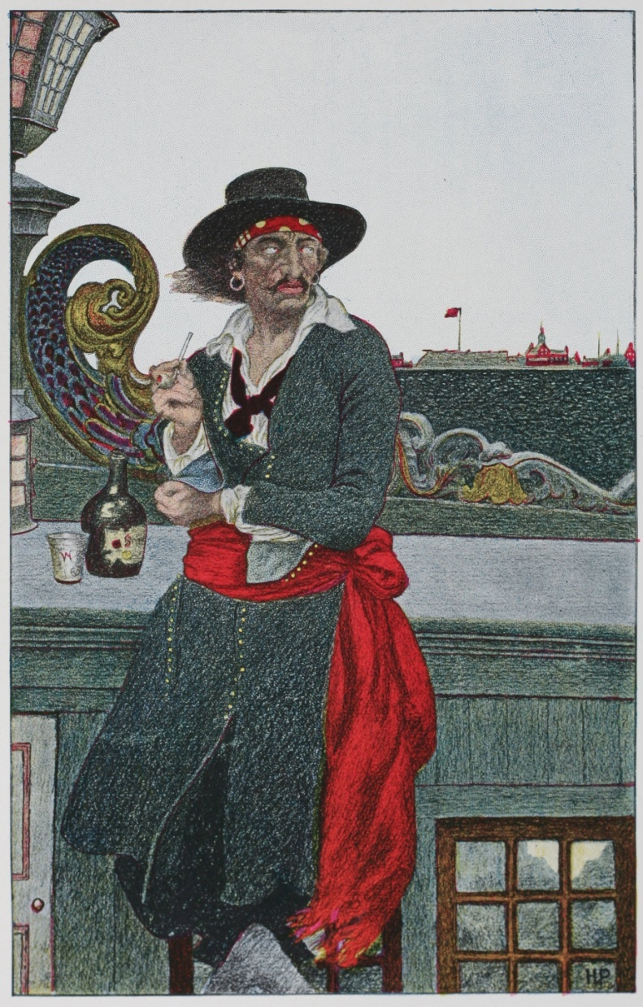
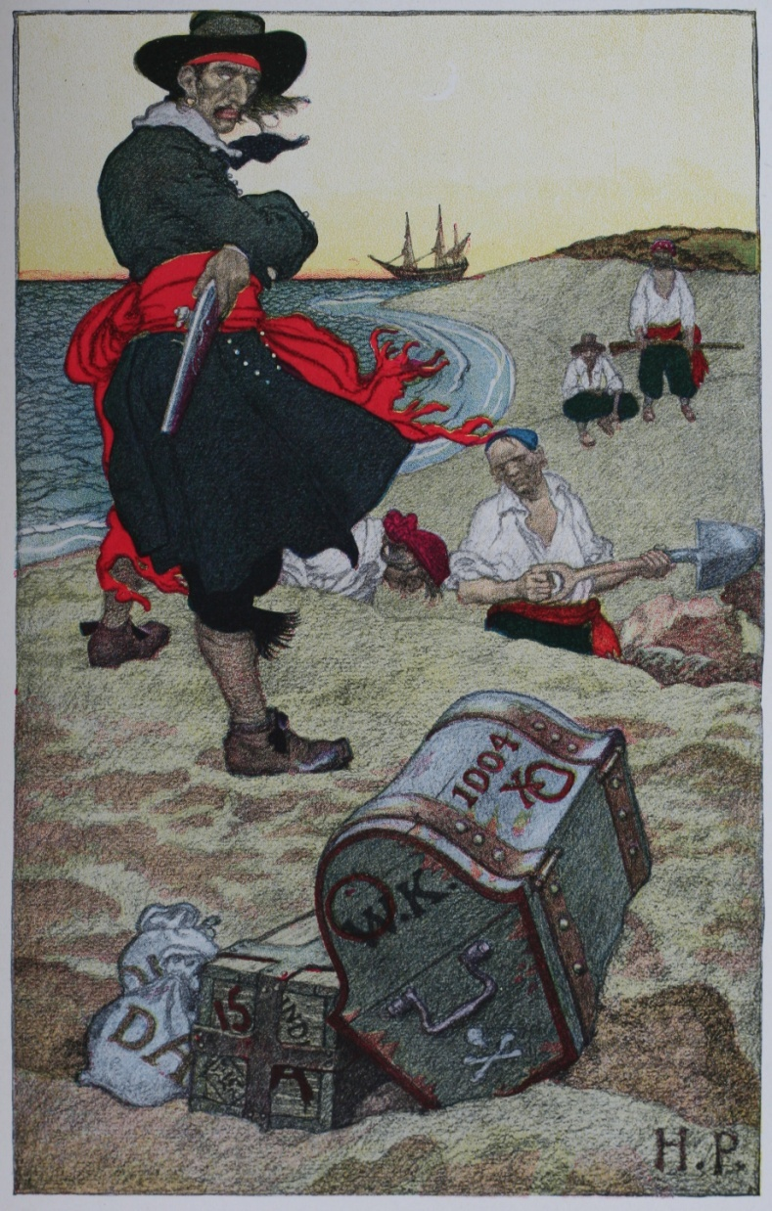
Captain Kidd
Notes:
1. Have you ever heard of stories of Captain Kidd?
2. If you could meet Captain Kidd, what question would you ask him and why?

Slide 4
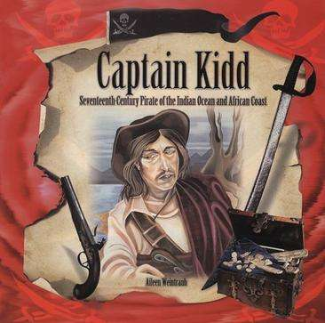
Captain Kidd：
William Kidd, also Captain Kidd (c.1654-23 May 1701), was a Scottish sailor who was tried and executed.
People believed that Kidd had left buried treasure on Oak Island, Nova Scotia.

Slide 5
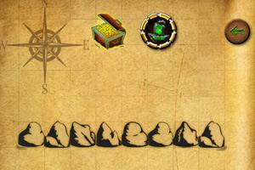
Treasure Hunting Begins!

Slide 6
Story Map for Captain Kidd
Setting (when/where):
Characters:
What did they do? How did they do it?
Event 1
Event 2
Event 3
Outcomes:
Notes:
1.Where and when did the story happen? (Setting)
2.Who were the characters in the story?
3.What did they do? And how did they do it? (Plot/Problem)
4.What was the outcome?

Slide 7
Story Map for the Whydah
Setting (when/where):
Characters:
What did they do?
How did they do it?
Outcomes:
Notes:
1.Where and when did the story happen? (Setting)
2.Who were the characters in the story?
3.What did they do? And how did they do it? (Plot/Problem)
4.What was the outcome?

Slide 8
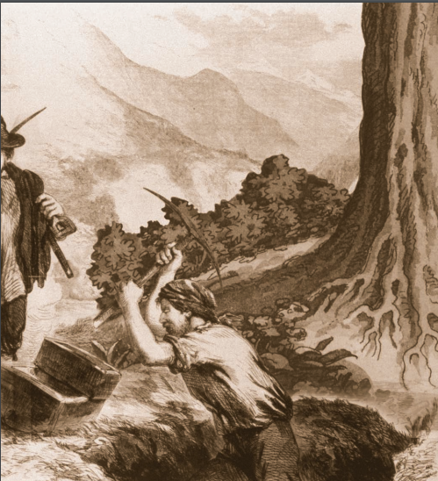
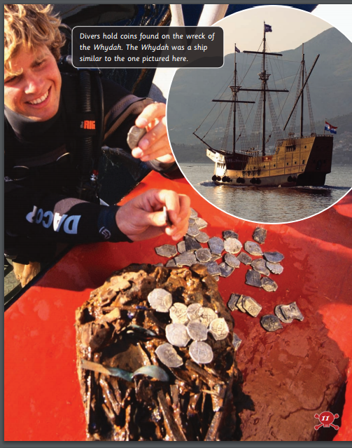
Please retell the story like this: Today we learnt two stories of pirates' treasure: one is not confirmed and the other is confirmed. The first one is about…
Notes:
Captain Kidd: pirate; explore; dig; treasure; pick; shovel
The Whydah: sink; search; magnetometer; digital camera

Slide 9
Group Discussion
1. Daniel and his friends shouldn’t have told anyone about the treasure. Do you agree? Why?
2. If treasure hunters find any treasure, they should keep it for themselves. Do you agree? Why?
3. Treasure hunting is a waste of time and money. Do you agree? Why?

Slide 10
Homework
Use the story maps to summarize two pirates’ treasure stories.
2. Make up pirates’ stories.

Slide 11
Thank You!

