Slide 1
多维阅读
第15级
One of a Kind

Slide 2
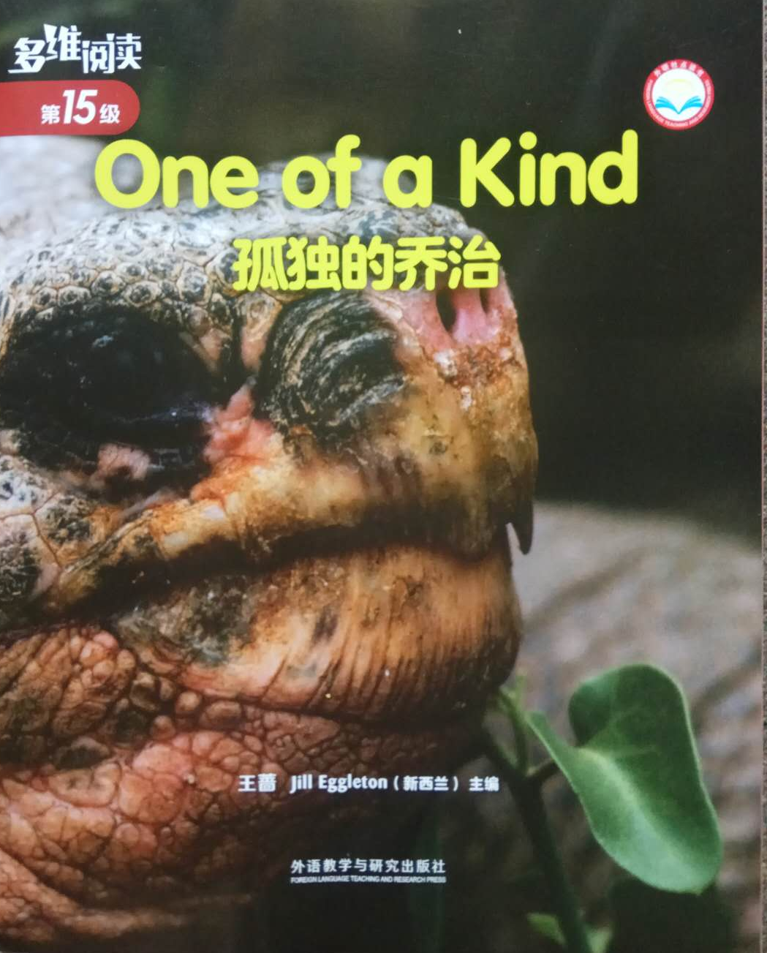
Look at the cover.
1. What’s this in the picture?
What’s the name of it?
2. What do giant tortoises look like?
Where did they live?
How old can they live to be?
Is there anything else you know
about them?
3. Why is the book titled One of a Kind?
Can you guess what happened to
giant tortoises?

Slide 3
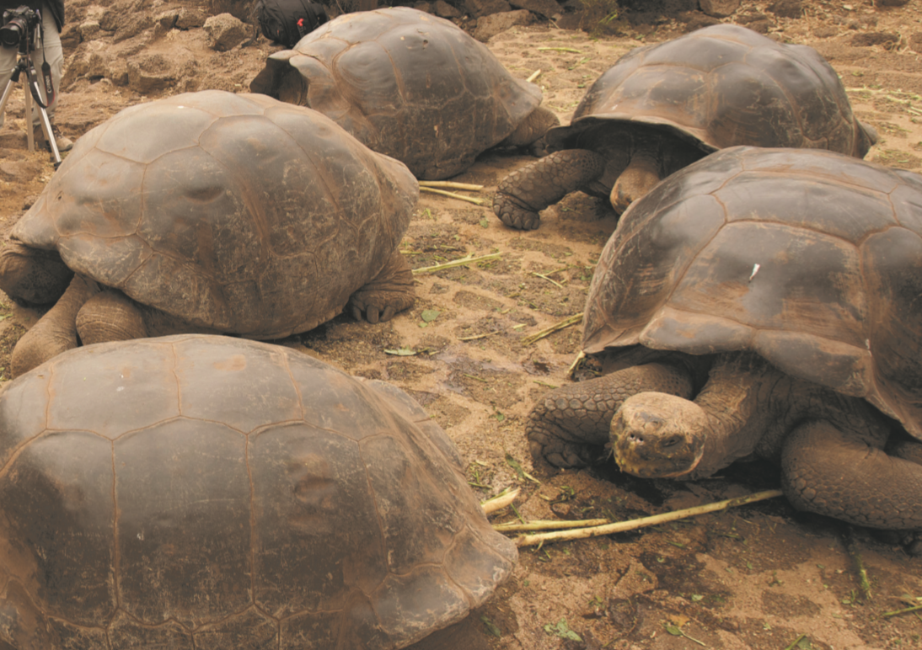
Read and answer the questions.
When Dinosaurs Lived
1. Where did giant tortoises live?
2. What kind of life did they live?
3. Were they rare? How many of them were there?

Slide 4
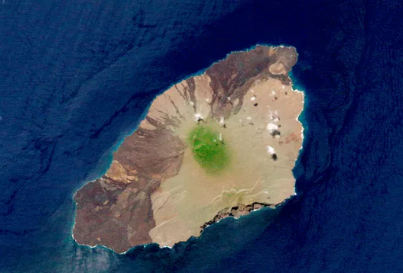
Read and answer the questions.
When Dinosaurs Lived
1.Where did giant tortoises live?
Pinta Island

Slide 5
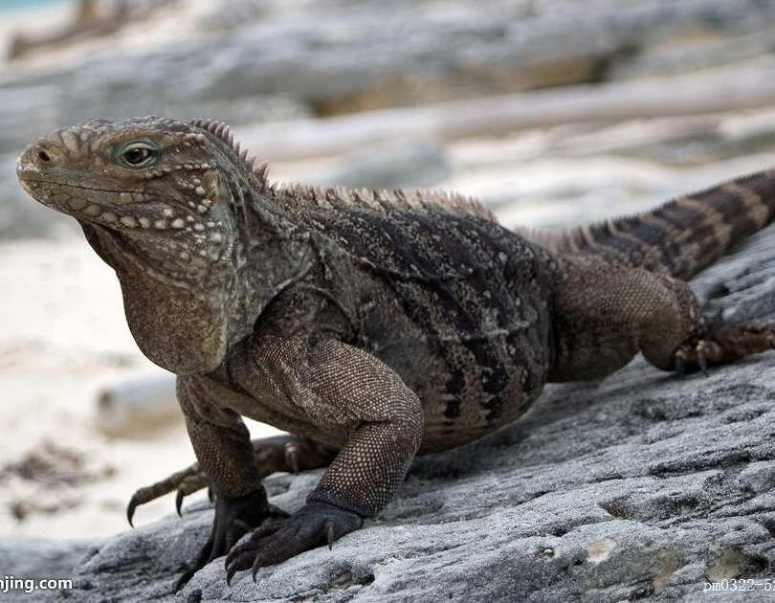
Read and answer the questions.
When Dinosaurs Lived
2.What kind of life did they live?
predators
shells

Slide 6
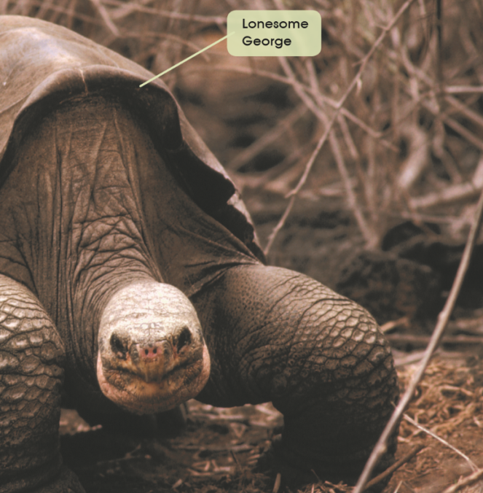
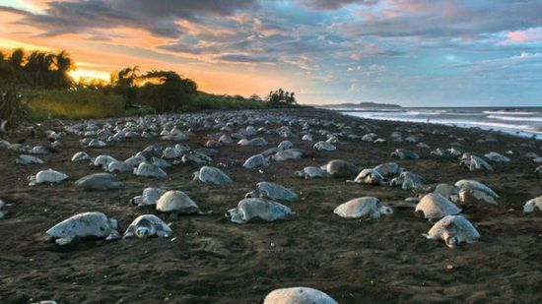
Read and answer the questions.
When Dinosaurs Lived
3. Were they rare? How many of them were there?
millions of

Slide 7
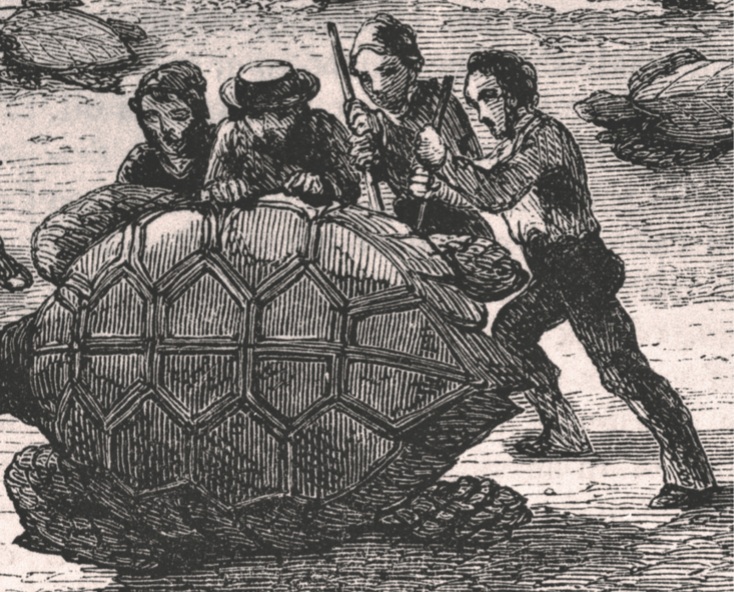
Read and answer the questions.
Giant Tortoises Disappear
1. How did giant tortoises disappear?
2. Was there any one of that kind left? If there was one, what was it called? Why was it called so?

Slide 8
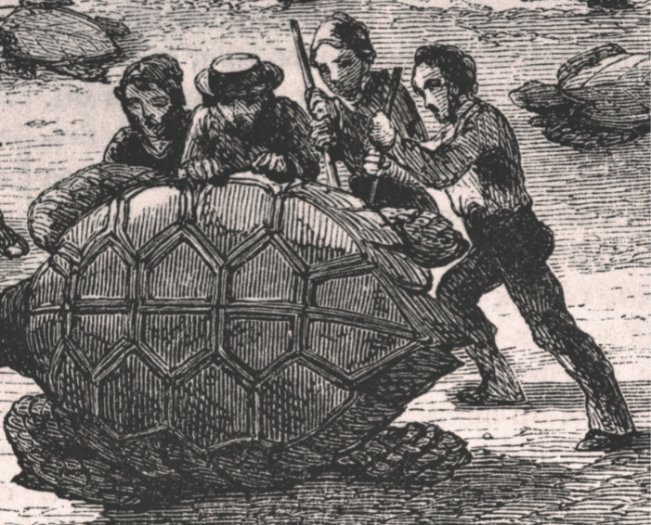
Read and answer the questions.
Giant Tortoises Disappear
1. How did giant tortoises disappear?
pirates

Slide 9
Read and answer the questions.
Giant Tortoises Disappear
2. Was there any one of that kind left?
If there was one, what was it called?
Why was it called so?
Lonesome George

Slide 10
Read and answer the questions.
Gone Forever
1. Where was he taken? Why?
2. What do you think made some animals become extinct?

Slide 11
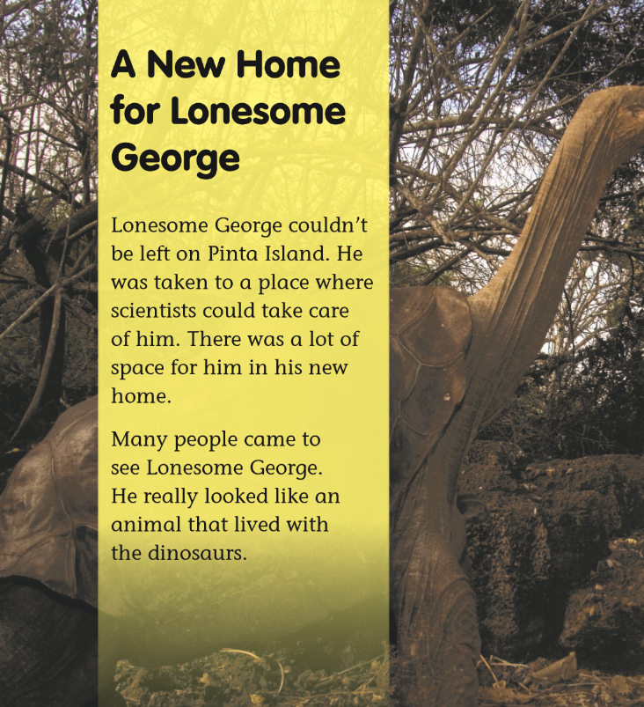
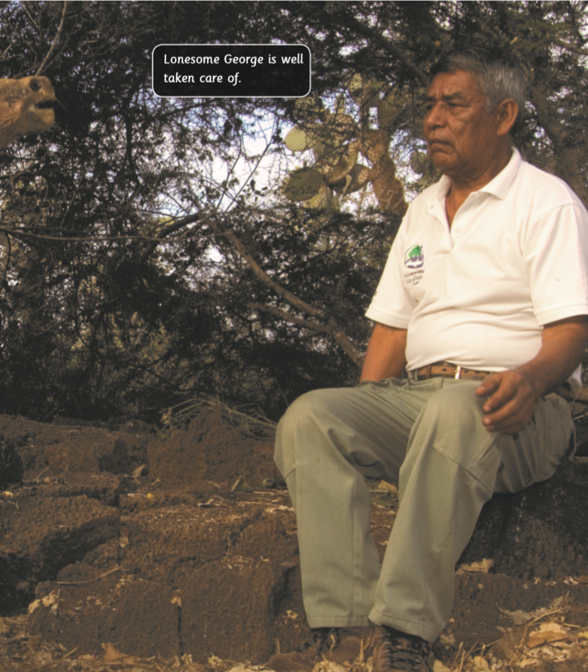
Read and answer the questions.
Gone Forever
1. Where was he taken? Why?

Slide 12
Read and answer the questions.
Gone Forever
2. What do you think
made some animals
become extinct?

Slide 13
1. Complete the chart. What happened to the giant tortoises on Pinta Island?
Group Work

Slide 14
2. List out the important facts and interesting facts about Lonesome George.
Group Work
Important Facts
Interesting Facts

Slide 15
3. Complete the mind-map with some basic information about the giant tortoises on Pinta Island.
Group Work
Giant tortoises

Slide 16
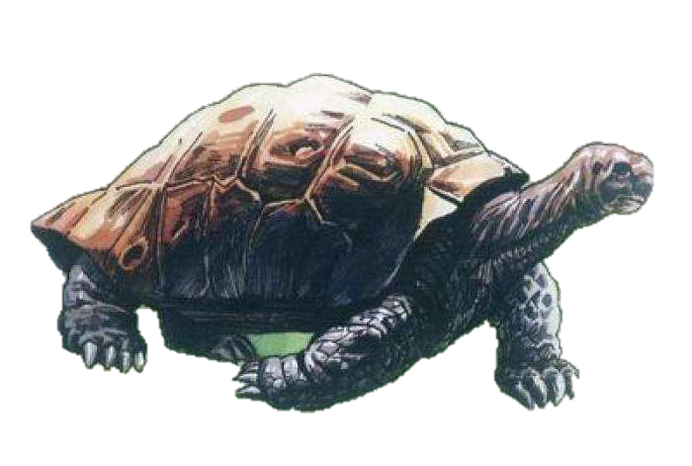
4. Work in a group of three. 1) Introduce basic information about the giant tortoises on Pinta Island and what happened to them. 2) Share your feeling about the extinction of the giant tortoises on Pinta Island.
Group Work

Slide 17
1. Why is the book titled One of a Kind?
Discussion
2. Why does the author write the book?
3. What can we do to protect animals?

Slide 18
和小组成员合作，制作一幅海报，介绍一种濒危动物，包括该动物的简介、其数量减少的原因以及如何保护该动物。在全班进行展示。
Learn More
和小组成员一起利用网络或者图书馆查询资料。看看是否有其他的平塔岛象龟还存活在世上。在全班汇报调查结果。

Slide 19
Thank you!

