Slide 1
多维阅读第15级
Dr Flockter
丛林历险记

Slide 2
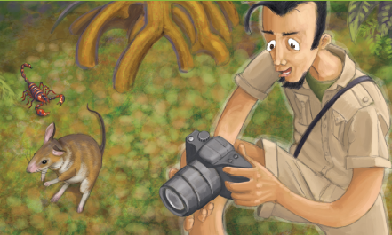
Lead-in
What can you see in the picture?
Who was the man? Where was he? Why he was here?
What might happen to the scorpion and the rat?

Slide 3
Page 2
Pair work
attack
1. Where was Dr Flockter?
2. How long had he been there?
3. Why did he go there?
4. Had he found what he had looked for?
5. What happened to the scorpion and the rat?
What do you think might happen later?
snatch
spider
rainforest
dinosaur

Slide 4
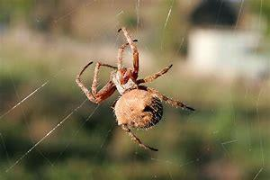
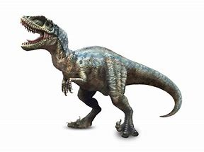
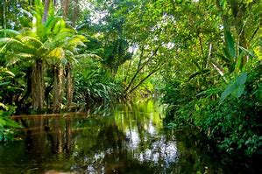
spider rainforest dinosaur

Slide 5
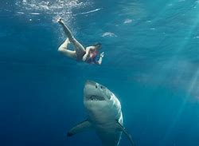
attack
to take aggressive actions with weapons or armed force, especially in a battle or war
When the Japanese attacked America's ships at Pearl Harbor on 7 December 1941,they did it secretly.

Slide 6
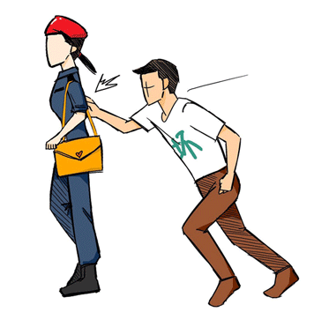
snatch
to seize by a sudden grasp
The thief snatched the purse from the lady.

Slide 7
Page 4
Pair work
Where did Dr Flockter sit?
What was wrong with the log?
What do you think was inside the log?
humming
stirring

Slide 8
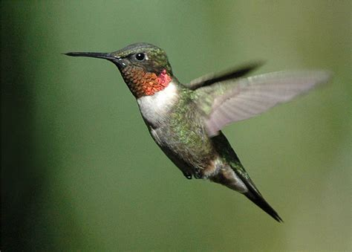
humming
making a long, low sound

Slide 9
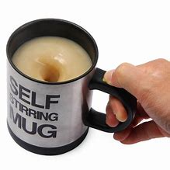
stirring
(stir)
starting to move
A gentle breeze stirred the leaves.

Slide 10
Page 6
Pair work
What did Dr Flockter see?
What do you think Dr Flockter would do?
pincers
leapt off
army ants

Slide 11
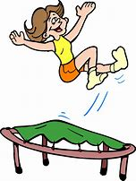
leapt off
jumped off
They both leapt off the cliff and fell to the ground.

Slide 12
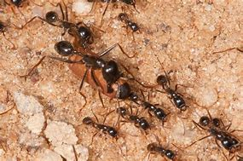
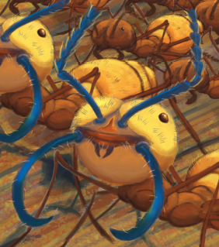
army ants pincers

Slide 13
Page 8
Pair work
What did Dr Flockter do?
Could he run very quickly? Why?
How did Dr Flockter feel?
What do you think Dr Flockter would do?
sting
branches
tree roots
prick
stumbled

Slide 14
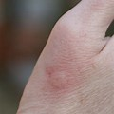
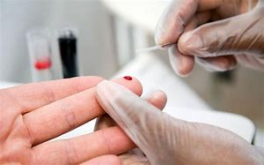
sting
prick
a painful wound caused by the thrust of an insect's stinger into skin
the act of puncturing with a small point

Slide 15
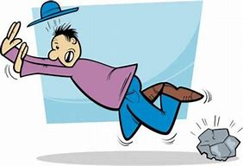
stumbled
tripped when walking or running
Her foot caught a shoe and she stumbled.

Slide 16
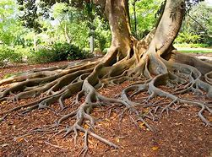
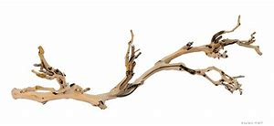
tree roots branches

Slide 17
Page 10
Pair work
What did Dr Flockter see at that time?
What would have happened if Dr Flockter had been stung by the army ants?
swarming
skeleton
What do you think Dr Flockter would do?

Slide 18
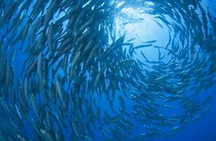
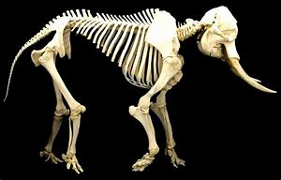
swarming
moving in a large group
skeleton
the structures of bones that support the body of a person or an animal

Slide 19
Page 12
Pair work
What did Dr Flockter do?
piranhas
vine
What do you think Dr Flockter would do?

Slide 20
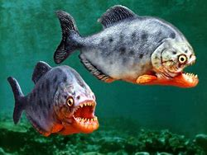
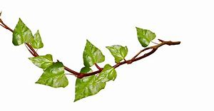
piranhas vine

Slide 21
Page 14
Pair work
What did Dr Flockter do?
What did he see?
How do you think Dr Flockter felt then?
toad
swung
grabbed
patches

Slide 22
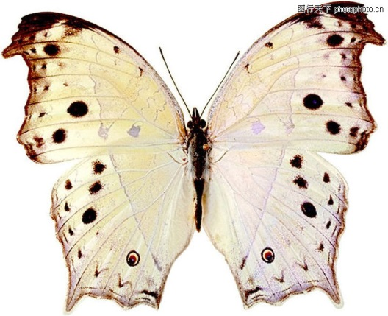
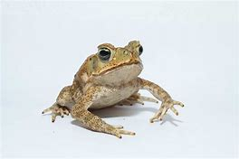
toad
patches

Slide 23
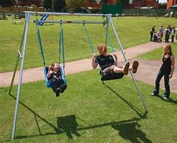
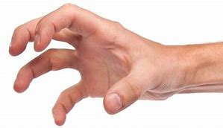
grabbed
swung
moved vigorously through a wide arc or circle
grasped or seized suddenly and roughly

Slide 24
Page16
Pair work
How did Dr Flockter feel then?
How would Dr Flockter leave the island?

Slide 25
Reread the story
What difficulties did Dr Flockter meet when searching for a new animal?
What difficulties did Dr Flockter meet when trying to escape from the army ants?
How did Dr Flockter manage to escape and find a new animal?

Slide 26
Retell the story
Requirements:
use the words and expressions you have learnt in this story
from the view of the first person
retell the whole forest adventure

Slide 27
Summary
What good qualities do you think Dr Flockter has as a zoologist? Why? (mind-map)
What can you learn from Dr Flockter?
Dr Flockter
(a zoologist)

Slide 28
Assignment
Task 1: Continue the story based on the following questions.
Will Dr Flockter manage to leave the rainforest and bring the toad back?
What difficulties will he meet when getting out of the rainforest with the toad?
How will he deal with them?

Slide 29
Assignment
Task 2: Search & share information.
Find more exploration stories of zoologists.

