Slide 1
多维阅读第14级
Home, Safe Home

Slide 2
Answer some questions
1. What can you see on the
cover?
2. What’s the title and what do
you think the meaning of
the title is?
3. What do you think might
happen to the boy?

Slide 3
Open the book and
enjoy the reading time

Slide 4
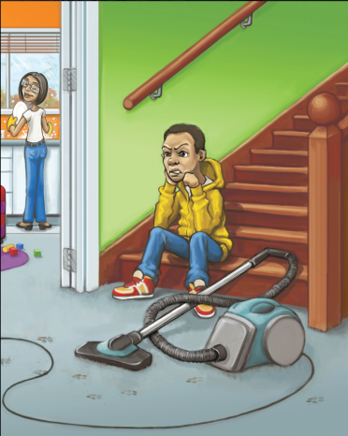
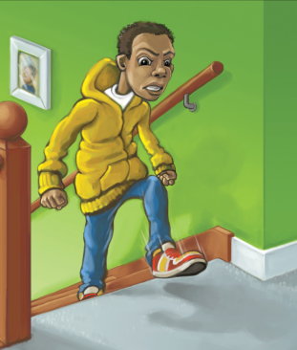
Read and answer
Read pages 2-5 and answer the questions.
1. What did Monty always do at home?
2. What did Monty’s sisters always do at home?
3. How did Monty feel?
4. What did Monty decide to do? Why?
He always had to help his mother.
They had to look after the baby.
He felt angry and not fair.
He decided to run away because he thought nobody cared about him.
Do you think Monty’s mother was fair? Why do you think that?

Slide 5
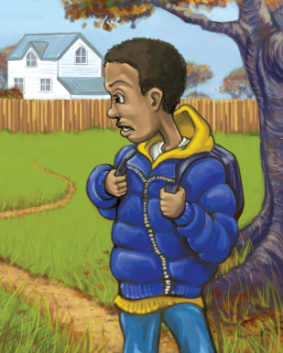
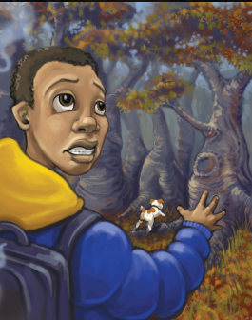
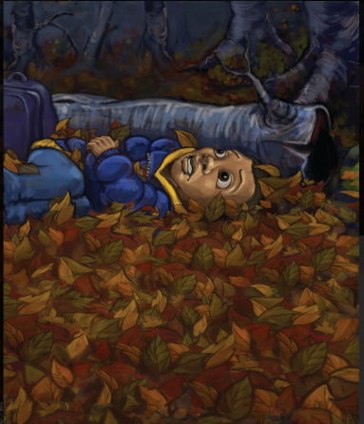
Read and answer
Read pages 6-15 and answer the questions.
1. Who made a rustle in the grass behind Monty?
2. What happened to Monty after chasing Trip?
3. What was Monty’s feeling?
4. How did Monty sleep at night?
5. How did Trip lead Monty to leave the trees?
His dog, Trip.
He wasn’t on the track anymore and lost.
He felt fear.
He lay in the hole and covered himself
with the leaves.
Trip was off with his nose to the ground and
Monty crashed through the trees after him.

Slide 6
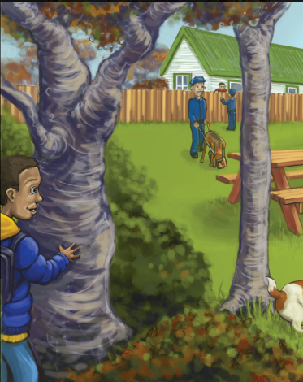
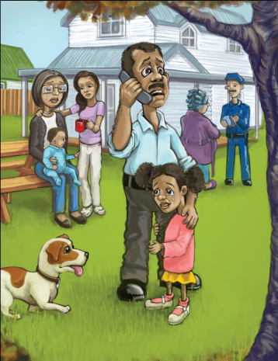
Read and answer
Read pages 16-17 and answer the questions.
1. What did Monty see when he got home?
2. How long did Monty watch people near his home?
He saw his mother and sisters crying and his dad was there too.
For only a minute.
What did Monty
realize finally?

Slide 7
Read for detailed information
Complete the emotion graph of Monty.
Emotion
Time

Slide 8
Read for deeper meaning
Imagine you were Monty,
his teacher, sister and friend,
Work in groups of four.
Take your own challenges and answer your questions.
Write down your answers in 8-10 minutes.
Share your answer with others in your group.

Slide 9
Read for deeper meaning

Slide 10
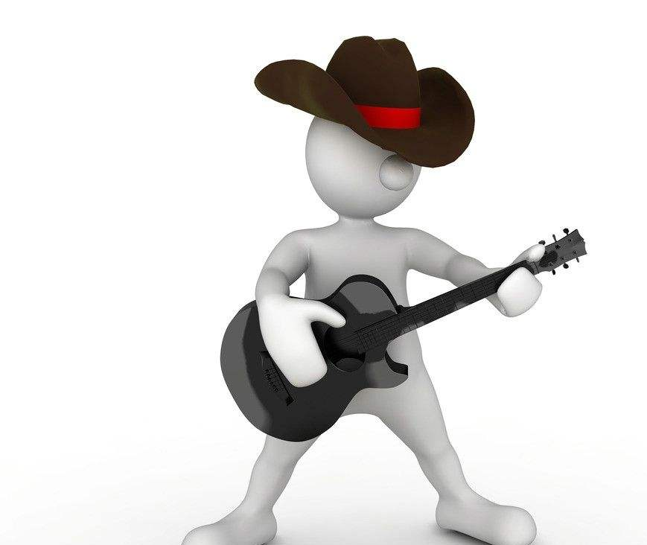
Make a new story
Imagine Trip never found Monty,
what would the story be like?

Slide 11
Gallery walk
Things to do:
1. Walk around the classroom.
2. Look at each other’s story!
3. Stick your star on your favorite work.

Slide 12
Summary

Slide 13
Homework
Write down what we should do if we are
unhappy at home.
Write down what we should do if we find
our family members are not happy at home.

