Slide 1
选自《多维阅读第12级》
Inside-out Skeletons
神奇的“铠甲”

Slide 2
Look and say
1. What are inside-out skeletons?
2. How do they work? Are there anything you have known about them?

Slide 3
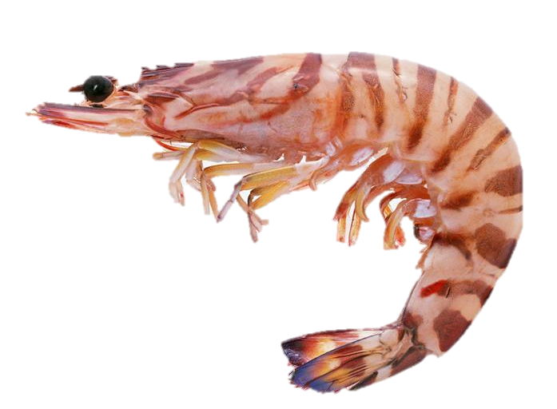
Read and answer
Animals and their exoskeletons
Are skeletons important? Why?
support, move, protect…
2. What is an exoskeleton?
…on the outside…
3. What animals have exoskeletons?
shellfish, spiders, crabs…

Slide 4
Read and answer
Animals and their exoskeletons
4. How are the exoskeletons made?
chalk, chitin
5. How do exoskeletons help animals?
protect the soft inside, stop water…
6. How do the animals with exoskeletons grow?
slip off, the new grows underneath

Slide 5
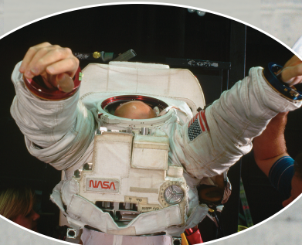
Read and answer
People and their exoskeletons
Who would wear exoskeletons just like some animals?
knights, astronauts, divers…
2. What might exoskeletons be like in the future?
little motors

Slide 6
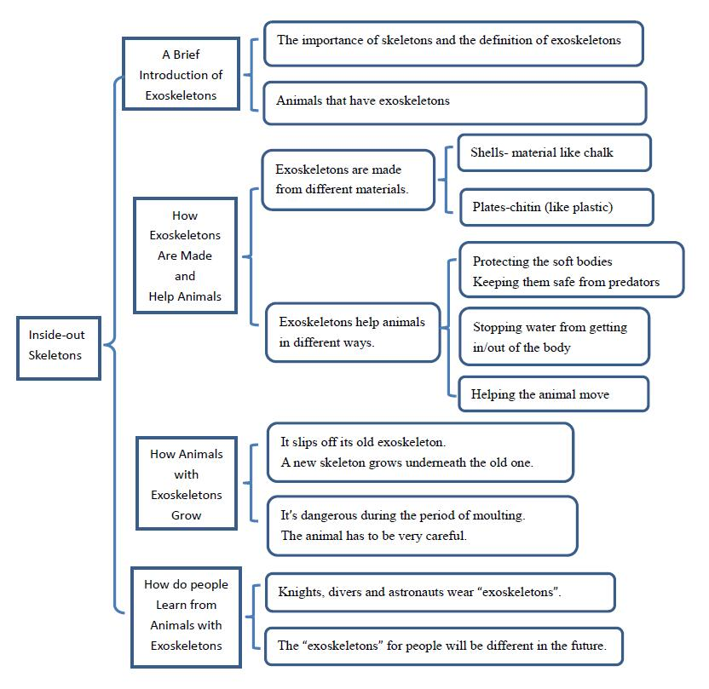
Discuss and do
1. Complete the chart with what you have learned in this book（one word for each blank）and talk about it.
Notes:
教师可打印PPT中图片给学生使用

Slide 7
Discuss and do
2. Complete the flow map about how animals with exoskeletons grow, and then talk about it.

Slide 8
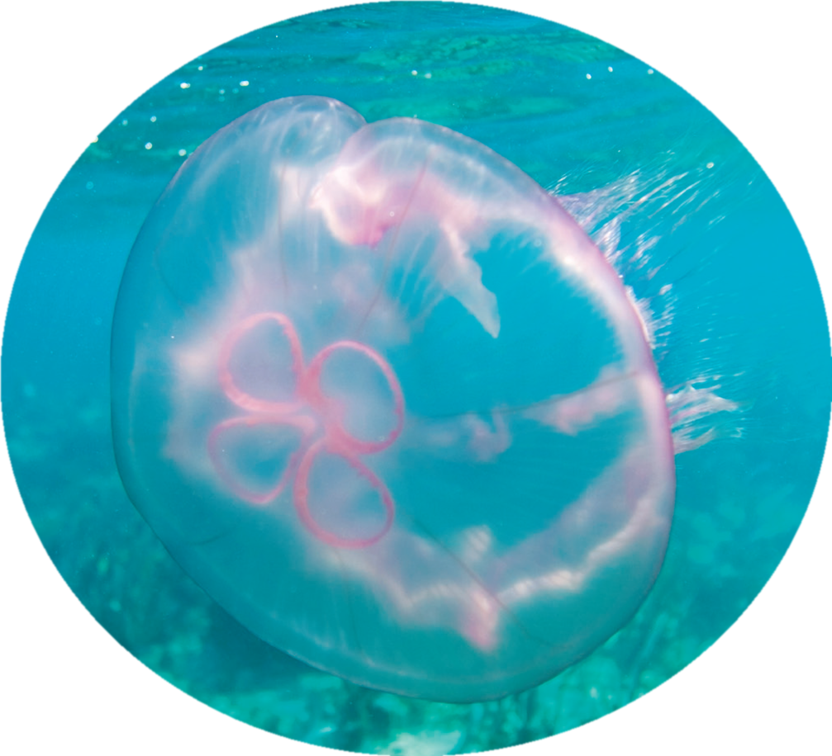
Discuss and say
What would be some animals like if they didn’t have skeletons?
wobbly blobs of jelly
2. What is the old exoskeleton like for an animal?
an old coat

Slide 9
Discuss in groups
Do you know any other animals that have special ways to protect themselves?
protective coloration, gecko…
2. What about people? What else have we learned from animals?
soldier's uniform

Slide 10
Assignments (Choose one)
向家长介绍本课所学的主要内容，即哪些动物拥有外壳、外壳的构成，以及外壳是如何发挥作用的；亦可制作海报进行展示；
2. 课后和小组成员一起利用网络或者图书馆查询更多的关于动物自我保护方式的资料，并在全班汇报调查结果。

Slide 11


