Slide 1
A Trip to Space Camp
太空训练营
选自《多维阅读第12级》

Slide 2
Pre-reading

Slide 3
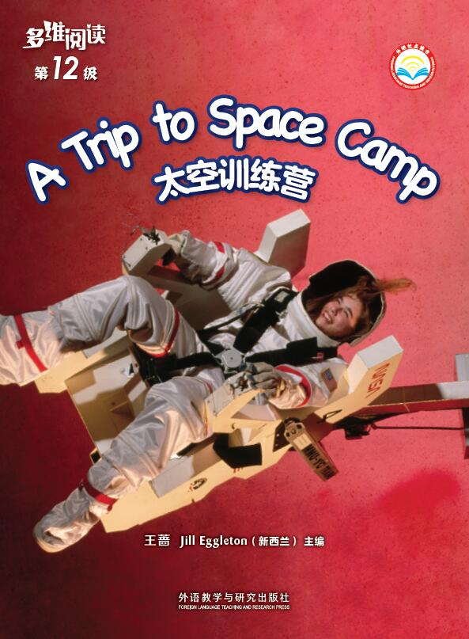
1. What can you see from the cover?
2. She looks clumsy. Do you want to wear like that? Why?
3. What is the book about? Guess!
插入学生用书的封面和封底图

Slide 4
4. What do you know about space?
5. What do you want to know from the space camp?
Notes:
图片来源：Paixin.com

Slide 5
What I want to know about space camp
K (What I Know) | W (What I Want to Know) | L (What I learned)

Slide 6
While-reading

Slide 7
Read the book and think:
1. What do you know after reading the contents page?
2. What do campers do in the space camp?

Slide 8
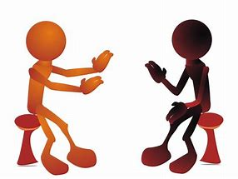
Discuss with your partner:
What is the main idea of this book?
Notes:
图片来源：Traveljee.com

Slide 9
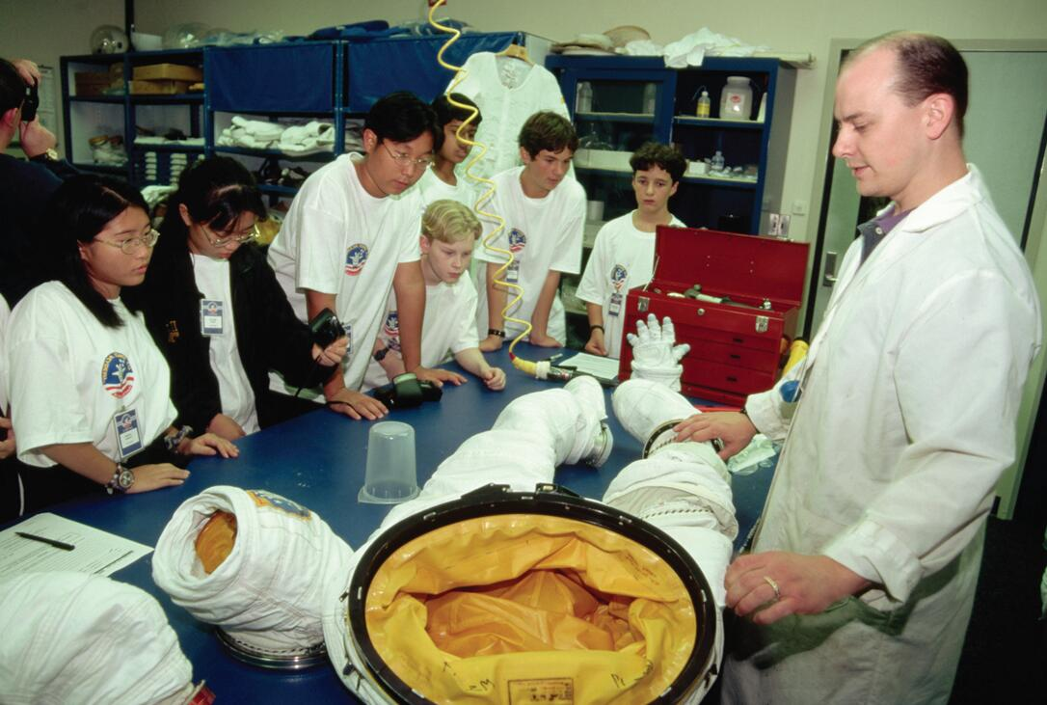
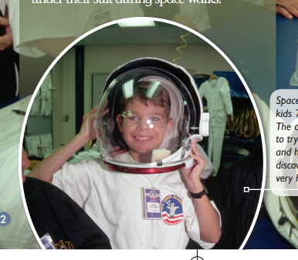
Part 1 What Is Space Camp?
(P2-P3)
1. What do you think the kids in the photo are doing?
2. What do you think a space camp is?
3. Would you like to go to a space camp? Why?
4. Why do you think the astronauts have to wear a
nappy during the space walks?

Slide 10
Try to read aloud(Part 1)
What Is Space Camp?

Slide 11
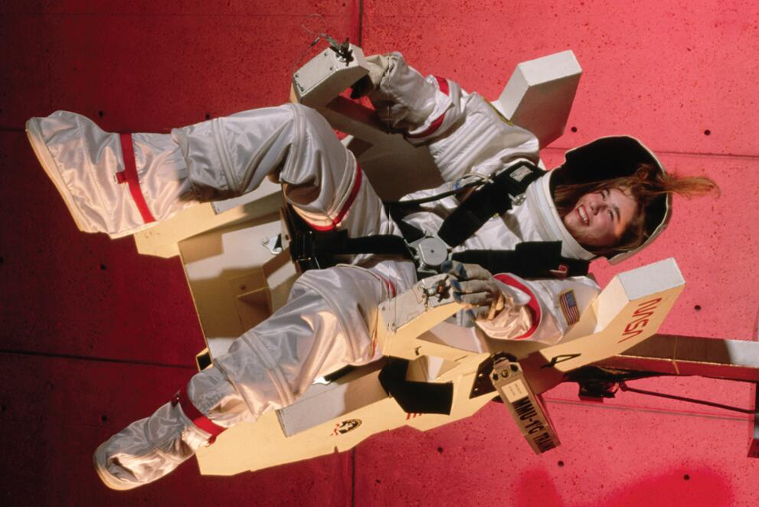
Part 2 What Happens at Space Camp?
(P4-P5)
1. What do you think is happening in the photograph?
2. How does the girl feel?
3. Why do you think the chair needs to move in so many different ways?
4. What kind of work do you think astronauts do in outer space?

Slide 12
Try to read aloud(Part 2)
What Happens at Space Camp?

Slide 13
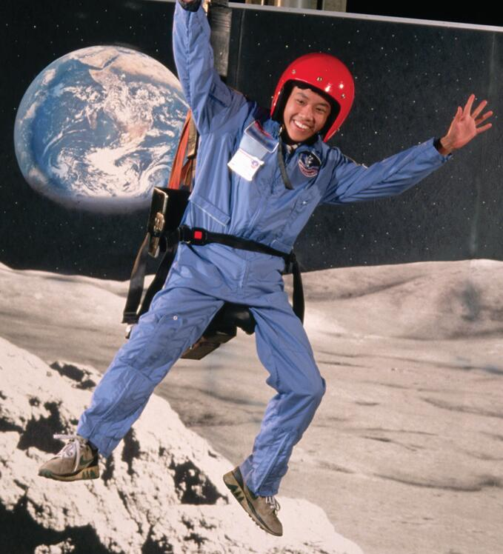
Part 3 Training for Moon Walking
(P6-P7)
1. What interested you about this chair?
2. How is the gravity on Earth different to that on the moon?
3. Do you think you would weight more or less on the moon? Why do you think that?
4. Why do you think it would be necessary to
practise walking in a gravity chair?

Slide 14
Try to read aloud(Part 3)
Training for Moon Walking

Slide 15
Part 4 Training for Spinning in Space
(P8-P9)
1. Why do you think astronauts need spin training?
2. Why do you think some people call this chair “the vomit ball”?
3. Why don’t campers get dizzy or feel sick in this machine?

Slide 16
Try to read aloud(Part 4)
Training for Spinning in Space

Slide 17
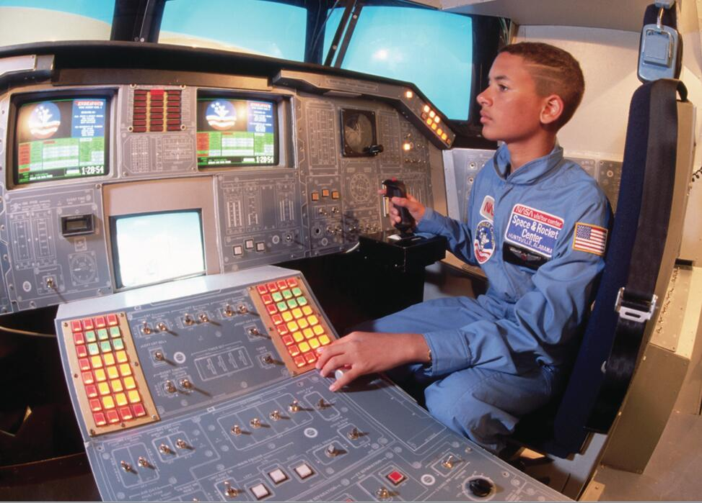
Part 5 A Space Mission
(P10-P11)
1. What do you think this boy is doing?
2. What does cockpit mean? What is it like?
3. How do you know there is a lot to do on a flight? Find out the words in the passage.
4. What qualities do you think make a good astronaut?

Slide 18
Try to read aloud(Part 5)
A Space Mission

Slide 19
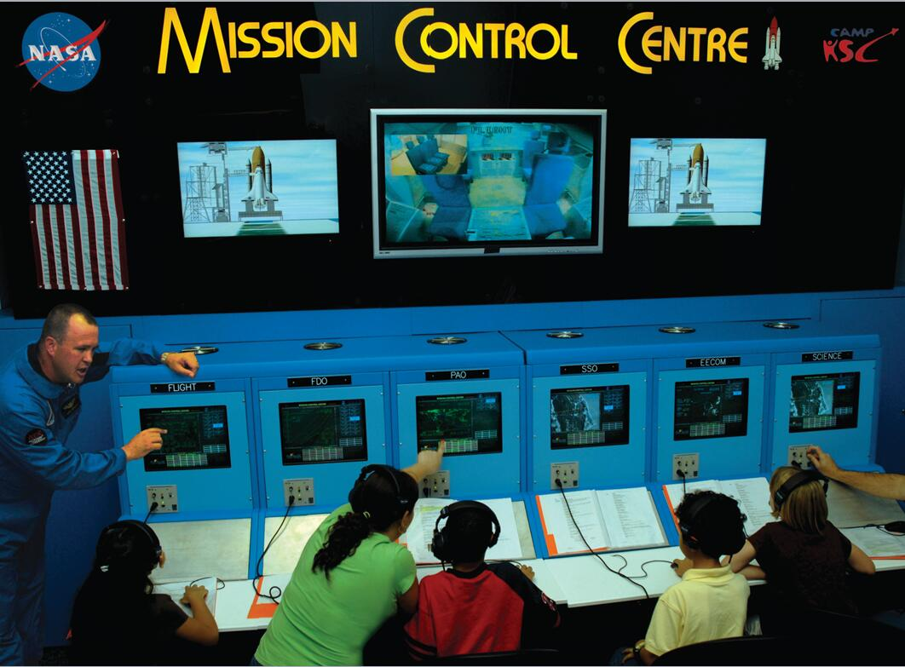
Part 6 Working as a Team
(P12-P13)
1. Why do you think it would be important to work as a team?
2. What do you think a launch script might tell the campers?
3. What did you learn about the space or astronauts that you did not know before?

Slide 20
Try to read aloud(Part 6)
Working as a Team

Slide 21
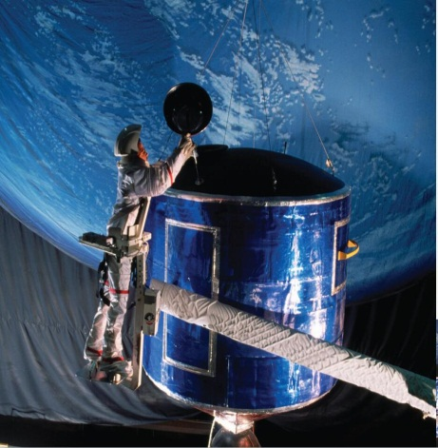
Part 7 Making Repairs
(P14-P15)
1. What do you think the campers might be learning to do there?
2. What do you think is meant by “Astronauts have to be prepared for everything in space”?
3. Why do you think it would be dangerous making repairs in space?

Slide 22
Try to read aloud(Part 7)
Making Repairs

Slide 23
Part 8 At Space and Rocket Centre
(P16-P17)
Do you agree with the sentence “A week at space camp is the best way to explore space without even leaving Earth!”?
Why or why not?

Slide 24
Try to read aloud(Part 8)
At Space and Rocket Centre

Slide 25
After-reading

Slide 26
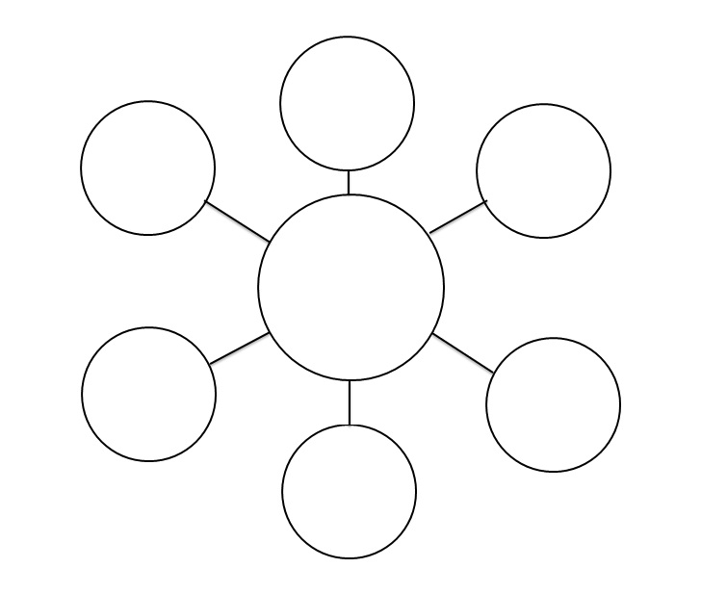
Read and make a mind map.
Try to talk about it.
Notes:
图片来源：osborne10thlit.com

Slide 27
What do you learn from this book?
K (What I Know) | W (What I Want to Know) | L (What I learned)

Slide 28
Why does is the author write this book?
Do you like to join in a camp like this? Why or why not?
When have you been somewhere to learn something new? What have you learnt? Share it with your partner.
Notes:
图片来自：canacopegdl.com

Slide 29
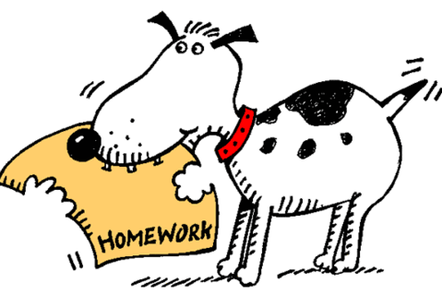
HOmework
Introduce the space camp to your parents.
Choose a topic about a trip or a camp and give an oral report to your classmates.
Notes:
图片来源：clipartpanda.com

