Slide 1
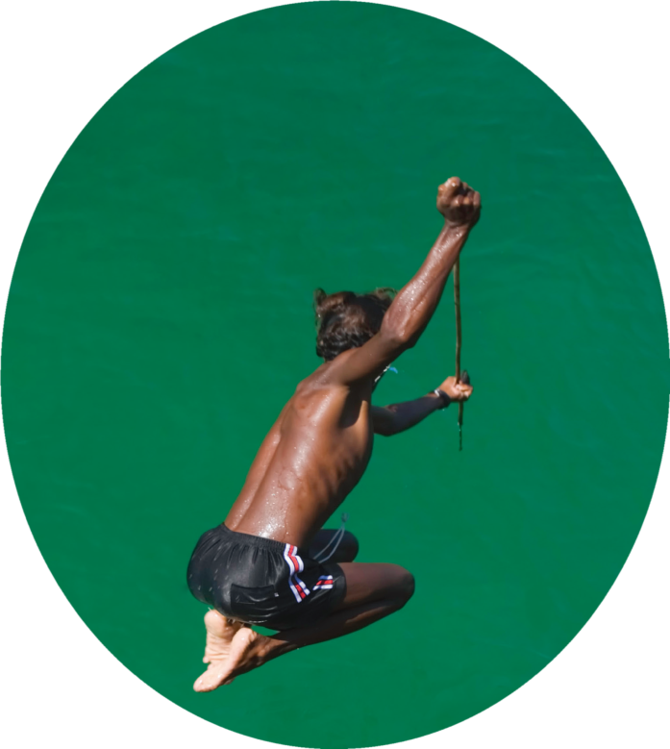
The Call of the Sea
海上“吉普赛人”
选自《多维阅读第12级》

Slide 2
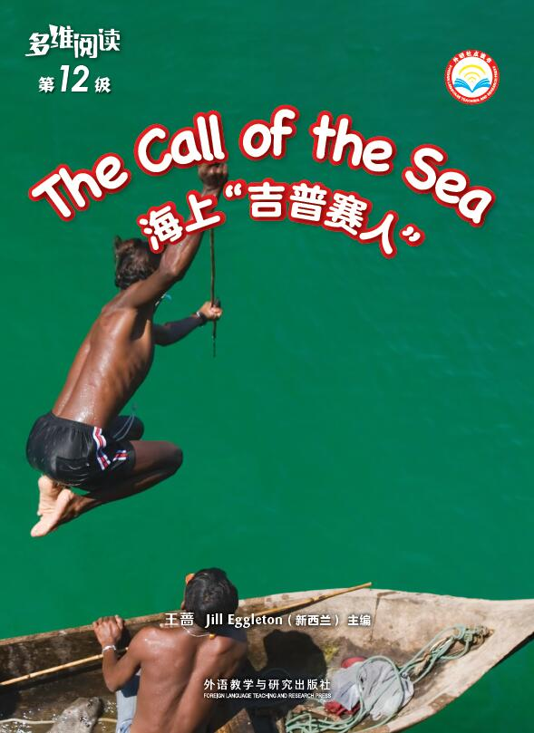
Activity 1
1.Look at the picture and the title. What do you know about the Moken sea people?
2.What else do you want to know about them?

Slide 3
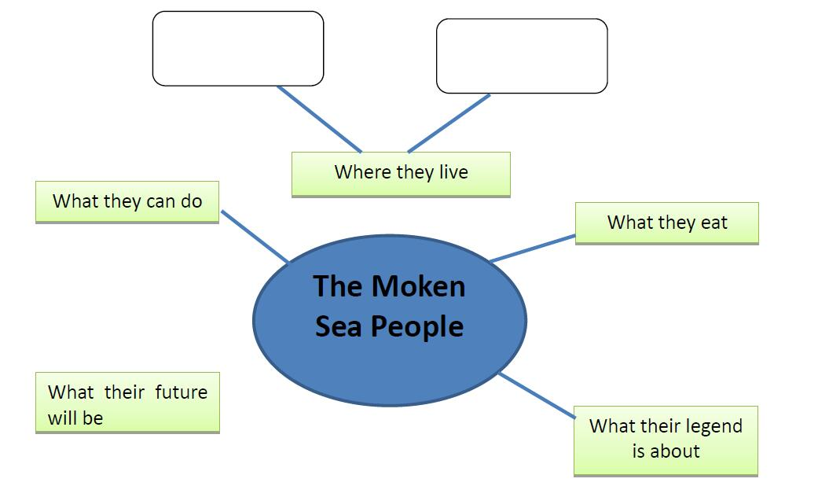
Activity 2

Slide 4
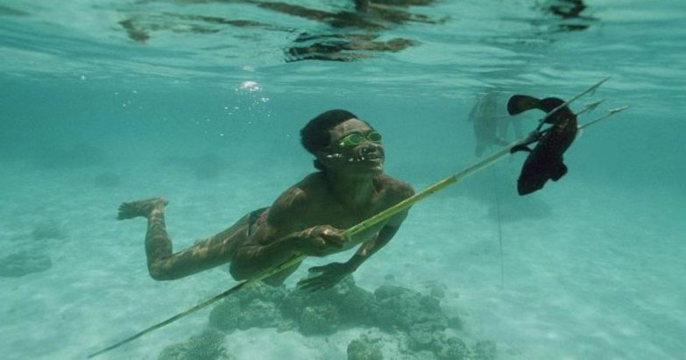
The Moken Sea People
1.Why do people who live in a rain forest need to know all about the trees and animals that live there?
2.Why do you think the Moken sea people need to learn all the sea environment?
3.What did you think of when you read “it is the sea and all that it gives”?

Slide 5
Home on the Sea
1. What do you think it means by “They have learnt to read the wind and the waves?
2. Why do you think that skill is important to them?

Slide 6
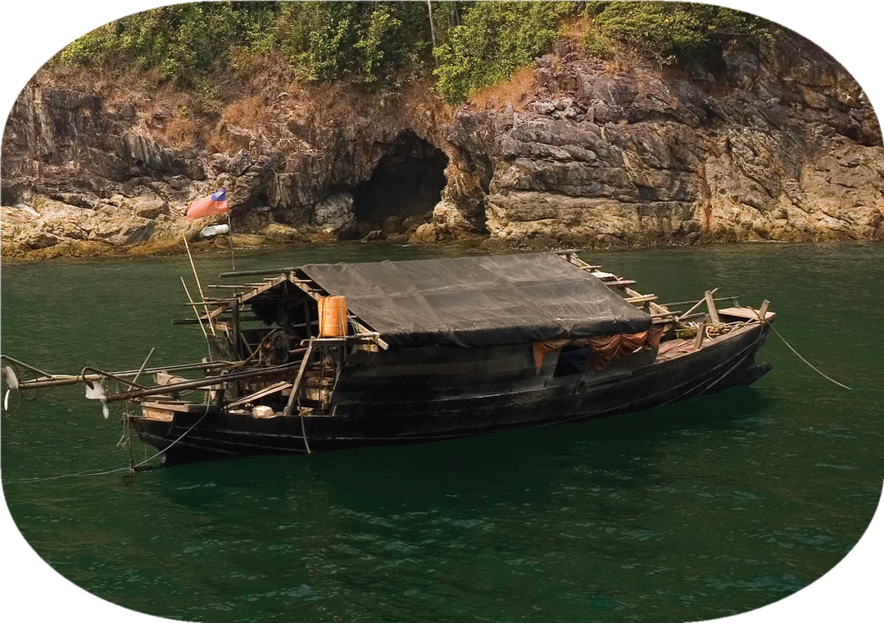
A Floating House
Where have you seen a thatched roof? How is the thatched roof different to the roof of your house?

Slide 7
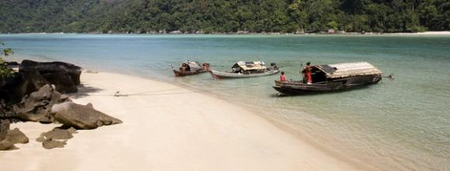
A floating house
2. Why do you think the tree that becomes a kabang doesn’t have any knotty or bumpy wood?
3. What makes you think the kabang must be very big? Find the words that give you a clue.
kabang

Slide 8
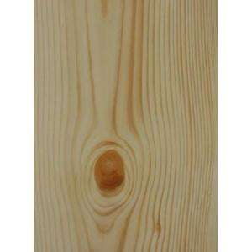
bumpy wood
knotty wood

Slide 9
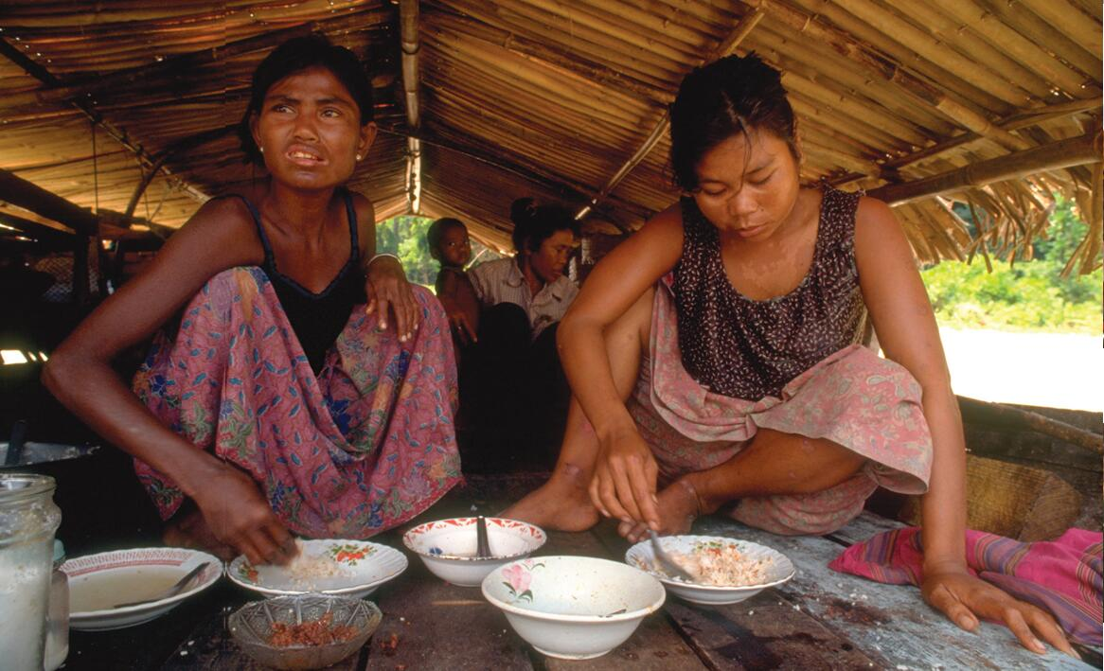
A Floating House
4. How do you know they get more fish than they can eat in one day?
5. If you were cooking a meal on a kabang what would you have to be very careful about?
6.What kinds of animals do you think might be on the kabang? Why do you think that?

Slide 10
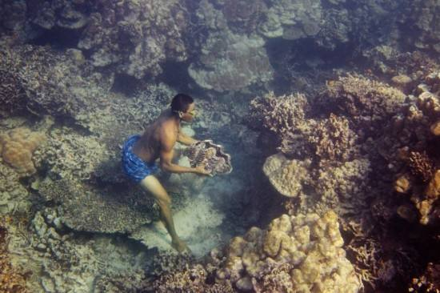
Surviving
1. Which sentence helps you know that the Moken people care about their environment?
2. How do you think they learn to swim so young?
Why do you think it’s important for them to learn to swim so young?
What can the Moken people do in the sea？

Slide 11
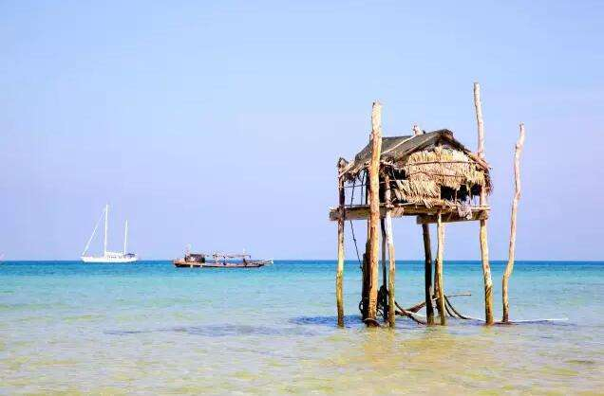
Home on Land
What is monsoon?
Why do the Moken people leave the sea during the monsoon time?
Why do the Moken people live in huts on tall poles?

Slide 12
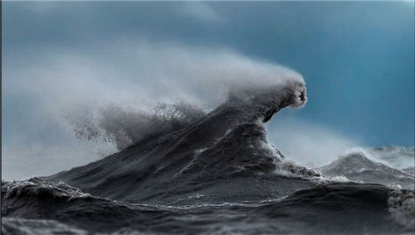
A Legend Comes True
1. What is meant by “waiting out the monsoon”?
2. What events led up to Saleh warning the people about the wave?
3. Why do you think the legend called it a man-eating wave?
4. How do you know Saleh didn’t just care about himself? Find the words that tell you.

Slide 13
The Giant Wave
1. What do you know about a tsunami?
2. What helped Moken people survive? Find the words that tell you.
3. How do you think people all over the world heard the story?

Slide 14
Future of the Moken
1. What does “permanent” mean?
2. Why do you think there are not so many Moken people who move around on houseboats?
3. What would be some advantages of living in a village?
4. What do you think could happen in the future to the Moken people?

Slide 15
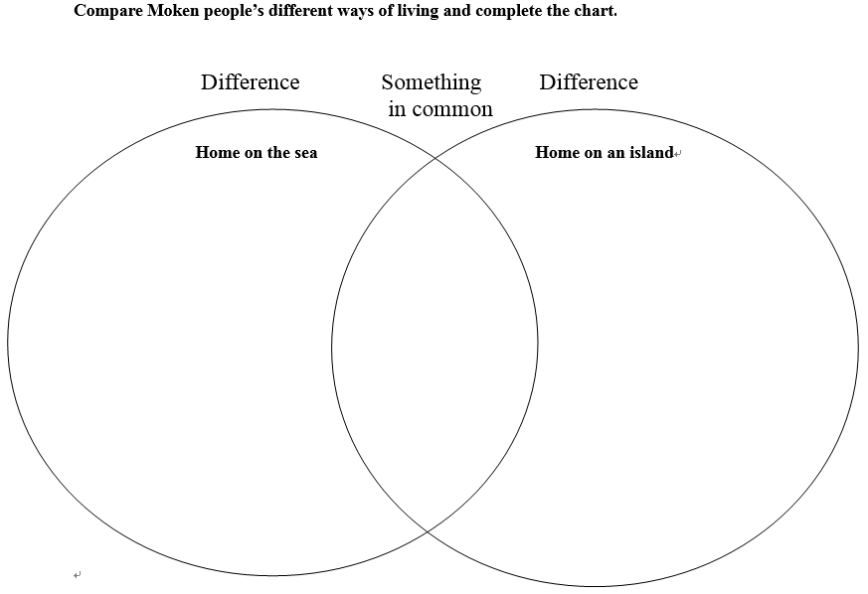
Activity 3
Read and compare.

Slide 16
Activity 4
Show and tell.
Hello, everyone. I will introduce something about the Moken people to you.
They are …. They live in …. or on …
They can …. Some of them are good at …
They like …
In the future, they will …
I think they are…
Hello. I am one of the Moken people. We are …
We live in … or on the …
We can …Some of us are good at …
We like …
We know the sea so much, such as…

Slide 17
Activity 5
1. Why is the book titled “The Call of the Sea”?
2. Why does the author write the book?
3. What can we do to care about nature?

Slide 18
Further Study
（1）Make a poster with your partner to introduce one of the minority ethnics.
（2）Look for more information about the Moken people's life and share with your classmates.
Learning tips:
Choose one task. Finish it with the help of what you learnt from the book.

Slide 19
Thank you!

