Slide 1
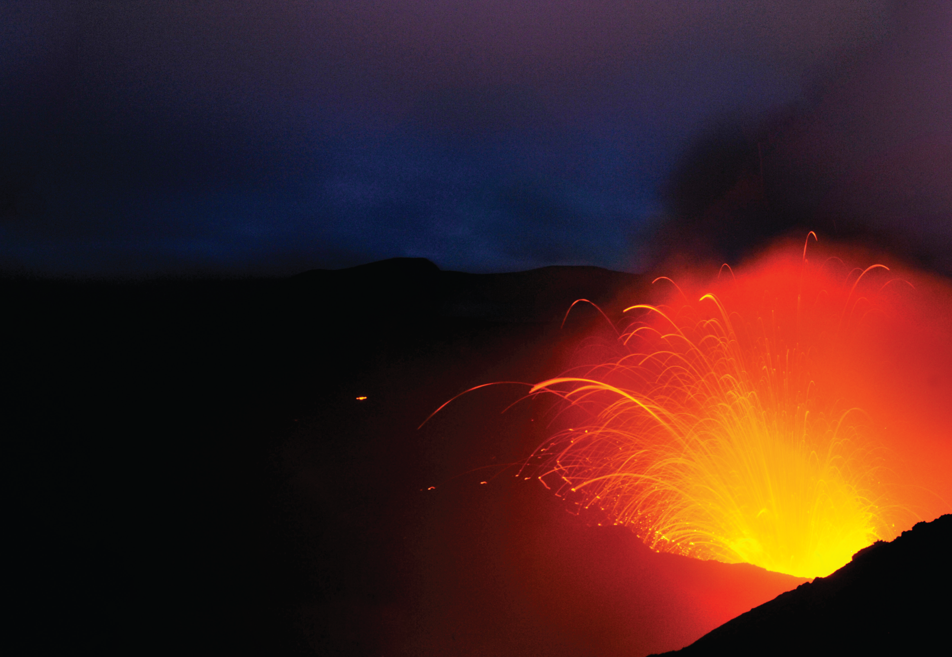
The Hand of Nature
疯狂大自然
选自《多维阅读第12级》

Slide 2
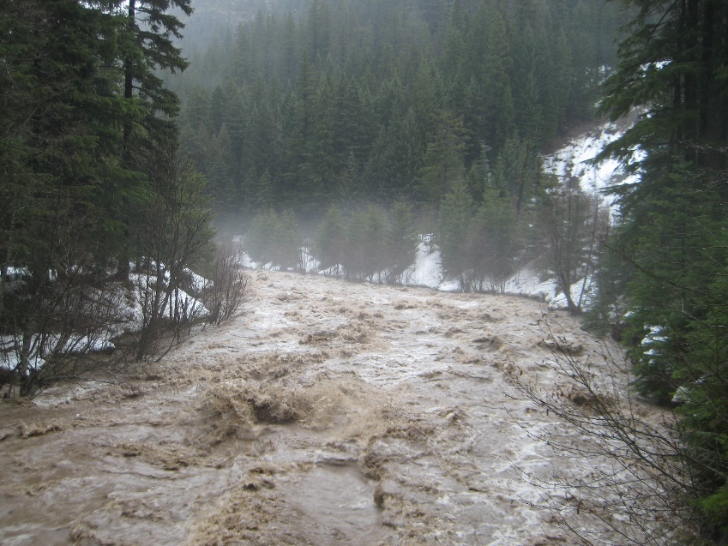
Would you please list something that happens in the nature, for example, a flood?
Notes:
图片来源：https://www.vcg.com/creative/1002259924?phrase=%E6%95%99%E5%B8%88%E4%B8%8E%E5%AD%A6%E7%94%9F%E5%8D%A1%E9%80%9A&rand=8QP867_ba4a24717540a659b49f2788284da7b5&keyword=%E6%95%99%E5%B8%88%E4%B8%8E%E5%AD%A6%E7%94%9F%E5%8D%A1%E9%80%9A

Slide 3
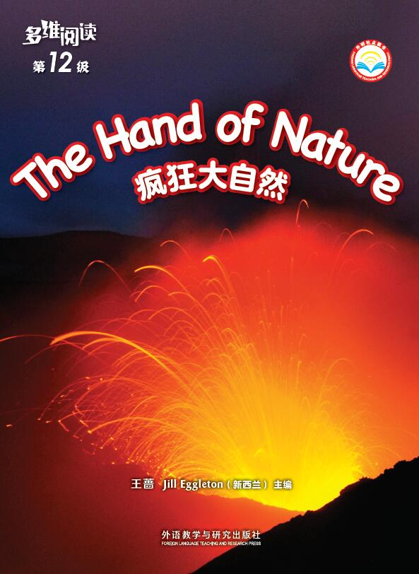
1. What can you see from the cover? Is it a natural happening?
2. What’s the title of the book? What does it mean?
3. Why is the book named The Hand of Nature? What do you think of this “Hand”?

Slide 4
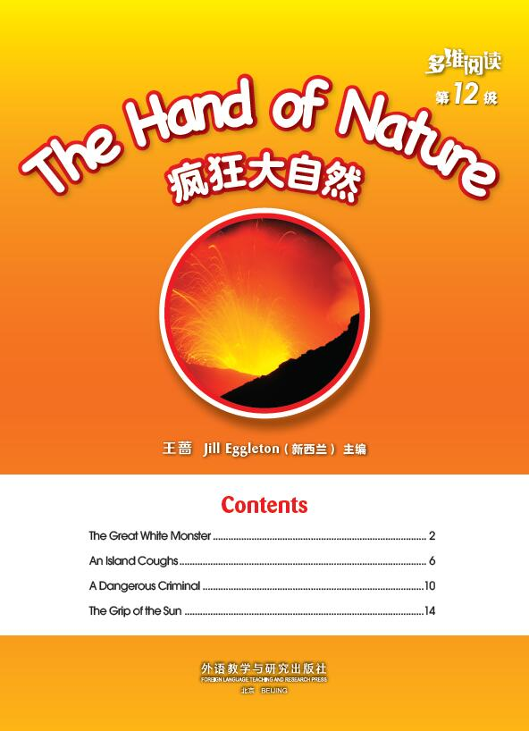
·Read the contents page, guess and discuss the meaning of the subheadings.
· Match the natural happening with the proper subheading by copying it down.
· Read the book and check your answer with your partner.

Slide 5
Choose, read and underline the important words.
1.The Great White Monster
1) Why did the author say it was a beautiful morning?
2) What sound told you the avalanche began?
3) What words helped you most to make the picture of the avalanche?
4) How did Josh feel when he saw the white monster rushing towards him?
2. An Island Coughs
1) What were the first signs that meant the volcano was going to erupt, according to page 6?
2) What part of this description don’t you see in the photograph on pages 8-9?

Slide 6
Choose, read and underline the important words.
3. A Dangerous Criminal
1) When the storm comes closer to land, what does it look like?
2) When the eye of the storm has come, why does the author say the danger isn’t over?
3) Being a hurricane tracker, what does Matt do?
Do you think his work is important and why?
4. The Grip of the Sun
1) How did the drought affect the land in the photo on page 14? How did it affect the grass and the trees?
2) What do you think is meant by “It had just crept up on silent feet”？
3) How do you know Monjii was very happy at last?

Slide 7
Form groups and
discuss the answer you’ve got.

Slide 8
This book uses words to illustrate natural happenings by describing sights, sounds, actions, and feelings.
Please copy them into the proper categories and share with your group members.

Slide 10
Form new groups
and share what you’ve got.
1 1
1 1
2 2
2 2
1 2
3 4
1 2
3 4
3 3
3 3
4 4
4 4
1 2
3 4
1 2
3 4

Slide 11
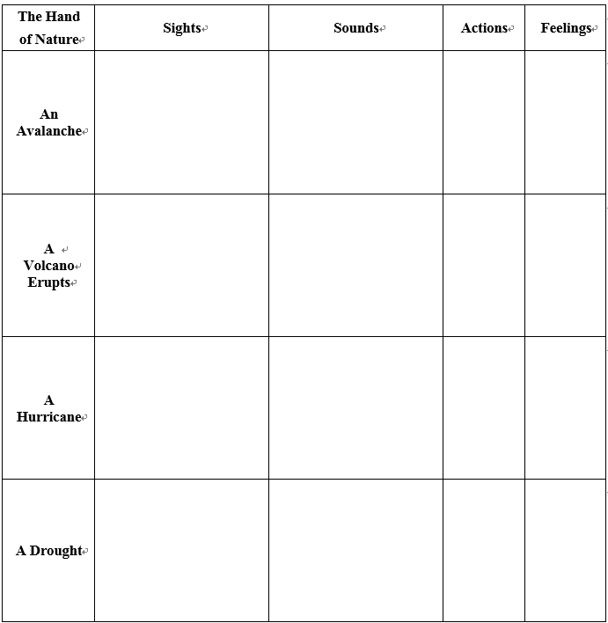

Slide 12
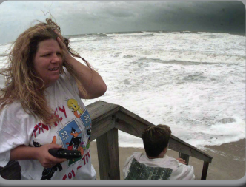
If you were in an avalanche, how would you feel?
Why did Kim and Jack speed to shore when they saw the thick, black cloud and heard the noise?
How did they feel？
If you were Matt, when you’re tracing a hurricane, how would you feel?
Look at the woman in the inset photo on page 13, can you guess how she felt at that moment?

Slide 13
Why do you think Monjii was hoping for black clouds?
Why did Monjii’s dry tongue spring out to grab the drop of water on her face?

Slide 14
Choose a natural happening you experienced or you know to talk about it, for example, “Have you ever been in a strong wind?”
A Strong Wind
Tips:
Pay attention to the description of what you see, hear and feel.

Slide 15
Think and discuss.
·What do you think of the HAND of nature now?
·Why does the author write the book?
·What can people do with the natural happenings?

Slide 16
Homework
Have you read any other books that describe some things that are similar to what is in this book? Tell it to your parents or classmates.

