Slide 1
Hunting for Treasure
寻找宝藏
选自《多维阅读第11级》

Slide 2
Which one can be considered as an exciting job？
policeman, pilot…

Slide 3
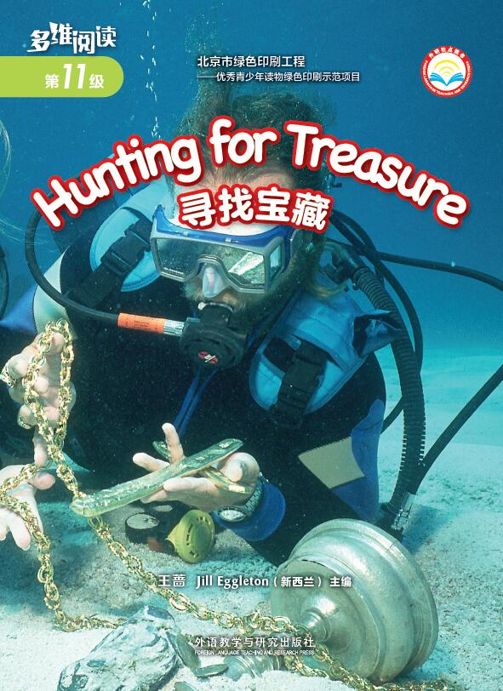
1.What’s this in the picture?
2. What kind of treasure do they want to hunt for?
3. What do you know about hunting for treasure?

Slide 4
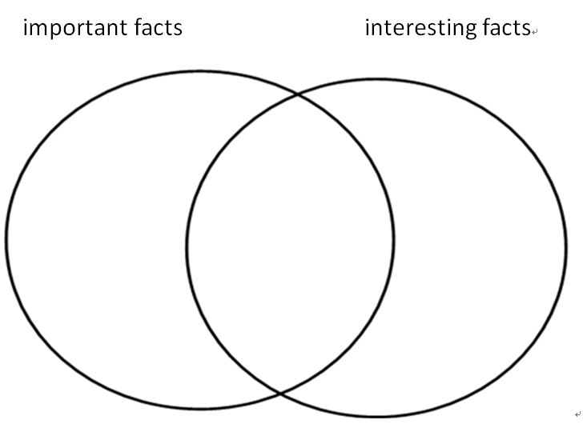
Read one part of the book. List the important facts and interesting facts about it.
Reading Circle

Slide 5
Word Master
The words we would like to remember!
The page of the word on.
The pronunciation of the word.
The meaning of the word.
Show us an example.
word

Slide 6
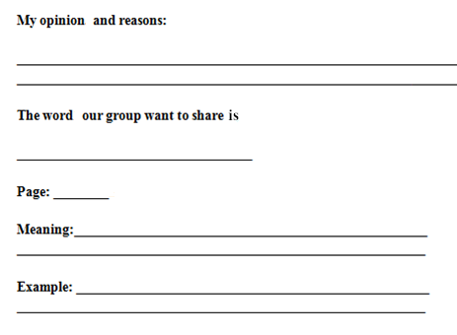
Choose one word and share with others.
Word Master

Slide 7
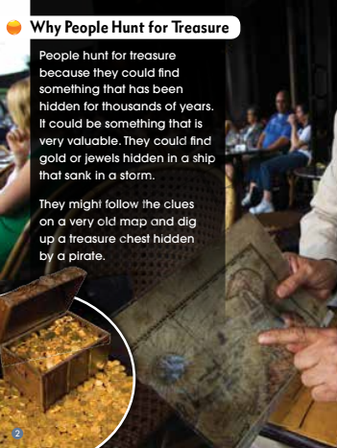
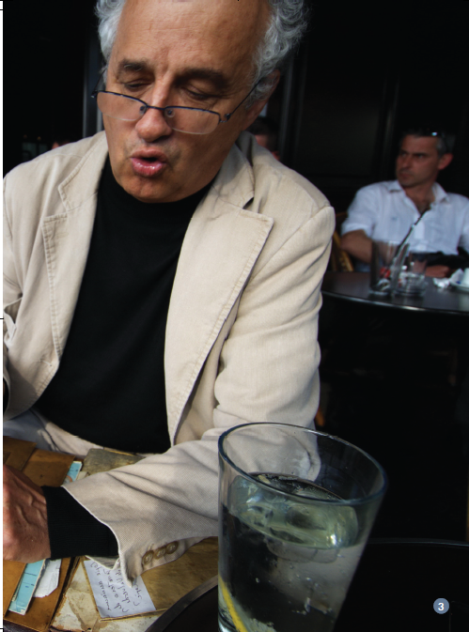
Answer these questions
Group A（PP2-3）
We know people want to hunt for valuable things, what other word could be used instead of valuable?
What do you know that is valuable?
What do you do with valuable things?

Slide 8
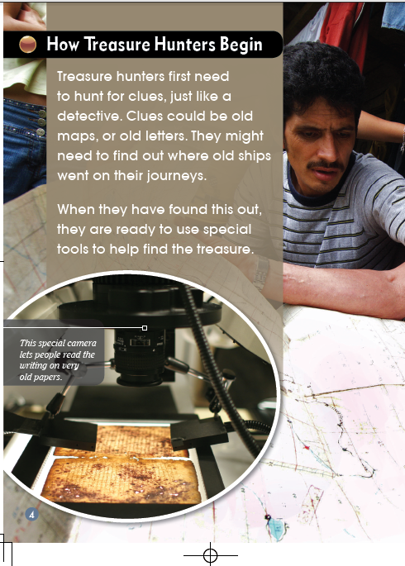
Answer these questions
Group B（PP4-5）
What do you know about the job of a detective?
How is a treasure hunter’s job the same as and different to a detective’s?

Slide 9
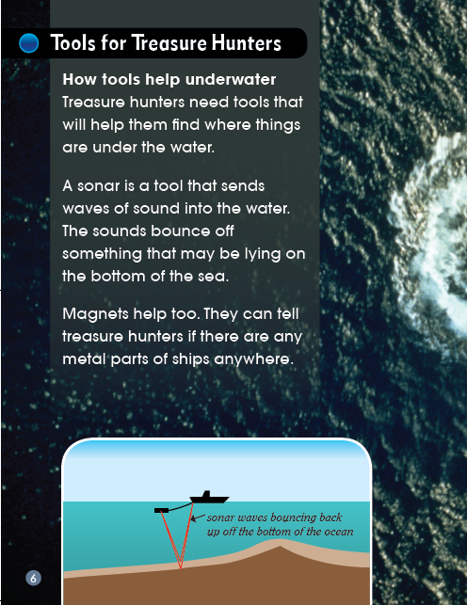
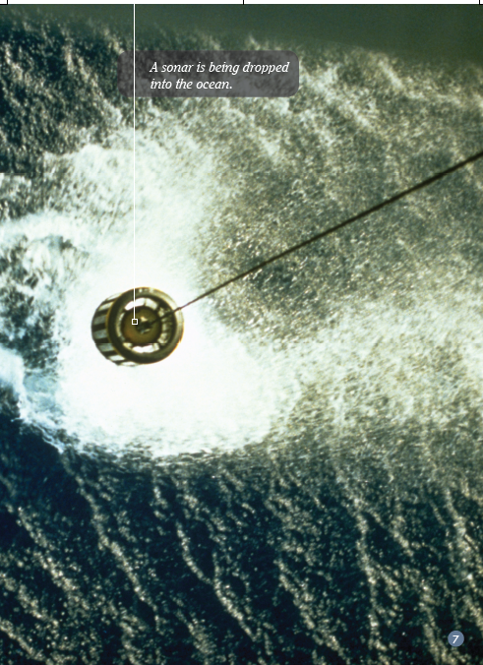
Answer these questions
Group C（PP6-P7）
What do magnets do?
How do you think they might help?

Slide 10
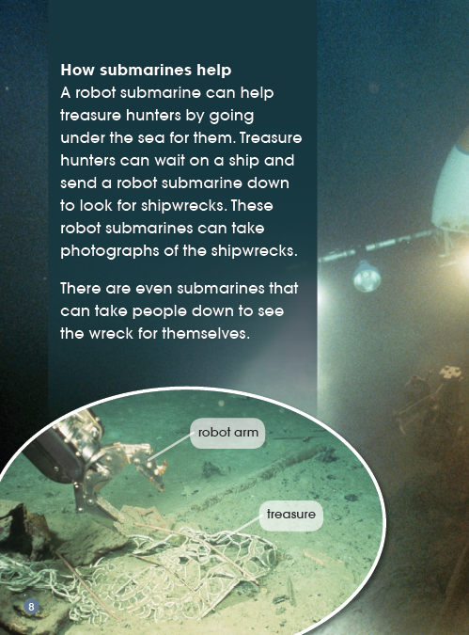
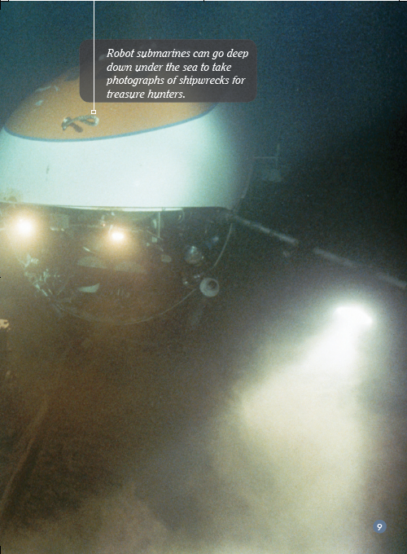
Answer these questions
Group D（PP8-9）
Look at the photo on the page. What do you think the robot submarine is doing?

Slide 11
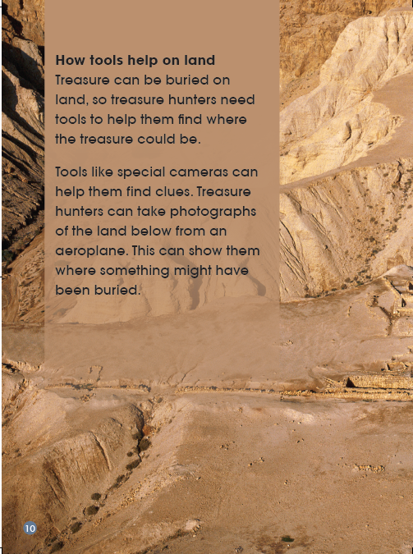
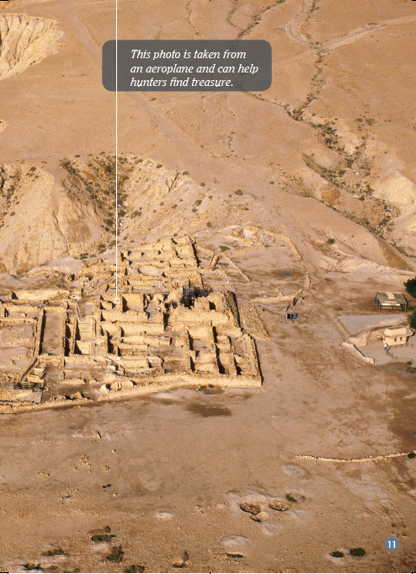
Answer these questions
Group E（PP10-11）
What is the same about the tools used on land and the tools used under the sea?

Slide 12
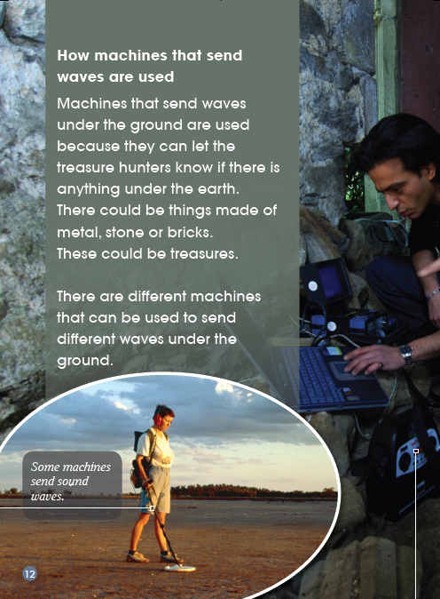
Answer these questions
Group F（PP12-13）
Why do you think machines that send waves are used?

Slide 13
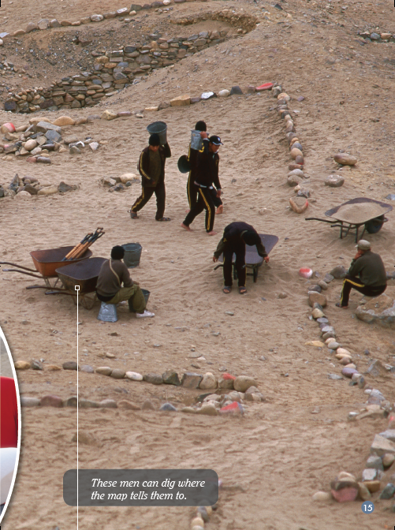
Answer these questions
Group G（PP14-15）
How do you think the information the tools give help the treasure hunters?

Slide 14
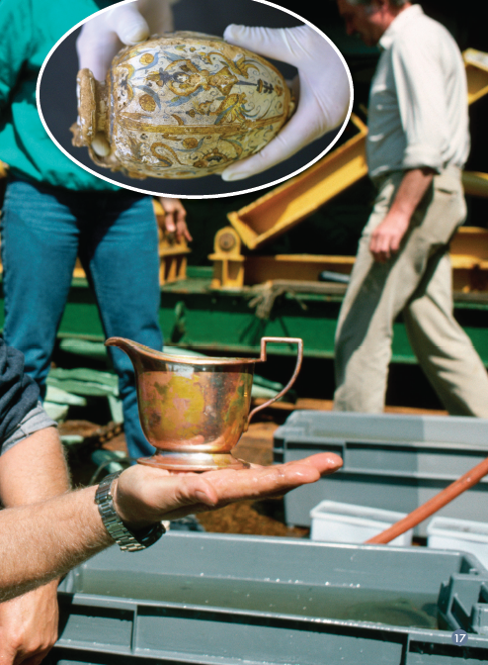
Answer these questions
Group H（PP16-17）
Why do you think treasure hunters need to be careful?

Slide 15
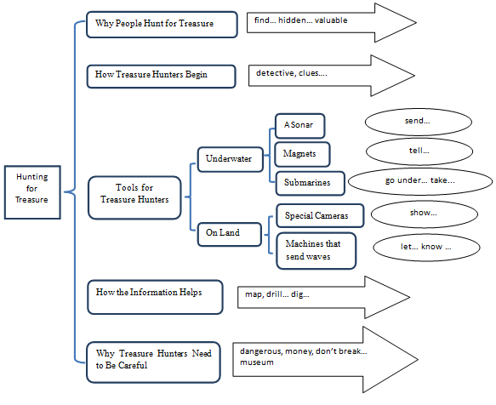
Please give a speech on Hunting for Treasure.

Slide 16
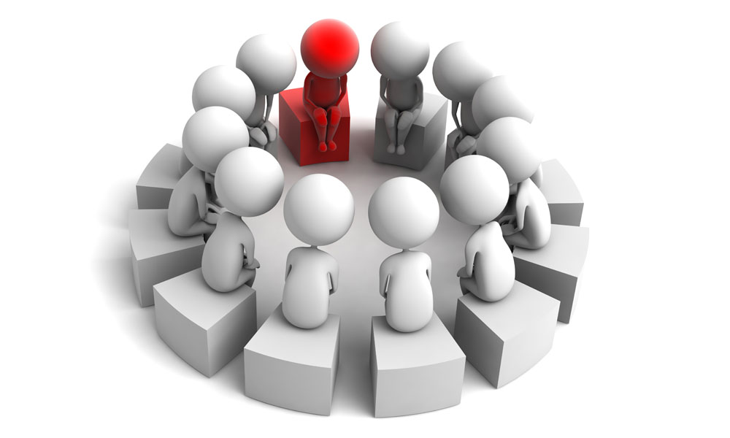
Discussion
1. Do you think hunting for treasure can be very dangerous?
2. Do you think people should dig up treasure? Why? Why not?
3. Do you agree that all treasure should be put into museums? Why do you think that?
4. What do you think we might learn from treasure?

Slide 17
What connections can you make?
Text-to-Self between the book and your life
Text-to-Text between the book and another book
Text-to-Media between the book and something you have seen on TV or computer

Slide 18
Homework
（1）与小组成员合作，制作一幅海报，介绍自己知道的寻宝知识，可以进行相关拓展。在全班进行展示。
（2）课后和小组成员一起利用网络或者图书馆查询资料。看看是否有其他方面的寻宝知识。在全班汇报调查结果。

