Slide 1
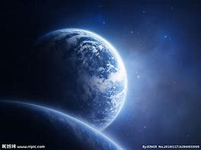
A Suit for Space Walking
航天服大揭秘
选自《多维阅读第10级》

Slide 2
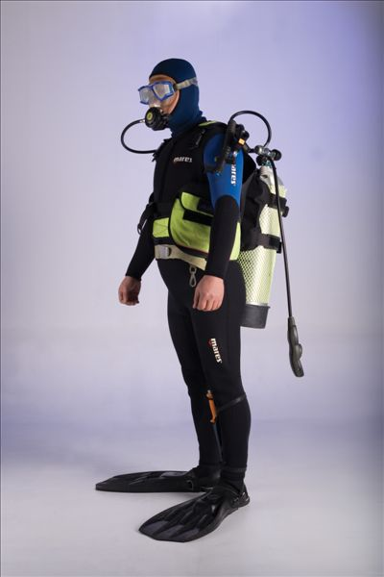
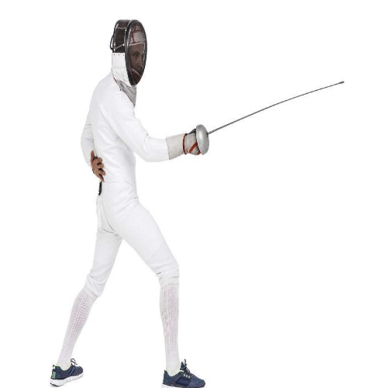
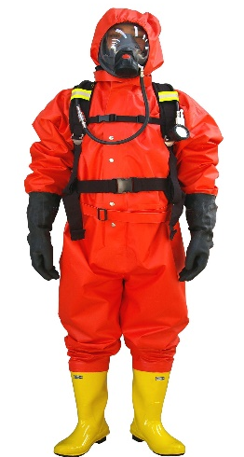
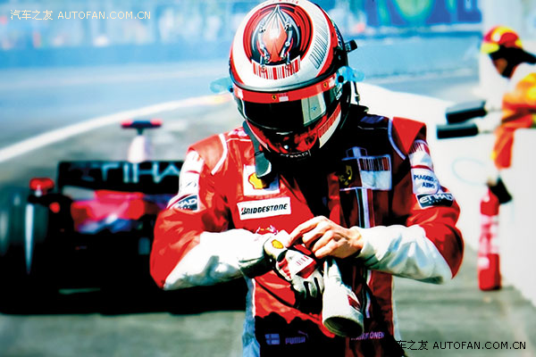
Pre-reading
Do you know these suits?
Why people wear them?
What other suits do you know?
fireman uniform
swimming suit
fencing clothes
racing suit
Notes:
提问建议：
1.Do you know these suits?
2.What other suits do you know?
3.Why do people wear them?

Slide 3
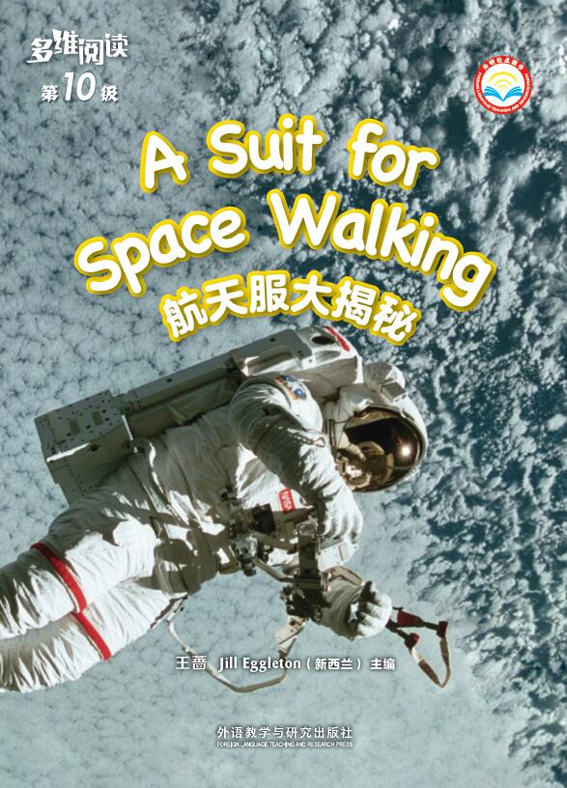
While-reading
1. What do you know from the cover?
2. What information can you get from the title?
Notes:
提问建议：
1. Look at the photograph on the cover, what can you tell from the cover? Who is the man? Where is he?
2. Look at the title, what is the name of the suit for space walking? What do you know about a space suit? What do you want to know about the space suit?

Slide 4
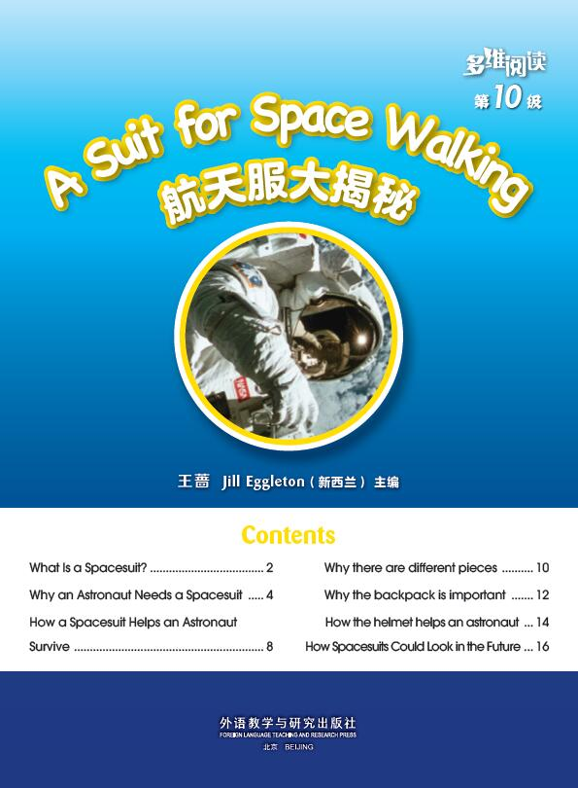
Read contents
1. What information will you get from the book?
2. What information have you known from the contents?
Notes:
提问建议：
1. What information will you get from the book?

Slide 5
Read and find
What is a spacesuit?
Why do people call it an EMU?
Notes:
提问建议：
1.What is a space suit?
2.Why do people call it an EMU?

Slide 6
Read and find the answers
What is a spacesuit?
How does a spacesuit help an astronaut?
How could spacesuits look in the future?
Why does an astronaut need a spacesuit?
Notes:
提问建议：
1. Why does an astronaut need a space suit?
2. How does a space suit help an astronaut?

Slide 7
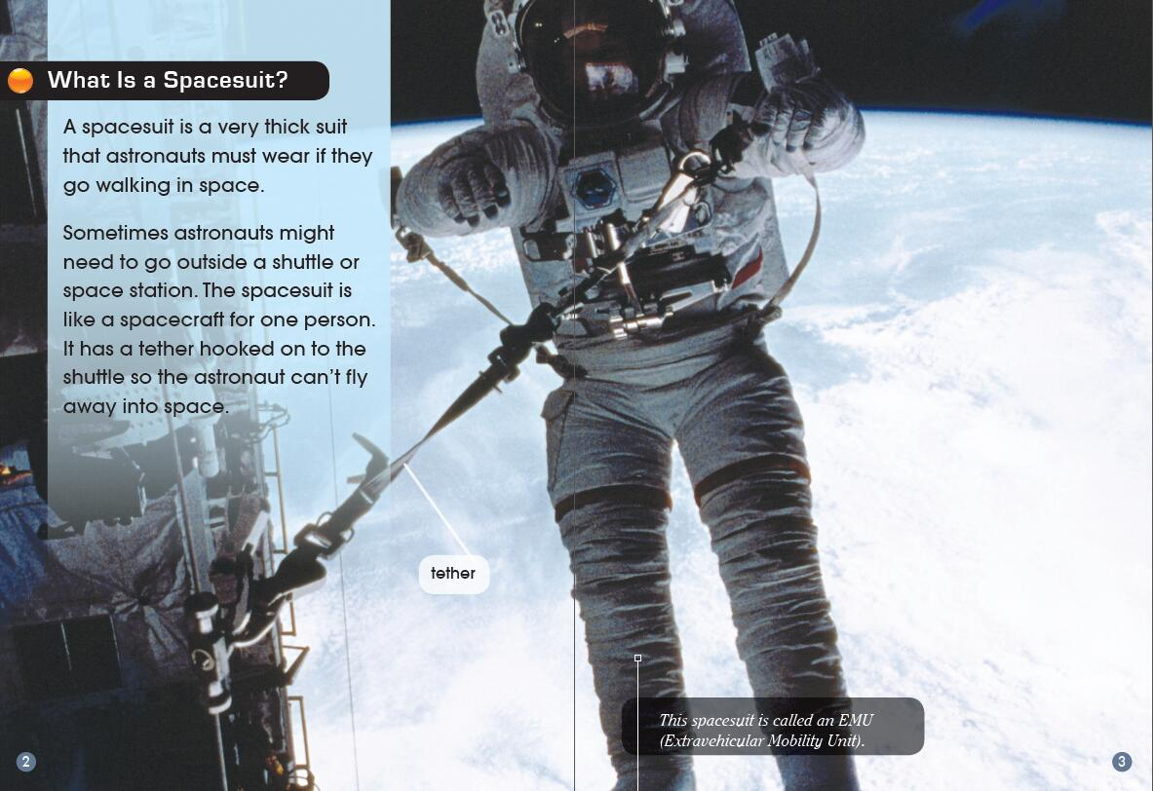
After-reading
Listen and read
Notes:
阅读后：
Activity 1 跟读录音，朗读全文
(1)学生听录音跟读全文。
(2)通过小组活动，分享朗读自己感兴趣的一页。

Slide 8
Listen and read

Slide 9
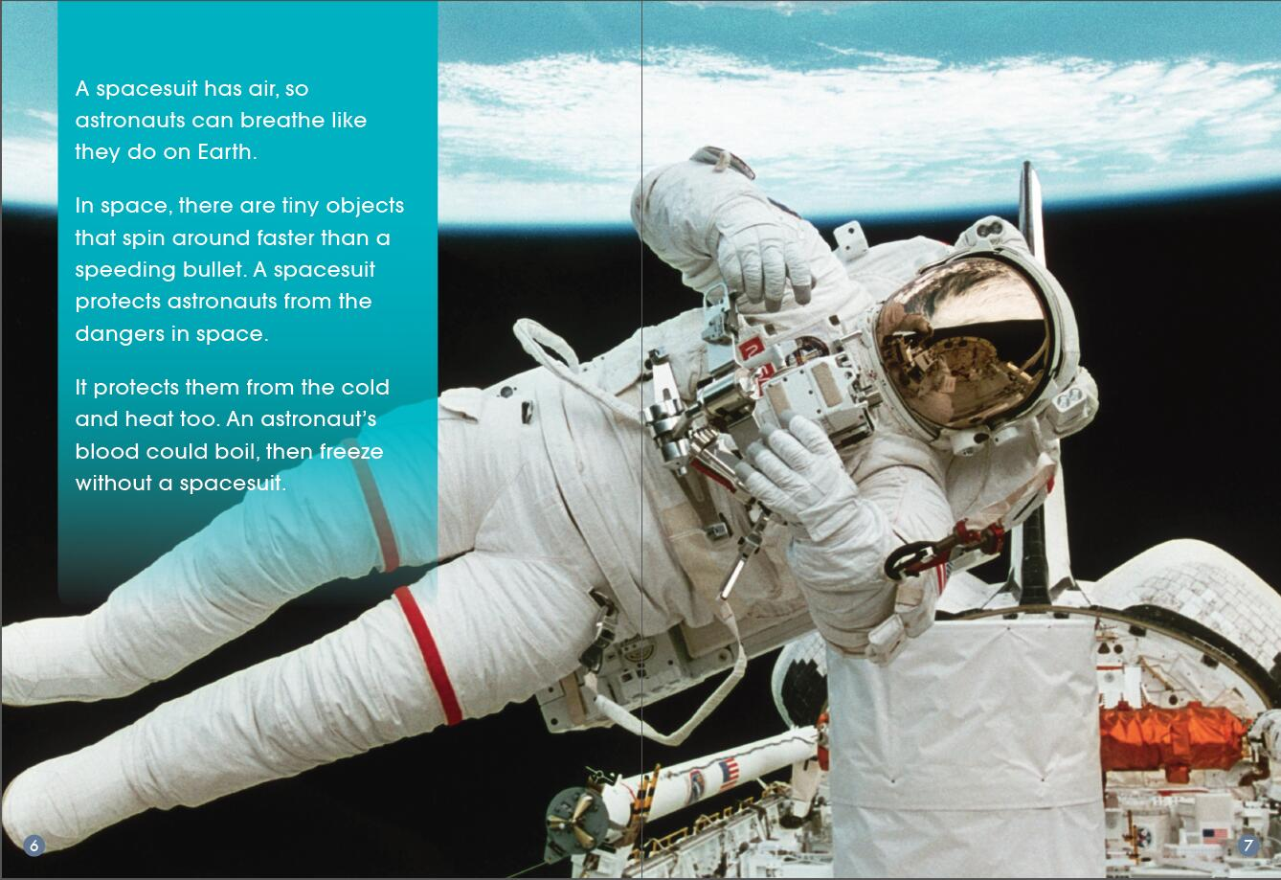
Listen and read

Slide 10
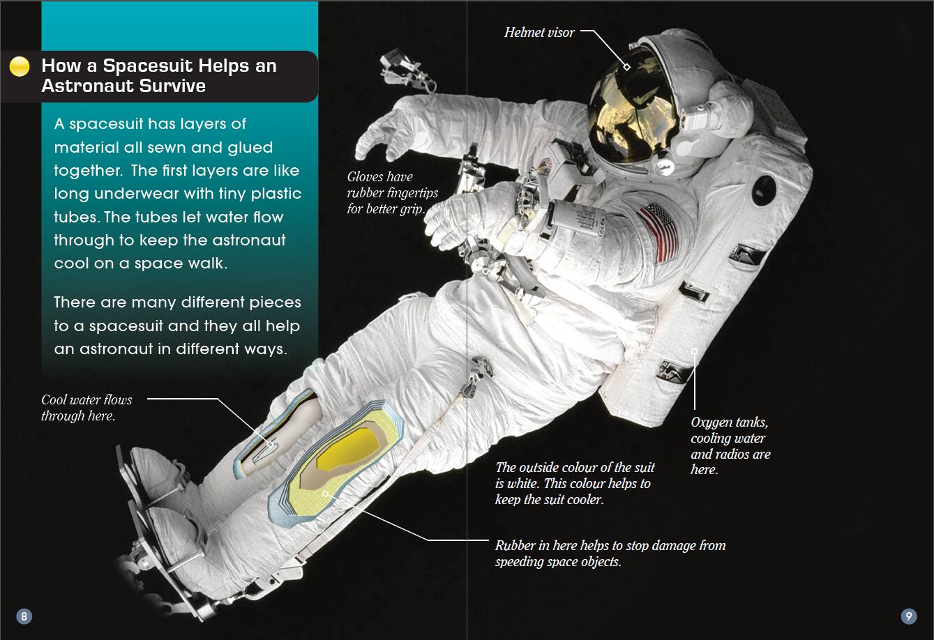
Listen and read

Slide 11
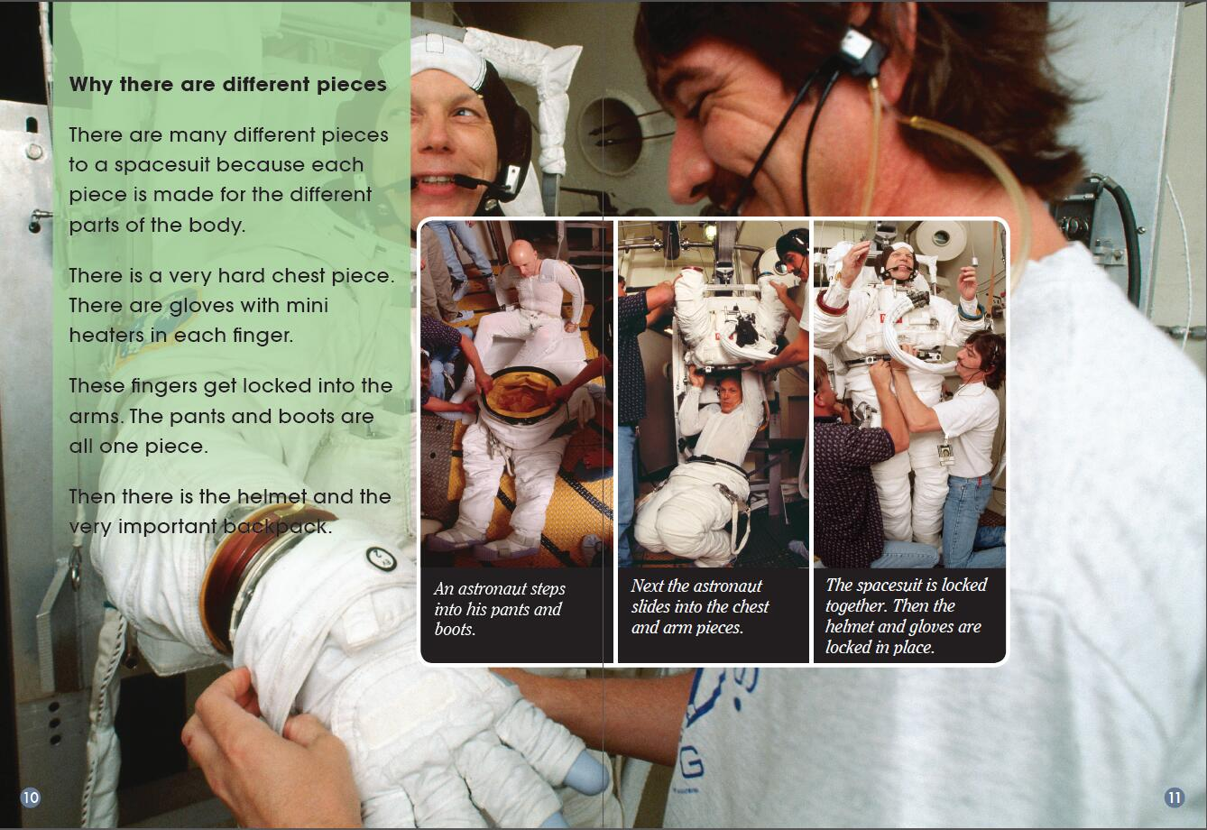
Listen and read

Slide 12
Listen and read

Slide 13
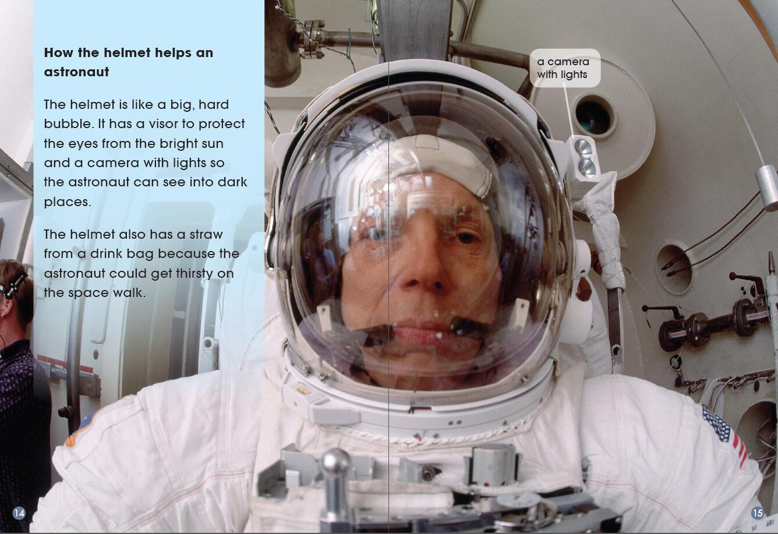
Listen and read

Slide 14
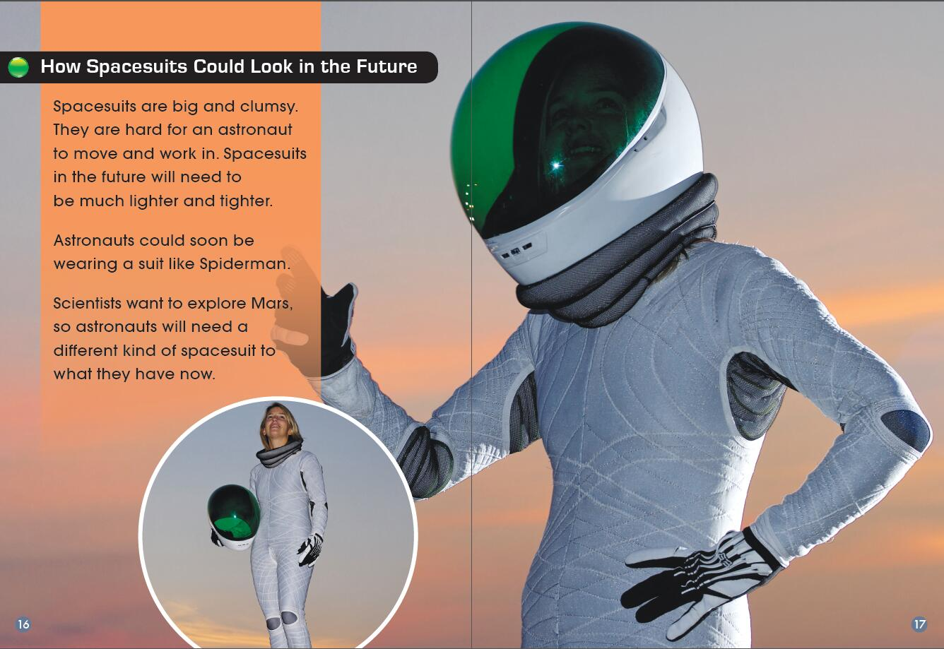
Listen and read

Slide 15
Homework
Introduce one of the suits that people wear in our life and explain how it helps people.

