Slide 1
Alien Trouble
外星人和自行车
选自《多维阅读第9级》

Slide 2
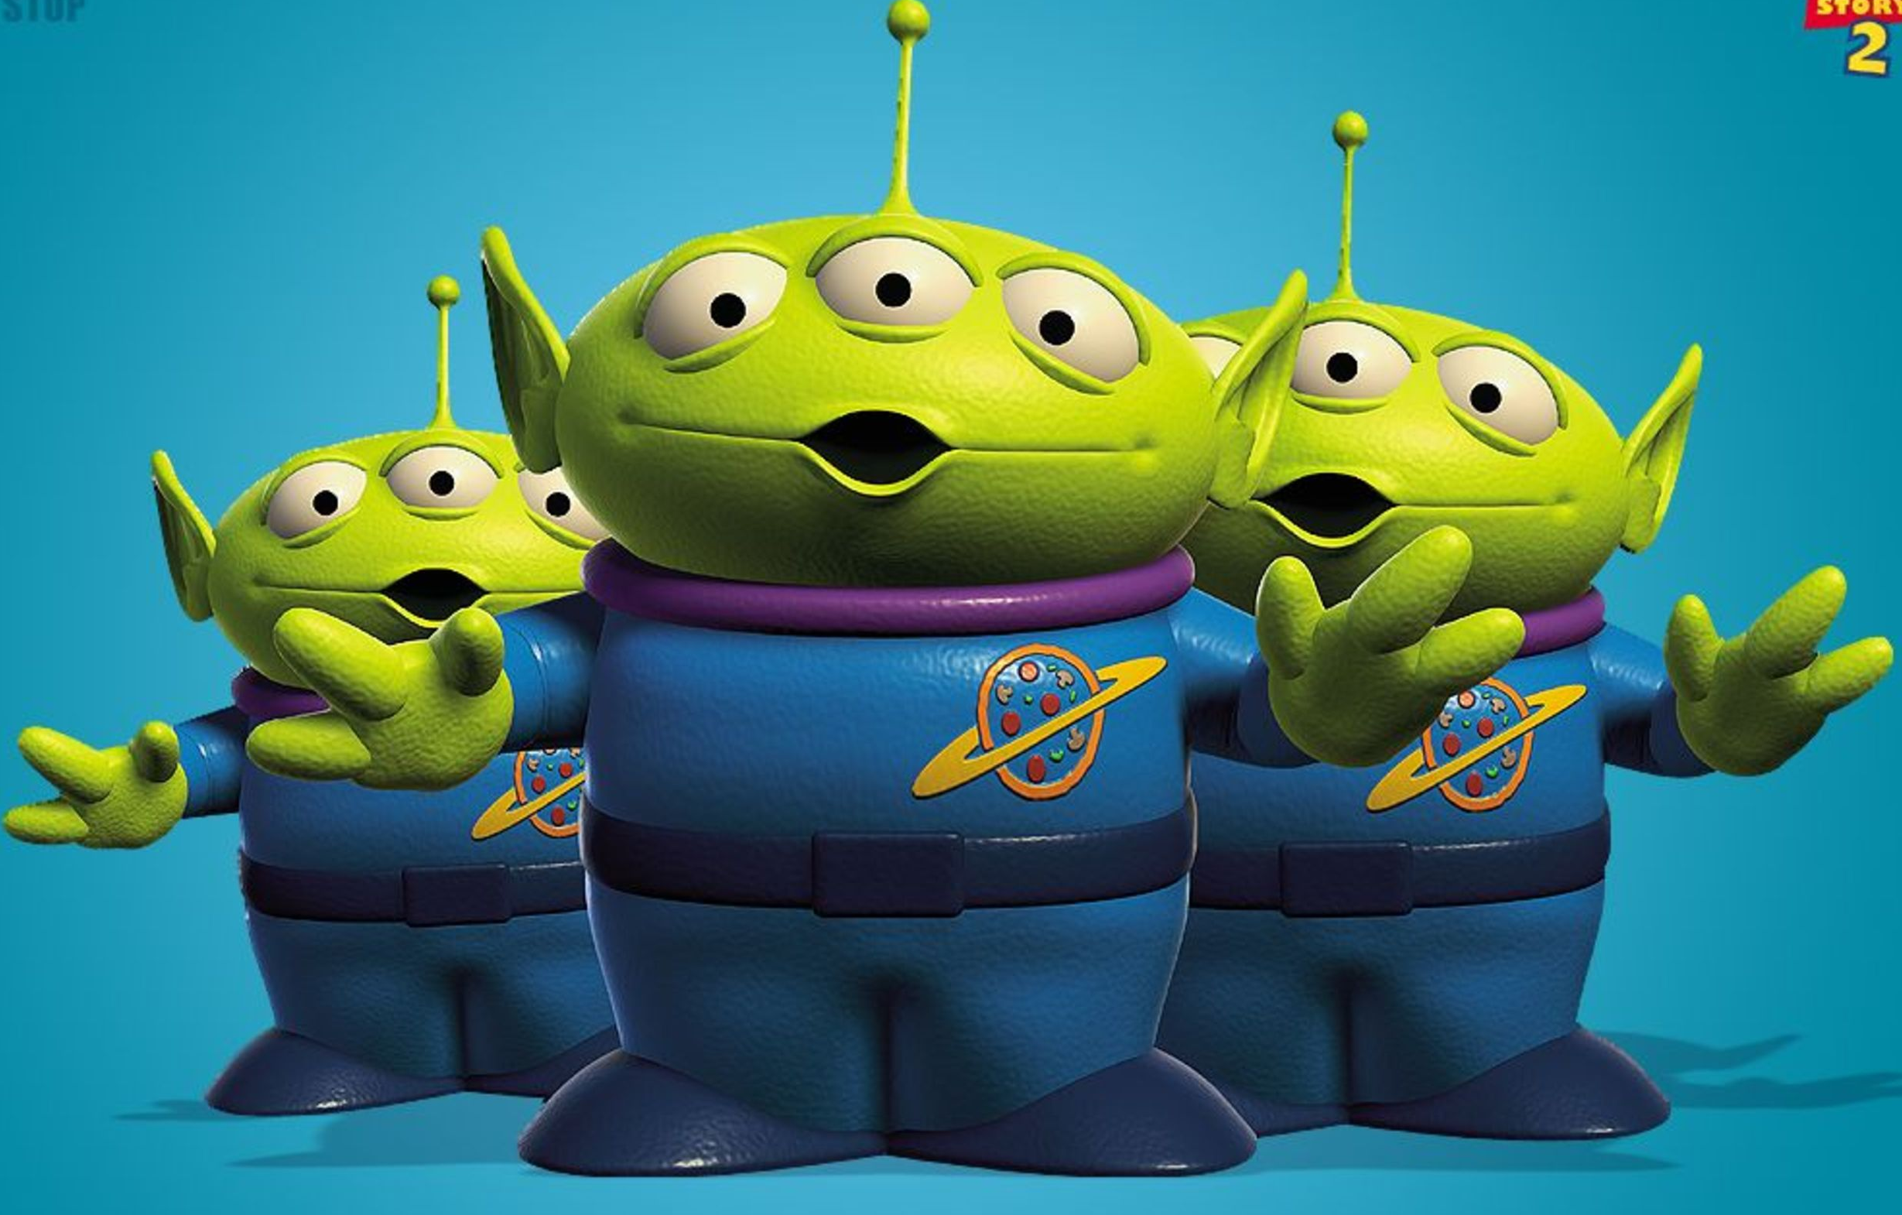
What do you know about aliens?

Slide 3
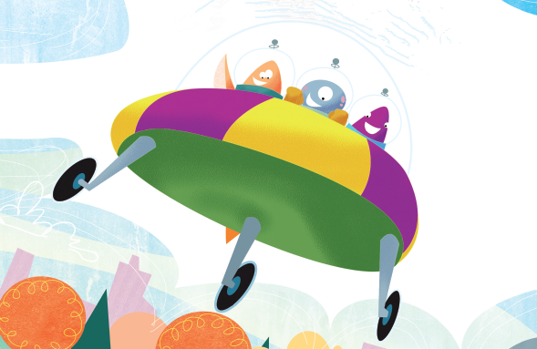
Enjoy a movie about aliens

Slide 4
If the aliens came to your community, what problems would they cause?

Slide 5
Q1: What do you know from the cover?
Q2: What trouble would the aliens cause?

Slide 6
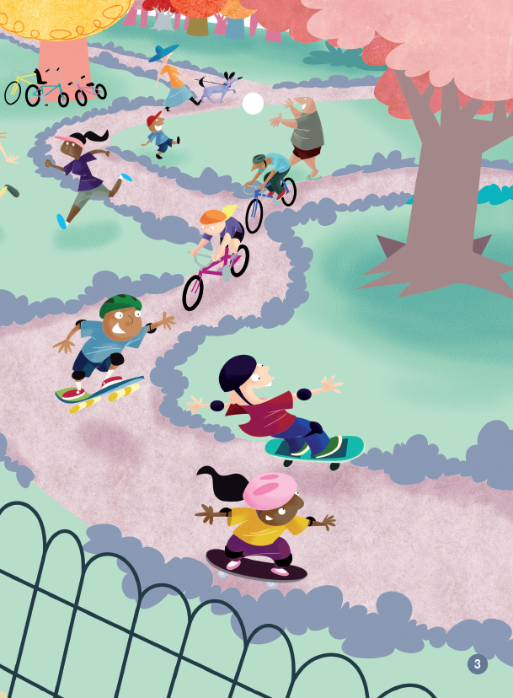
Q1: Where were the aliens?
?
Q2: What do you think the aliens might be thinking?
Q3: Why did the aliens think so?

Slide 7
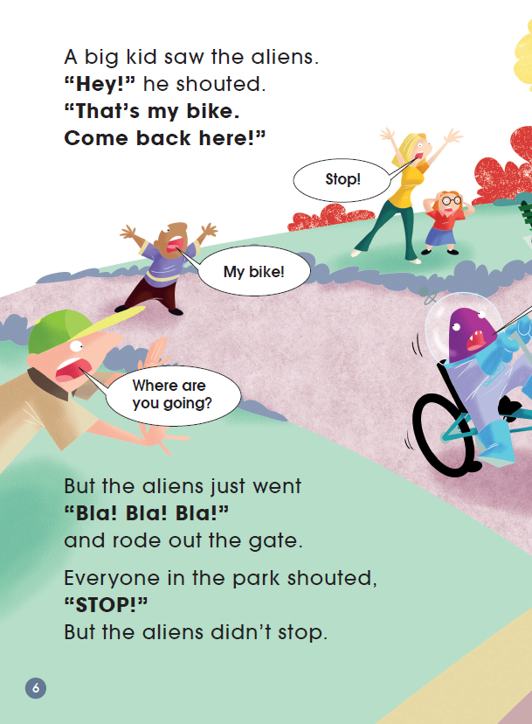
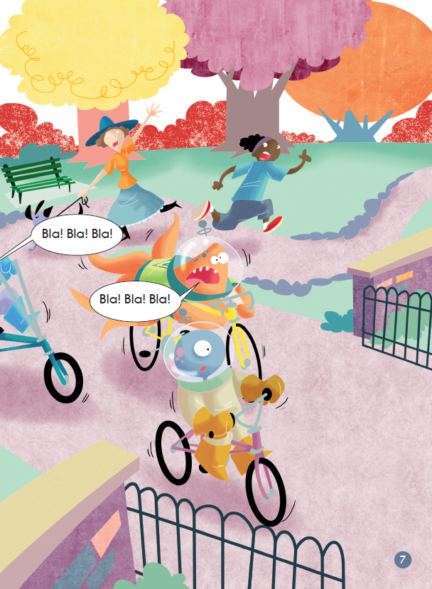
Q1: What happened in the story?
?
?
?
trouble
Q2: What might the people say?
Q3: Would the aliens stop? Why do you think so?

Slide 8
1st Reading: Read the story quickly. Find out the characters and the setting.
Title
Alien Trouble
Characters
kids
Aliens
Setting
in the park

Slide 9
2nd reading: Read the story again. Finish the worksheet in groups.
Setting
in the park
on the road
in the police office
rode the kids’ bikes away
Trouble
You can’t take something that is not yours.
Rules

Slide 10
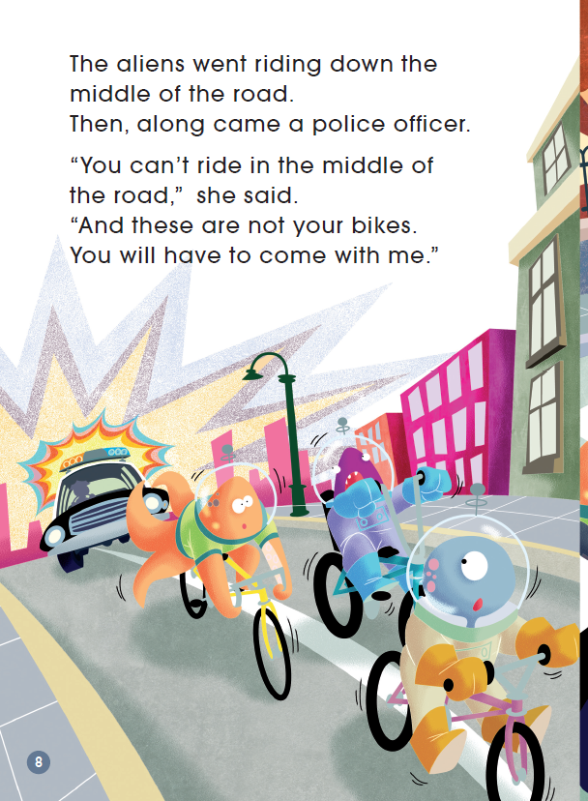
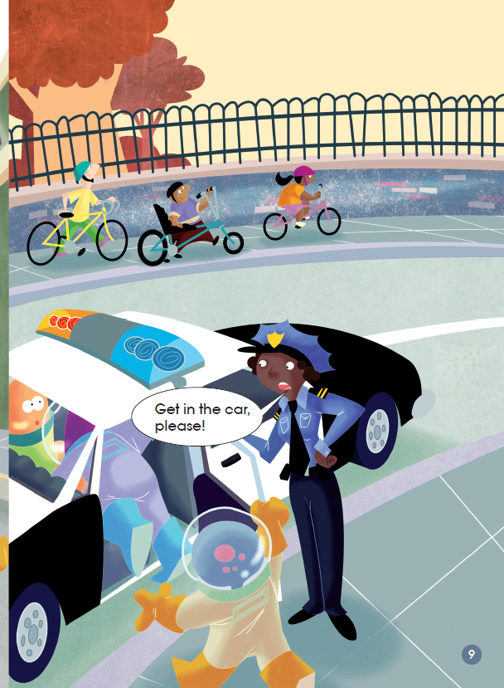
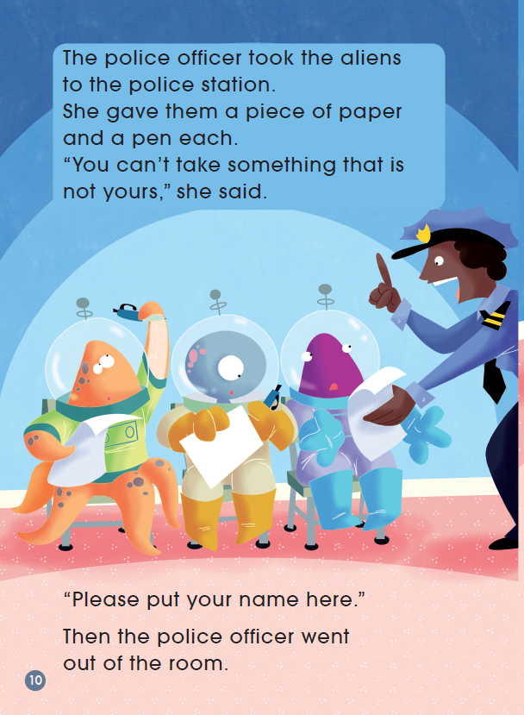
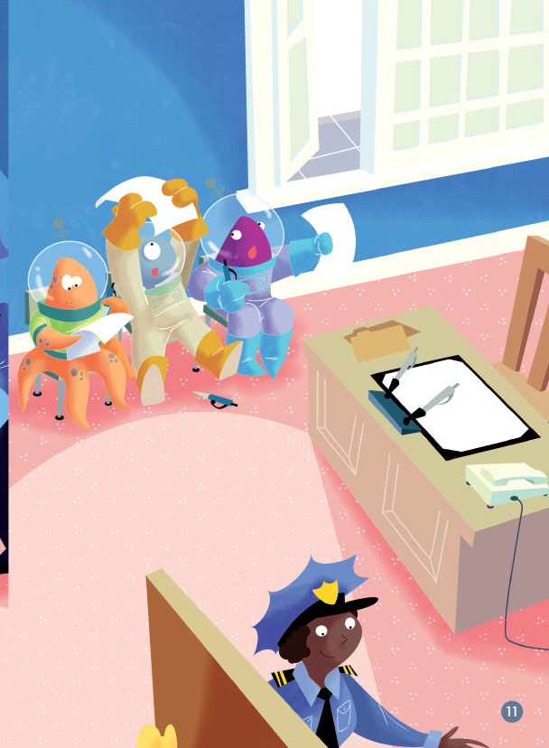
Read PP 8-15 and answer.
Q1: Why did the aliens go to the police office?
Q2: What rules did the police officer think that the aliens broke?
Q3: Do you agree with these rules? Why? Why not?

Slide 11
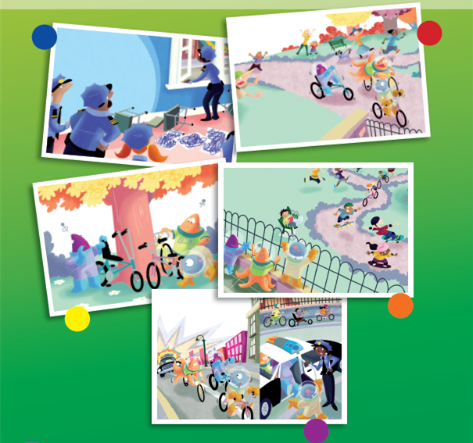
Listen to the story.
Which setting do you think is very interesting? Read with your partner.

Slide 12
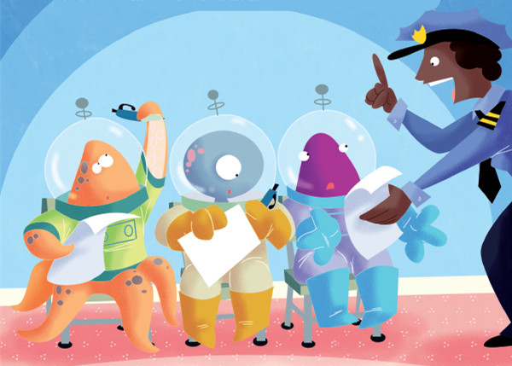
Role-play: If you were the police officer, what would you say and do to those aliens?
?

Slide 13
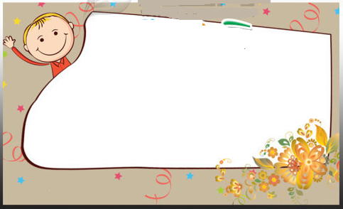
Tips for Aliens
Tips in the ________

Slide 14
Homework (Choose one of them)
1. Write down some rules that we should follow in our daily life.
2. If you were an alien, how would you tell the story? Try to write it down.

