Slide 1
A Snake Wrangler
捕蛇者
选自《多维阅读第9级》

Slide 2
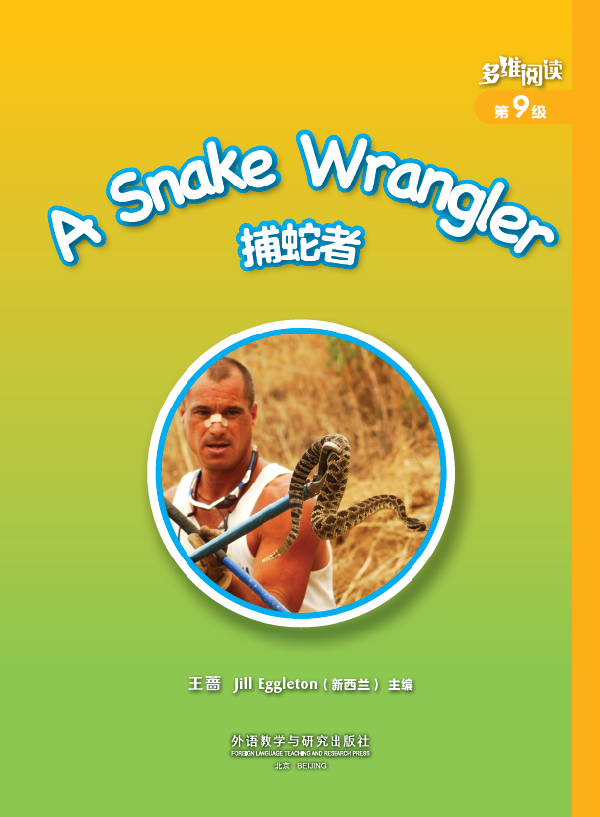
the title

Slide 3
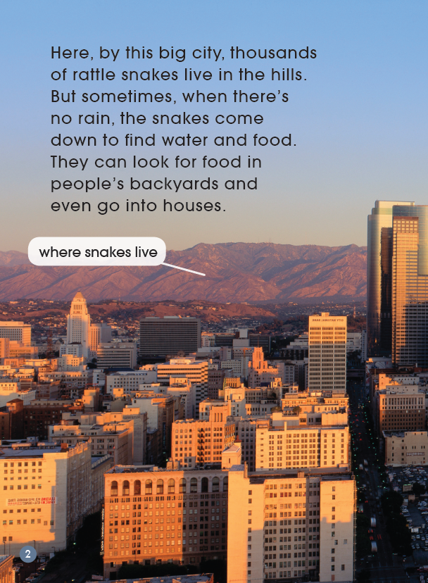
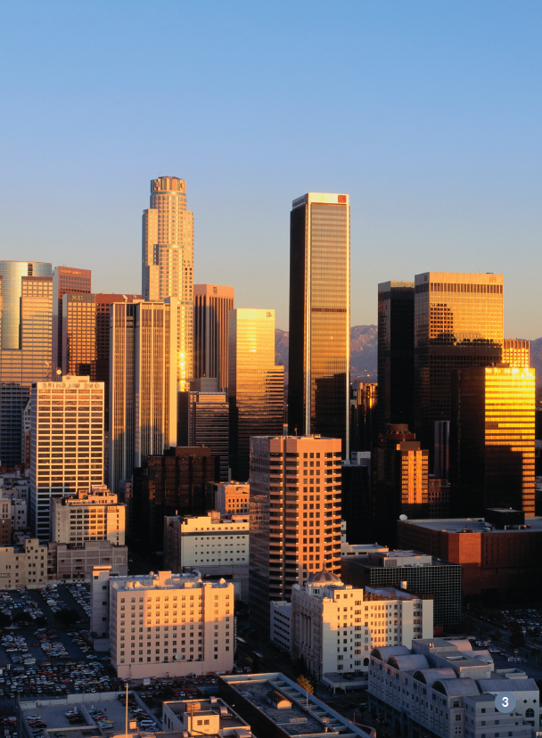
Do we need a snake wrangler in the big city?
What do you notice that is around the city?
What sort of animals might live in these hills?
How do you know there are a lot of snakes in these hills?
Why do the snakes come down from the hills?

Slide 4
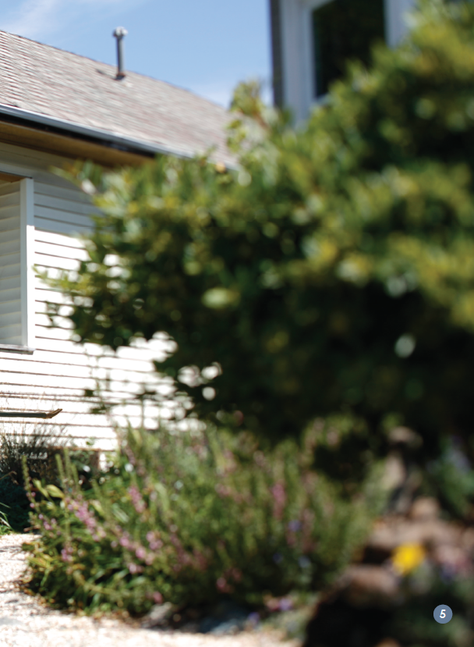

Slide 5
Jigsaw Reading

Slide 6
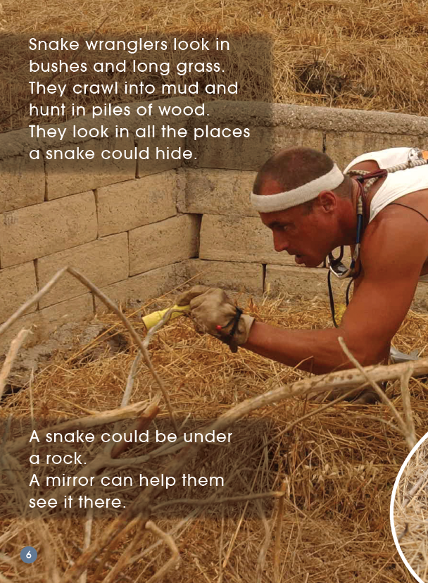
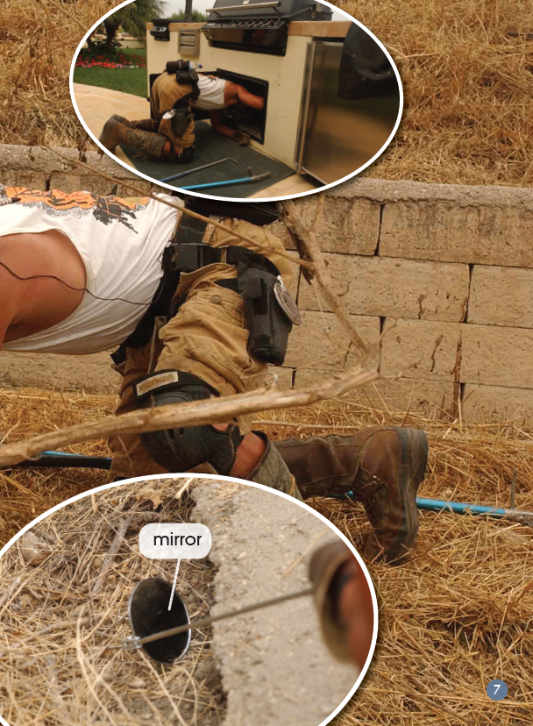
Card 1：PP 6-7
1. Mark the places where a snake wrangler can look for snakes.
2. How does the snake wrangler look for the snakes in different places? Find the verbs and write them down.
———————————————————
———————————————————

Slide 7
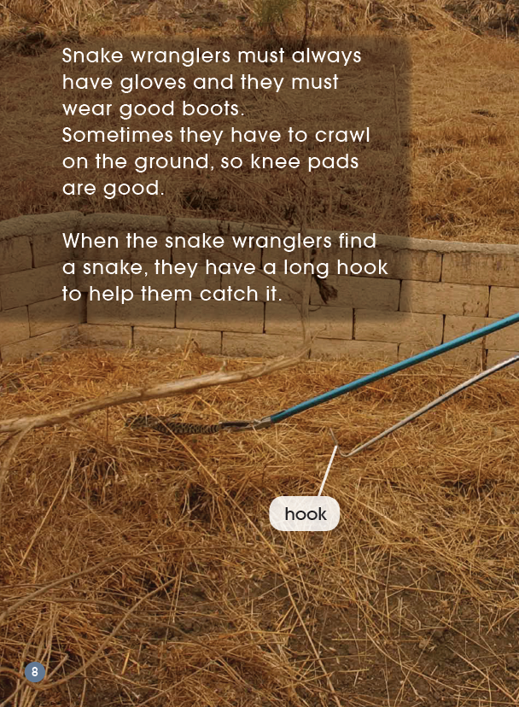
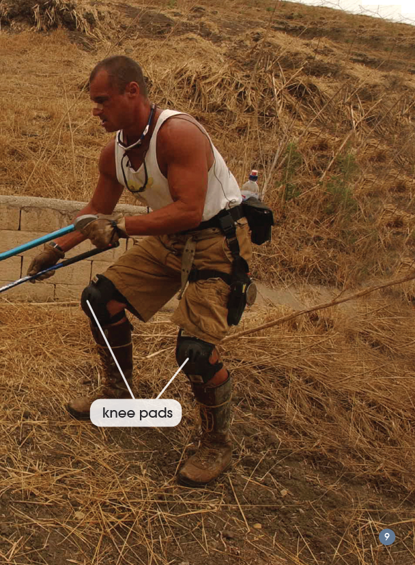
Card 2：PP8-9
1. What does a snake wrangler have to wear? Underline the words.
2. What tools do they need? Circle the tools.
3. What do you think would be important for him to wear? Why do you think that?
————————————————————
————————————————————

Slide 8
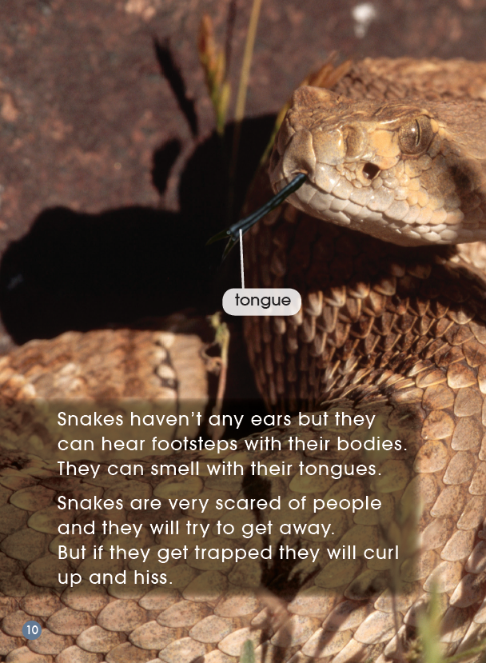
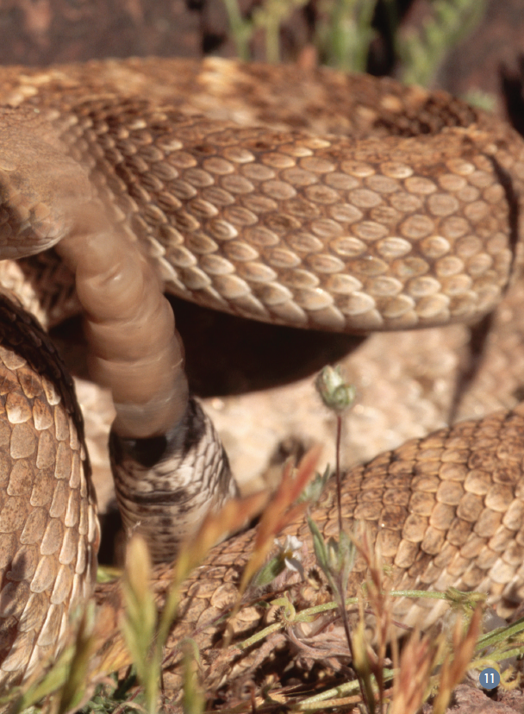
Card 3：PP10-11
1. Do you think the snakes can hear? Which words tell you how snakes hear? Underline the words.
2. What do the snakes use their tongues for?
—————————————————
3. Do you think snakes really want to attack a person? Why or why not?
—————————————————

Slide 9
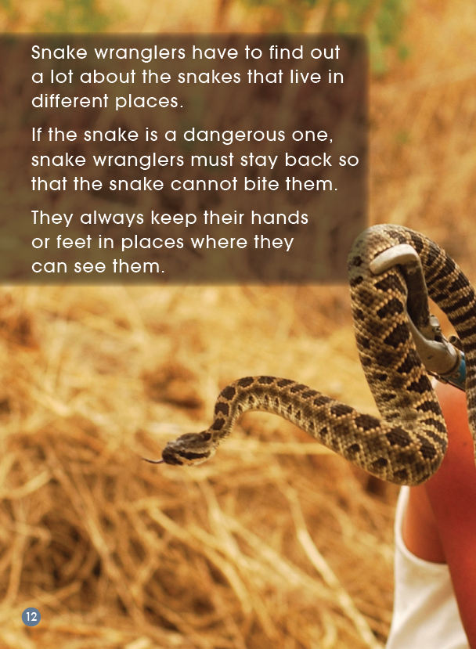
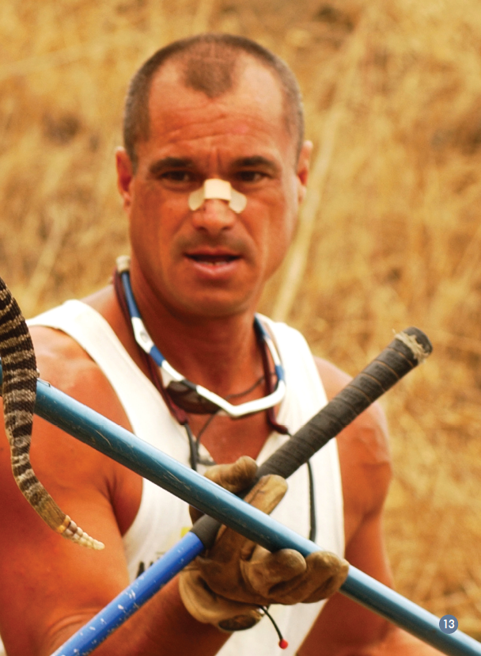
Card 4：PP12-13
1.What part of the snake do you think he has to be careful of?
—————————————
2. What is important for snake wranglers to find out?
—————————————

Slide 10
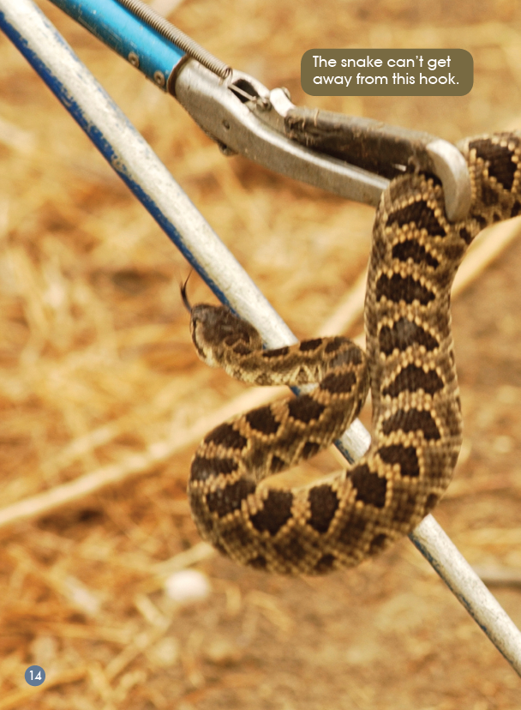
Card 5：PP14-15
1. What does the snake wrangler do with the snake?
—————————————————
2. What sort of place do you think the snake will be taken to?
————————————————

Slide 11
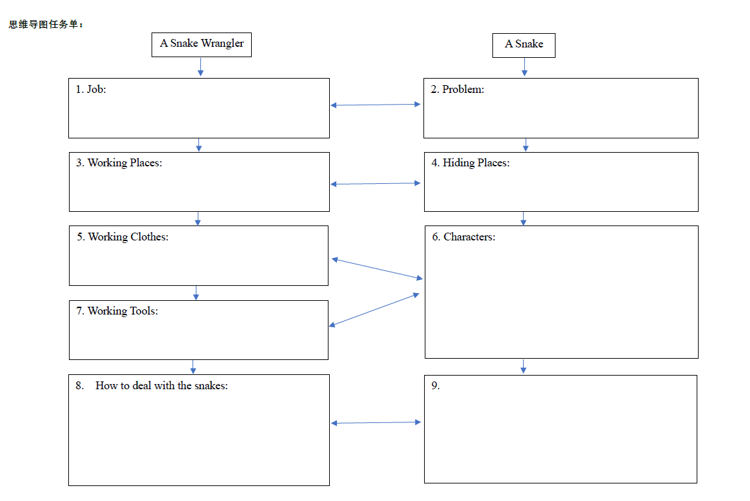

Slide 12
Homework
Listen and read the text again.
Share the text with your parents or friends.
Find more information about a wrangler (e.g. horse wrangler) and share with your friends.

