Slide 1
选自《多维阅读第9级》
Bug Hunters
昆虫学家揭秘

Slide 2
Look at the cover and answer the questions
1. What can you see from the cover?
2. What’s the title and what information do you think the photograph is telling you?

Slide 3
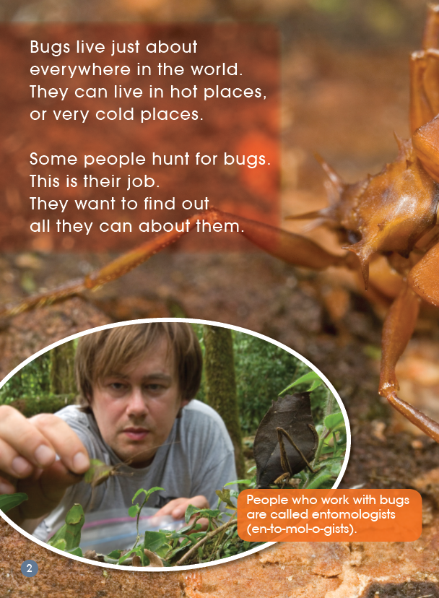
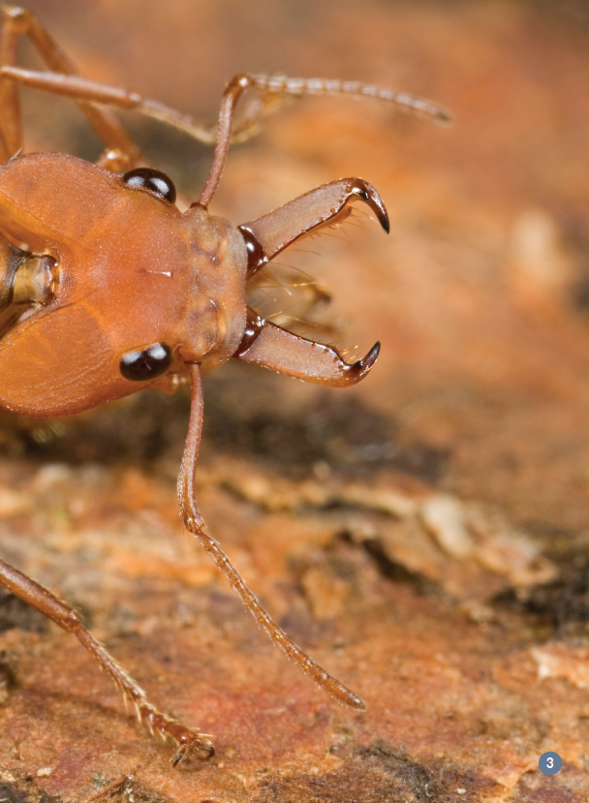
Jigsaw reading

Slide 4
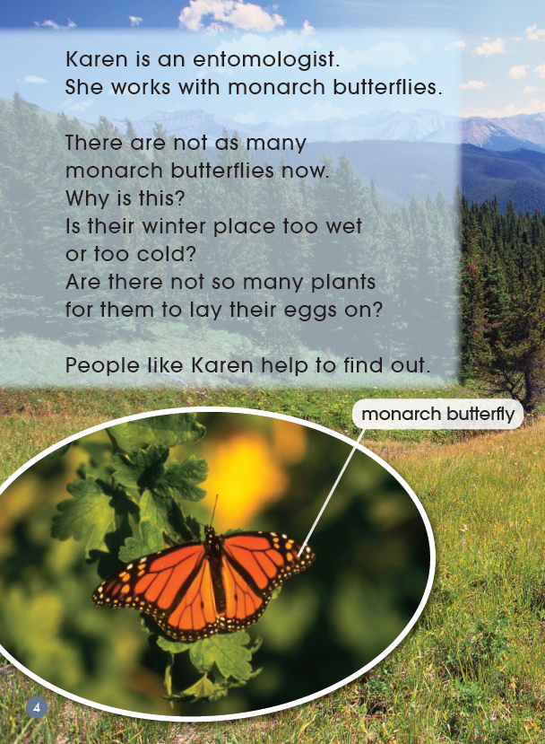
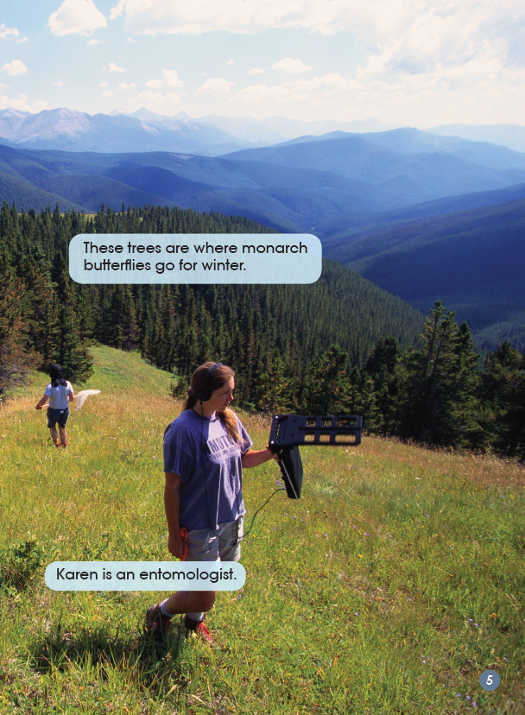

Slide 5
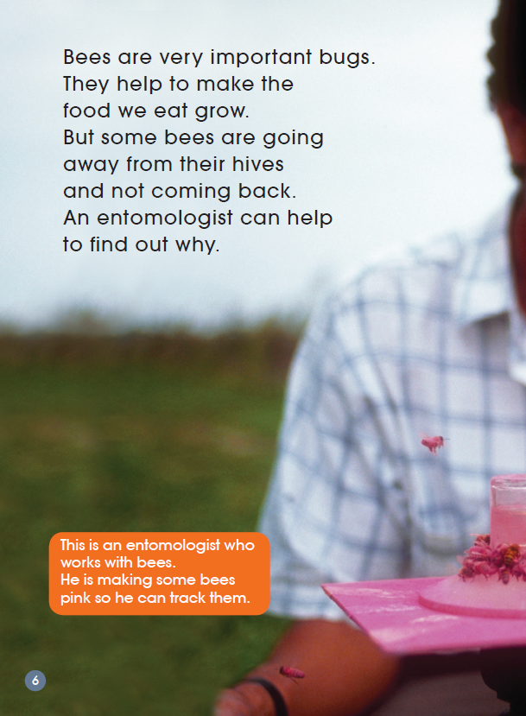
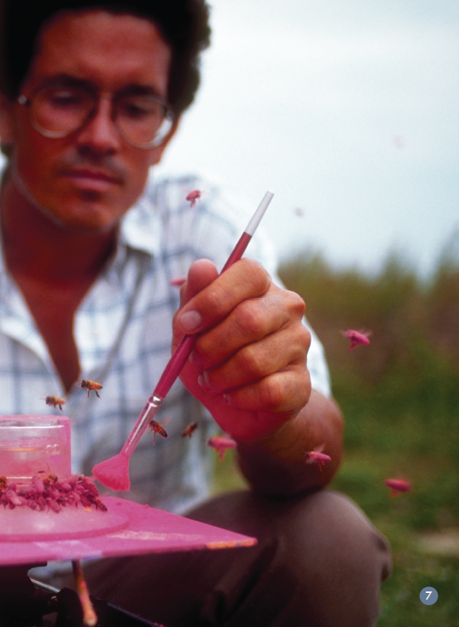

Slide 6
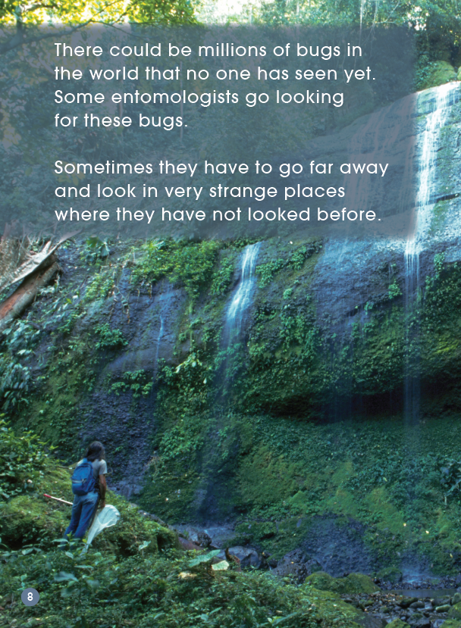
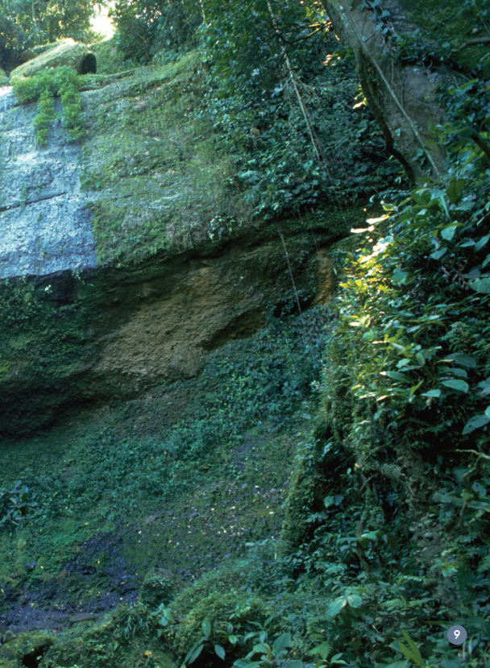

Slide 7
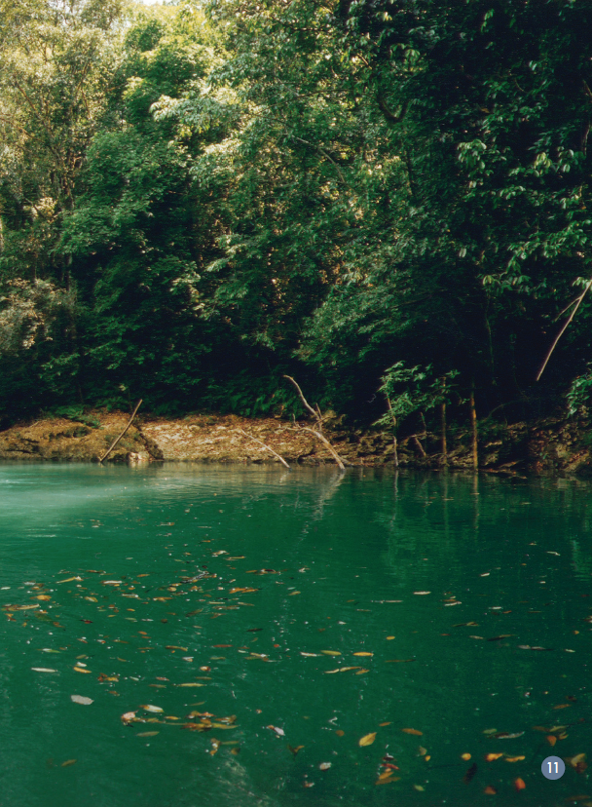

Slide 8
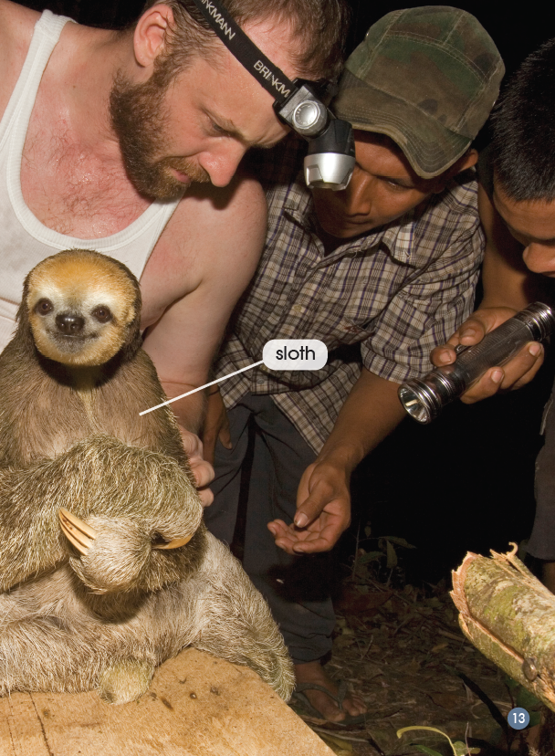

Slide 9
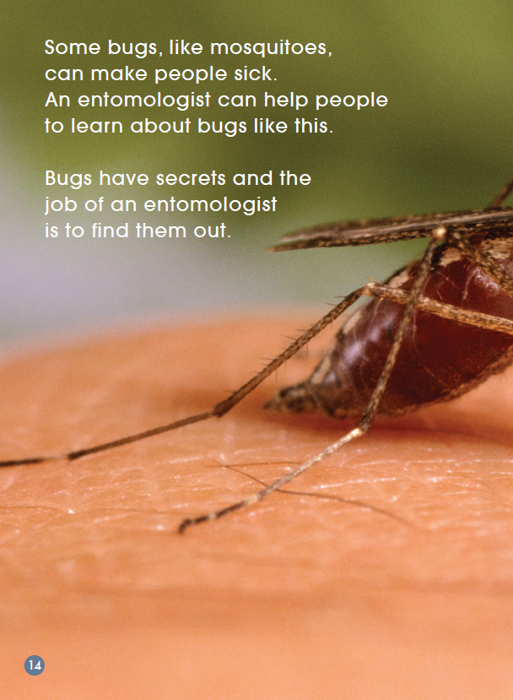
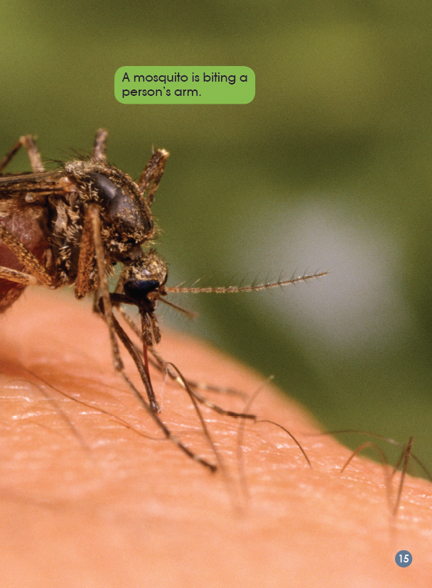

Slide 10
Talk in groups and answer these questions
Monarch butterfly
1. What do you know about monarch butterflies?
2. Why do you think there are not so many monarch butterflies now?
3. What is the reason that Karen is working with monarch butterflies?
4. What do you think would happen to monarch butterflies in the hot or cold places?

Slide 11
Bee
1. What bug is this entomologist working with? What is he doing?
2. Why do you think he is painting the bees pink?
3. How do you know we must have bees?
4. How do bees help to make the food we eat grow?
5. Why do you think bees are not coming back to their hives?

Slide 12
Moth
1. How do you know Chris went a long way to look for bugs?
2. Why do you think Chris had to go so far?
3. What do you know about sloths?
4. What does “dangerous” mean in the text?
4. What things might be dangerous in the forest for Chris?
5. What did Chris find?

Slide 13
Mosquito
1. What do you know about mosquitoes? Have you ever had a bite by it?
2. How do you know mosquitoes can be dangerous for people?
3. What do you think it means by “Bugs have secrets”?
4. Do you think entomologist should find the secrets? Why do you think that？

Slide 14
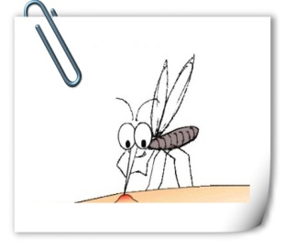
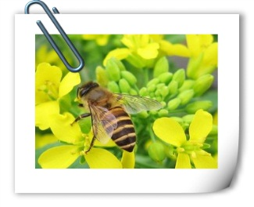
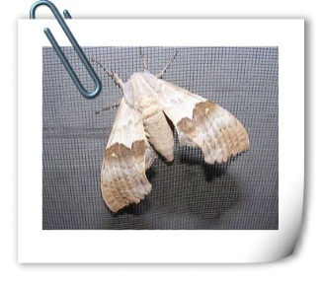
Finish the mind map and retell the secrets of bugs
What secrets about mosquitoes did the entomologist find?
____________________
____________________
____________________
____________________
____________________
What secrets about bees did the entomologist find?
____________________
____________________
____________________
____________________
____________________
Entomologists
What secrets about moths did the entomologist find?
____________________
____________________
____________________
____________________
____________________
What secrets about monarch butterflies did the entomologist find?
____________________
____________________
____________________
____________________
____________________

Slide 15
Group work-analogue interview
For example:
Interviewer can ask some questions:
Why did you want to work with monarch butterflies?
When did you start to work?
Where did you work?
What secrets about monarch butterflies do you want to find out?

Slide 16
Group sharing
What new things have you learnt about bugs?
Do you think entomologists should find out bugs’ secrets and why?
What do you have to do in order to know something new?

Slide 17
Homework
1. Choose a bug that you are interested in and make a poster to introduce the bug.
2. Introduce this book to your parents or friends.

