Slide 1
Baxter 大狗巴克斯特
选自《多维阅读第9级 》

Slide 2
Free talk.
Do you have a pet？
What pet do you like？
What do you often do with your pet？

Slide 3
Look at the cover and answer the questions
1. What is the title? Who is Baxter? 2. What did they do? How did they feel? 3. What will happen between Baxter and Max?

Slide 4
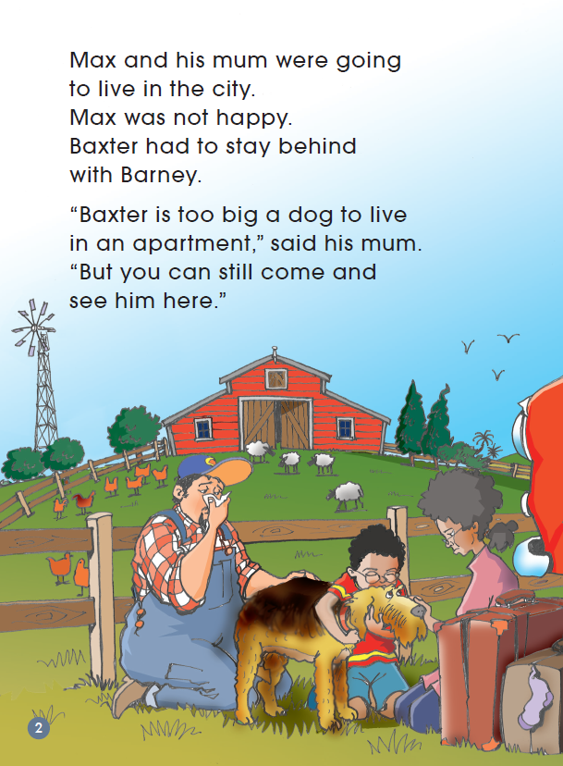
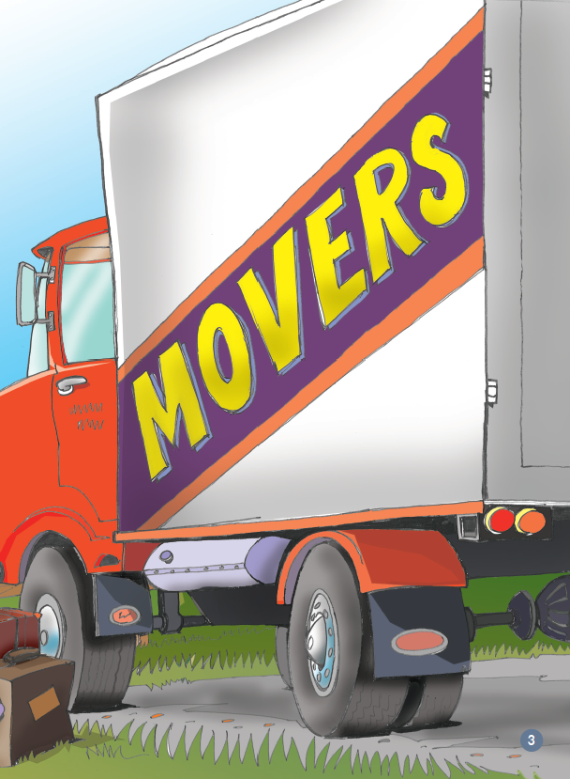
Read and answer
1. Who are the characters? What is the setting of this story?
2. What was the problem? How do you know that?
3. How did they solve the problem? What would happen next？
Max was going to live in the apartment.
But it is too small for his dog Baxter.
Max left Baxter on farm.

Slide 5
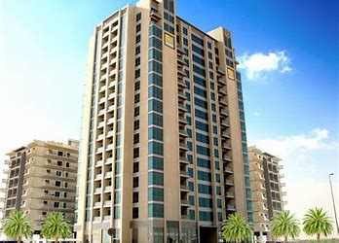
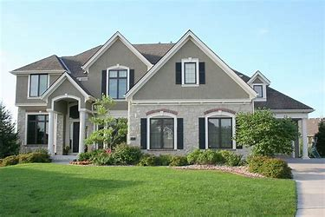
apartment
house

Slide 6
Read the story and finish the chart.
Baxter
beginning
middle
end
character:
setting:
problem
solution
What happened?

Slide 7
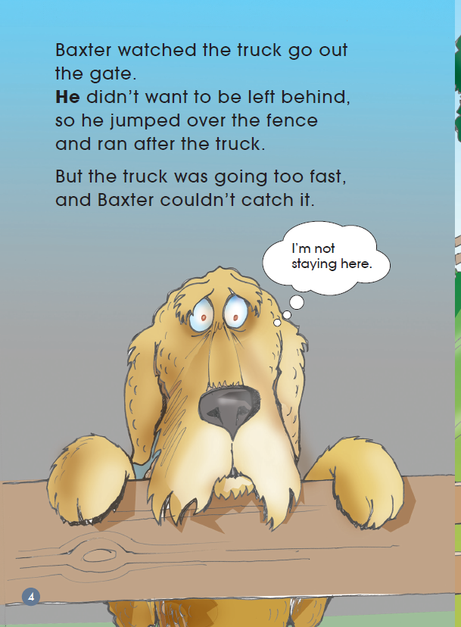
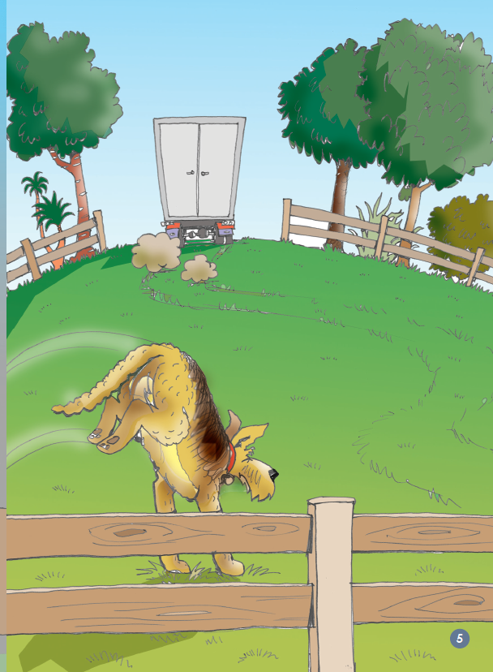
Read and check
1. How did Baxter look? 2. What did he think? What did he do?
？
？

Slide 8
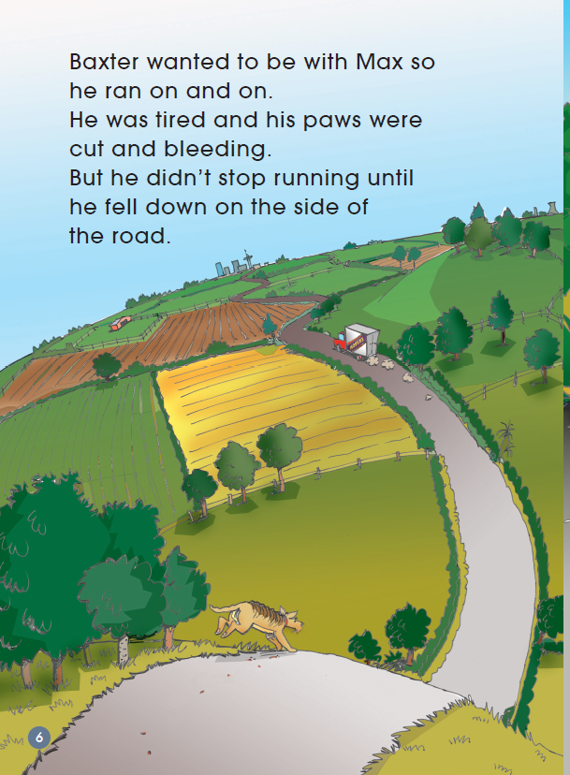
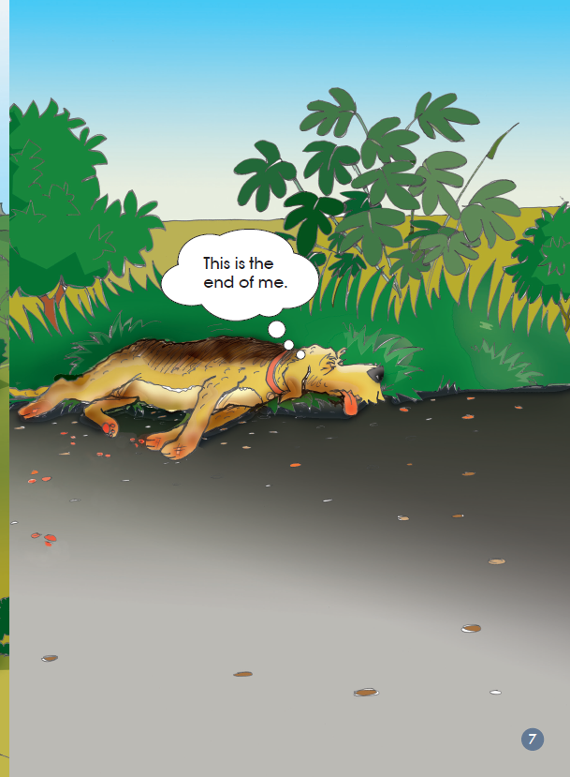
Read and check
How did Baxter show he was determined?
Find the words that tell you.
？

Slide 9
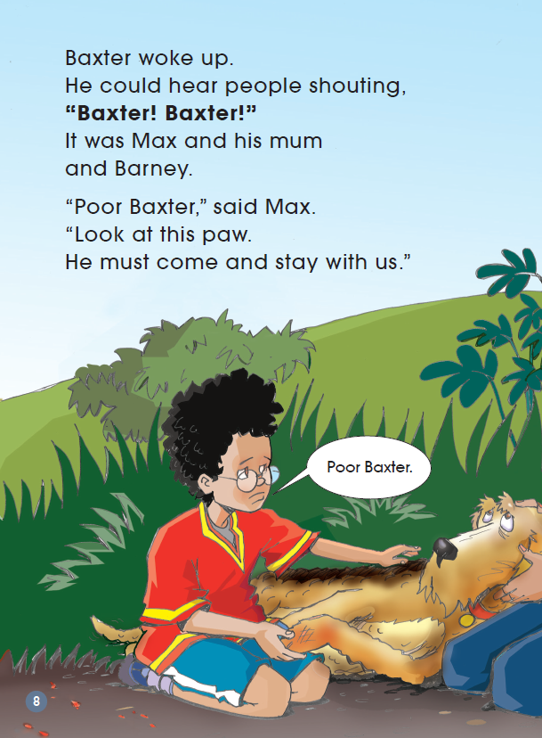
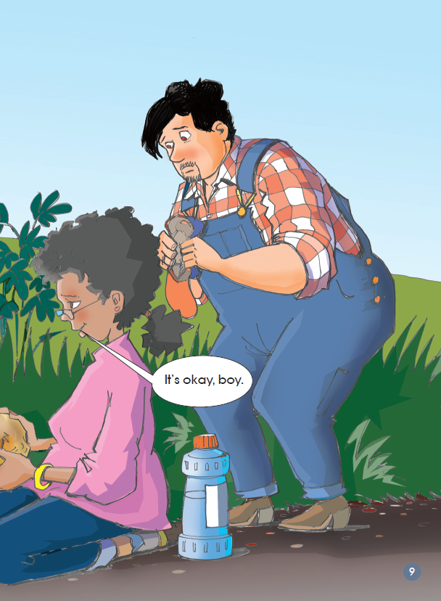
Read and check
How do you know Max really cared for Baxter？

Slide 10
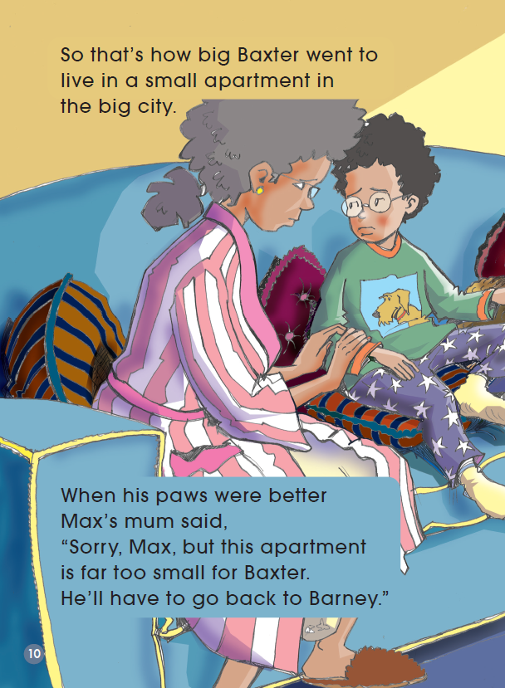
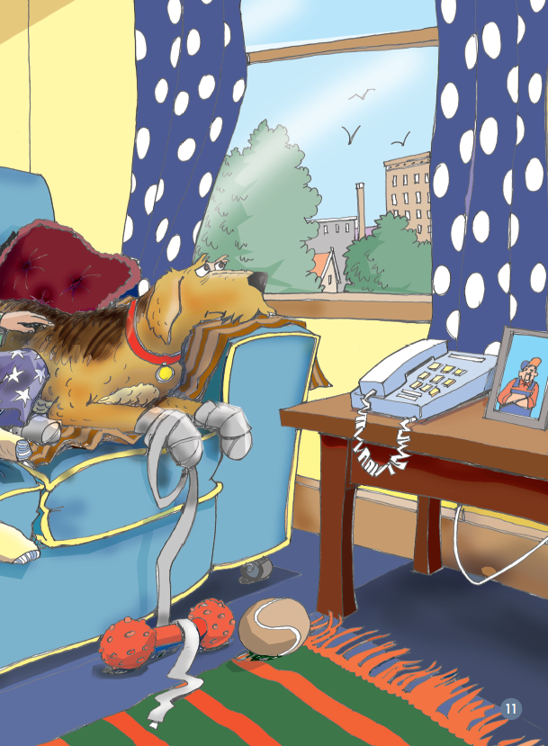
Read and check
What made Max/Baxter sad？

Slide 11
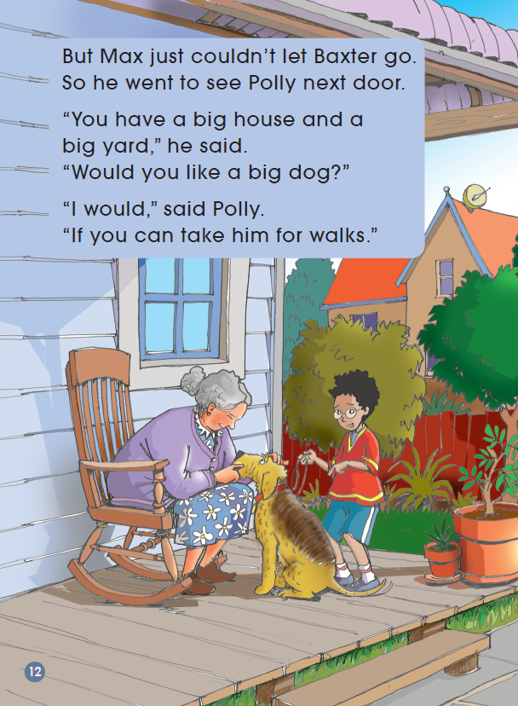
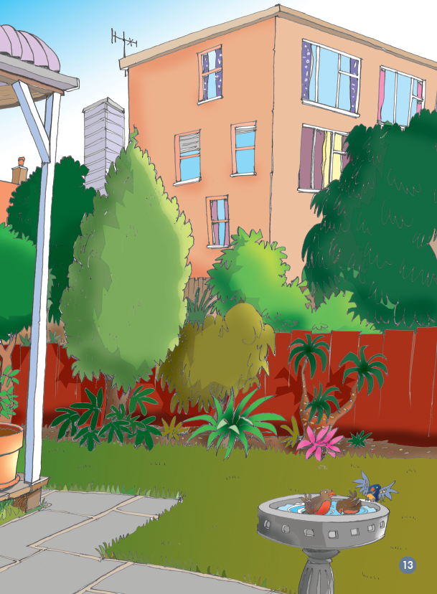
Read and check
Who do you think this new character is?

Slide 12
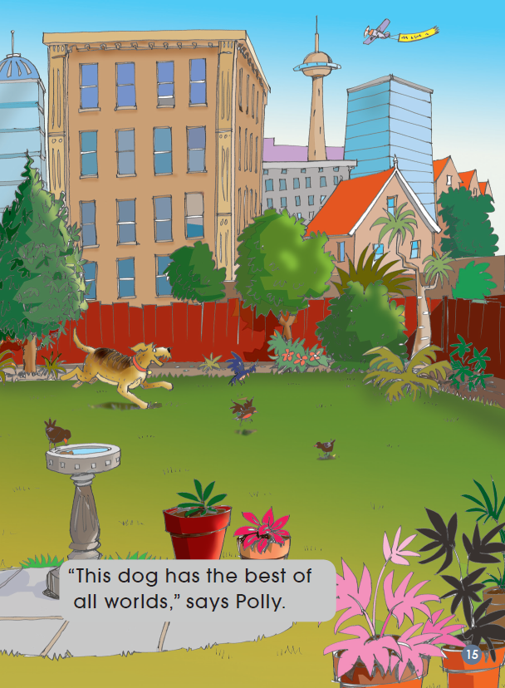
Read and check
Why did Polly say “This dog has the best of all
worlds”?

Slide 13
Read after the recording and retell the story

Slide 14
Talk in group, share different opinions
Scene1: Max was going to live in the apartment. But it is too small for his dog Baxter.
Do you think it was a good idea to leave Baxter with Barney when they moved to the city？ Why or why not？
If you have this problem, what will you do？
Scene2: Baxter ran after the truck and fell down on the side of the road with bleeding paws.
Do you think Max and his mum should take Baxter to the apartment？ Why do you think that？
Do you think there will be another problem？What could it be？
Scene3: The apartment is too small for Baxter. He can't play in it.
Do you think there is another way to solve this problem？
Share in your group, and give your advice.

Slide 15
Imagine and write
Draw the ending of the story

