Slide 1
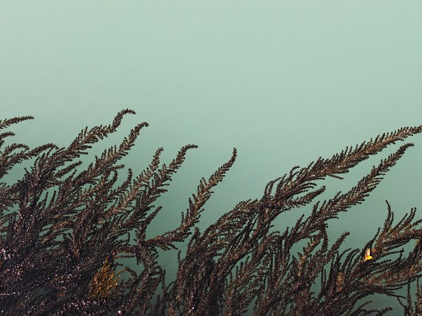
Different Plants
奇异的植物
选自《多维阅读第8级》

Slide 2
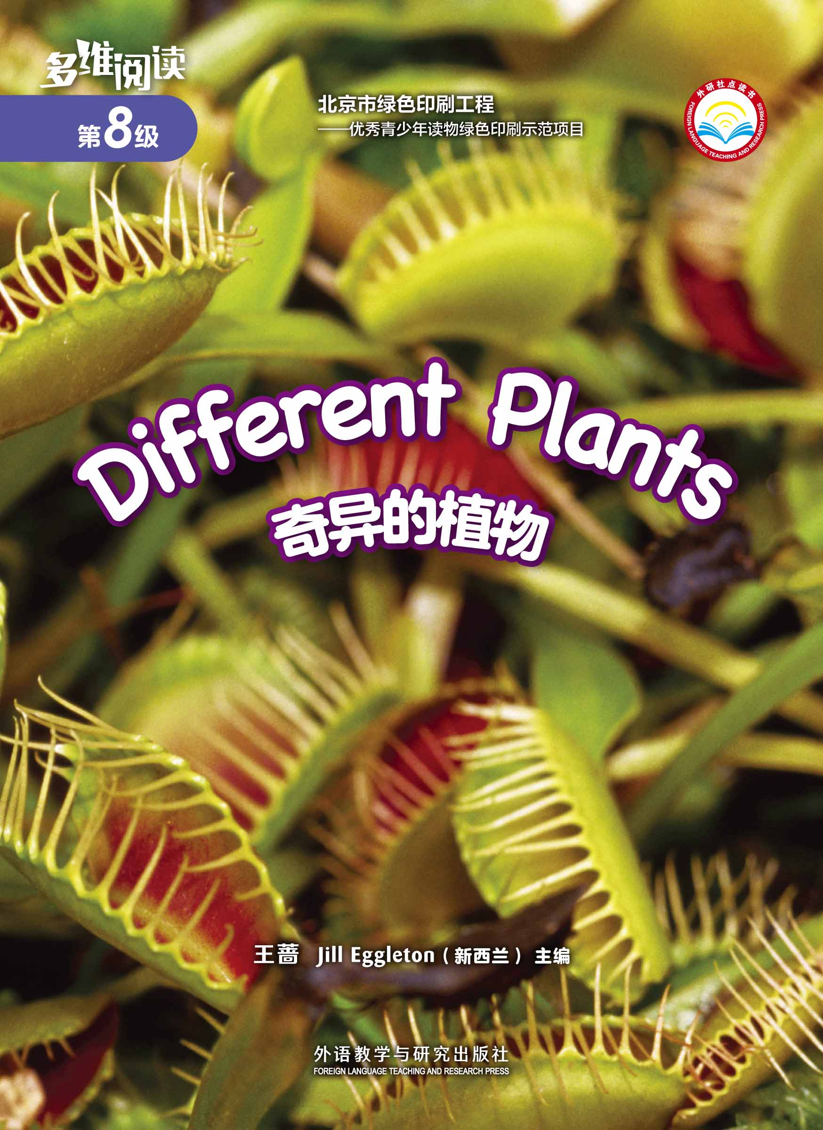
What do you know from the cover?

Slide 3
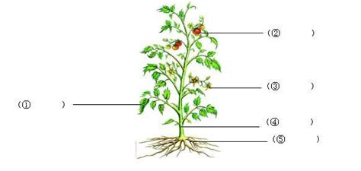
What do most plants have?
How do we say each part in English?
What can they do for the plants?
What else do you know?

Slide 4
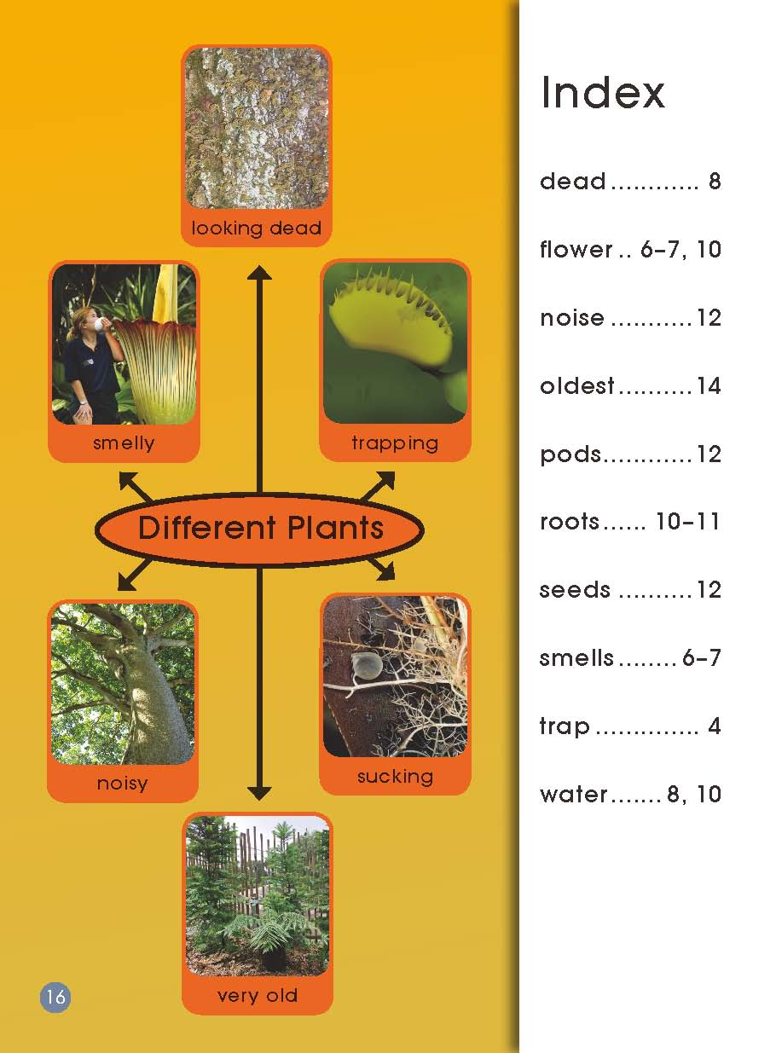
What’s special about these plants?

Slide 5
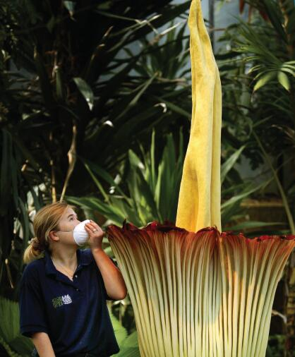
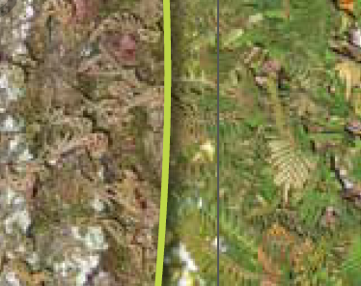
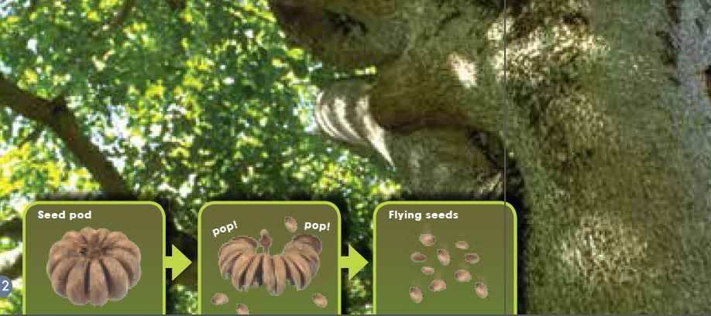
Read pages 4-15 in six groups.
What’s special about them?

Slide 6
very old
sucking
trapping
Different Plants
smelly
noisy
looking dead

Slide 7
Introduce the plants in groups
Which one is most special?

Slide 8
Introduce the plants.
Read the names of the plants.
Introduce where they live.
Explain how they are different.

Slide 9
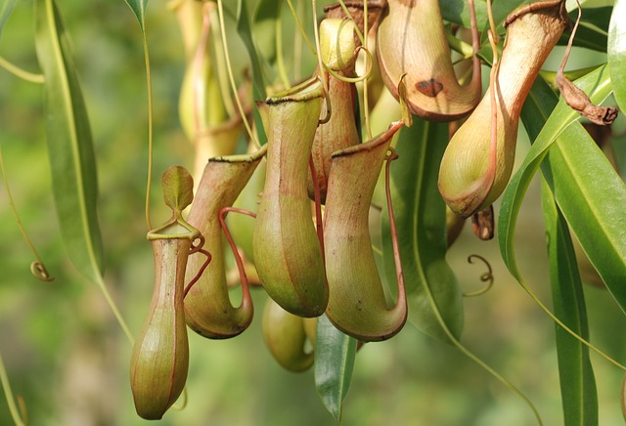
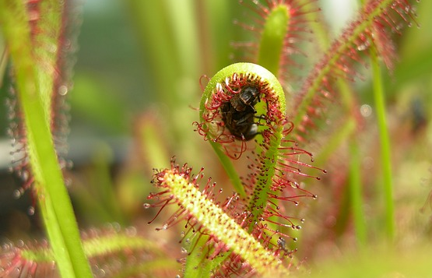
Do you know any other plants?

Slide 10
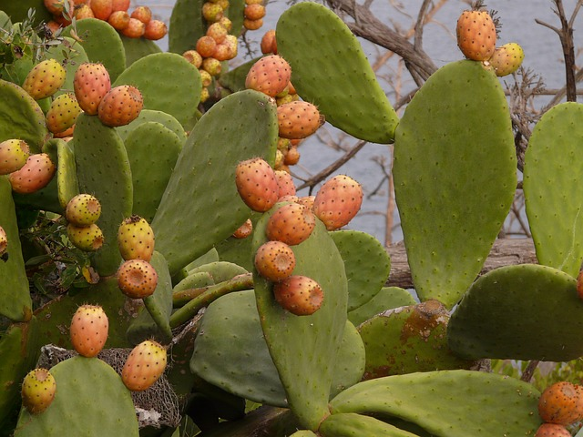
Introduce a special plant
you know.
This plant lives on/in/under…
It can...

Slide 11
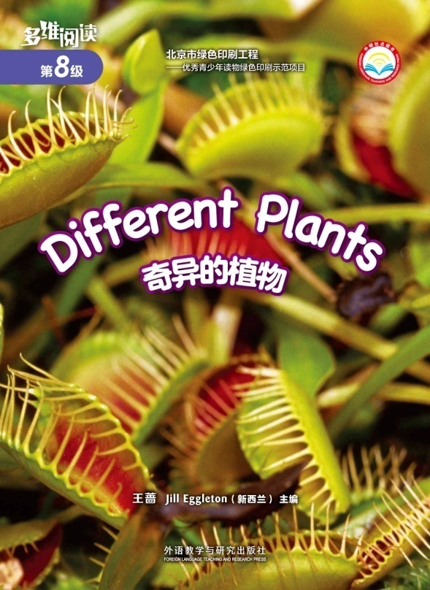
Homework
1. Make a poster of special plant(s).
2. Find more information about different plants around us.

