Slide 1
Let’s read
第6级

Slide 2
Series name
Level
Title
Authors
Publisher

Slide 3
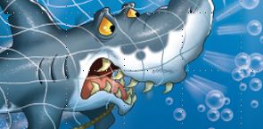
What do you know about sharks?
Food
Habitat
They eat ...
They live ...
Appearance
Living
Style
They are ...
They ...

Slide 4
What do you want to know about the story?
What?
Where?
When?
Why?
Who?
How?

Slide 5
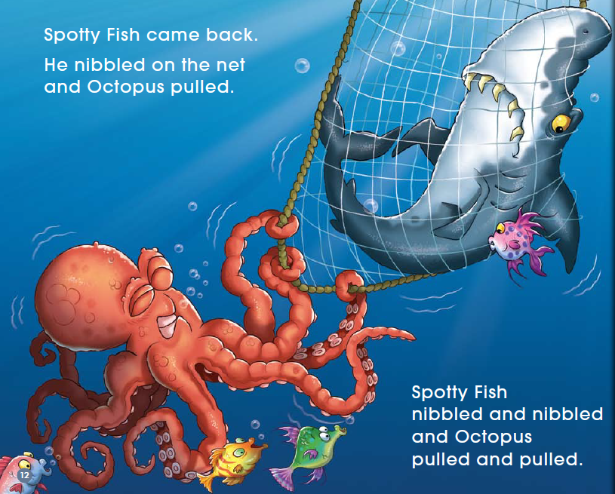
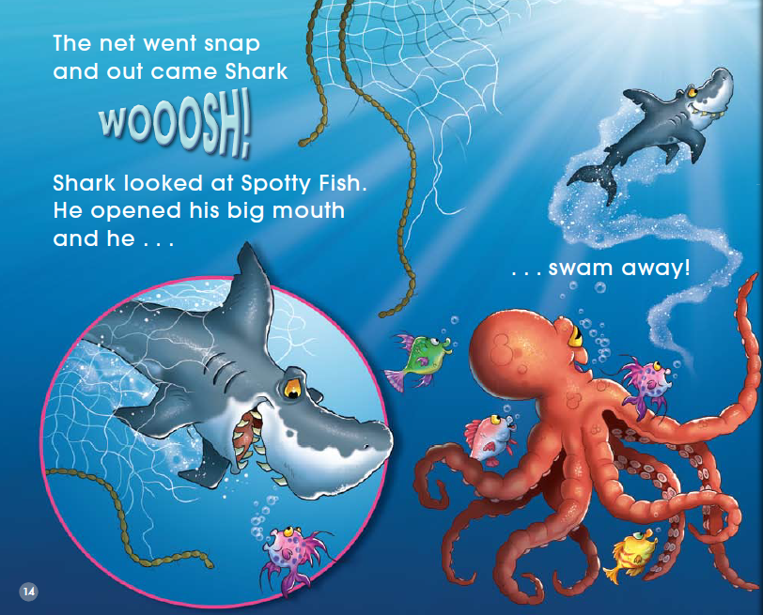
What happened in the pictures?

Slide 6
Were they friends in the story?

Slide 7
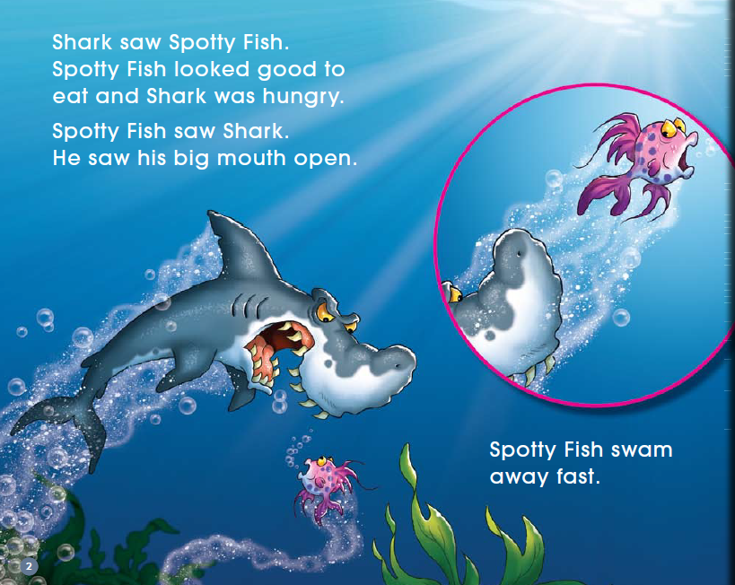
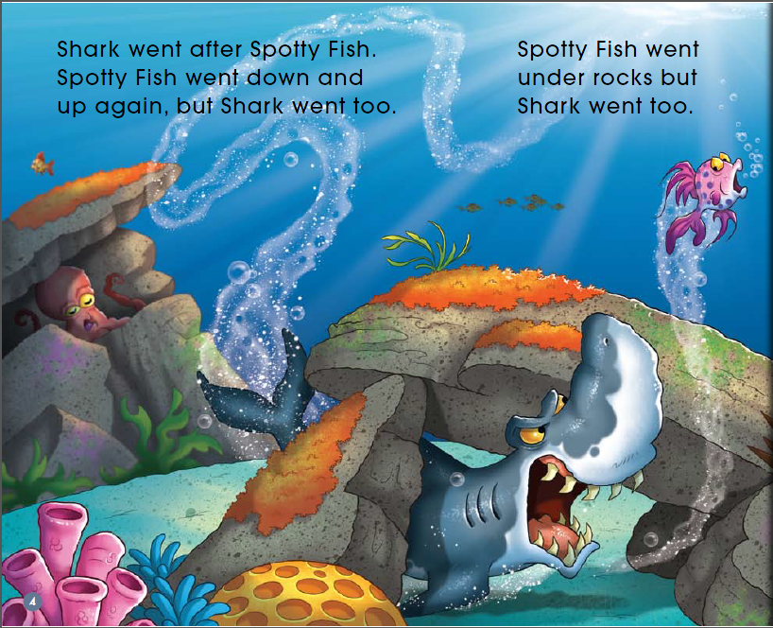
Read PP 2-5
What's the relationship between them?

Slide 8
Share in groups
I think they are ..., because ...

Slide 9
chased and ate
helped

Slide 10
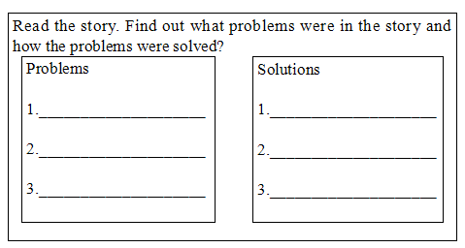
Q: What problems did they have in the story?
How did they solve them?
Tips:
1. Read by yourself carefully.
2. Follow to read.

Slide 11
Listen and repeat
Tips:
1. Listen carefully.
2. Read with full emotion.

Slide 12
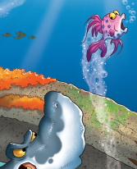
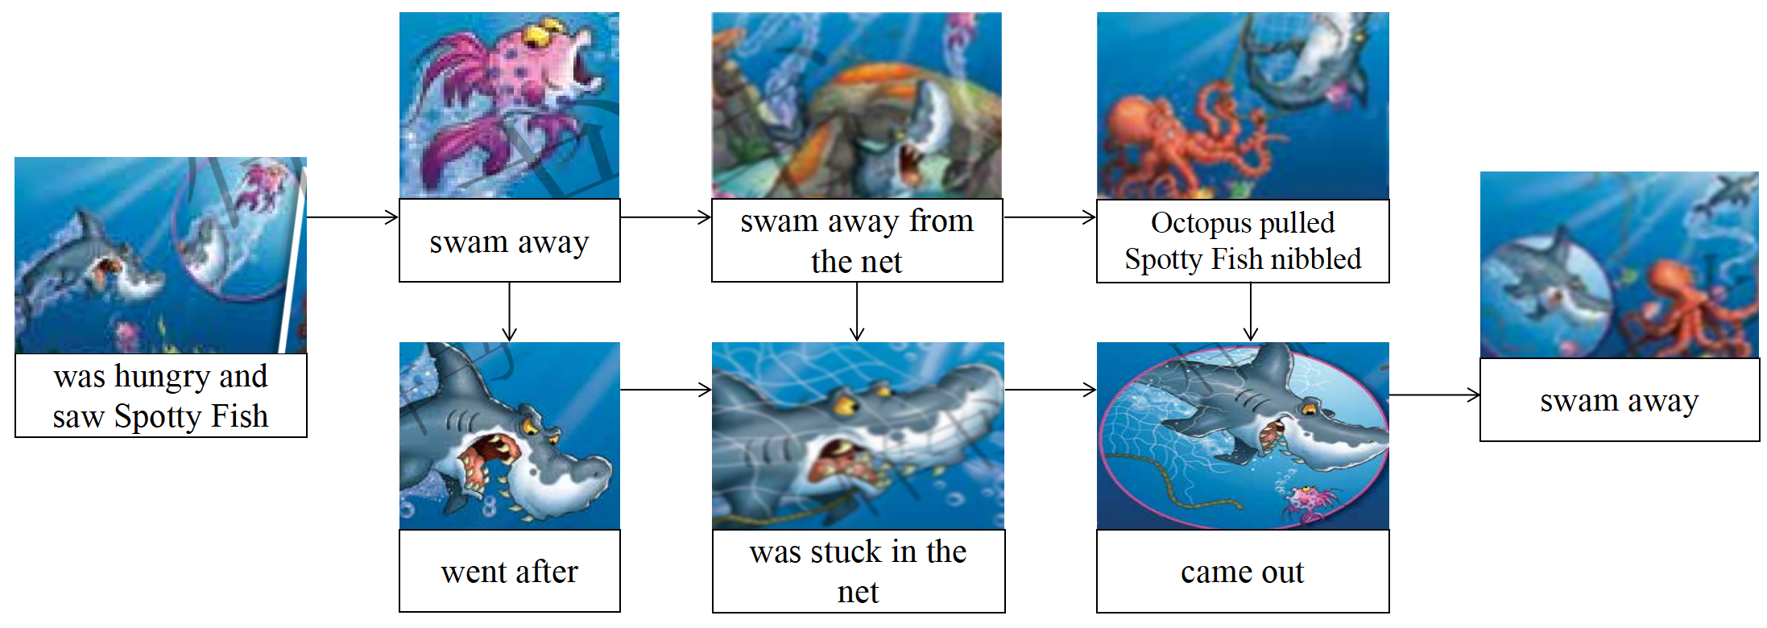
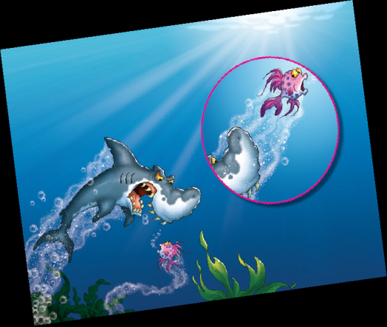
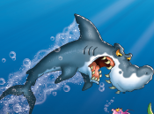
Q: How much do you know about the story?
Tips:
1. Tell the story in groups.
2. Share it in class.

Slide 13
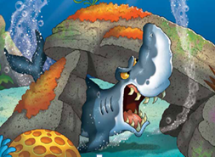
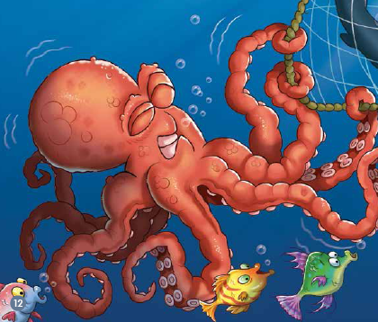
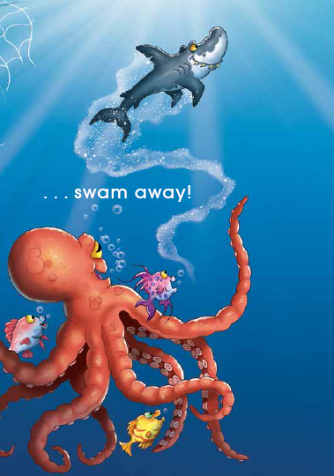
What do you think of them? Why?
helpful
grateful
fierce（凶猛的）
warm-hearted
brave
forgive and forget（既往不咎）
I think ... Because ...

Slide 14
What do you learn from them?
In the story, ... I think ...

Slide 15
Homework
1. Retell the story.
2. Draw a story about forgiveness and gratefulness.

Slide 16
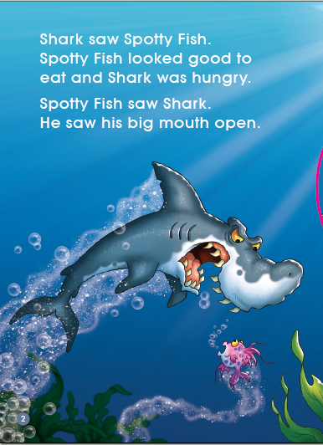
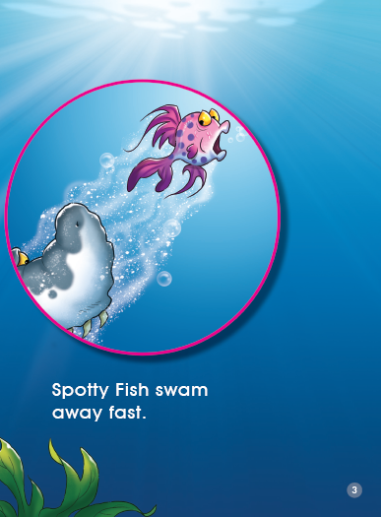

Slide 17
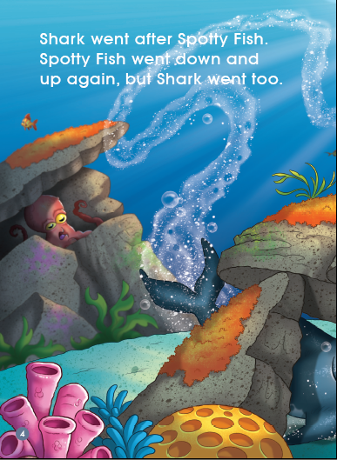
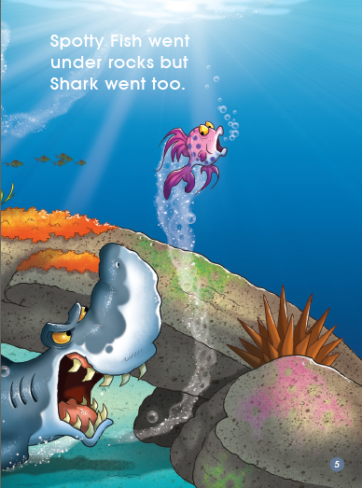

Slide 18
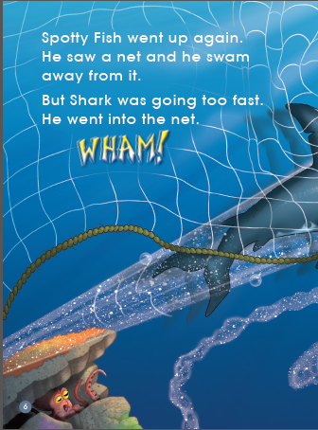
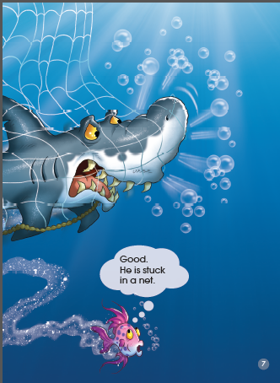

Slide 19
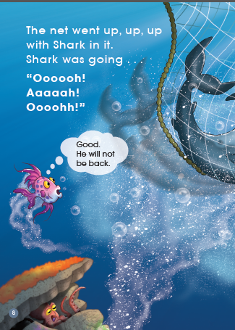
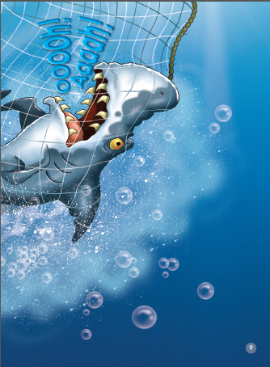

Slide 20
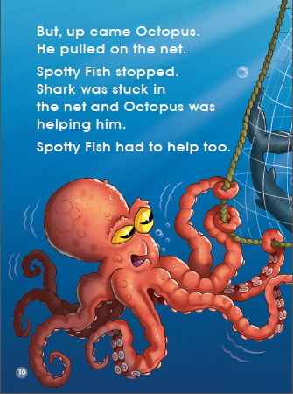
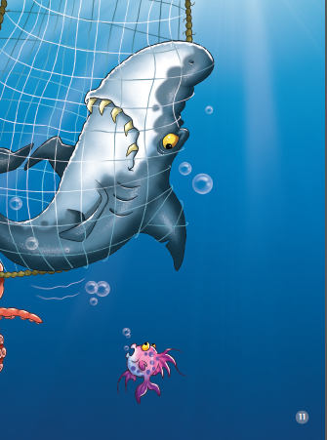

Slide 21
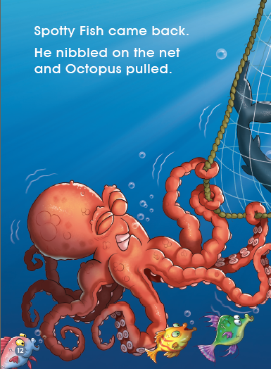
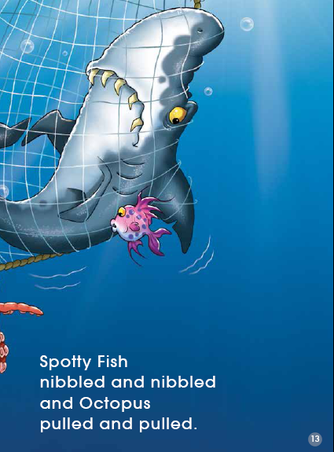

Slide 22
