Slide 1
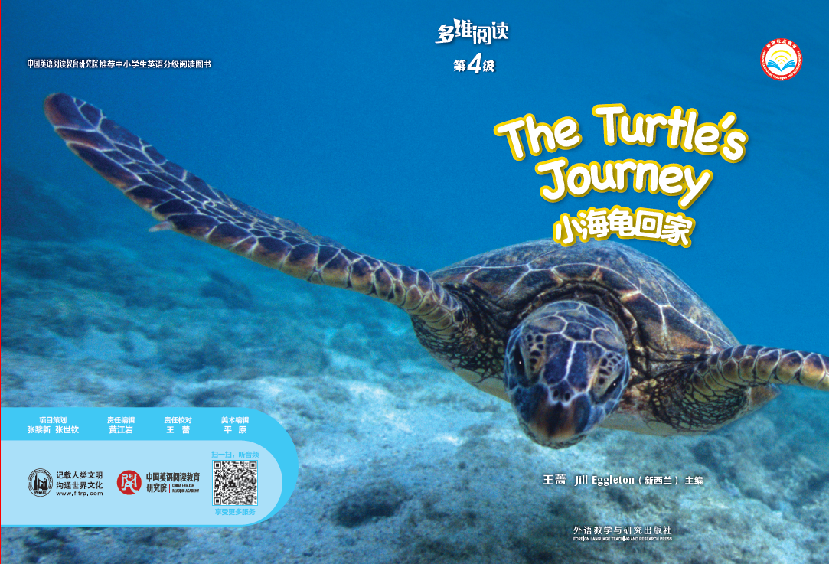
多维阅读第4级
The Turtle’s Journey

Slide 2
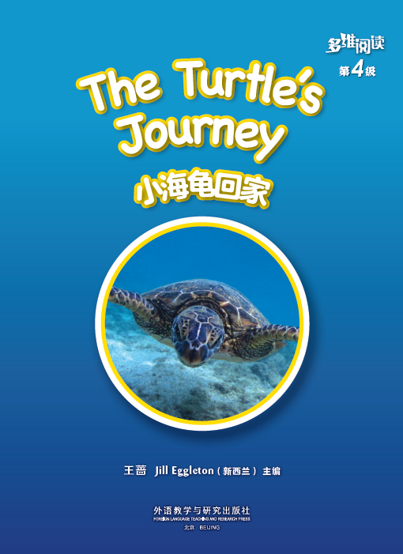
What animal is it?
Where does it live?
Title 标题
sea
turtle
Writer 作者

Slide 3
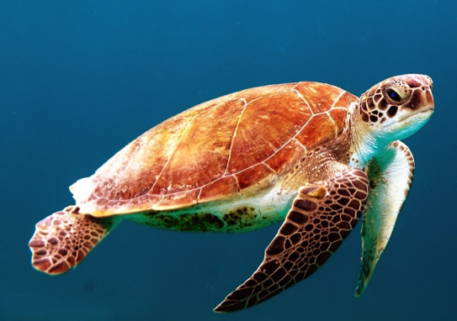
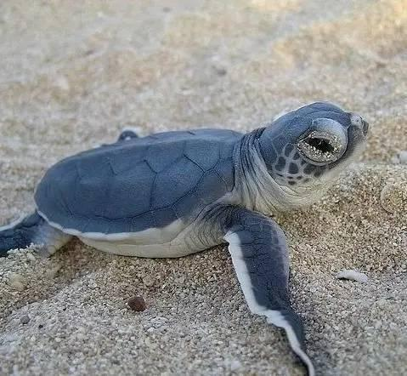
What’s this?
a turtle
a baby turtle
= a hatchling

Slide 4
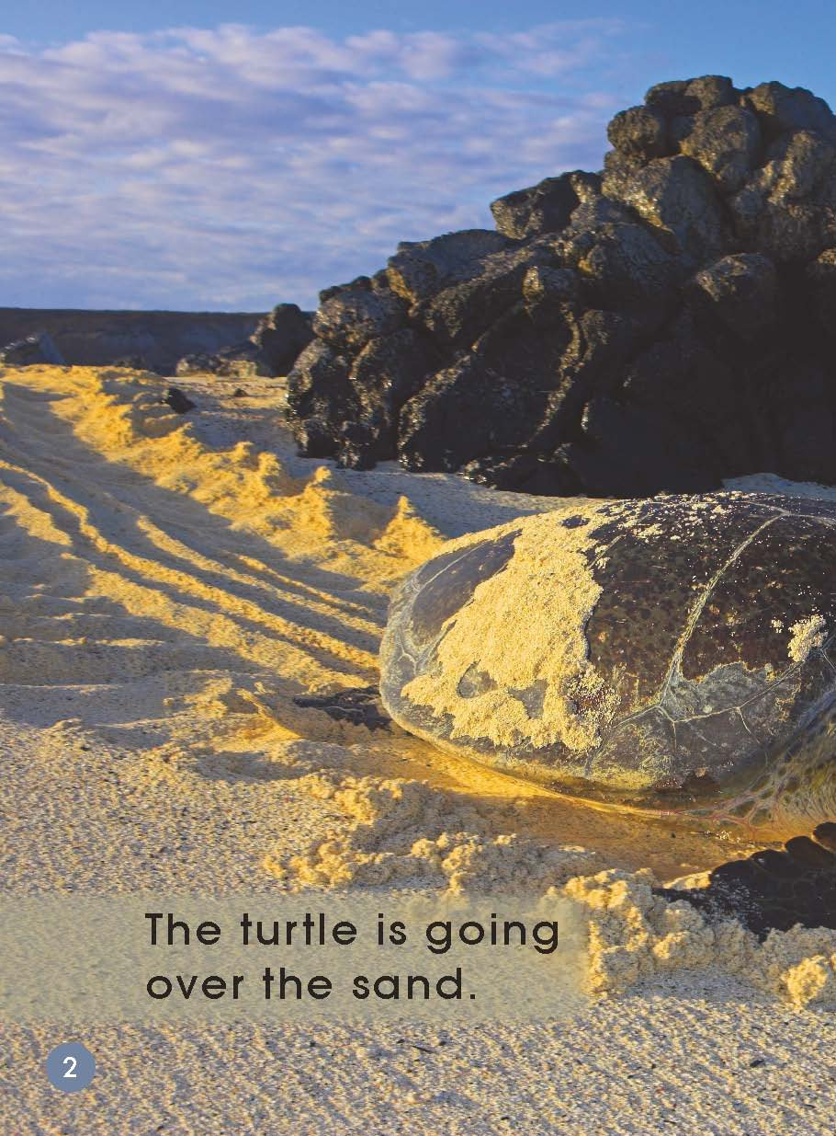
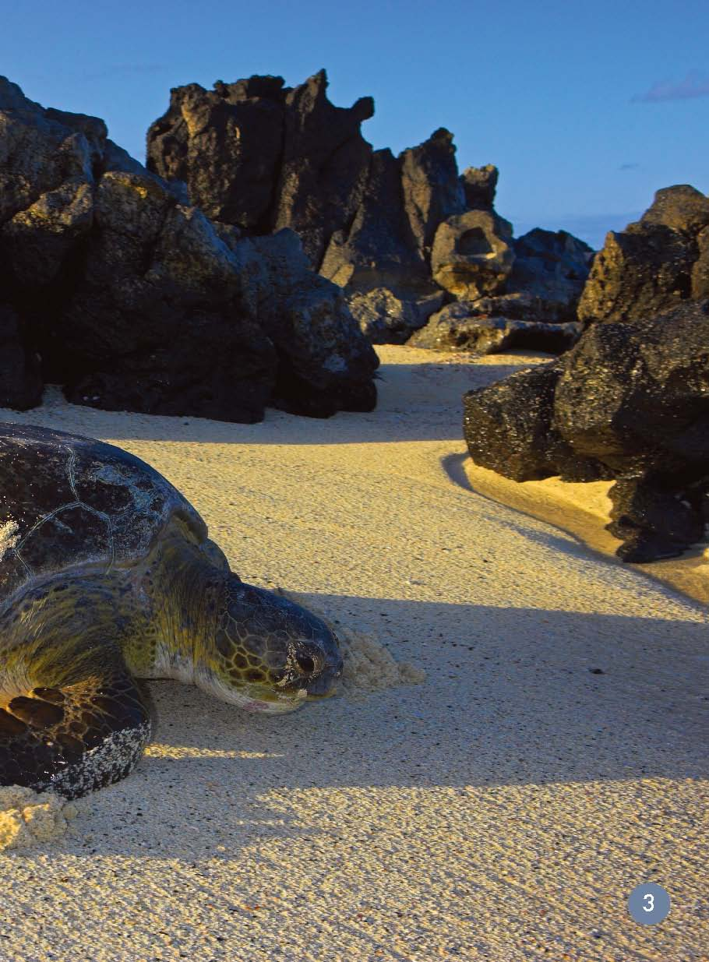
Where is it from?
Where is it going?

Slide 5
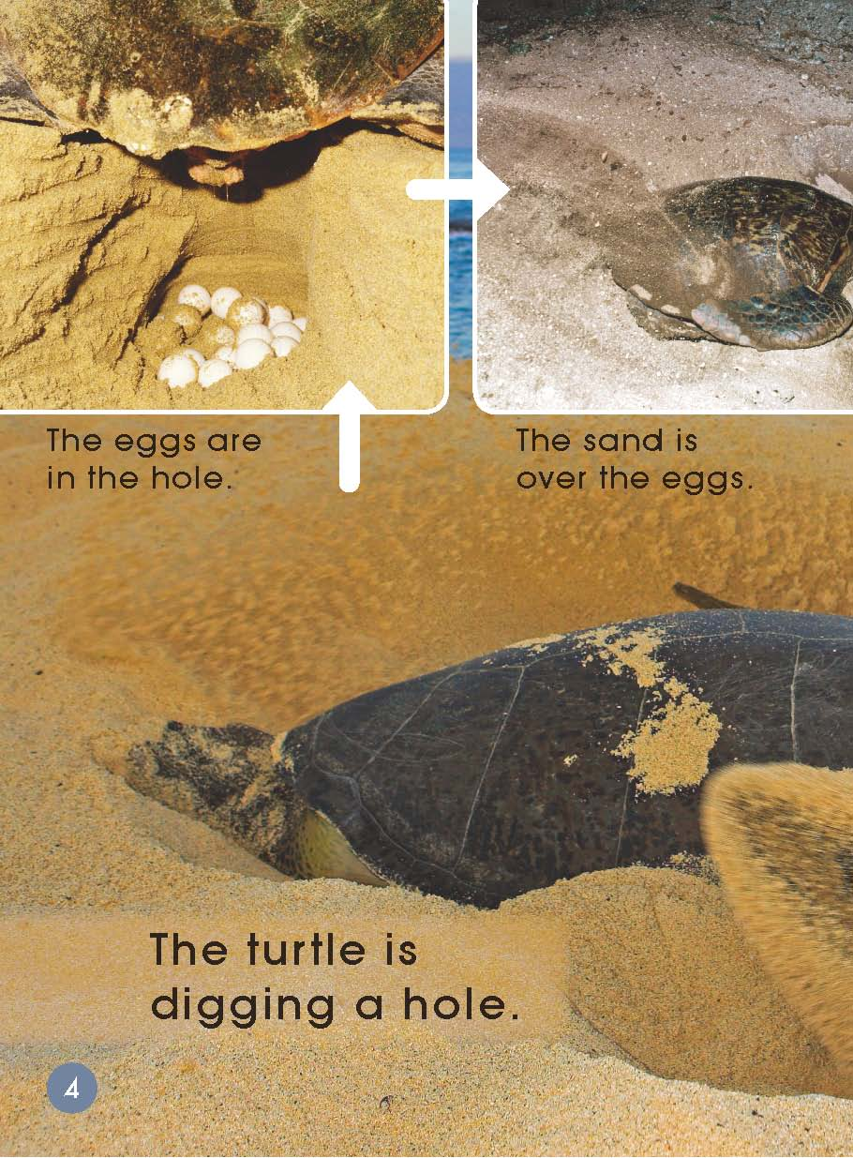
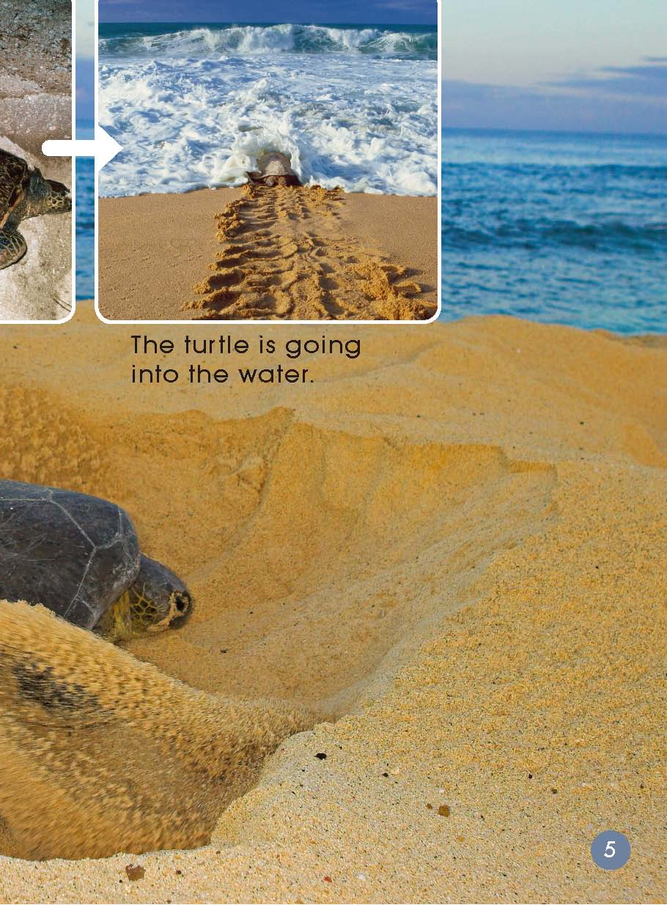
What is it doing?
Why?
lay eggs
Where is the turtle now?
What is happening to the eggs?

Slide 6
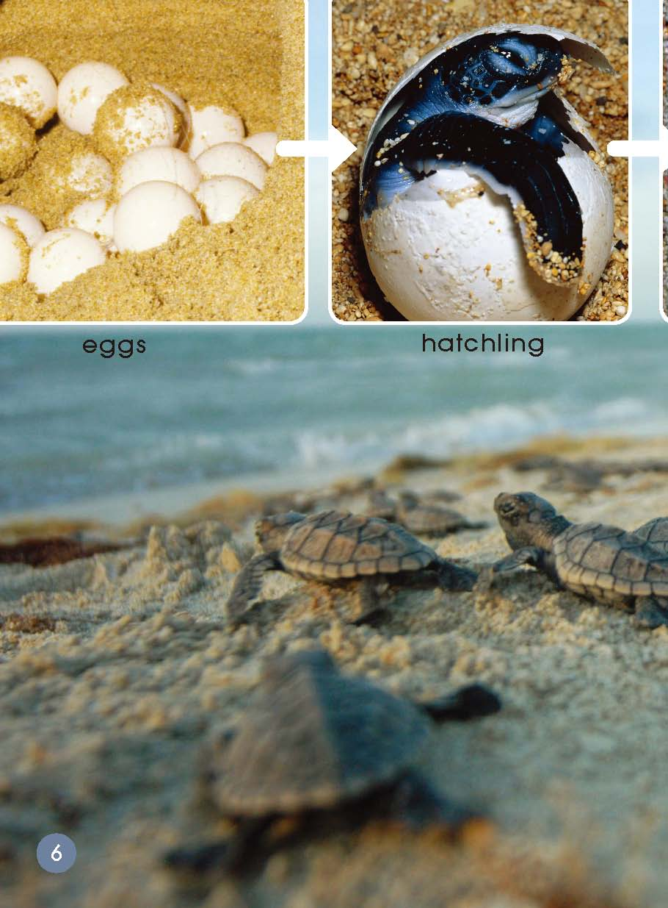
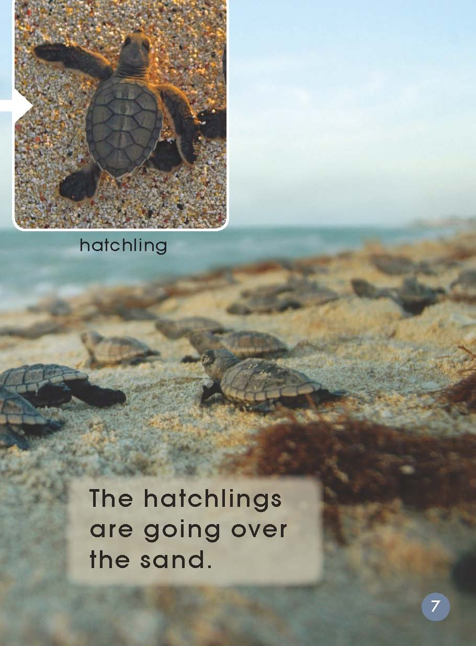
What is happening to the eggs?
What are hatchlings going?

Slide 7
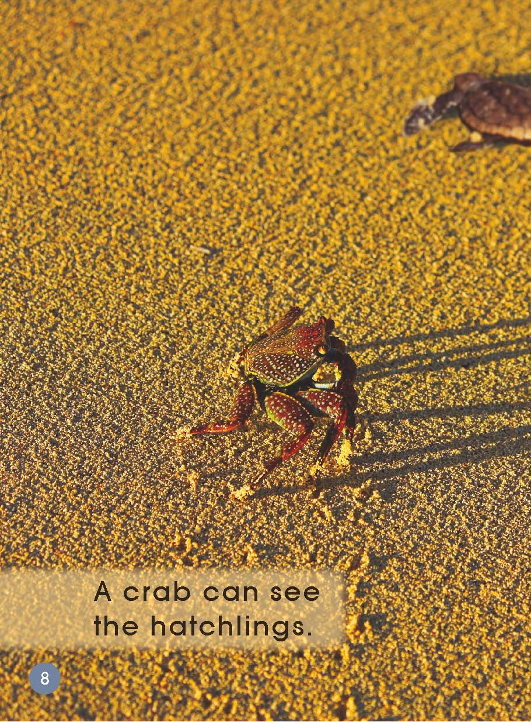
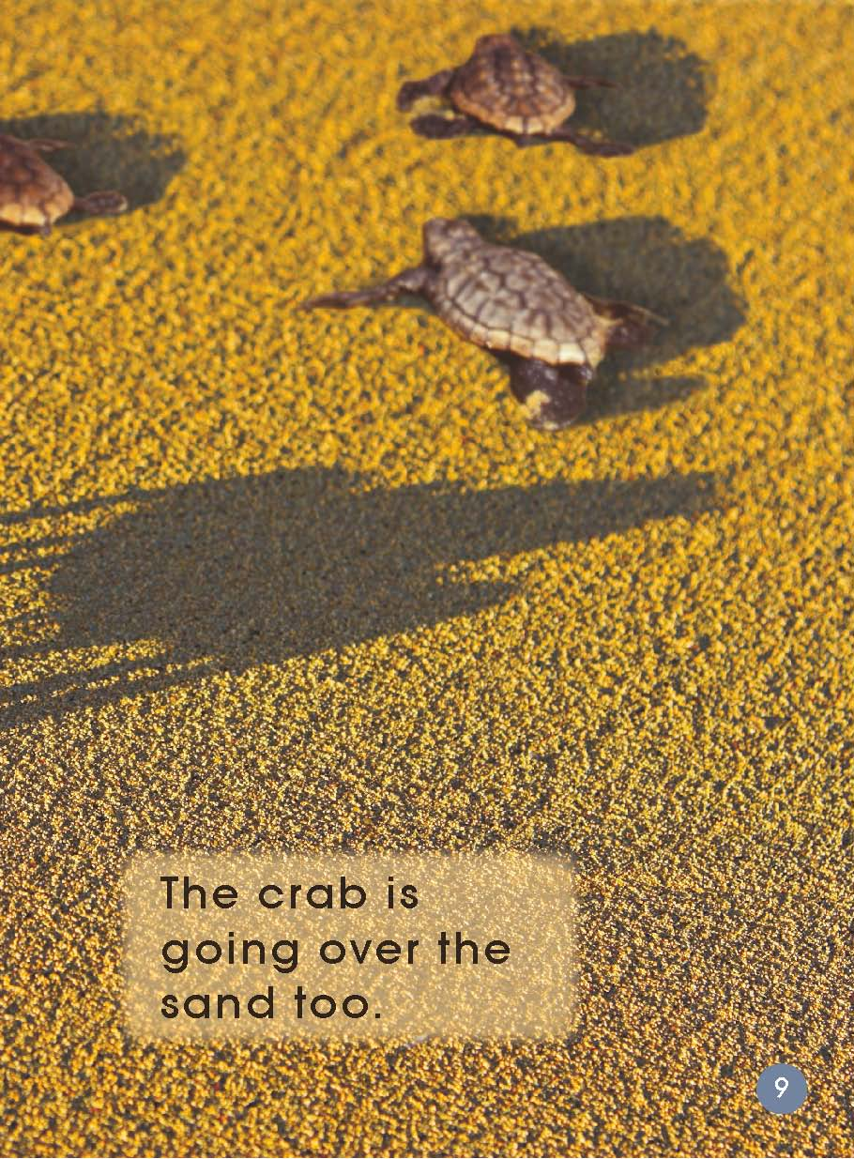
What’s this?
What is the crab doing?
What are the hatchlings doing?
a crab

Slide 8
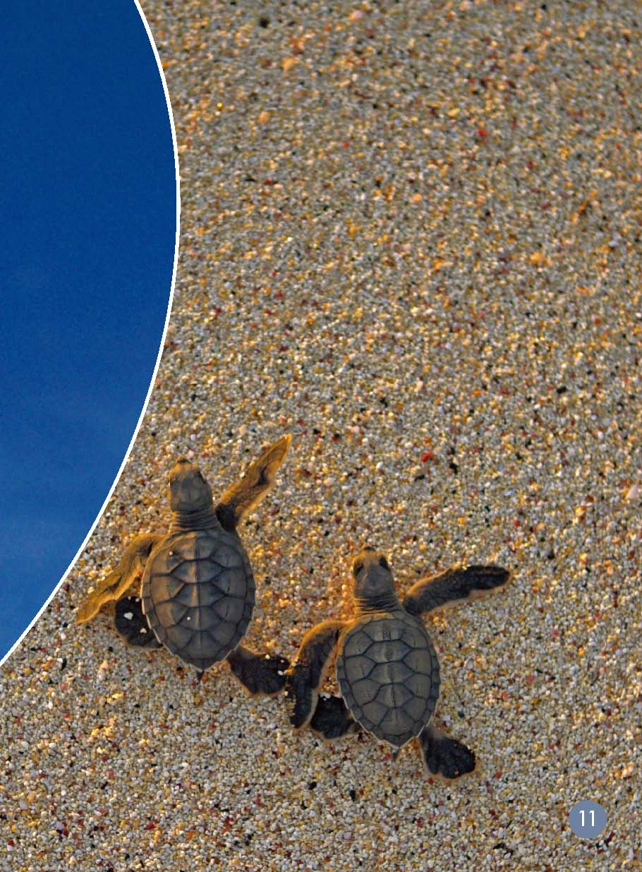
What’s this?
What is the
bird doing?
What are the hatchlings doing?

Slide 9
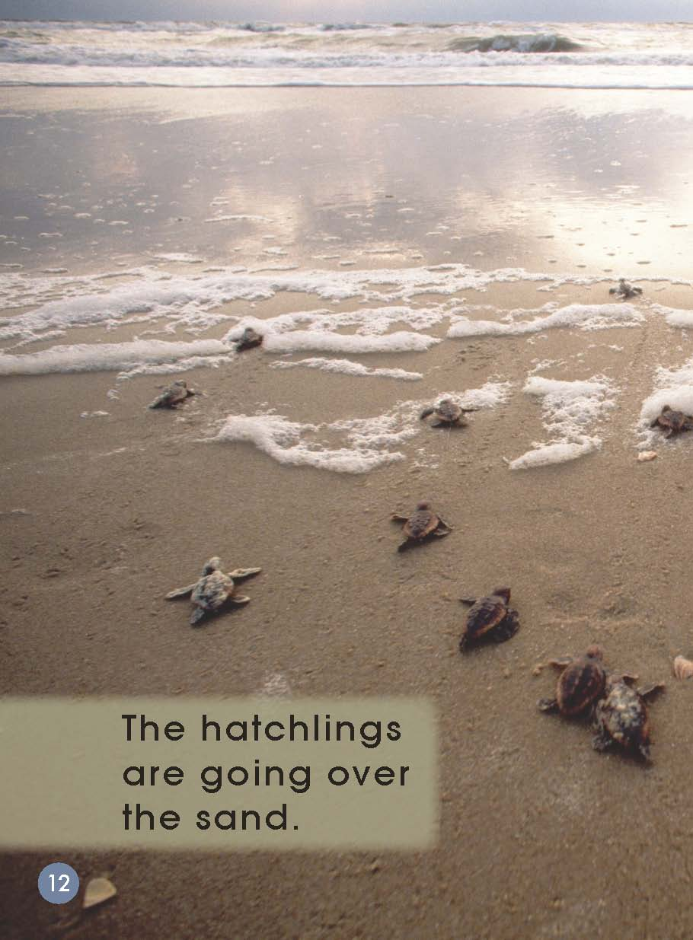
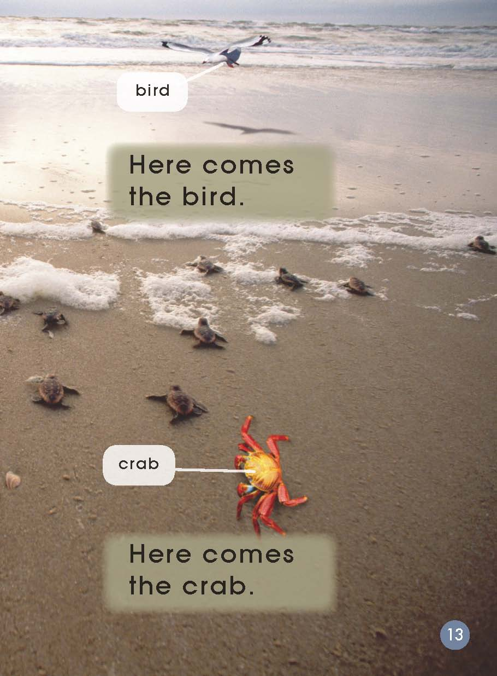
Why are the bird and the crab coming?
What are the hatchlings doing?

Slide 10
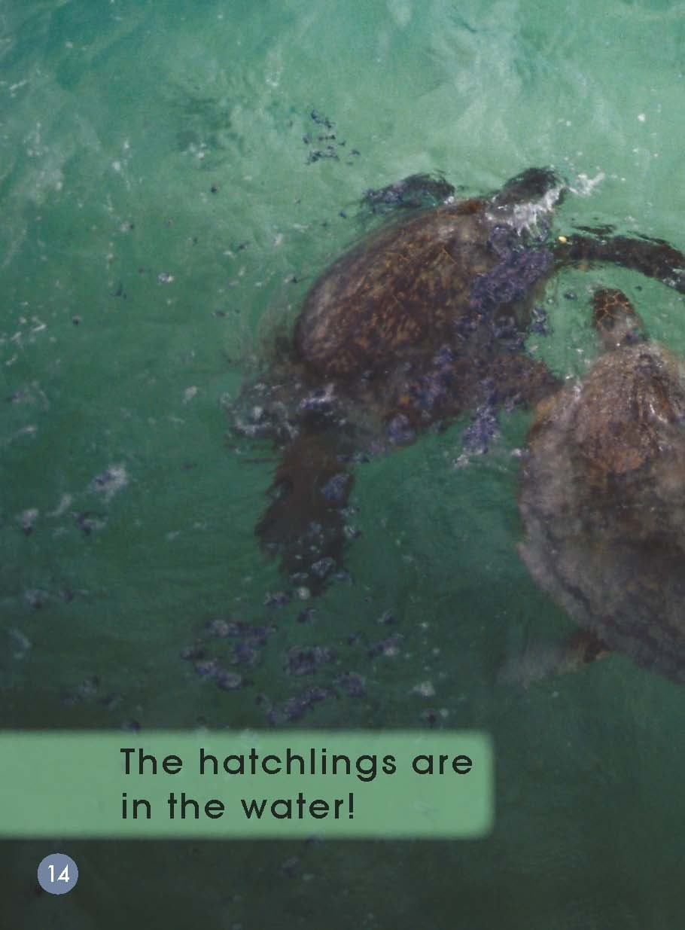
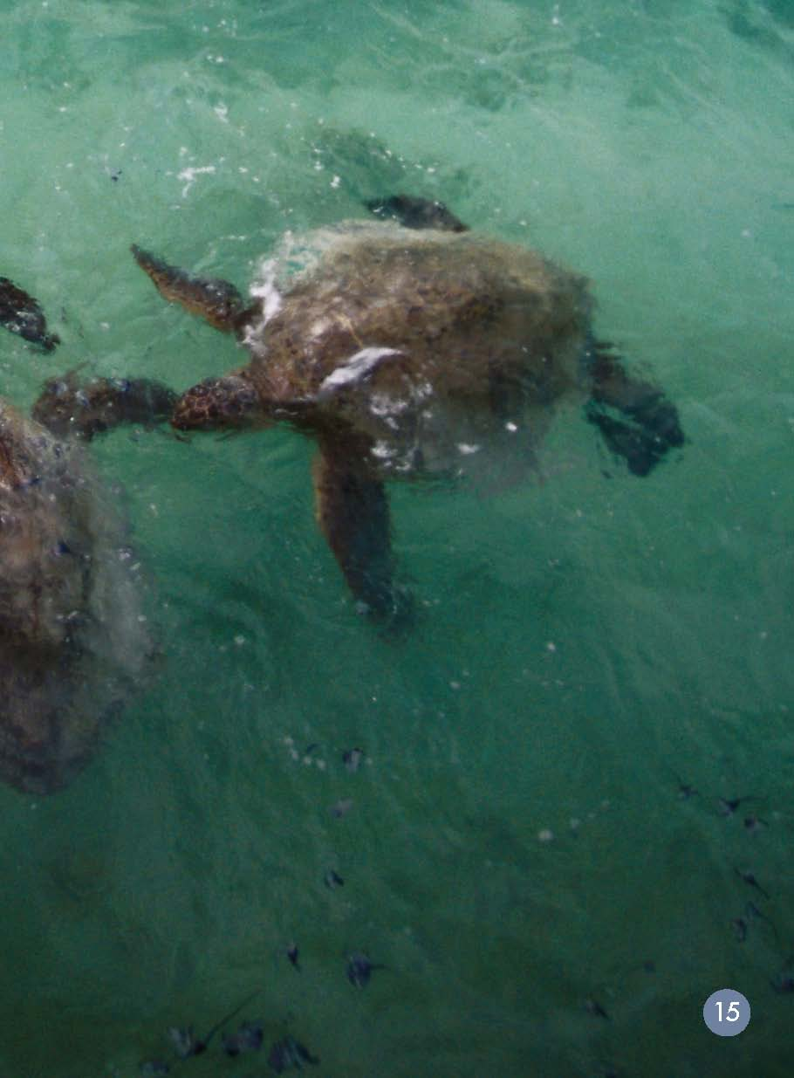
Where are the hatchlings now?

Slide 11
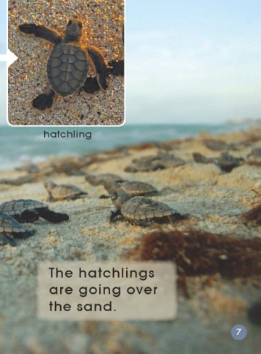
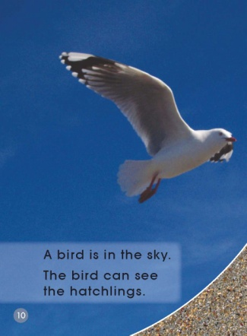
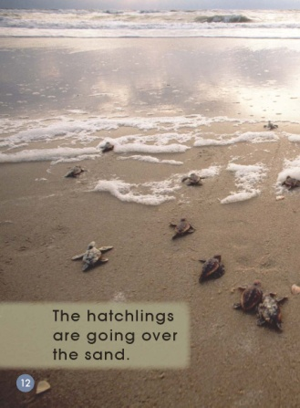
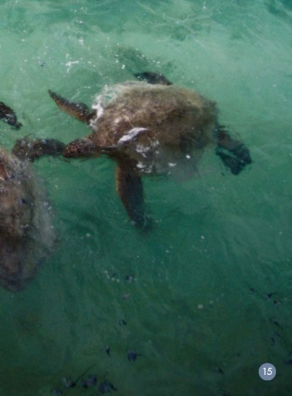
Let's listen and point.
Listen again and read after it.

Slide 12
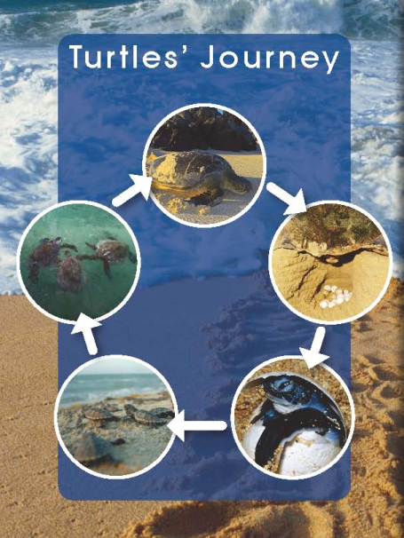
The title is The Turtle's Journey. What does the word journey mean?
A 旅行
B 一生
C 探险
D 成长

Slide 13
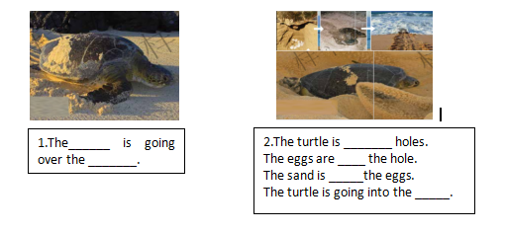
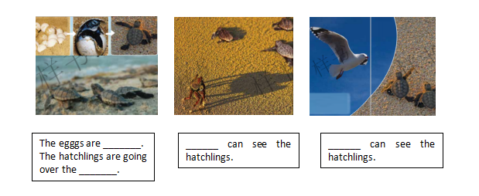
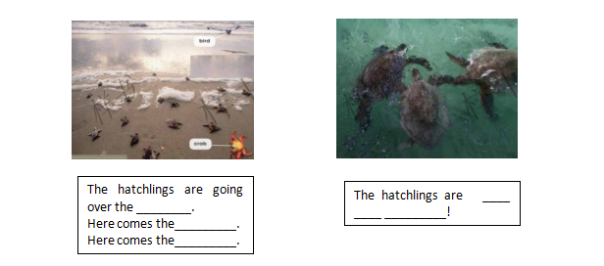
Please complete the diagram to show what happened in the story. Retell the story with your partner using the story map.

Slide 14
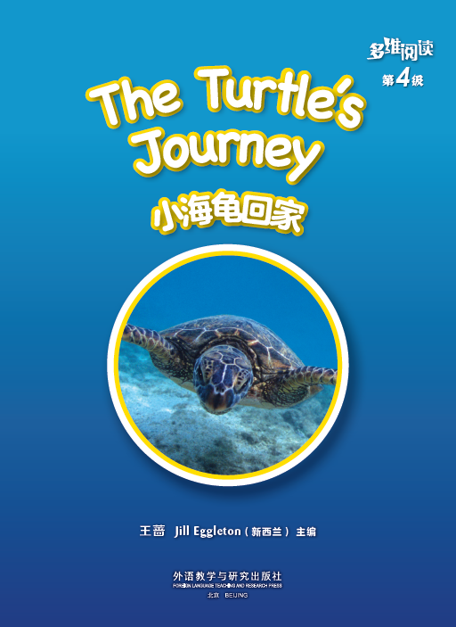
Let's read again and answer the questions.

Slide 15
Which word says going? How do you know?
Which words tell you where the turtle is going?

Slide 16
Read the sentence at the bottom. Which words tell you where the turtle is going?

Slide 17
Which word says hatchling? How do you know?

Slide 18
Which word says crab? What are the first two sounds you can hear in crab?

Slide 20
Which word say comes?
What does the s sound like in comes?
Which word says hatchlings?
What does the s sound like in hatchlings?

Slide 22
Talk in pairs.
Why do the hatchlings have to go into the sea?
What do you think of the turtle’s journey? Why?
What other difficulties are they going to meet?
Can we help them? How?

Slide 23
Talk in pairs: What are they going to say?
The bird: _________.
Act it out with your partner.
The hatchlings: _________.
The crab: _________.

Slide 24
Let's retell the story again:

Slide 25
Homework
学生从老师布置的两个个作业中任选一项并完成。
课后和小组成员一起利用网络或者图书馆
查询资料，了解海龟在回归大海后的生命历程，选择相应的方式进行汇报。
2. 学生与小组成员合作，制作一幅海报，仿
照本课问题，介绍另一种和有相似生命历程
的动物，在全班进行展示。

