Slide 1
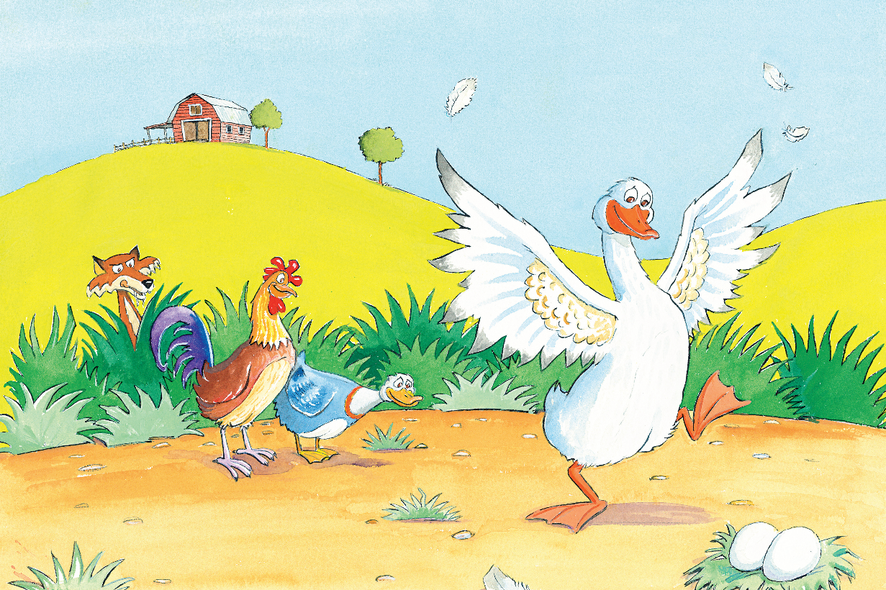
多维英语第4级
Tricky Goose

Slide 2
Sing a song.

Slide 3
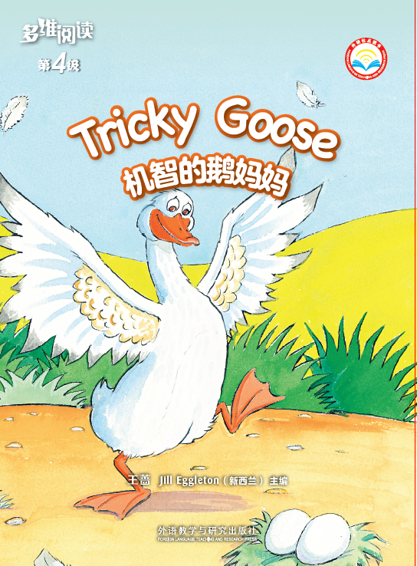
Read and guess.
1. What can you see from the front cover? Where did the story happen?
2. What’s the title and what do you think the story is going to be about?

Slide 4
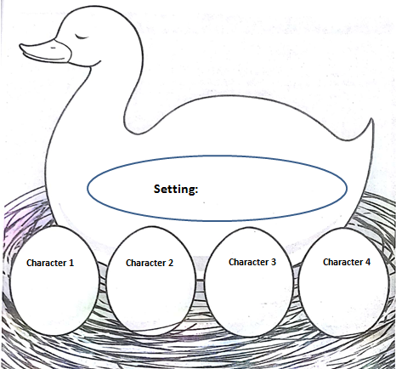
Read and Finish.

Slide 5
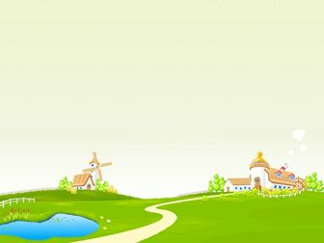
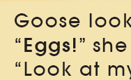
PP2-5
1 What do you think Fox might be thinking?
2.What were Duck and Rooster doing? Why were they acting like this?
3. How did Goose feel when she saw eggs?

Slide 6
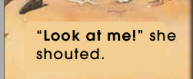
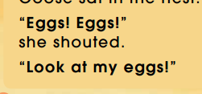
PP6-11

Slide 7
PP6-11
1. What was Fox doing?
2. How does Goose feel now?
3. What do you think the mud
monster is?
4. What do you think Duck and
Rooster are thinking?

Slide 8
PP12-15
1.When Fox saw the eggs, how did he feel? How do you know that?
2.How did Fox feel at last?

Slide 9
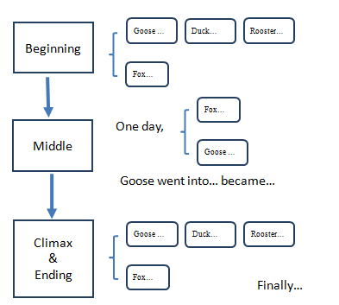
Read and Finish.

Slide 10
Read the story.

Slide 11
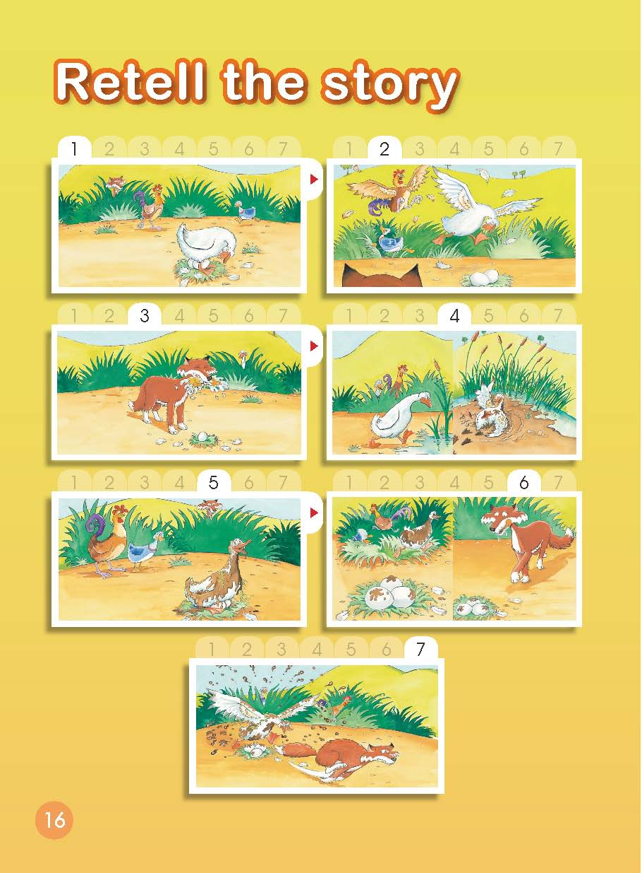
Retell the story

Slide 12
Think and say.
We know the eggs were eaten
by Fox. If you were Goose,
what should you do?
2. How did Fox feel at last? Do
you think he will come back again? Why or why not?
3. What do you think of Duck and Rooster?
4. What do you think of Goose?

Slide 13
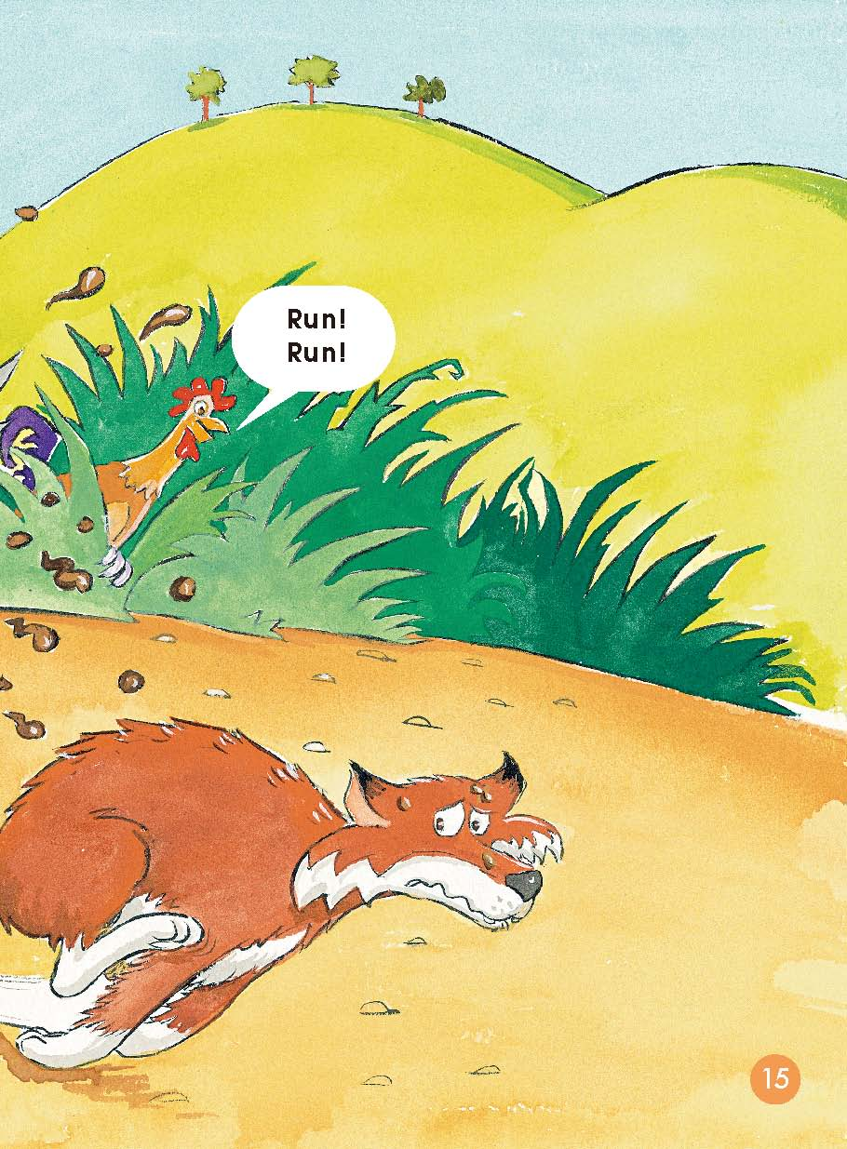
Write an ending.
What do you think of the ending of the story?
Can you write an ending for the story?

Slide 14
Think and discuss.
In the story, Goose was very tricky to protect her babies. In our daily life, when you meet some problems or troubles, how do you solve them?

Slide 15
Tell the story “Tricky Goose” to your parents.

