Slide 1
多维阅读第3级
Day and Night in the Desert

Slide 2
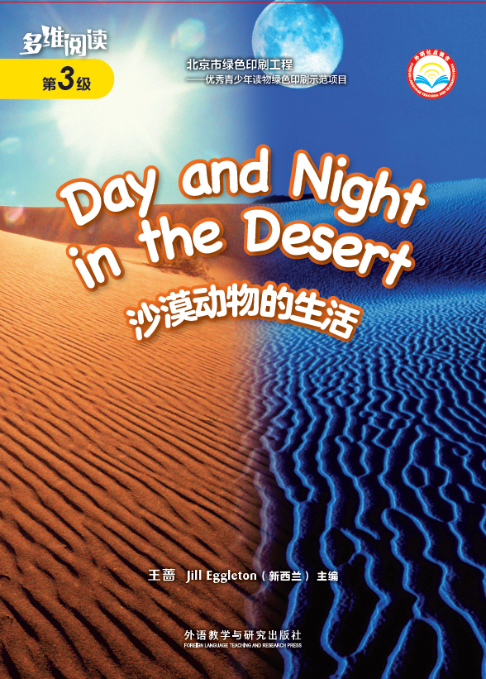
What’s the title of the book？
Who is the writer？

Slide 3
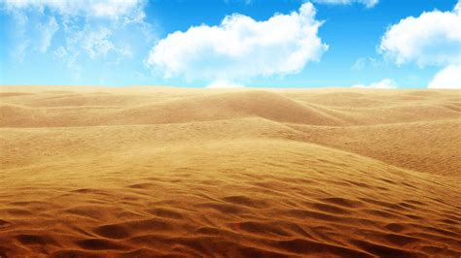

Slide 4
What do you think it would feel like
if you walked on this sand?
What’s the weather like in the desert?
Who lives in the desert?
desert

Slide 5
First Reading

Slide 6
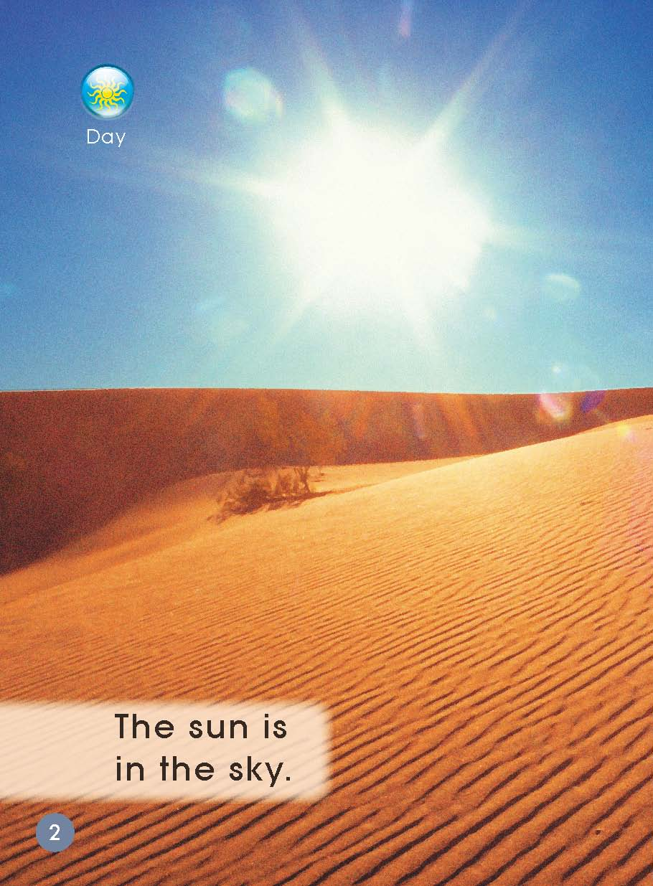
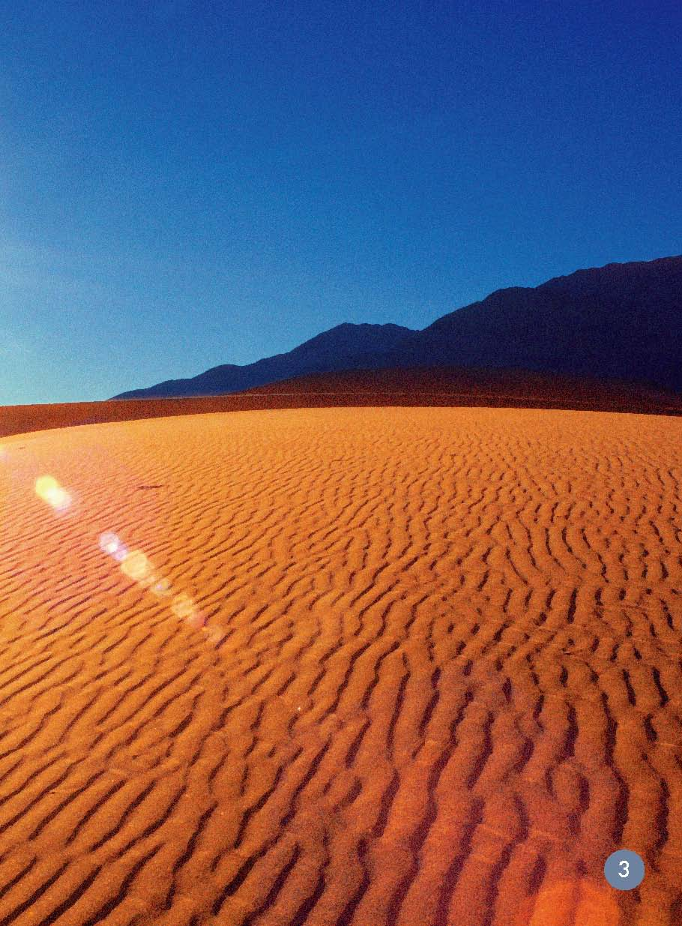
Second Reading
What can you see? How do you know it is daytime?
Do you think it is hot or cold in the desert in the daytime?

Slide 7
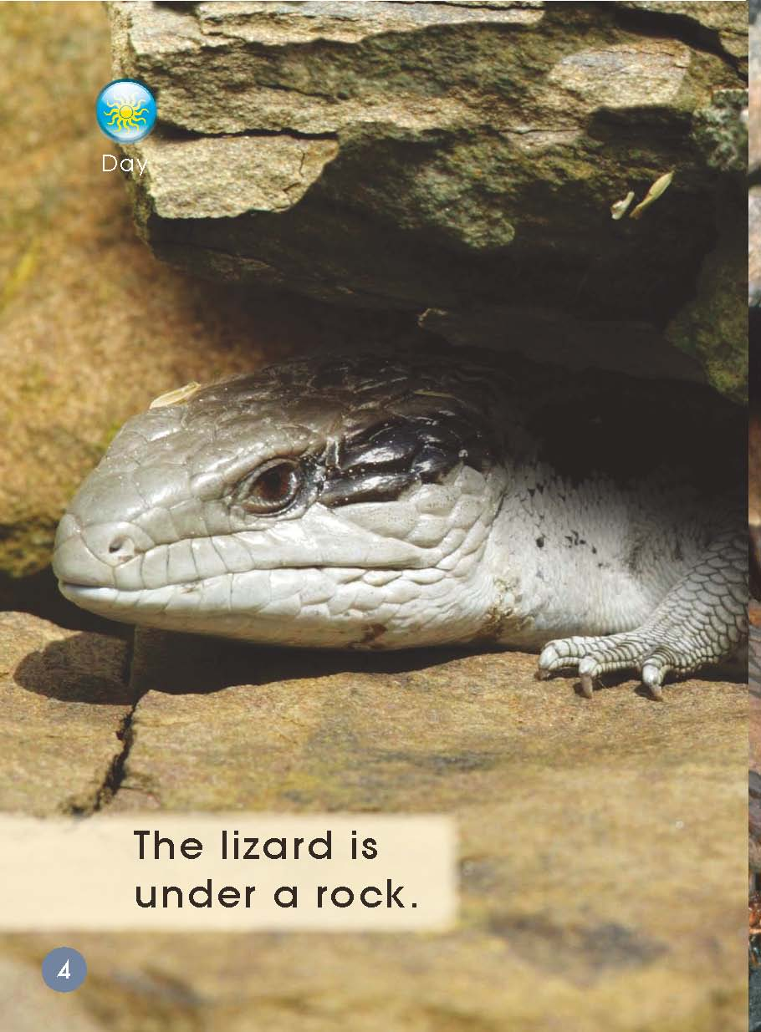
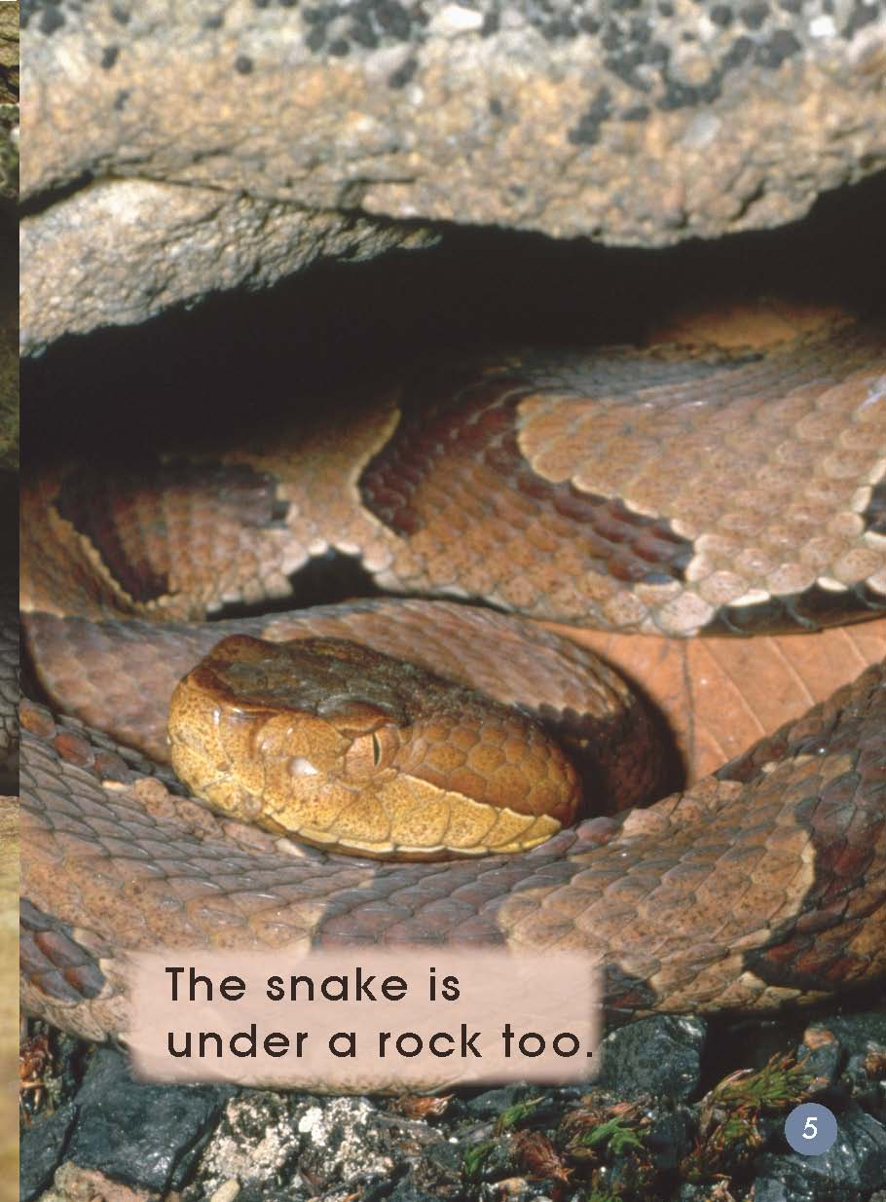
Why do you think they are in these places?
What animals can you see here? Where are they?

Slide 8
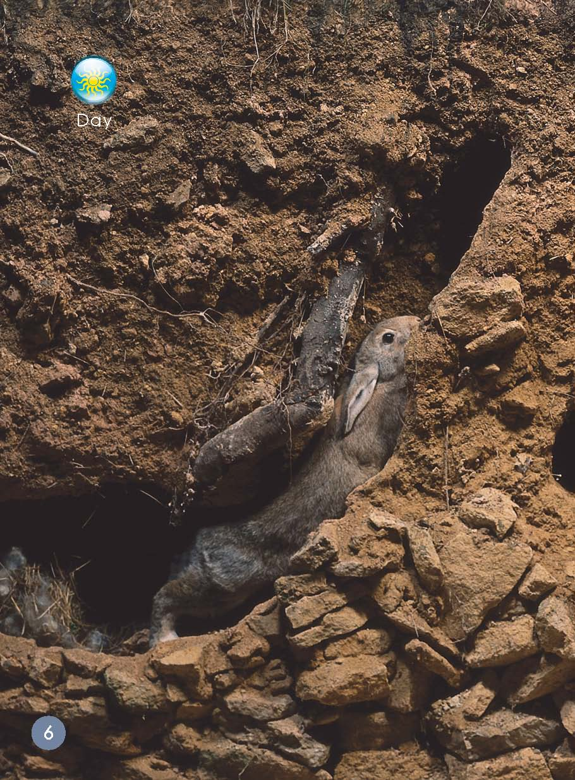
…
Where is the rabbit?
What might the rabbit say?

Slide 9
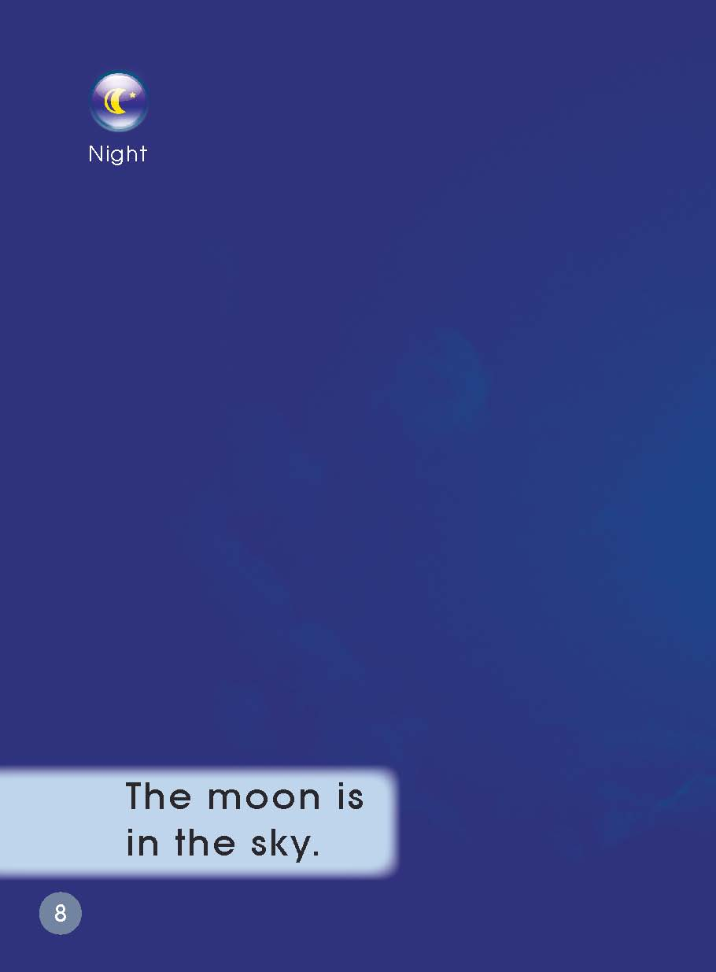
How do you know it is night?
What’s the different about the sky now?

Slide 10
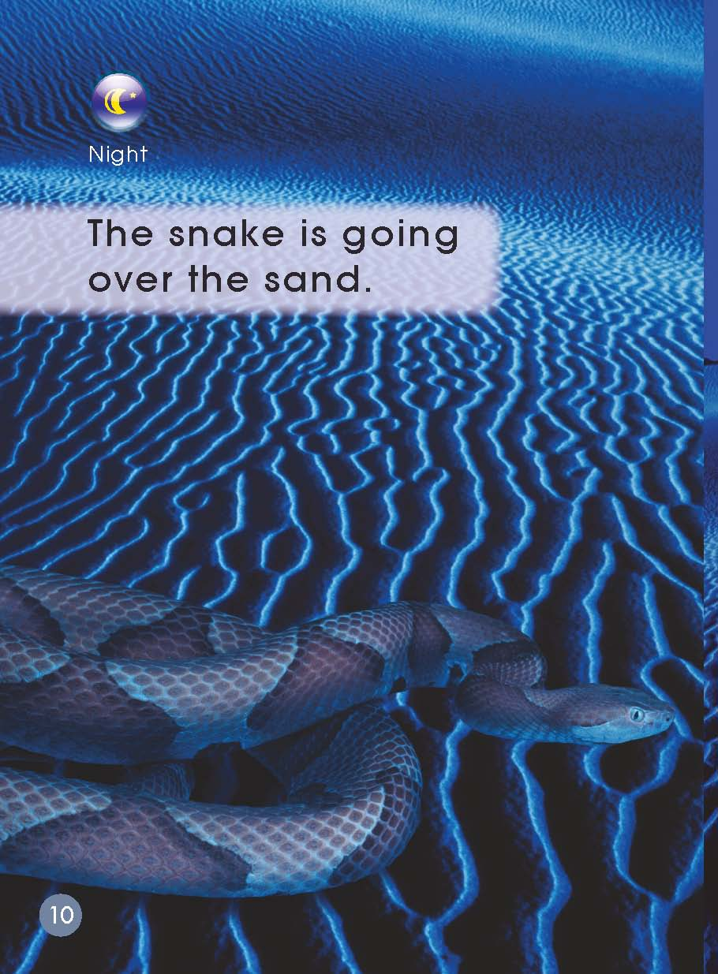
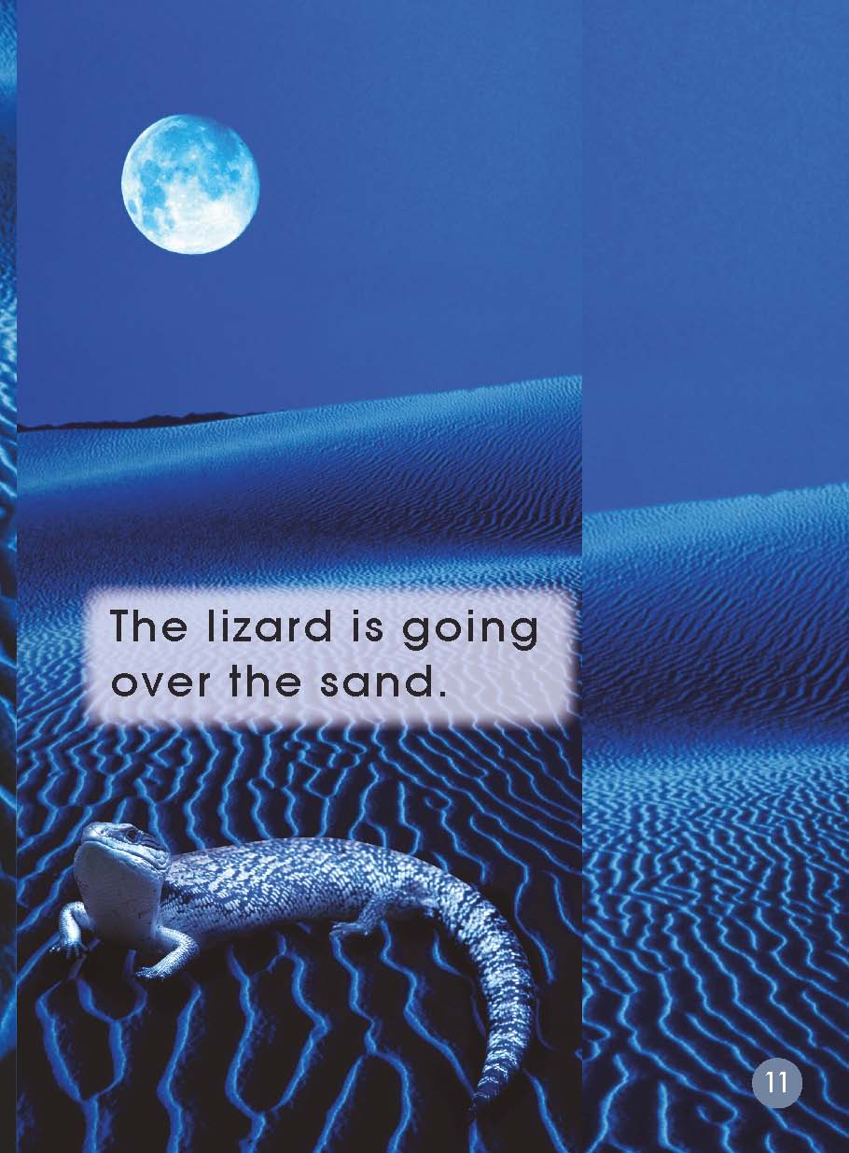
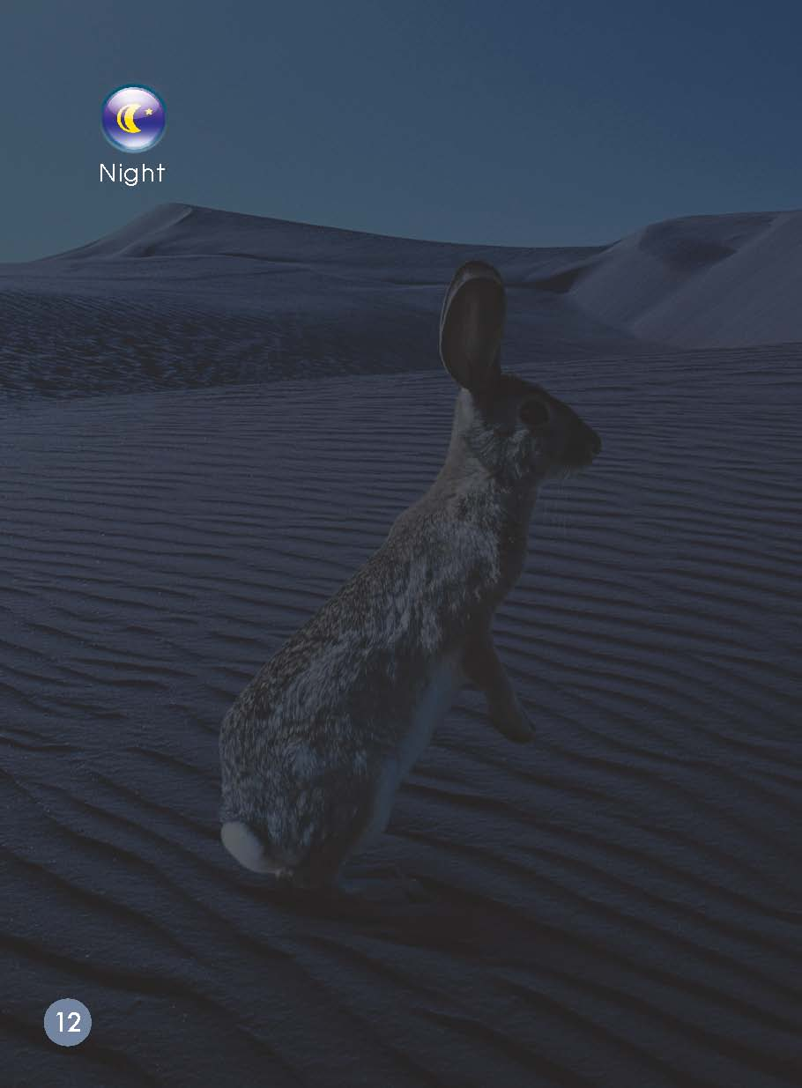
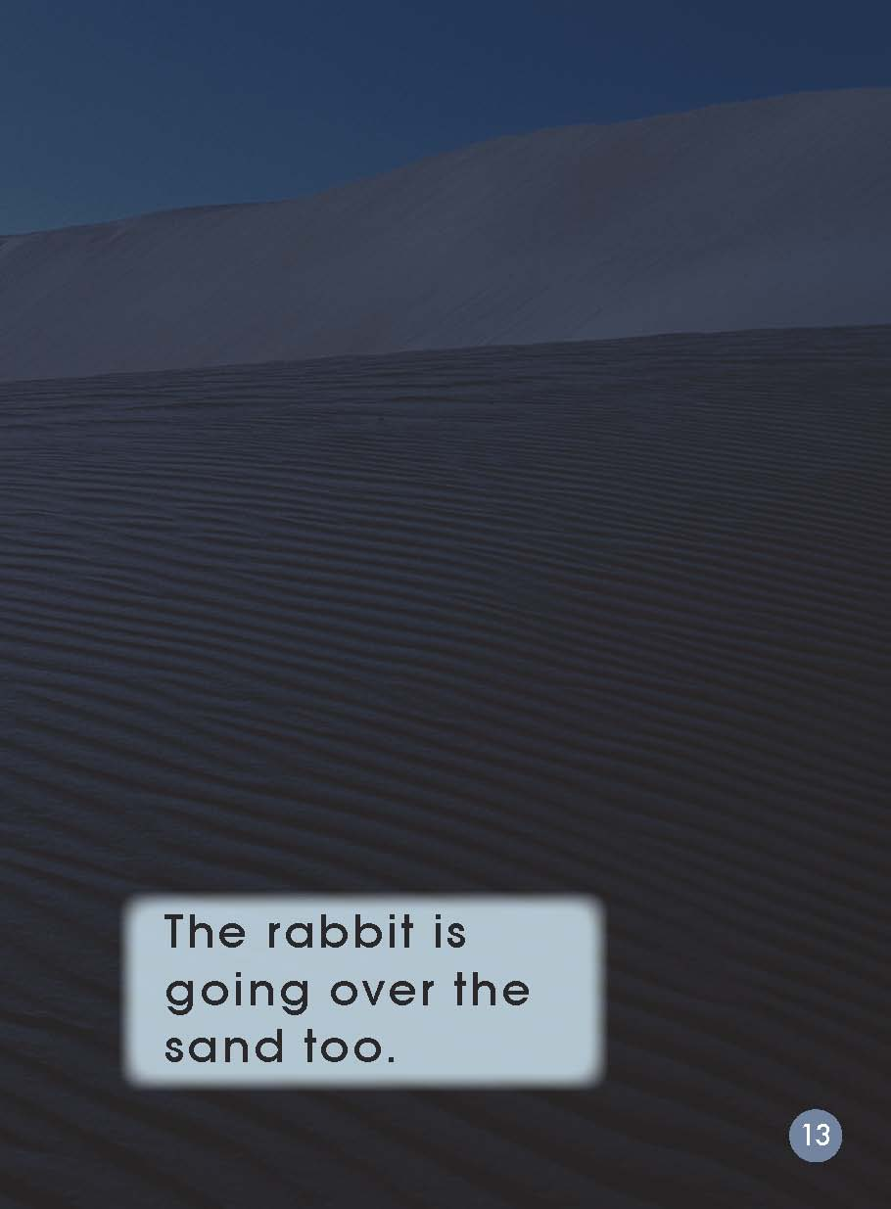
What are the lizard /snake /rabbit doing？
Where do you think it is going？
Why do they come out at night？

Slide 11
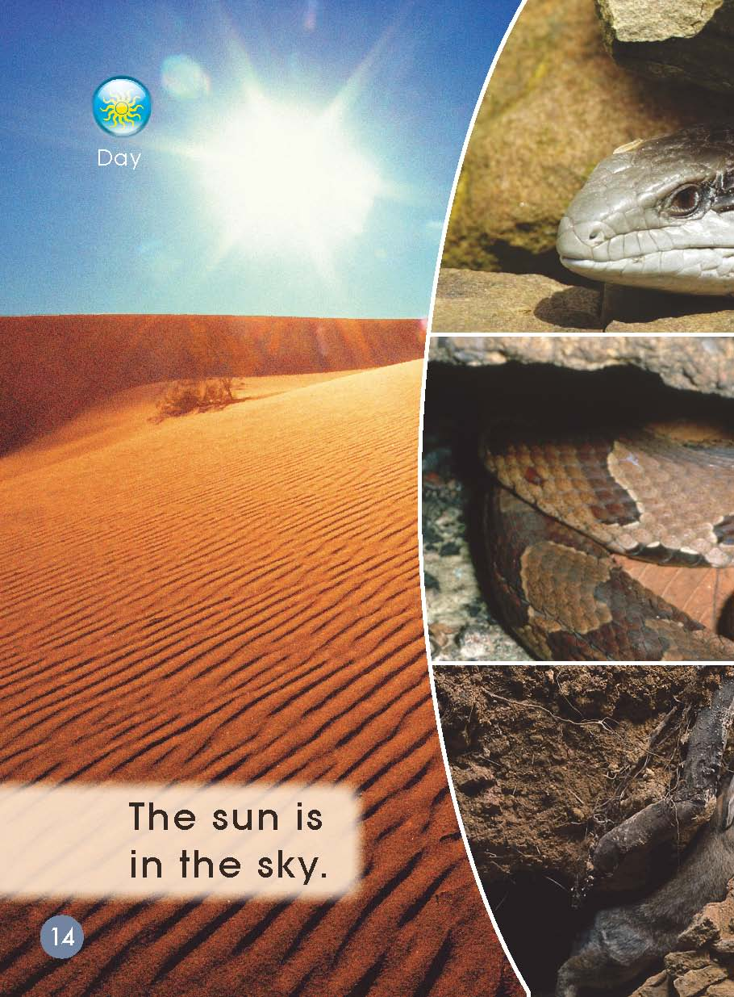
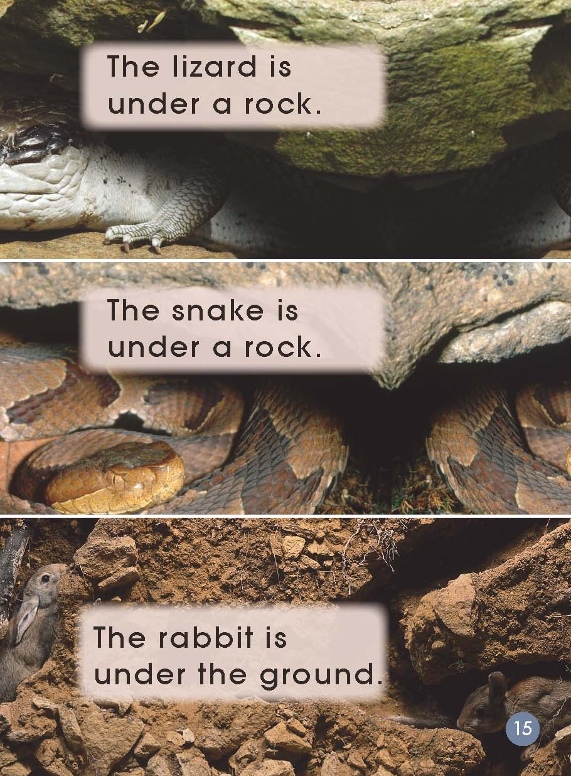
What can you see in the pictures?
Why are the animals back in these places?

Slide 12
Third Reading
Complete the story map to show what happened in the story.

Slide 13
sky

Slide 14
snake

Slide 15
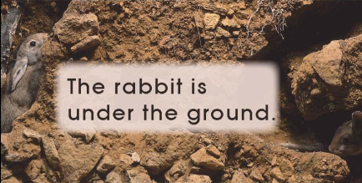
ground
grass

Slide 16
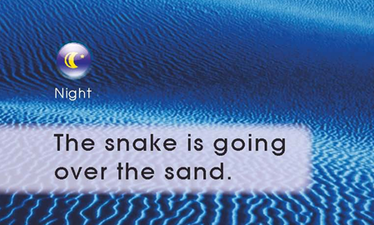
sand

Slide 17
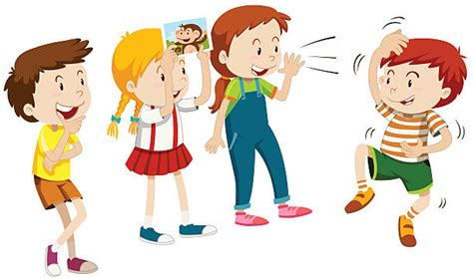
Act out the story!
表演故事

Slide 18
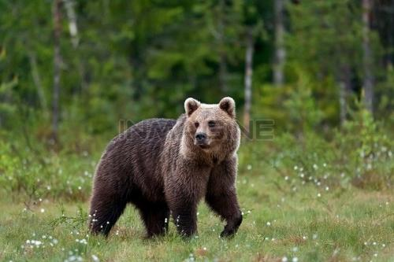
What do you do in the day?
What do you do at night?
The animal do different things during day and night. Why? What do you think of them?

Slide 19
Homework
Listen to the audio and read the story.
And tell the story to your parents.
Look for more information about
animals in the desert.
Make a new book.

