Slide 1
I Am Wet
好心办坏事
选自《多维阅读第2级》

Slide 2
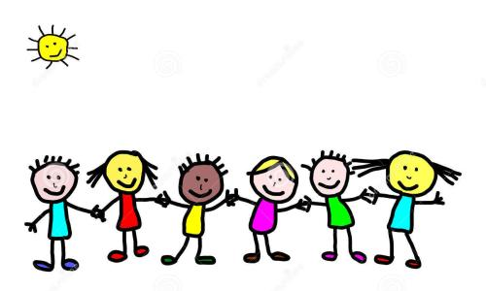
Listen and guess
Game Time
Notes:
Listen & Guess （听音猜物）
学生通过听动物的叫声来猜测动物。
提出问题：What animals do you hear?

Slide 3
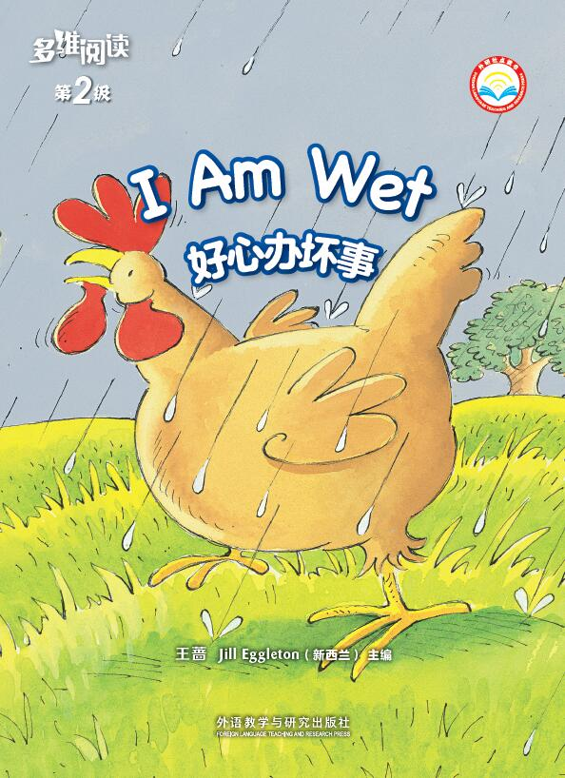
Look and say
What can you see from the cover?
What is the title?
What's the weather like on the cover?
Why does the title say “好心办坏事 ”?
Notes:
学生阅读书的封面并回答老师提出的问题。

Slide 4
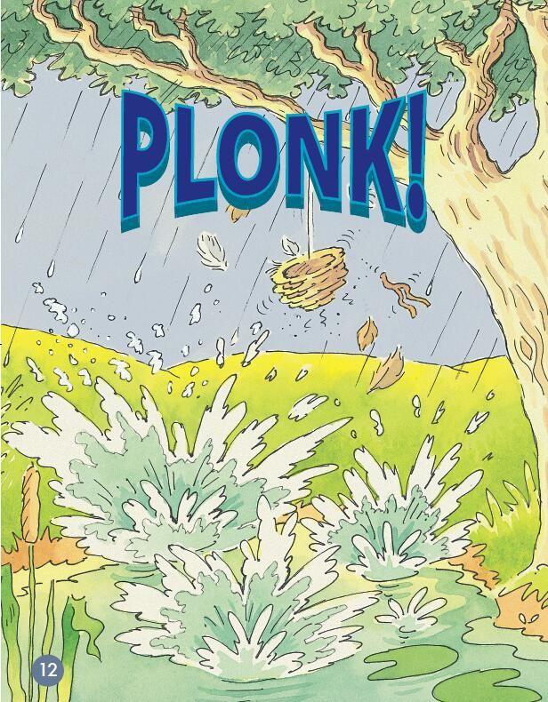
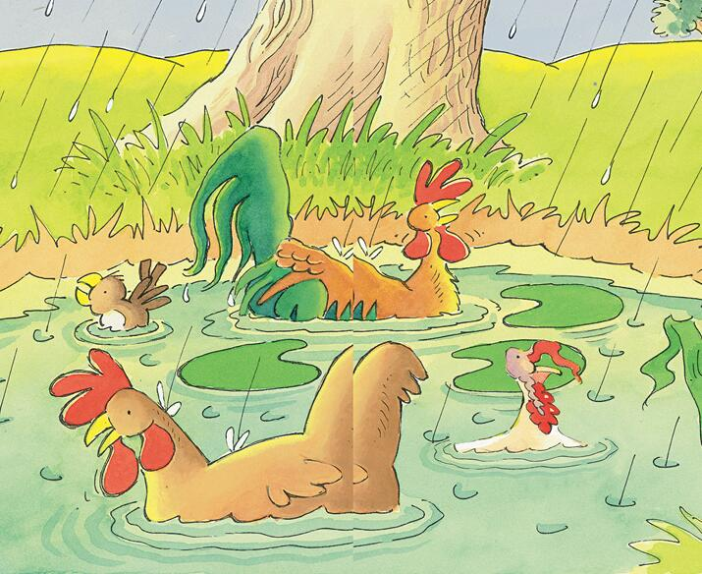
Look and predict
What animals can you see?
Why did the animals fall into the pond?

Slide 5
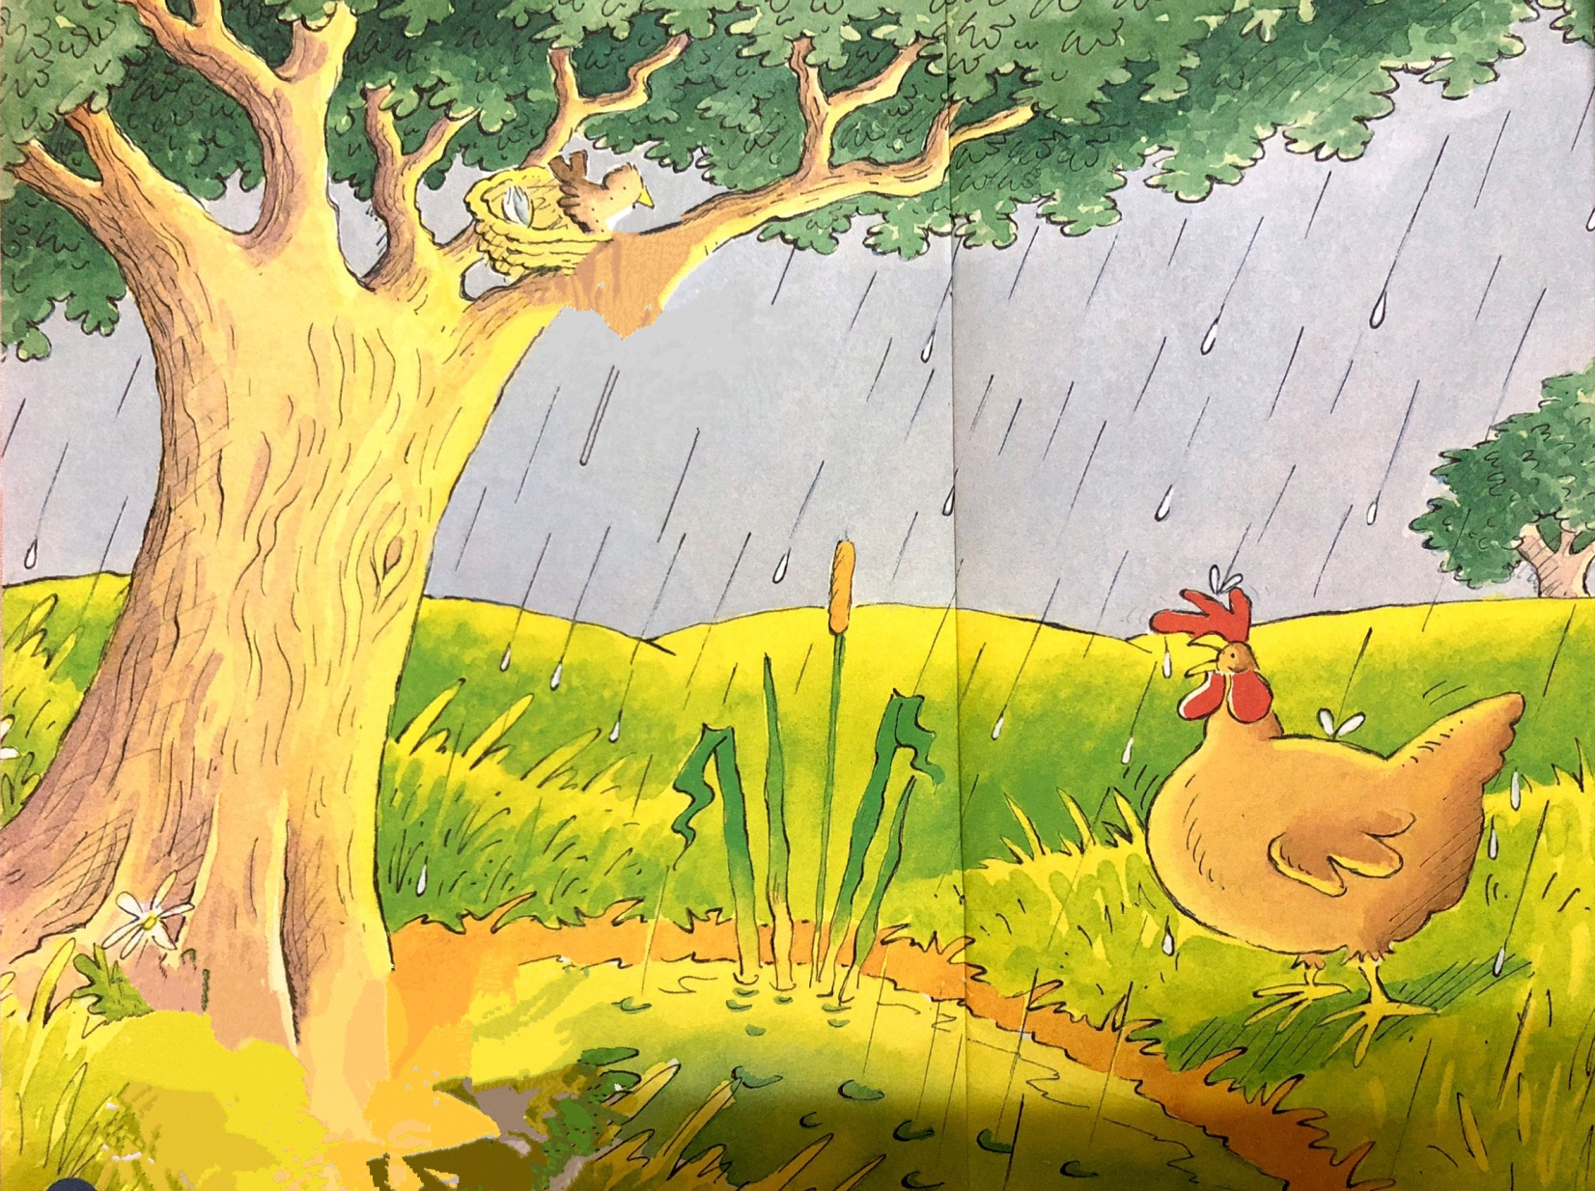
Picture walk
What do you think is wrong with the hen?
What do you think the bird is saying?
What could the hen have done to get out of the rain?

Slide 6
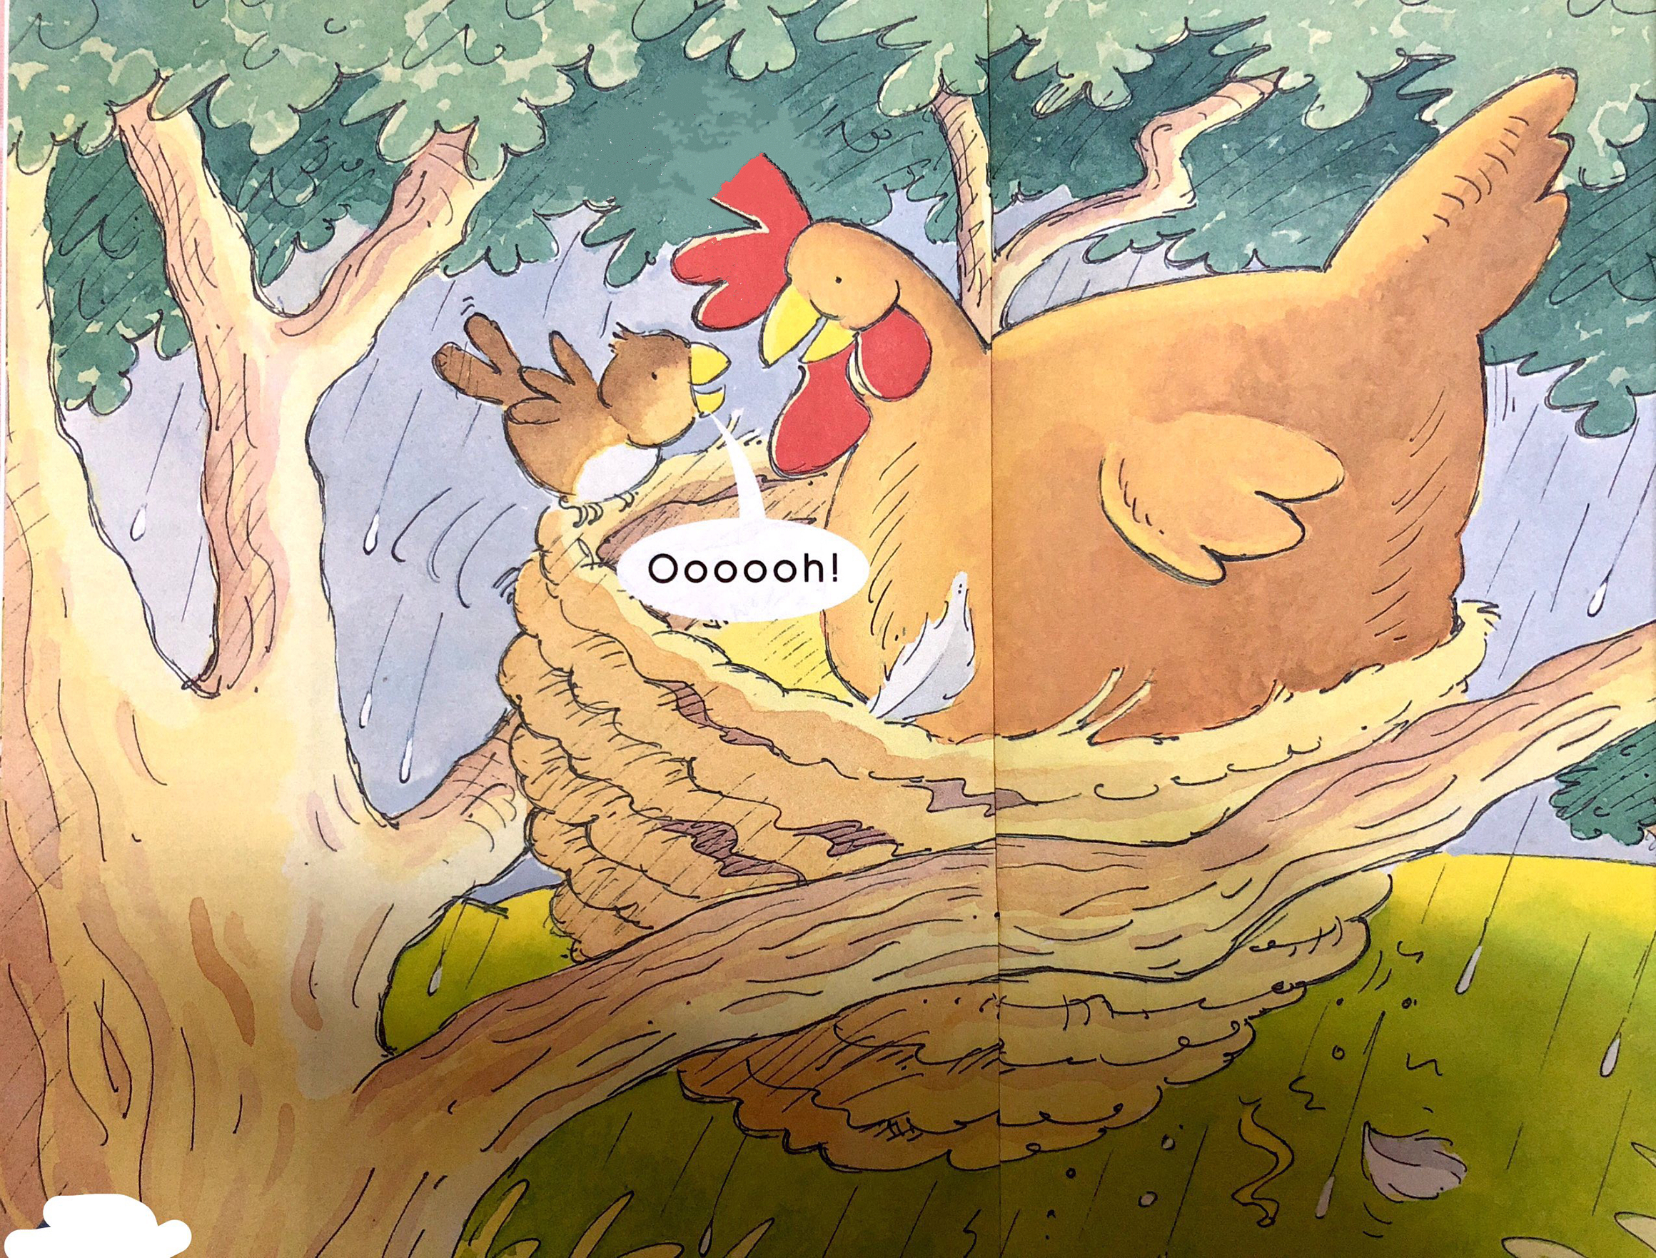
Picture walk
Where is the hen now?
The little bird is saying “Oooooh!”Why do you think it is saying that?
Do you think the hen should have got into the nest?
Why? Why not?

Slide 7
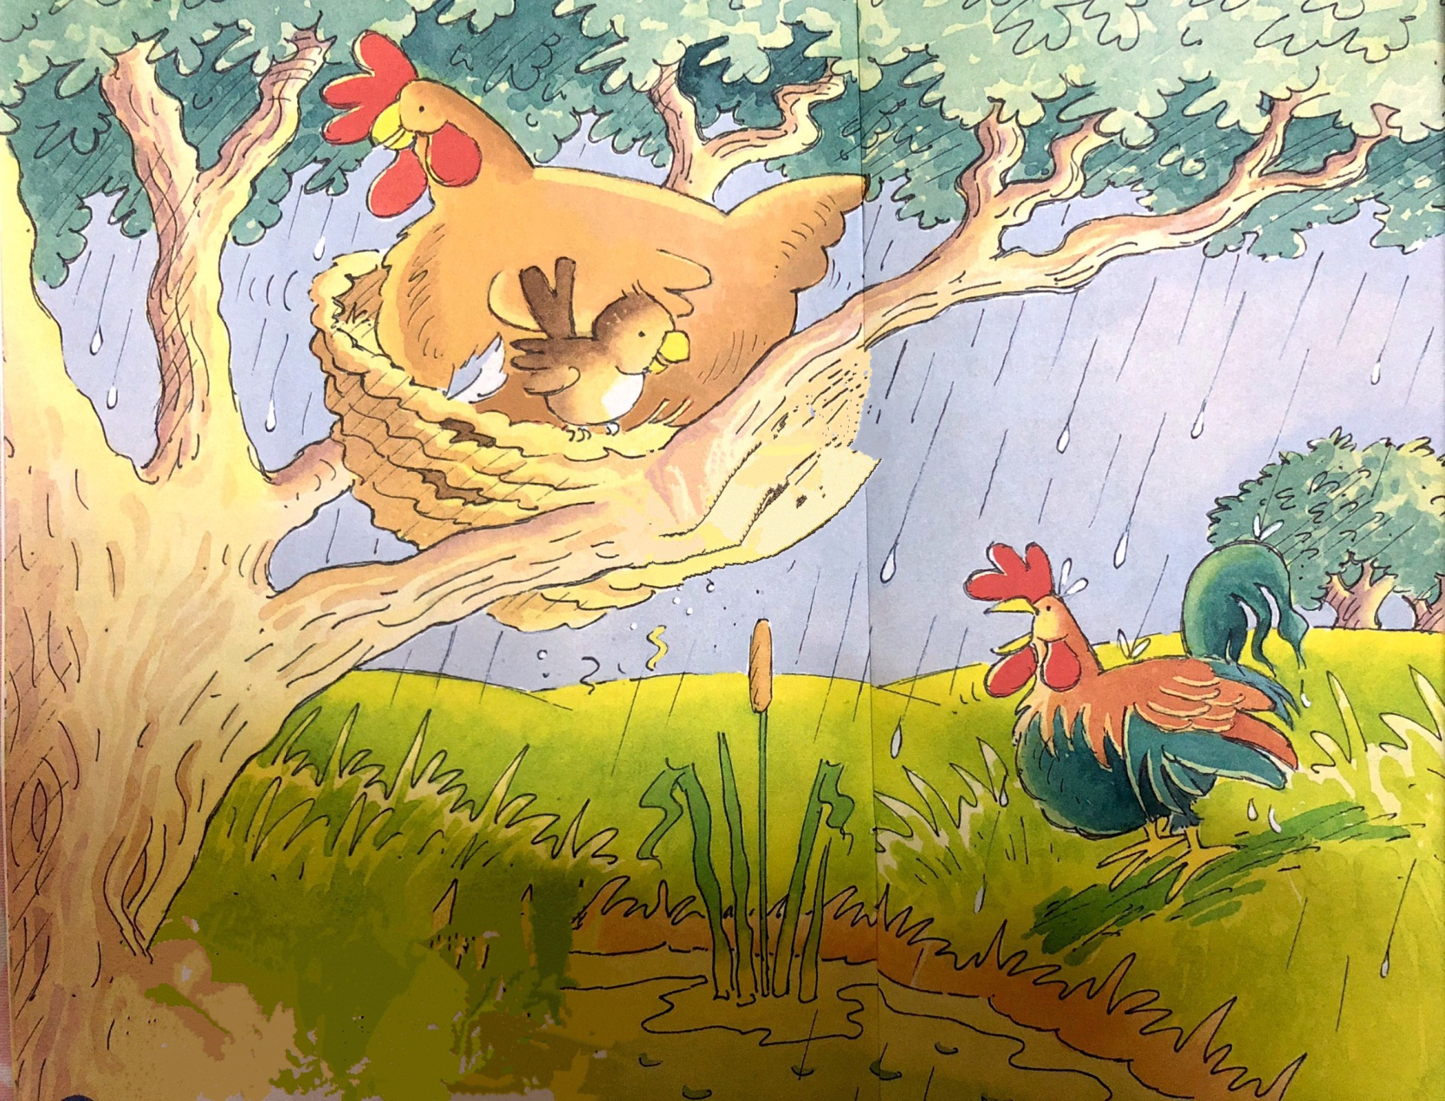
Picture Walk
Who is coming?
Rooster
Will the rooster go into the nest?
What question could you ask the rooster or hen?
You can use -How,When, Why, What, Where, Who?

Slide 8
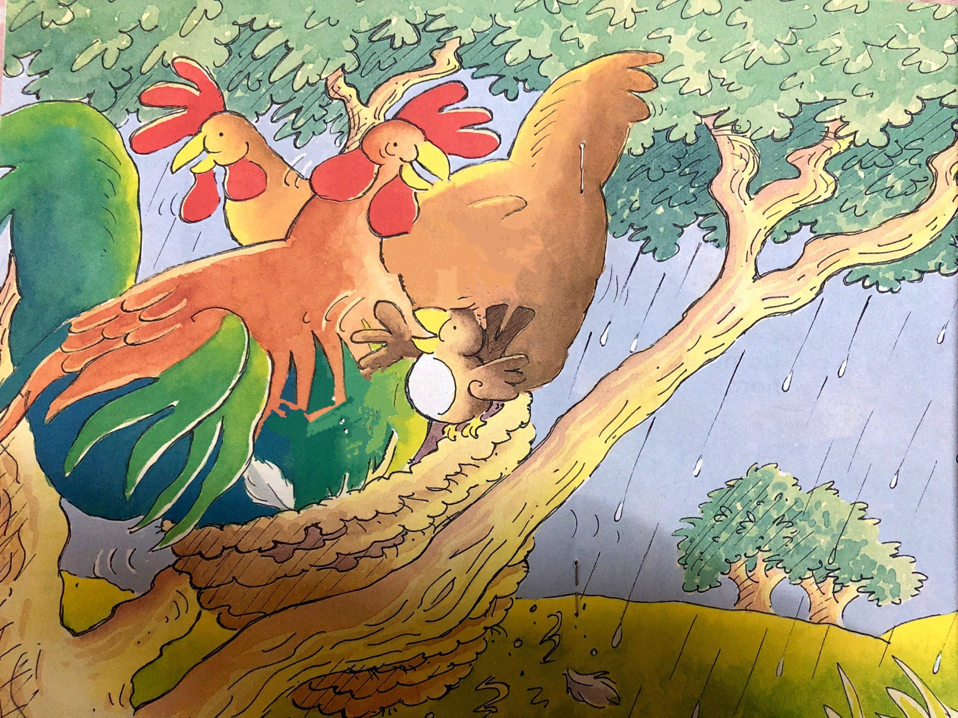
Picture walk
What is happening now?

Slide 9
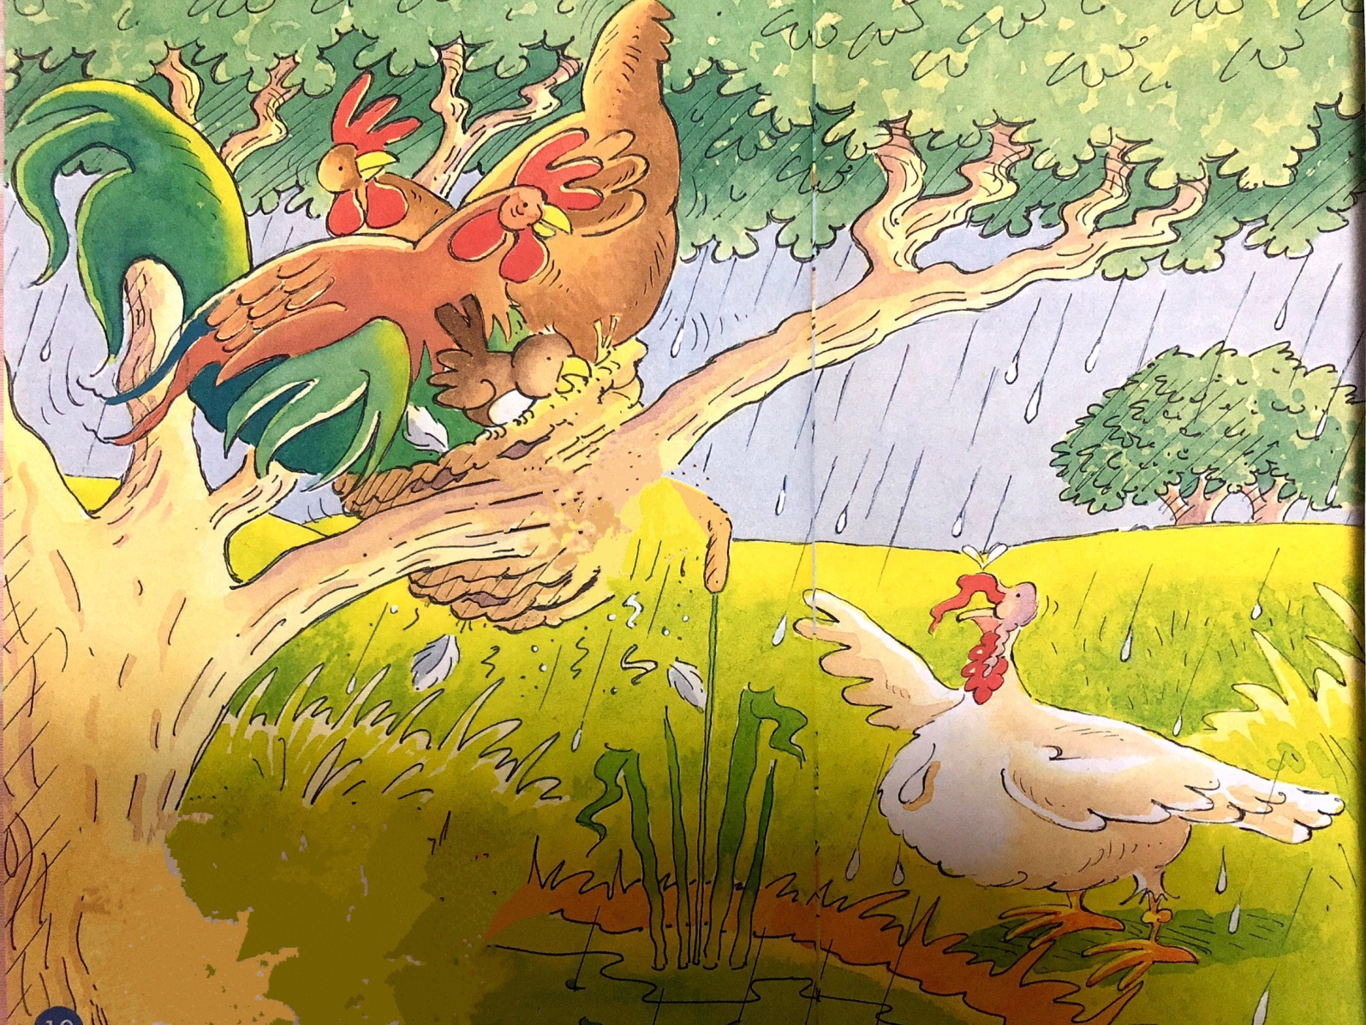
Picture walk
What new animal is in the picture now?
The bird is telling the turkey to come into the nest. Do you think the turkey should go into the nest?
Why? Why not?

Slide 10
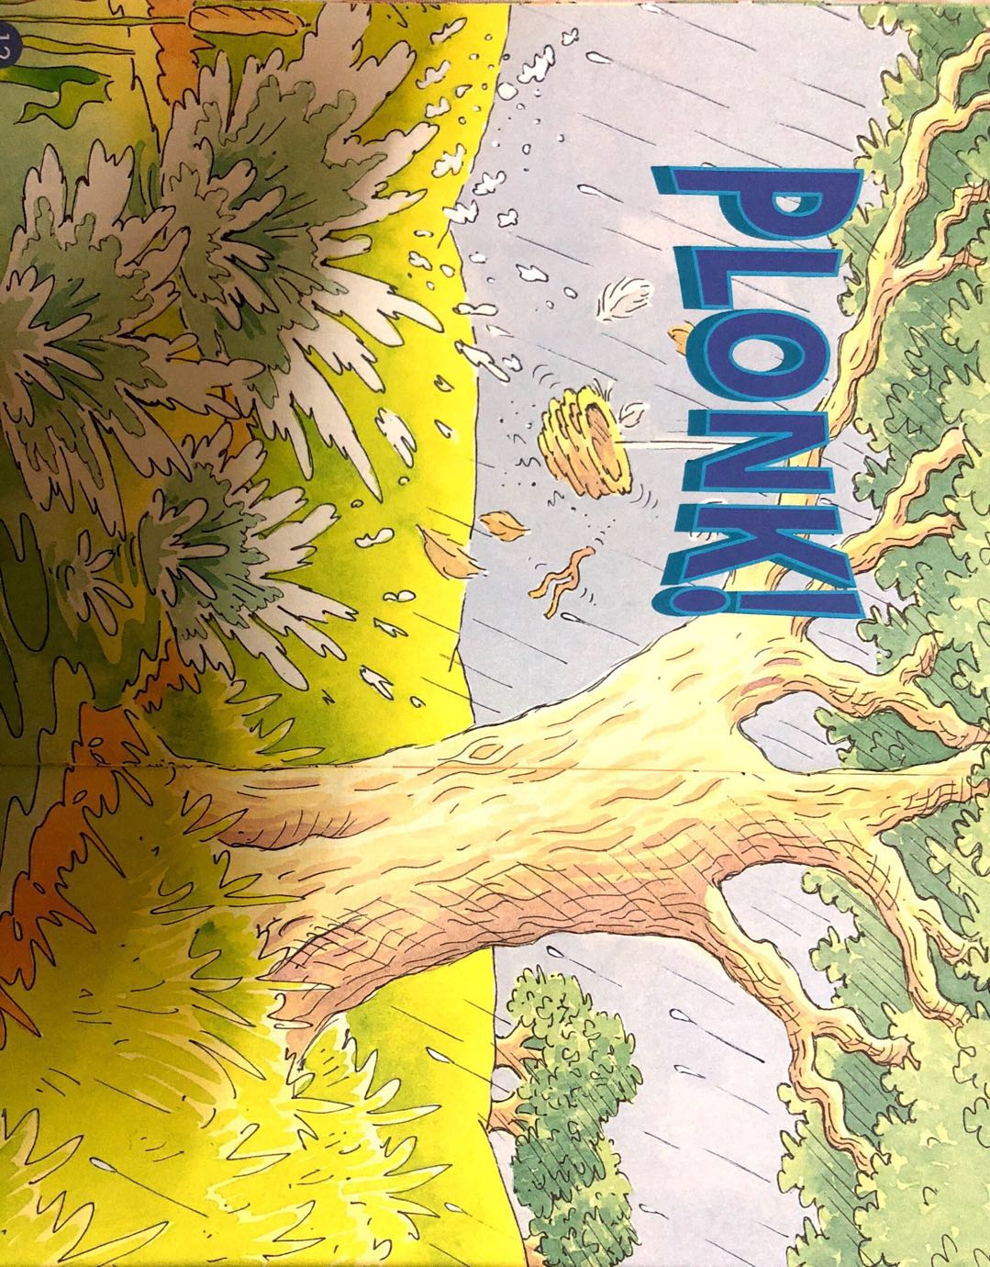
Picture walk
What has happened? Why?
What’s the problem?
What do you think might happen now?

Slide 11
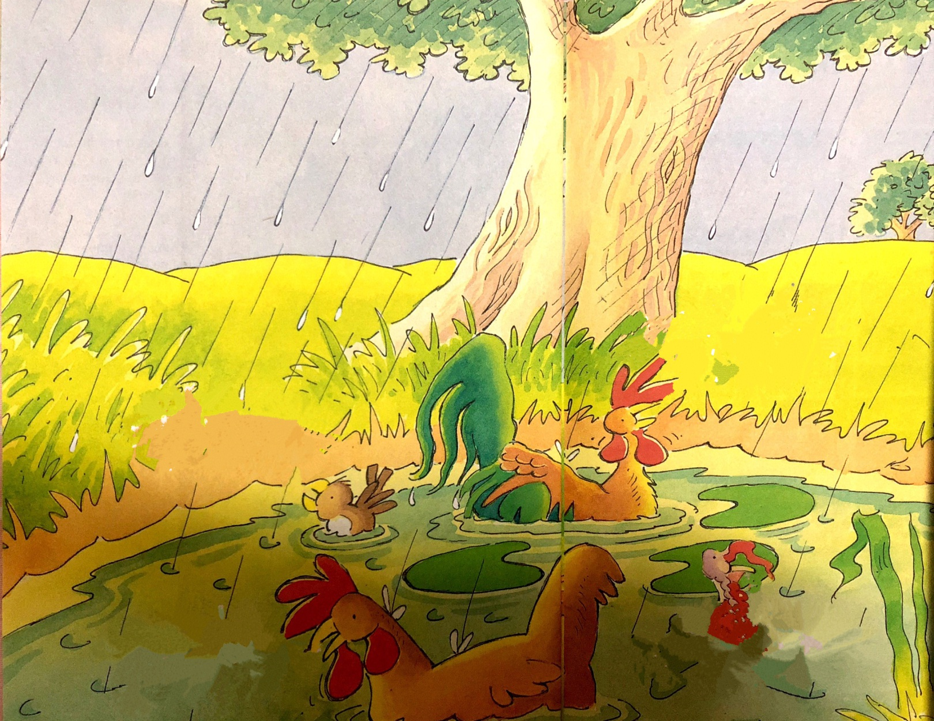
Picture walk
What do you think the animals will do now?
How do they feel?

Slide 12
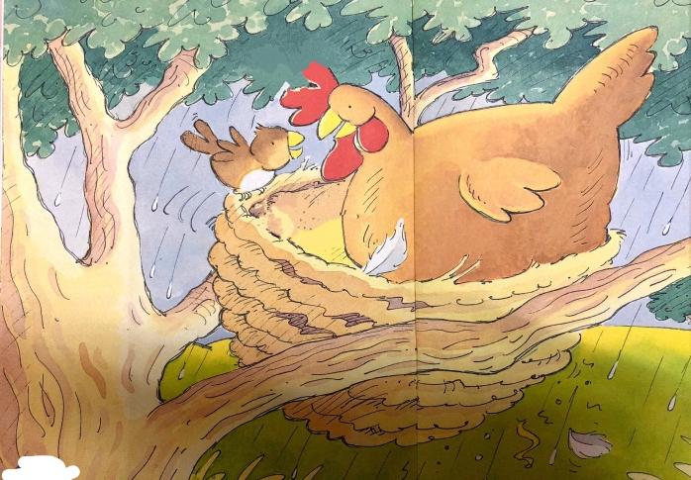
Think and stick
1
2
3
4
5
6
7
Notes:
Think & stick
使用建议：
1.根据故事发展的过程变化，在相应的位置贴出相对应的绘本图片。
2.根据实际情况以小组或个人形式进行。
此部分内容也可根据实际情况改编成Think & order (读图排序）

Slide 13
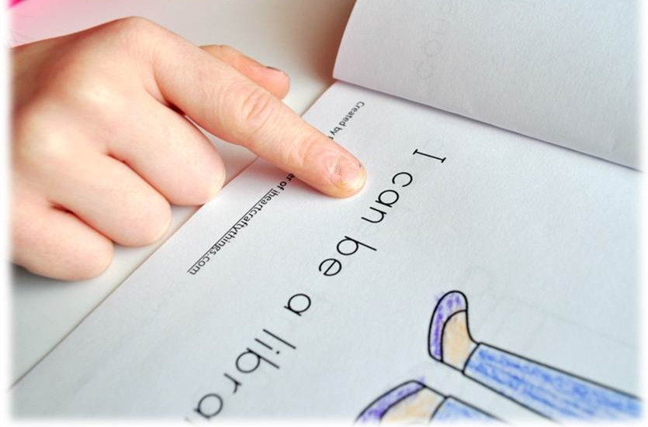
Read and find
Tips:
1. Point and read
2. Read the speech bubble

Slide 14
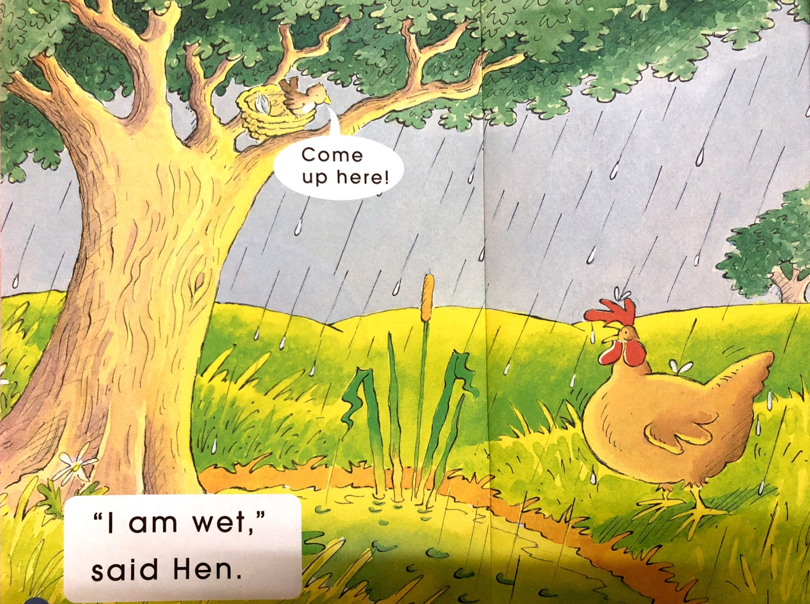
Do you know any of these words? Which ones?
What is the hen saying? How do you know? Read the sentence.

Slide 15
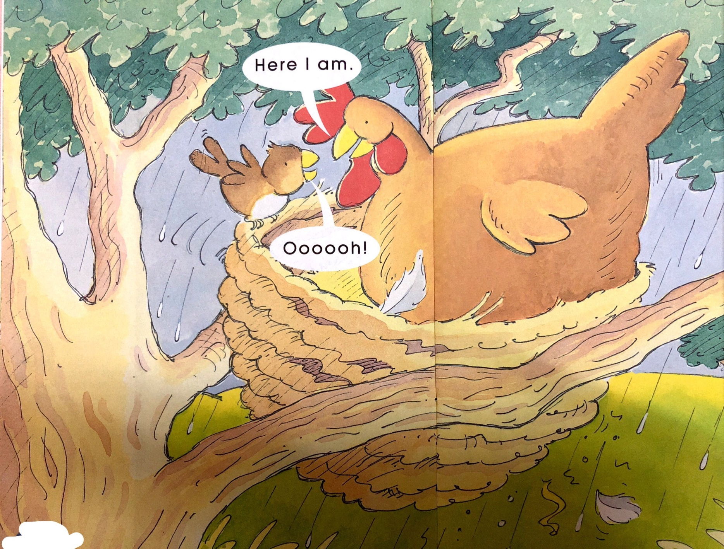
Read in the way the bird and hen may have said.

Slide 16
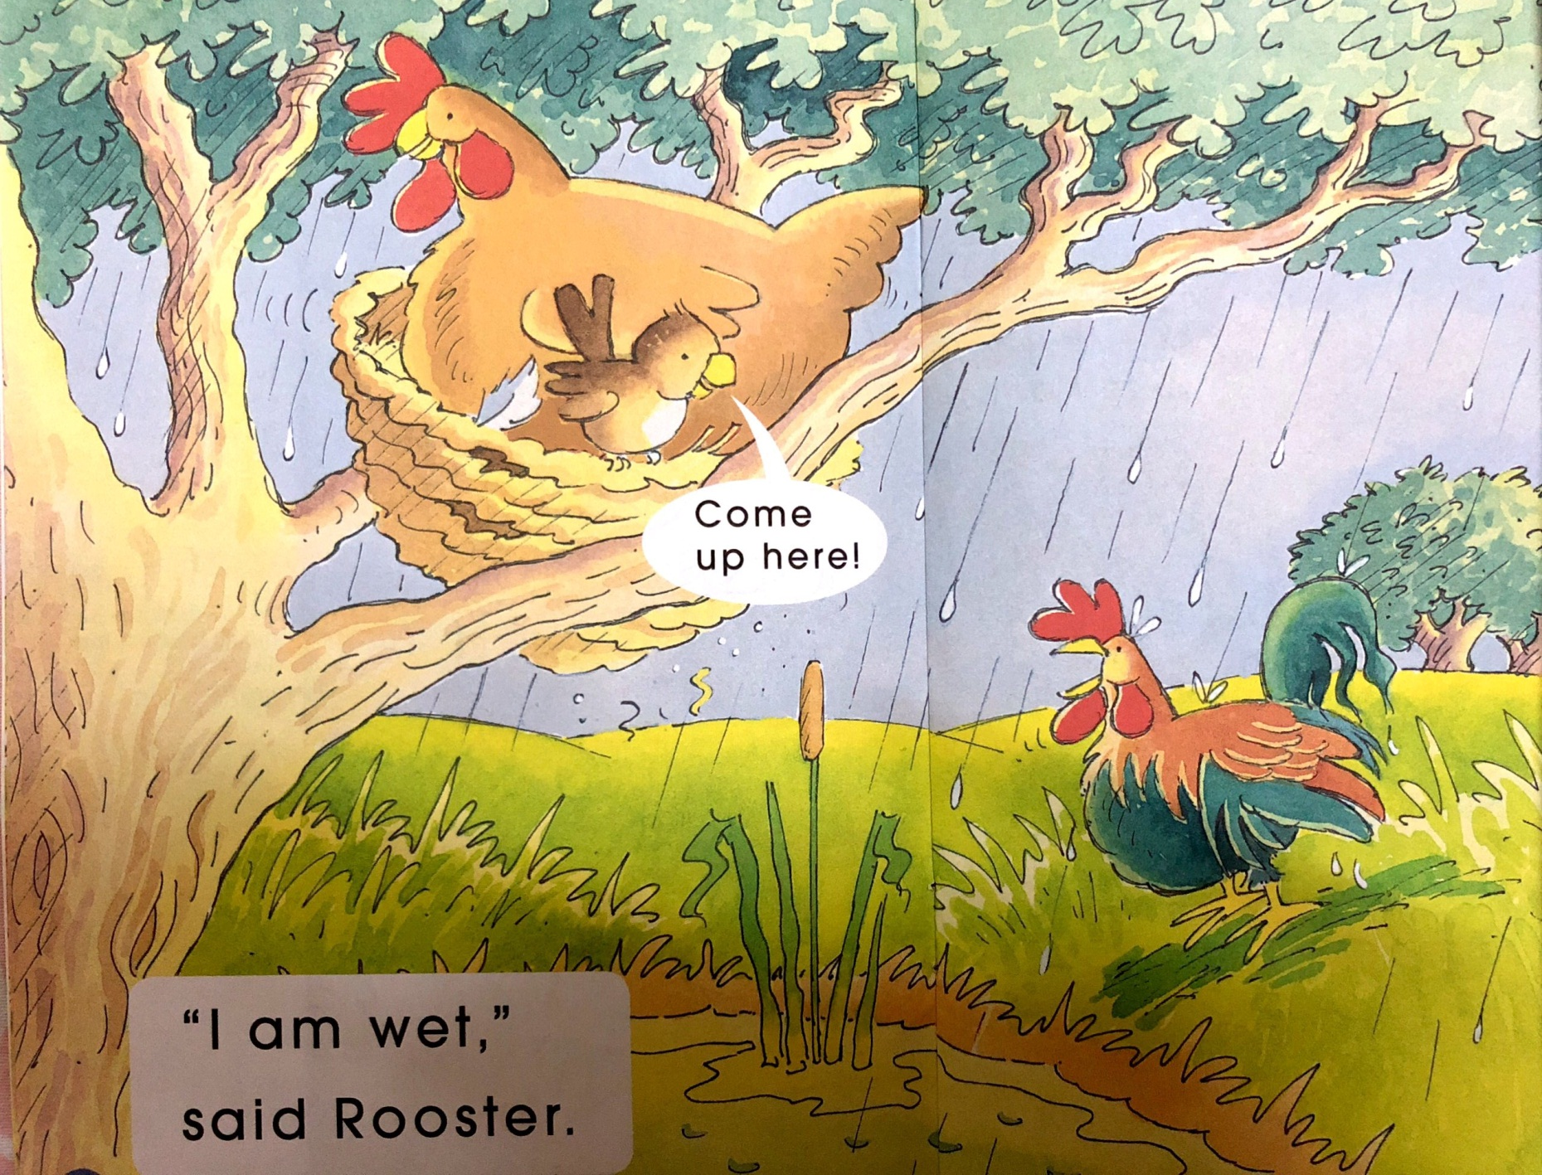
Which word says rooster?
The rooster is talking. How do you know?
Make a circle with your fingers around the speech marks.
Change your voice between the speech marks to sound like the rooster.

Slide 17
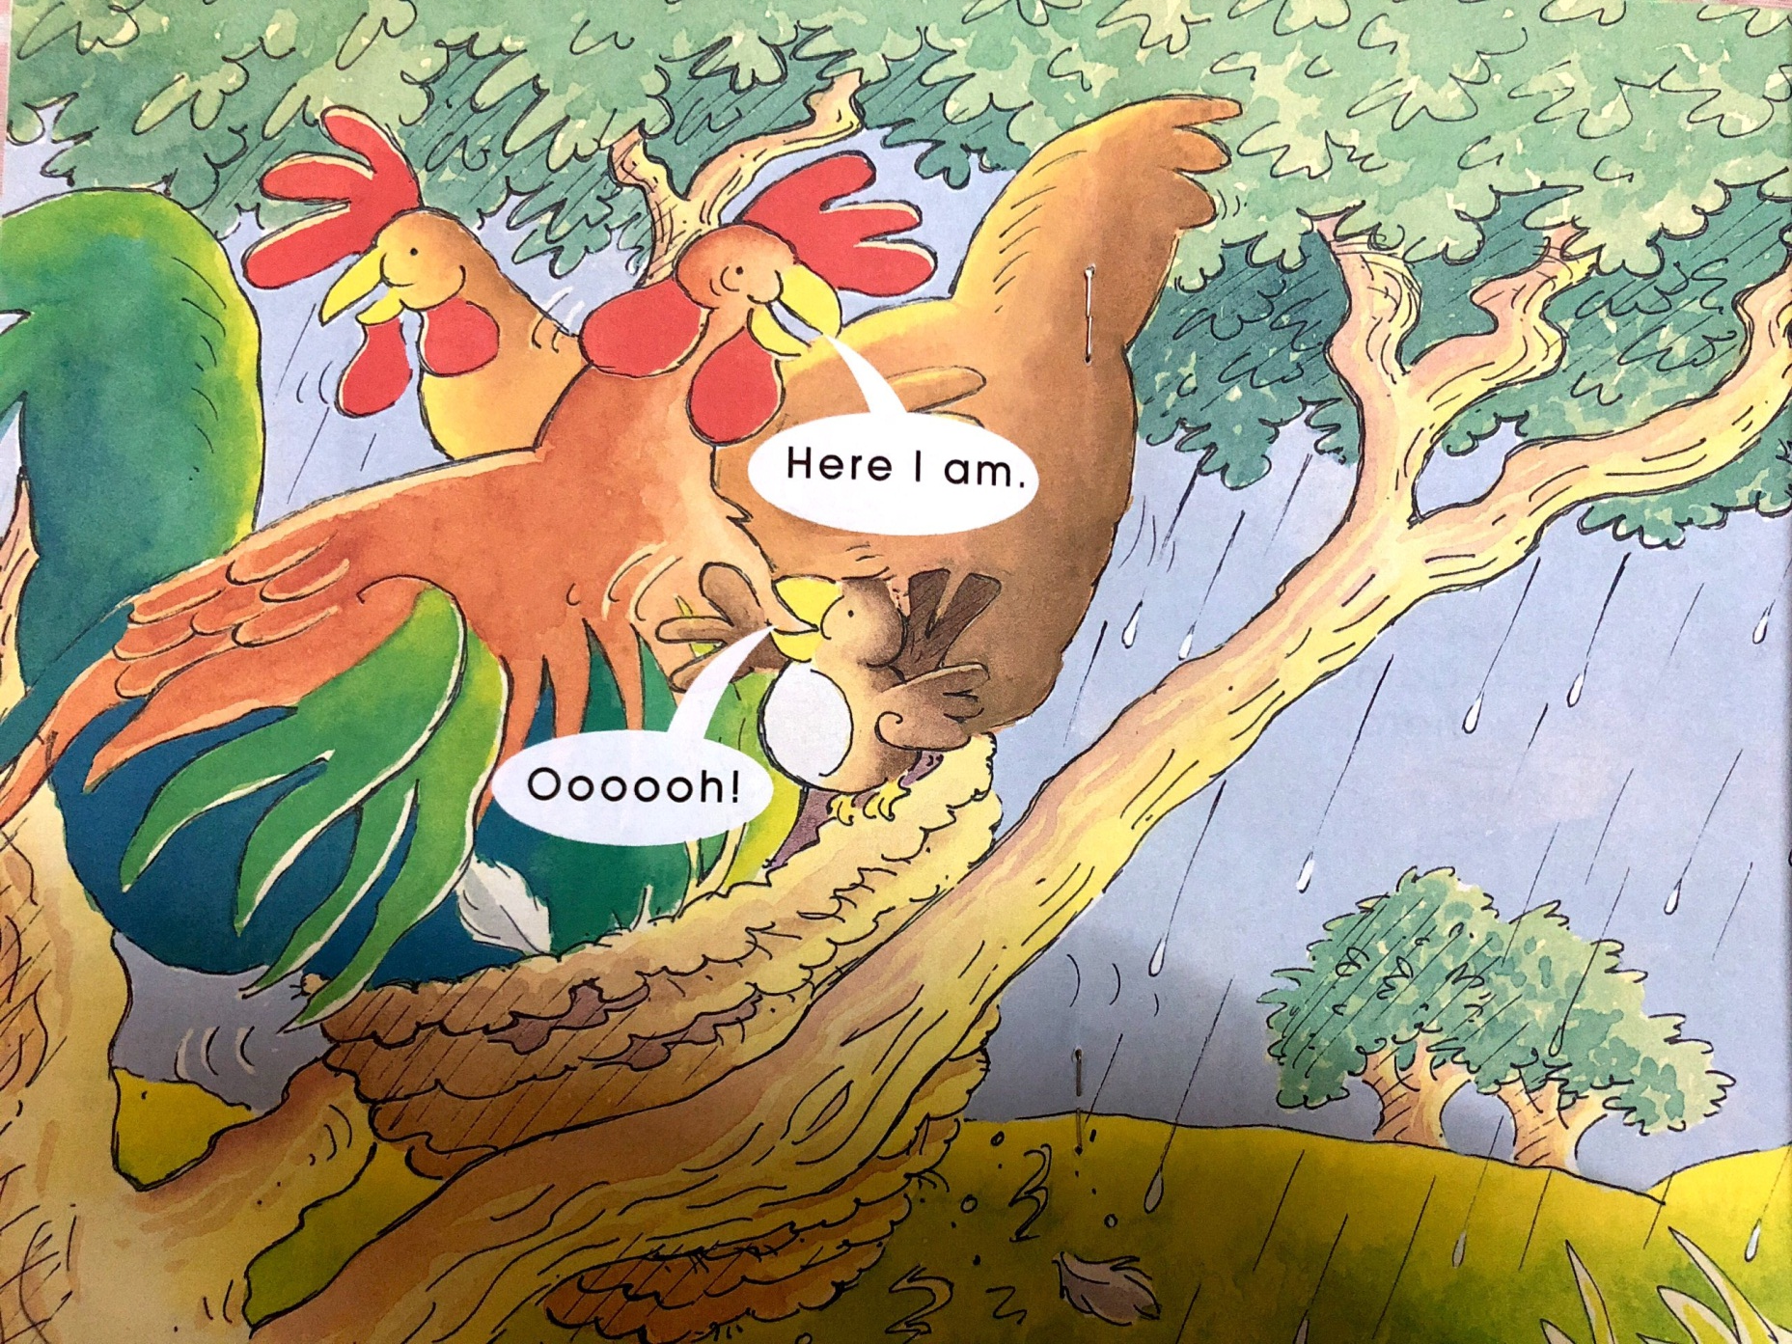
Make your voice sound like talking.
What sound does am start with? Make a circle with your finger around the a in am.
What other words start with/æ/?

Slide 18
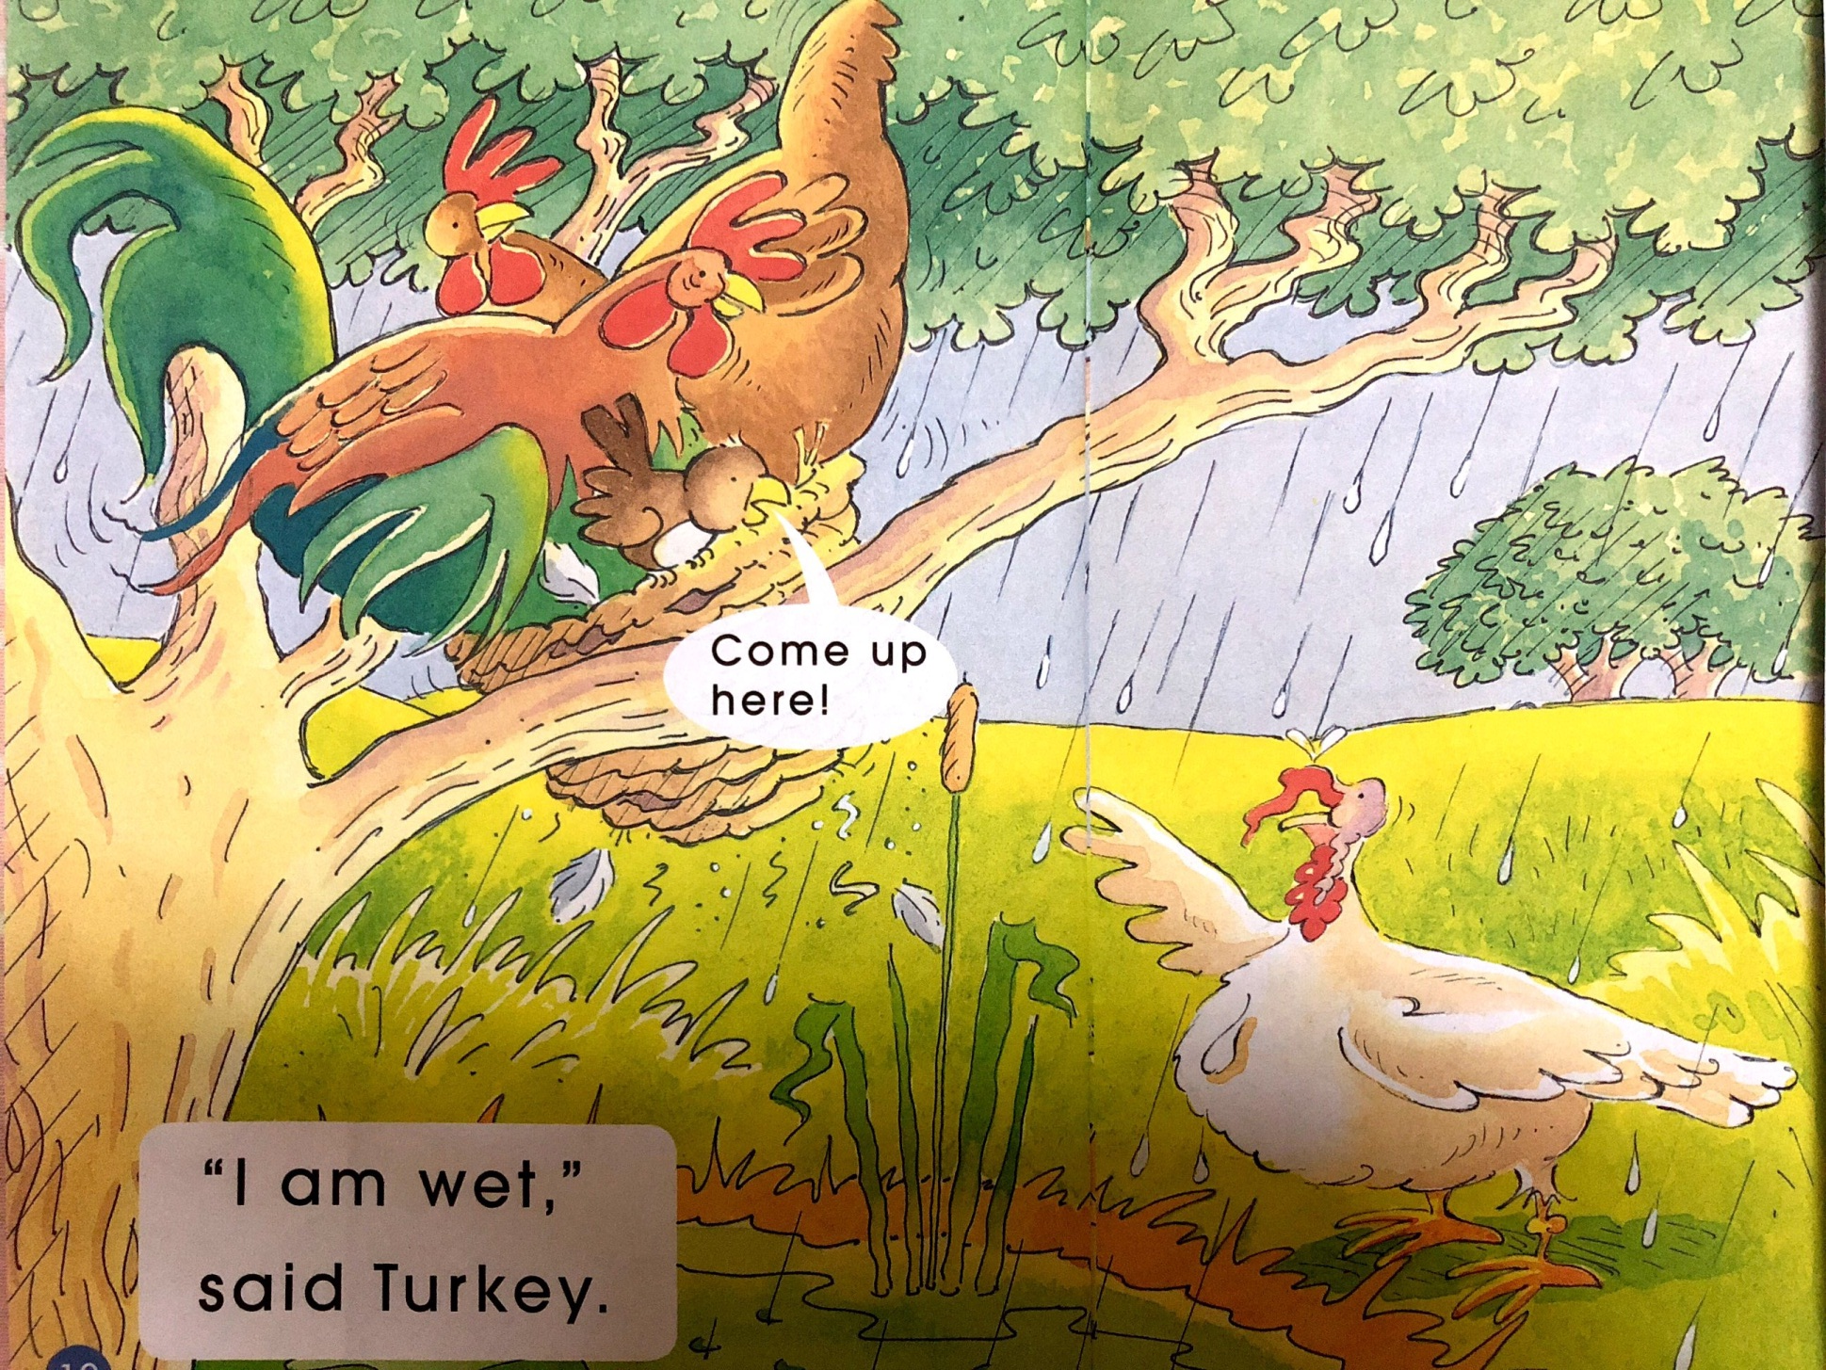
Which word says turkey? How do you know?
Make a circle with your finger around the word Come.

Slide 19
Put your finger on the illustrative text (PLONK).
2. How will you read this?
Why?

Slide 20
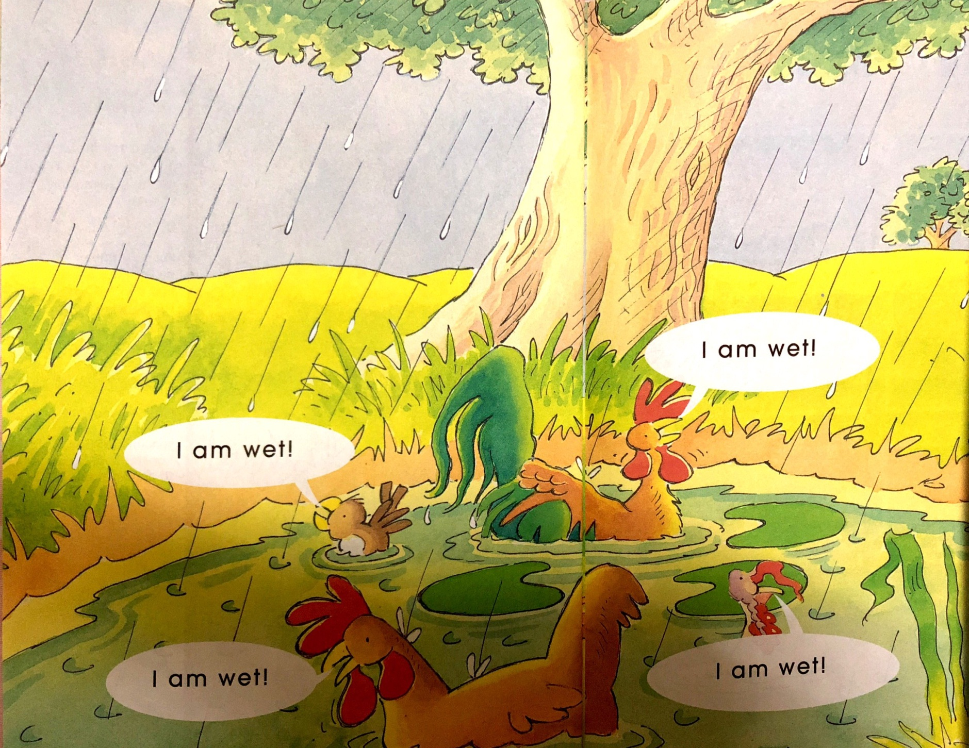
Read the speech bubbles and make your voice sound like the animals are talking.

Slide 21
Try to retell
1
2
3
4
5
6
7
Notes:
学生利用自己完成的故事脉络图在组内或在全班复述故事。
建议： 可以个人也可以小组合作完成对故事的复述。

Slide 22
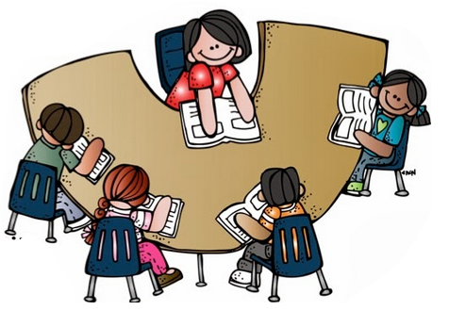
Read in groups

Slide 23
Try to act it out
1
2
3
4
5
6
7

Slide 24
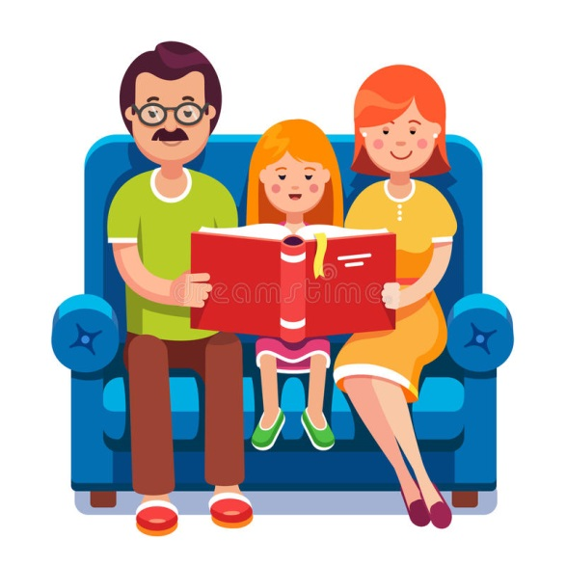
为故事改编结局，或续编故事。
Notes:
结合绘本内容，发挥想象，画出故事中的一个情节,并在画的下面写一句话。
为故事改编结局，或续编故事。

